Slide 1
Quarterly Update
You can add your content here. Brief introduction of your report will be preferred to balance the graphic design.

Slide 2



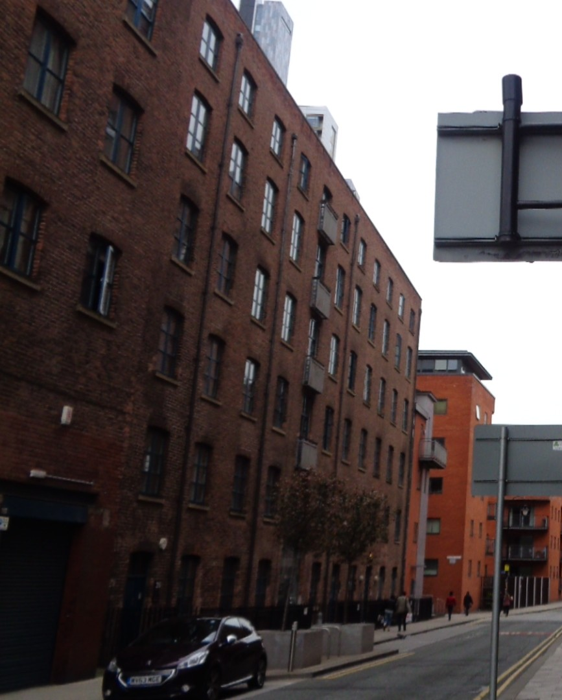




CONTENTS
Introduction to Our Team
Annual Training Plan
Project Management
Management Effectiveness

Slide 3

Introduction to Our Team
Team Members
Analysis
Action Plan

Slide 4
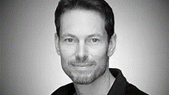
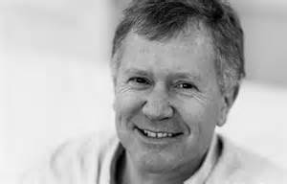

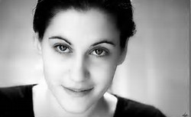
Our Team
Dianne Locker
Cathy Lee
Training Coordinator
Training System Administrator
Joe Evans
Andrew Birch
Director of Talent Management Office
Training and Development Analyst
OUR MISSION
Our mission is to design the performance module of all positions and relevant training system which will contain training courses of all works, instructors and coaches, career development routine and employees engagement.

Slide 6

Action Plan
April
Project Kick-off and annual budget start-line
May
Organizational Performance Review
June
HRIS introduction & Public platform building
July
Organization development of the new branch
Key milestones could be added in the charts. Further explanation could be written in the new text box and combine them with the arrow chart.
Key milestones could be added in the charts. Further explanation could be written in the new text box and combine them with the arrow chart.

Slide 7
Annual Training Plan
Internal Training
External Training
Ongoing Coaching

Slide 8

Internal Training
Training Needs
Administration
Evaluation
Make a training need survey around all departments and analyze their needs.
Schedule all training classes according to the need analysis with instructors and students.
Finish all three out of four levels of evaluation and record the training result. Action plan will be necessary.

Slide 9
External Training
Trainees/
Requestors
Supervisor/
Manager
Training Dept.
Finance Dept.
General Manager
Training Request
Training Analysis
Training Permission
Monitor & Permission
Permission
Payment Request
Attendance
Training Fee Payment
Prepare hotel & meal invoices, training report and certificate
Announcement
Pay Bills
Reimbursement
Money Back

Slide 10
Ongoing Coaching
Ongoing Coaching
Strategic Awareness
Customer-orientation
Individual Development
Mission
Vision
Division
Centralization
Service
Cooperation
Qualification
Promotion
Ongoing Coaching is introduced to track the improvement after training.

Slide 11
Project Management
Learning System
Talent Management
Performance

Slide 12






Learning System
Learning System
Course System
Training Paper Files
A system which will cover all database and delete all paper work.
Instructor Database
Evaluation Database

Slide 13
Learning System
Managers
Supervisor A
Supervisor B
Supervisor C
…
Member a1
Member a2
…
Member b1
Member b2
…
…
…
Training Administrator
Control and response to all training requirements in the department.
Follow up all training projects and track the completion.
Analyze all team members regularly and propose the training or coaching plan.
Attend all compulsory training courses and select optional courses according to the quarterly performance.

Slide 14
Talent Management
Career Development
People on the same ladder are encouraged to rotate* to extend their skills.
Manager
Supervisor
Team Leader
Team Member
Intern
Recruitment
Rotation
Promotion
It’s the best method to introduce people of new ideas.
Opportunities will be firstly offered in internal recruitment.
*Rotation will not just happen in the same boundaries, but this is a two-way choice.

Slide 16
Management Effectiveness
Leadership
Internship
Communication

Slide 17
Leadership
VCS Visual Control Standard
CPC Central Process Control
BEF Beave Elite Forum
High potential talents will be covered in all three programs. Undergraduate interns are the most preferred people.

Slide 19
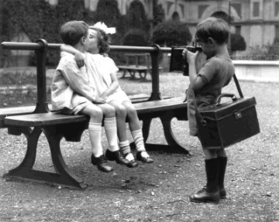




Communication
This is a place where you work with love.

Slide 20
Thank you
If you need further assistance, please contact:

