Slide 1

Analysis Into the Disproportionate Impact
-Covid-19 on BAME Population in the UK
Marisa Dinko, Isha Gangal,Pranitha Maddi,
Zetao Wang

Slide 2
Motivation
COVID-19 has affected the lives of people globally, but has disproportionately impacted BIPOC
In America, we have seen the intersection between issues of race, healthcare, and access to resources.
The prevalence of these issues has become more public as the Black Lives Matter movement surged in the summer of 2020
As we begin to explore issues of COVID, we want to analyze the role that race and ethnicity play in experiences of health and safety globally as well -- COVID is a universal issue that has different effects in each nation
Notes:
The motivation of this project

Slide 3
Background
The UK has healthcare that is provided by the state to everyone. It is meant to protect and improve the nation’s health/wellbeing and reduce health inequalities.
Background of our data:
Respiratory Datamart and the Second Generation Surveillance System were used for information about all the samples tested and the results of these tests were from the public health, NHS, and private laboratories.
Newly admitted hospital patients with COVID 19 were reported to the COVID 19 Hospitalization in England Surveillance system by acute NHS trusted secure web portals.
Mortality rates were found using 3 sources: NHS England, Health Protection teams, and Demographic Batch Service.

Slide 4
Related Work
Covid-19 has had a disproportionate effect on ethnic minorities in multiple countries, including Brazil, France, the United States, and the United Kingdom (Bachelet).
Numerous organizations have investigated this effect, trying to determine the factors at play, including:
the Pew Research Center (US)
The Lancet (US and UK; Brazil)
National Health Service (UK)
Public Health England (UK)
Each of these analyses identified multiple socio-economic factors whose effects may be compounded in minority communities, such as employment (as essential workers), overcrowded housing, chronic health issues, and access to to healthcare
Even in the UK, where there is universal access to health care, such disparities remain.

Slide 5
Claim / Target Task
As the figures from our data already show, there is a trend that exists between ethnicity and excess deaths from COVID-19
As we have explored in America, there are often compounding variables that impact this trend -- from disproportionate poverty, to redlining, to inadequate healthcare
To build upon the findings from this data, we aim to map the relationship between ethnicity, population density, deprivation, and COVID-19 death rate
We believe that this task will have social impacts by exemplifying and visualizing the relationship between social experiences and the current impacts of the COVID pandemic.
Notes:
Here, we make the claim of this project.

Slide 6
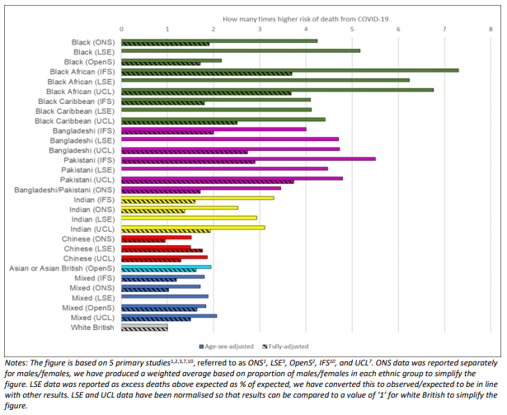
AN INTUITIVE FIGURE SHOWING WHY NEEDED
As this graph demonstrates, minorities have a much higher risk of dying from Covid-19 than white British patients.
Our project aims to investigate some of the key risk factors may be causing this effect
Source: University of Bristol, National Institute for Health Research
Notes:
Here, we make the claim of this project.

Slide 7
Proposed Solution
Map out the Covid-19 transmission tendency among the region and population density
Create visualizations that reflect the correlation between rates of deprivation in each locality, and the amount of excess deaths per ethnicity
Analyze the factors effect on minority groups
Notes:
Here is our proposed solution.

Slide 8
Implementation
Challenges
Not all data could be joined into a single, representative dataset
Dataset was very small
Solution
Created many visualizations & two datasets for models
K-Fold Cross Validation

Slide 9
Contributions
Quantifies the impact of confounding variables
Makes sense of data with a broad number of features
Provides the basis for a global conversation regarding race and inequality during a global health crisis
Moves the conversation from observation to analysis
Notes:
In the rest of this presentation, I’m going to talk about following contents:

Slide 10
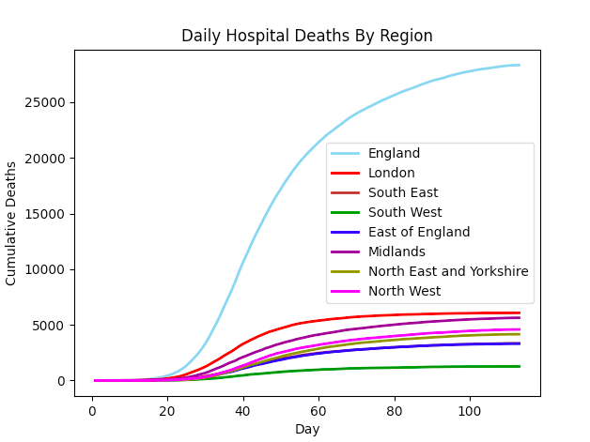
Data Summary
Notes:
In the rest of this presentation, I’m going to talk about following contents:

Slide 11
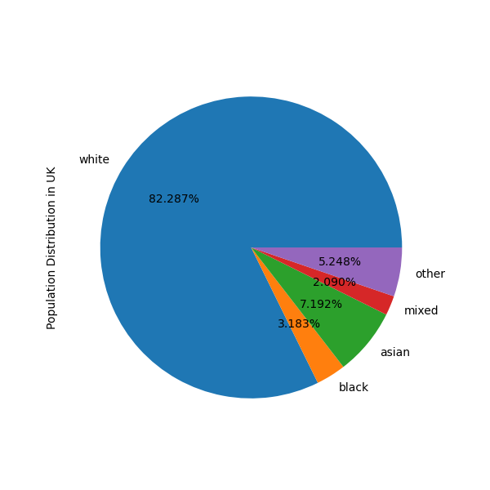
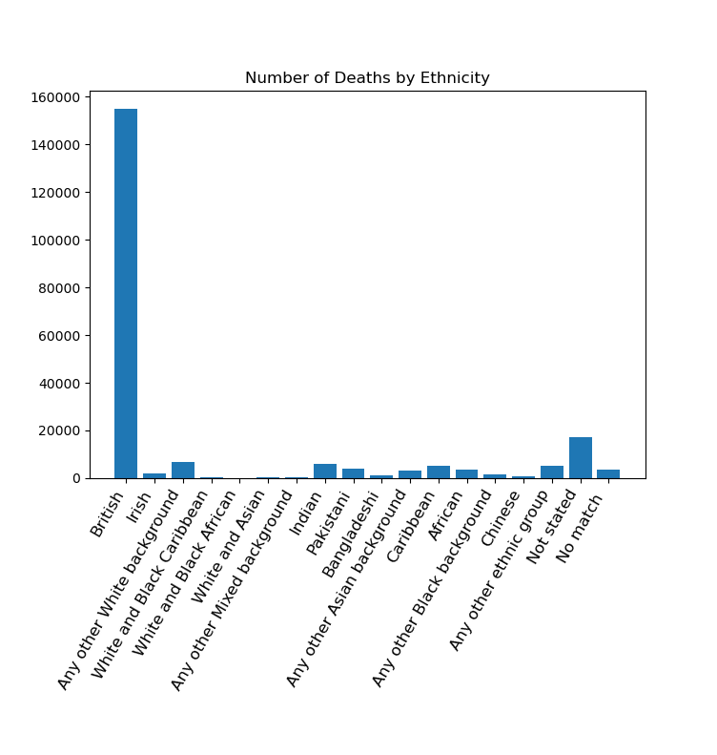
Population Distribution

Slide 12
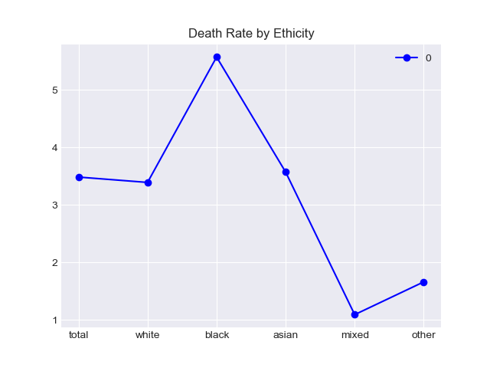
Death rate per 1,000
Ratio in different ethnicity groups
Parallel comparison between different ethnicity groups’ death rates

Slide 13
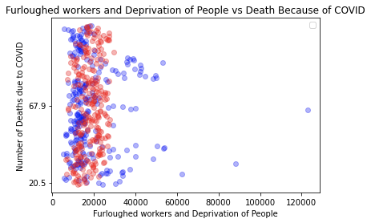
Furloughed worker
The blue points indicate the number of furloughed people based on a specific area name
The red points indicate the number of deprived people based on a specific area name
The y axis refers to the rate of COVID in these specific areas

Slide 14
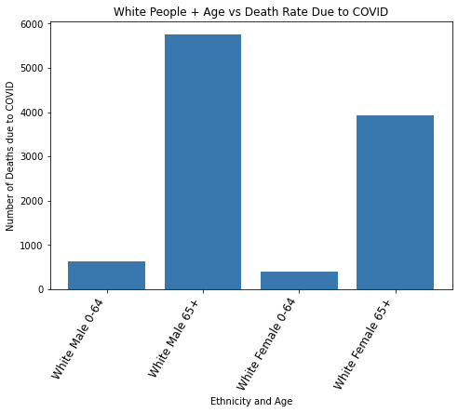
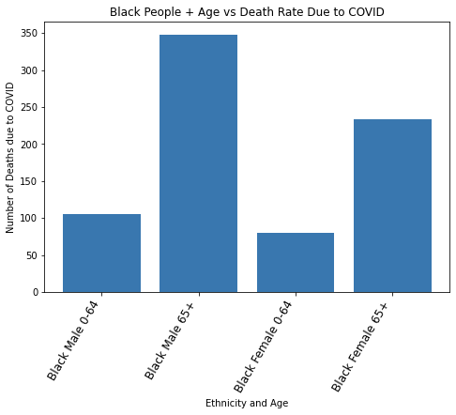
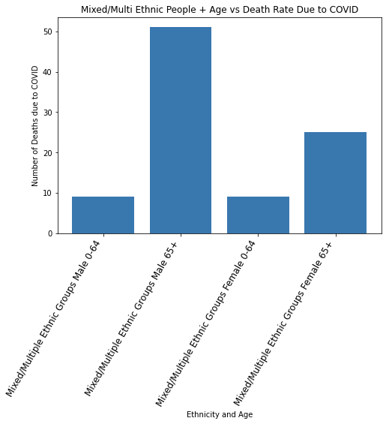
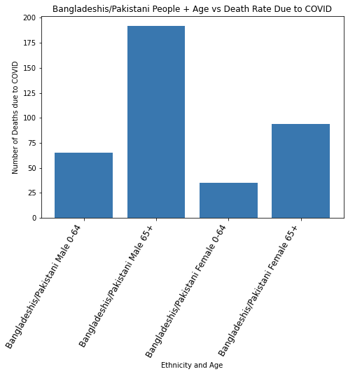
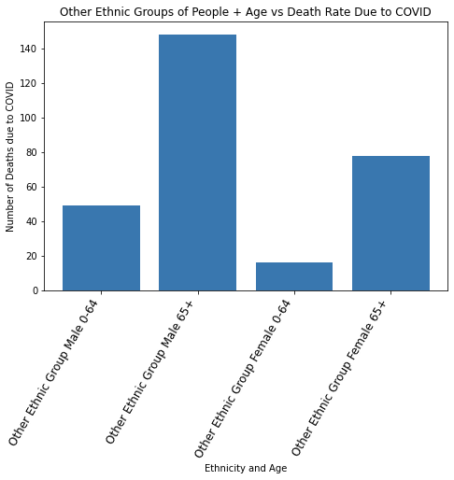
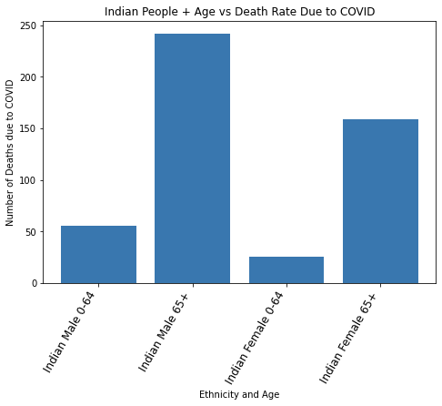
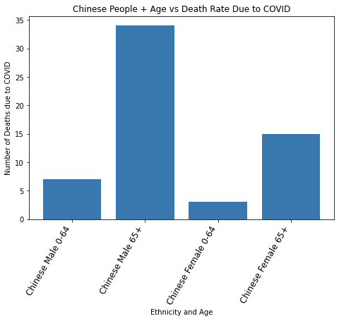
Death case in gender and age group

Slide 15
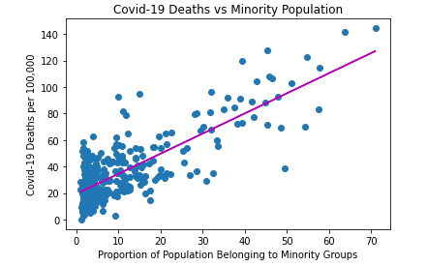
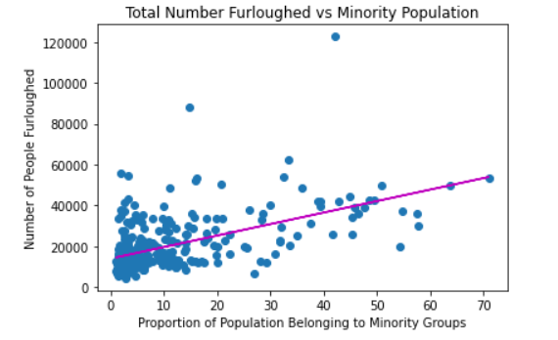
R Squared: 0.6254345303278283
R Squared: 0.305368432052154

Slide 16
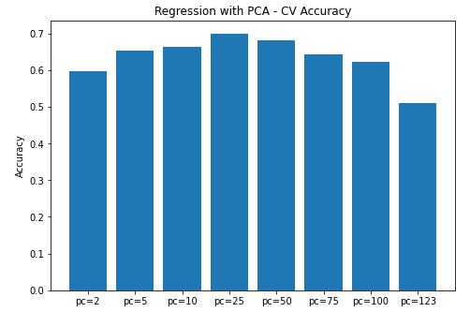
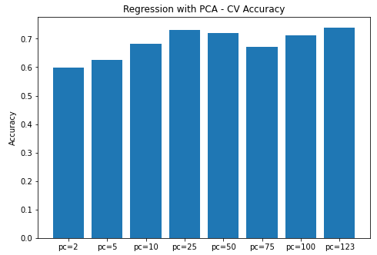
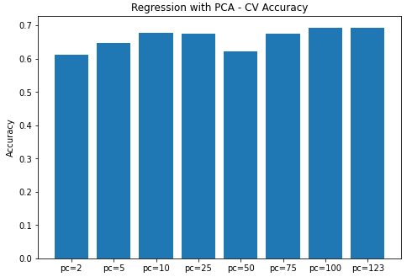
Experimental Results
K-Fold cross validation accuracy
 | Feature Representation
Regression | Granular | PCA | Summary
Linear | 0.5636 | 0.7074 | 0.5997
Lasso | 0.7161 | 0.7050 | 0.6024
Ridge | 0.7350 | 0.7496 | 0.5968
Best Alpha value
 | Granular | Summary
Lasso | 0.1 | 0.1
Ridge | 0.5 | 0.25
Notes:
In the rest of this presentation, I’m going to talk about following contents:

Slide 17
Experimental Analysis
Cross validation accuracy
Lasso and Ridge regressions
PCA implementation
Notes:
In the rest of this presentation, I’m going to talk about following contents:

Slide 18
Experimental Analysis
Cross validation accuracy
Lasso and Ridge regressions
PCA implementation
 | Feature Representation
Regression | Granular | PCA | Summary
Linear | 0.5636 | 0.7074 | 0.5997
Lasso | 0.7161 | 0.7050 | 0.6024
Ridge | 0.7350 | 0.7496 | 0.5968
Notes:
In the rest of this presentation, I’m going to talk about following contents:

Slide 19
Experimental Analysis
Cross validation accuracy
Lasso and Ridge regressions
PCA implementation
 | Feature Representation
Regression | Granular | PCA | Summary
Linear | 0.5636 | 0.7074 | 0.5997
Lasso | 0.7161 | 0.7050 | 0.6024
Ridge | 0.7350 | 0.7496 | 0.5968
Notes:
In the rest of this presentation, I’m going to talk about following contents:

Slide 20
Conclusion and Future Work
Determine the impact of confounding variables that may be present
Future Works
Deeper look at the model
Expand our data
Apply other model (mlp)
Provide the basis for a conversation about race and inequality on a global scale.

Slide 21
Colab Notebook

