Slide 1
COVID-19 Outcome Prediction Based on Mobility Measures in Virginia
UVA, Fall 2020
CS 4774: Machine Learning
Anna Brower (aeb2de) and Claire Dozier (ced9mq)

Slide 2

Motivation
Understanding how mobility impacts COVID-19 outcome measures plays an important role in determining whether the policies that state and local governments put in place can reduce the spread of and deaths from COVID-19
Given the quickly rising cases in recent weeks, it is especially important to determine if more rigorous social-distancing policies should be re-implemented or better enforced

Slide 3
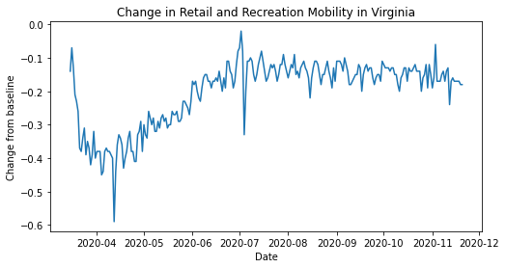
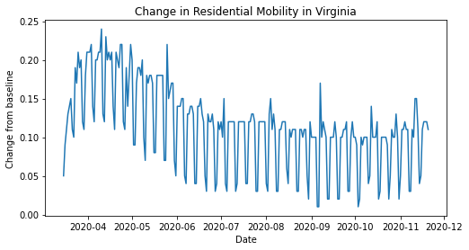
Background
Over 14 million confirmed cases in the US and 275,000+ deaths from COVID-19
Different policies restricting mobility have been put into place across the country with varying levels of success
On March 30, 2020, Governor Ralph Northam of Virginia implemented a stay-at-home order that required all non-essential workers to remain at home except to do necessary tasks like grocery shopping
Order began to be lifted towards the end of May in a phased re-opening
Since May, policies that limit gatherings to 25 people and enforcement of physical distancing guidelines have continued

Slide 4
Related Work
A country-level analysis measuring the impact of government actions, country preparedness, and socioeconomic factors on COVID-19 mortality and related health outcomes
Used multivariable negative binomial regression to predict COVID-19 mortality and related health outcomes from policy/actions of the government and socioeconomic factors
Work by Johns Hopkins University of Medicine, tracking timeline of COVID-19 policies, cases, and deaths in different states
Performing trend tracking on how opening and closing decisions made by states have impacted the number of COVID-19 cases and deaths
Pew Research Center analysis of public reception in in different countries to government COVID responses, and evaluation of economic/ political impacts

Slide 5
Related Work continued...
The effect of social distancing measures on COVID-19 epidemics in Europe: an interrupted time series (ITS) analysis
Looked to characterize the changepoint in COVID-19 for countries across Europe and to evaluate the association of the level of social distancing with decline in the national epidemics using ITS
Vector Autoregressive Models for Multivariate Time Series Analysis on COVID-19 Pandemic in Nigeria
Demonstrates VAR model with total cases, new cases, and deaths from COVID-19 to forecast future cases of covid-19 variables in Nigeria

Slide 6

Claim / Target Task
Build a vector autoregression (VAR) model to examine the relationship between the mobility trends and COVID-19 death rate and infection rate in order to predict future COVID-19 outcome metrics
Obtain greater insight on how changes in mobility can impact the spread of COVID-19 and motivate future social distancing policy decisions & enforcement

Slide 7
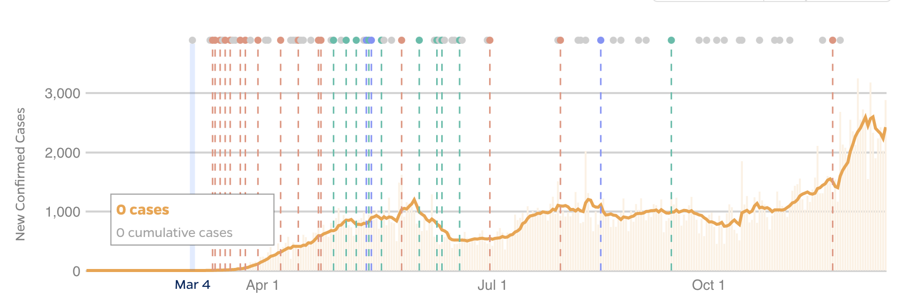
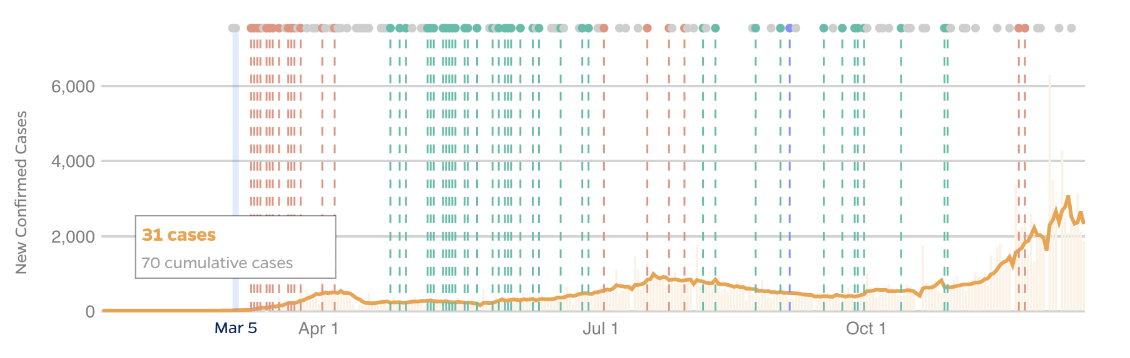
Intuitive Figure
Intuitive Figure: Why Needed?
Virginia
Washington:
Numerous initial closings/restrictions and re-implementations of policies when cases started to rise
Virginia:
Several initial closings/restrictions as they saw growing numbers
More restrictive policies have failed to be re-implemented and enforced, with rising numbers in recent weeks
Washington

Slide 8
Proposed Solution
Use VAR model to predict mortality and infection rate based off mobility data as a numerical indicator of policy efficacy
Mobility data locations include retail and recreation, grocery and pharmacy, parks, transit station, workplace and residential
In conjunction to mobility data, testing and death data can be used as an indicator of how well people are observing social distancing guidelines and adhering to stay-at-home orders
Notes:
“Mobility data” refers to aggregated and anonymized data collected by Google about population movement/ volume in different geographic areas
For example, “residential” geographic locations can refer to apartments, single family homes, condominiums, etc.

Slide 9
Data Summary
COVID-19 Data Repository from JHU: utilized daily time series data for confirmed cases and deaths from COVID-19 in Virginia
The COVID Tracking Project: utilized daily time series data for the total number of tests and total number of positive tests
Google COVID-19 Community Mobility Reports: utilized daily time series data that represented percent change for mobility trends across geographic regions in different categories of places
Training data from March 15, 2020, to November 20, 2020
Testing data from November 21, 2020, to December 4, 2020

Slide 10
Implementation
Clean and prepare data
Check for time series stationarity
Test causation using Granger causality test on the stationary data
Select order (p) of the VAR Model using AIC
Build a VAR model for predicting mortality and infection rate from mobility data as the indicator for policy efficacy
Predict on test data and analyze results

Slide 11
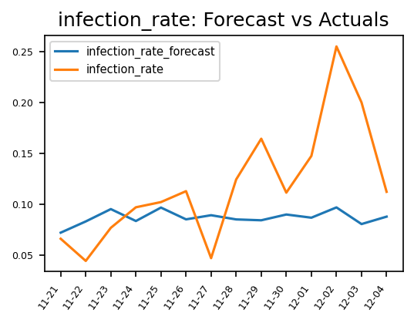
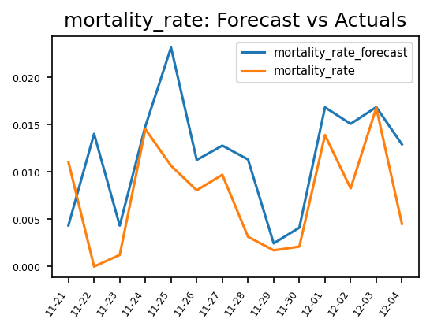
Experimental Results
Using the created VAR model, the following plots show the forecasts of infection rate and mortality rate from November 21 to December 4 compared to the actual rate

Slide 12
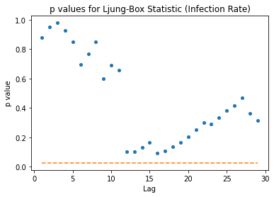
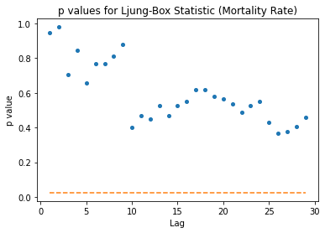
Experimental Analysis
Forecast accuracy of infection rate
MSE: 0.0040523103
RMSE: 0.0636577592
Corrcoef: 0.2264818128
Forecast accuracy of mortality rate
MSE: 4.47247e-05
RMSE: 0.0066876498
Corrcoef: 0.5593556241

Slide 13
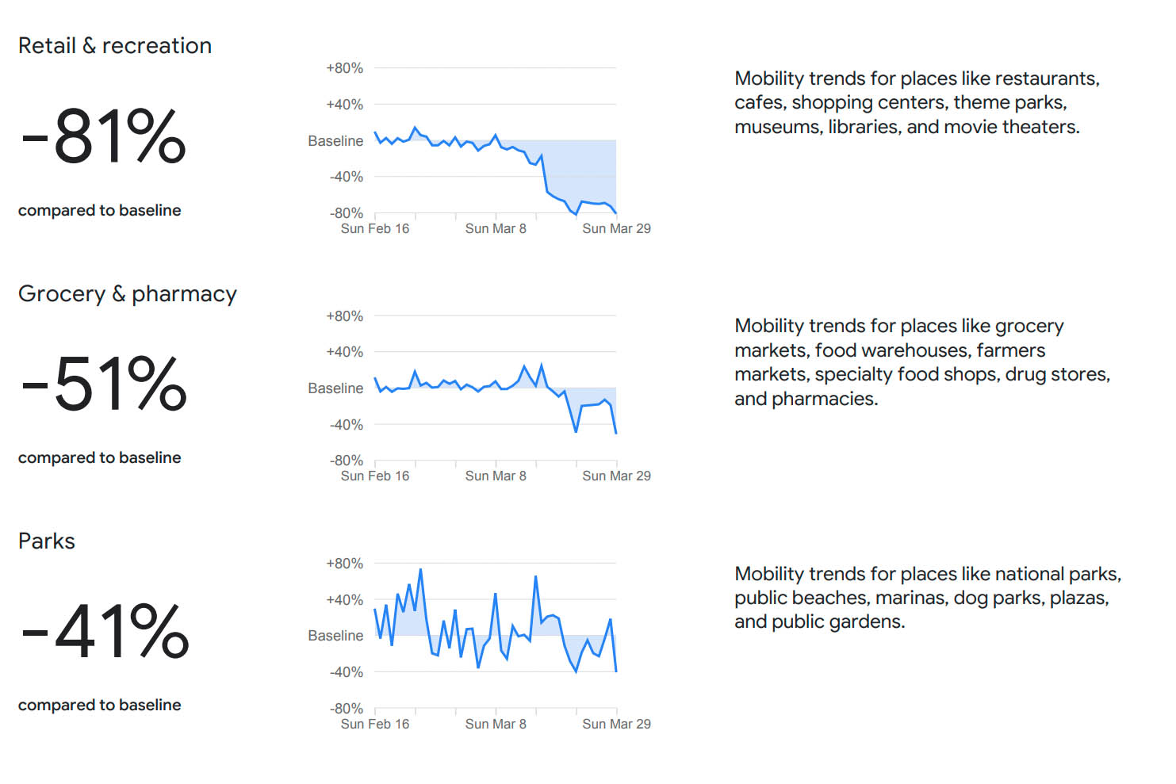
Contributions
Illustrated the viability of a VAR model in forecasting future metrics by performing multivariate time series analysis on COVID-19 predictor variables
Demonstrated that mobility data may provide a good numerical indicator for policy efficacy

Slide 14
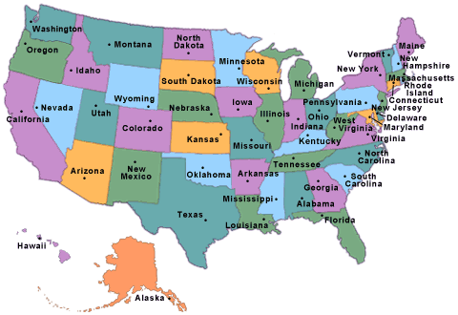
Conclusion and Future Work
Reproducing the results with states around the United States could aid in determining whether these factors generalize well to areas around the country
An interrupted time series with different policies including mask mandates, stay-at-home orders, and closing of schools could help create a better understanding on how specific policies impact COVID-19

Slide 15
References
https://www.pewresearch.org/global/2020/08/27/most-approve-of-national-response-to-covid-19-in-14-advanced-economies/)
https://coronavirus.jhu.edu/data/state-timeline
https://www.thelancet.com/journals/eclinm/article/PIIS2589-5370(20)30208-X/fulltext
https://www.ncbi.nlm.nih.gov/pmc/articles/PMC7288252/
https://abjournals.org/african-journal-of-biology-and-medical-research-ajbmr/wp-content/uploads/sites/17/journal/published_paper/volume-3/issue-2/AJBMR_O2OW66XY.pdf

