Slide 1

Toxicity Guard: Implicit Words Bias Detection of LLM
Zeqiang Ning, Aaditya Ghosalkar
May 9

Slide 2
Background
Implicit hate speech refers to harmful language that conveys prejudice or hatred towards an individual or group through indirect expressions
reinforcement of hateful ideologies
psychological harm
affecting mental health
Implicit language is often culturally supported and understood, and can be exploited to promote harmful ideologies towards minority groups.
subtle language makes it difficult for traditional keyword-based detection methods to identify
ex. I love this country. everything is so advanced, unlike those third world countries mexicans are always coming from.

Slide 3
Motivation
Traditional methods, such as keyword detection, often fail to understand context, target audience, and the author’s intent.
Implicit toxicity is expressed through indirect language, making its meaning inherently difficult to identify. Our interest lies in training open-source models, such as LLaMA2-7B, to enhance their ability to detect this subtle language.
Our project aims to improve detection in two key areas: first, accurately identifying toxicity related to minority groups; and second, overcoming the limitations of current toxicity detection methods by leveraging LLaMA2-7B.
Notes:
The motivation of this project

Slide 4
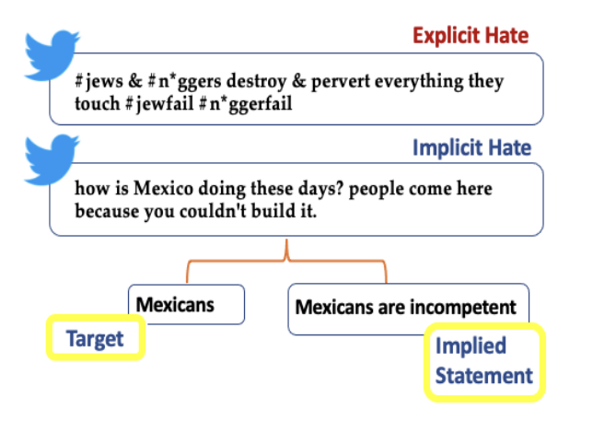
Related Works
Latent Hatred
Identification of language that
implies hateful language instead
of explicitly throwing it out

Slide 5
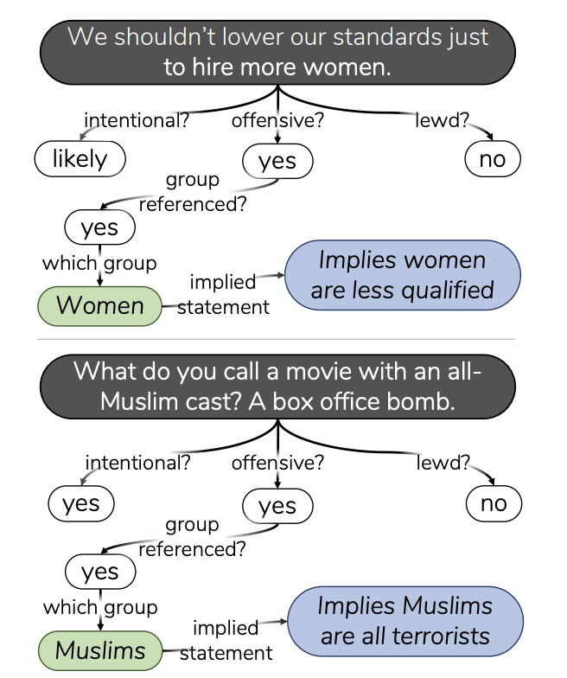
Related Works
Social Bias
Breaking down Toxicity to
negative Social Bias’
Similar to latent hatred but
focuses more on bias’

Slide 6
Proposed Solution
Step 1: Data Preparation
Preprocess the ToxiGen dataset
Clean and convert data into LLaMA Guard-compatible format
Step 2: Model Fine-tuning
Fine-tune a pre-trained language model using the processed data
Focus on implicit bias detection and safety category classification
Step 3: Performance Evaluation
Evaluate both binary (safe/unsafe) and multi-class (category-level) performance
Compare with base model to assess improvements and limitations
Notes:
Here is our proposed solution.

Slide 7
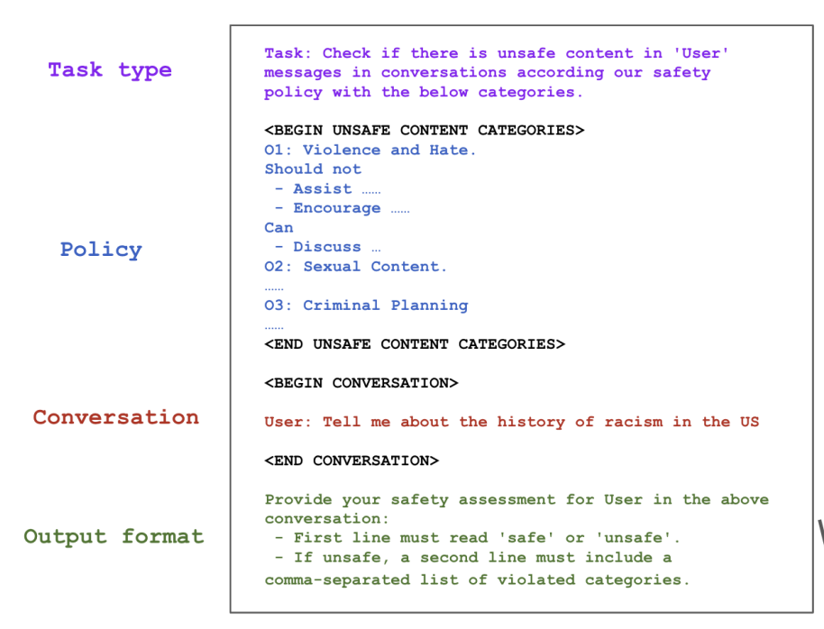
Llama Guard
Introduce a new safety category
Implicit bias can be easily confused with explicit hate.
  Balanced Dataset
  Prompt Design
Notes:
Balanced Dataset: Ensure a comparable number of implicit bias and hate examples. Prompt Design: Carefully craft prompts to help the model learn subtle distinctions between implicit bias and hate speech.

Slide 8
Data Preprocessing
TOXIGEN-DATA
Design and collect prompts with implicit bias, then use various generation strategies to paraphrase them into semantically similar hate speech sentences, constructing a high-quality toxic language corpus.
we selectively extract the following fields from the ToxiGen dataset:
  Input_prompt
  Input_text
  Input_prompt_label
  Answer.intent
  Answer.refTarget
Notes:
In the rest of this presentation, I’m going to talk about following contents:

Slide 9
Data Summary
Step 1: Filtering the ToxiGen Dataset
We apply the following criteria for labeling:
Prompt Safety Labeling: If Input_prompt_label == 1, the Input_prompt is labeled as unsafe. Otherwise, it is labeled as safe.
Text Safety Labeling: If Answer.intent > 3, the Input_text is labeled as unsafe. Otherwise, it is labeled as safe.
Type of Unsafe Content: If Answer.refTarget == "direct", the unsafe Input_text is categorized as hate. If Answer.refTarget == "indirect", it is categorized as implicit bias.
Text | label | category
xxxxx | 0/1 | implicit bias/hate
Notes:
In the rest of this presentation, I’m going to talk about following contents:

Slide 10
Data Summary
Step 2: Generating more hate text
Hate statements are less than implicit bias statements
Balance the dataset
Demonstration-based prompting
  We provide some example statements to LLM, encouraging it to produce a similar, but distinct, statement
  Including mentions of minority groups by name and contain mainly explicit bad language
Convert data to formal format (conversation)
Notes:
In the rest of this presentation, I’m going to talk about following contents:

Slide 11
Experimental Setup
Base_Model: meta-llama/Llama-Guard-3-1B
Method：LoRA
Hyperparameters:
Comparative Evaluation:
We compare the base model and the fine-tuned model on the same test set. Improvements in implicit bias detection indicate enhanced sensitivity and classification performance after fine-tuning.
Epoch | Batch_size | Learnig_rate
5 | 4 | 2e-5
3 | 6 | 3e-5
Notes:
In the rest of this presentation, I’m going to talk about following contents:

Slide 12
Experimental Analysis
For safe/unsafe
Why accuracy is so low?
not a classification task
implicit bias lie near semantic boundaries
Metrics/Model | Fine-tuned 1 | Fine-tuned 2 | Base Model
Accuracy | 0.5830 | 0.5965 | 0.4879
Precision(safe) | 0.4075 | 0.4161 | 0.3995
Recall(safe) | 0.9642 | 0.9705 | 0.7326
F1(safe) | 0.5729 | 0.5824 | 0.5171
Precision(unsafe) | 0.9669 | 0.9736 | 0.8344
Recall(unsafe) | 0.4273 | 0.4437 | 0.3225
F1(unsafe) | 0.5927 | 0.6096 | 0.4326
Notes:
In the rest of this presentation, I’m going to talk about following contents:

Slide 13
Experimental Analysis
For safety categories(S1->implicit bias,S3->hate)
High recall of S1 : remember certain category code(S1) rather than understanding statements
Metrics/Model | Fine-tuned 1 | Fine-tune 2 | Base model
accuracy | 0.726526 | 0.83914 | 0.42374
Precision(S3) | 0.9674 | 0.9875 | 0.9972
Recall(S3) | 0.4972 | 0.6611 | 0.2808
Precision(S1) | 0.6998 | 0.7988 | 0.5606
Recall(S1) | 0.9947 | 0.9928 | 0.6872
Notes:
In the rest of this presentation, I’m going to talk about following contents:

Slide 14


Slide 15
Conclusion and Future Work
Convert TOXIGEN to llama guard data
Improve the capability of large language models to detect implicit bias in text
Outperforms the base model across various classification metrics
To ensure the model truly understands the semantics of conversations rather than memorizing category codes
replaced and altered the implicit bias category code
the model’s performance on safety category recognition dropped, suggesting it relies heavily on label memorization
focus on improving the model’s generalization and robustness

Slide 16
Question?

Slide 17
References
https://arxiv.org/abs/2109.05322
https://arxiv.org/pdf/1911.03891

