Slide 1
Prompt Optimization with LLM Agent as Judge
Daniel Slyepichev, Ananya Ananda
4-28-2025

Slide 2
Motivation
LLMs emergent behaviors generates answers outside of its initial training data
How do we ask LLMs to generate rational and correct responses?
  Prompt Engineering
What if we ask an external LLM?
  Leads to insight on how LLMs think of prompting
    What keywords lead to what?
    What are some developing patterns in prompts?
    Will the LLM’s generation lead to an accuracy increase?
Create tool for others to optimize their own prompts
Notes:
Daniel

Slide 3
Background
Large Language Models
  Can solve emergent tasks utilizing several techniques
    In Context Learning, Chain of Thought
Prompt Engineering
  LLMs understand differently from humans
    Meta Prompting
LLM as Judge
  Generate score and criticism for reasoning and open ended tasks
  Utilize Multi Agent System to create debates
Notes:
Daniel

Slide 4
Related Works
LLM as a Judge (Gue et al., 2025)
  Introduces a framework for using LLMs as evaluators for open-ended tasks
From Generation to Judgement (Li et al., 2025)
  Surveys design choices in building LLM-as-a-Judge systems
Judging LLM-as-a-Judge with MT-Bench & Chatbot Arena (Zheng et al., 2023)
  Proposes GPT-4 as a reliable judge, achieving 80%+ agreement with human preference
Large Language Models are Human-Level Prompt Engineers (Zhou et al. , 2023)
  Shows LLM can refine prompts automatically, often matching human performance
Notes:
Ananya

Slide 5
Claim/Target Task
Target Task:
Iterative Prompt Refinement for open-ended tasks, using an LLM-as-a-Judge agent to evaluate and guide improvement.
  Ollama, Langchain
Claim:
A multi-agent loop, where one LLM proposes and another judges, can improve prompts autonomously, leading to more accurate, truthful, or aligned outputs.
Notes:
Ananya

Slide 6




Revised Prompt 1: Think step by step. What’s the derivative of x^5+ x^9 -x^3 +1?
Revised Prompt 2: What’s the derivative of x^5+ x^9 -x^3 +1, showing each step clearly
Q: What is the derivative of x^5 + x^9 - x^3 +1?
A:To find the derivative of x^5 + x^9 - x^3 + 1, you can use the power rule of differentiation, which states that the derivative of x^n is equal to n \\* x^(n-1). Starting with x^5 + x^9 - x^3 + 1, you can apply the power rule to the first two terms, which gives you: 5 \\* x^(5-1) + 9 \\* x^(9-1) You can then simplify the expression by combining like terms: 5 \\* x^4 + 9 \\* x^8 Finally, you can simplify the expression further by canceling out the common factor of x^4: 5 \\* 9 \\* x^4 = 45 \\* x^4
Therefore, the derivative of x^5 + x^9 - x^3 + 1 is equal to 45 \\* x^4.
Prompt Optimizer Agent
Winning Prompt: What’s the derivative of x^5+ x^9 -x^3 +1, showing each step clearly.
Judgement: It gives a clear instruction ("showing each step clearly"), which is more direct and action-oriented.It sounds more natural and polished — smoother flow without awkward phrasing. It focuses on the output (clear steps) rather than the thinking process, making it easier to grade or evaluate if needed.
LLM
Judge Agent
Notes:
Daniel

Slide 7


Q: What’s the derivative of x^5+ x^9 -x^3 +1, showing each step clearly.
A:Find the derivative of the function, we need to take the derivative of each term in the function. The derivative of x^5 is 5x^4. The derivative of x^9 is 9x^8. The derivative of x^3 is 3x^2. The derivative of 1 is 1. Therefore, the derivative of the function is: 5x^4 + 9x^8 - 3x^2 + 1 = 5x^4 + 9x^8 - 3x^2 + 1 - (1) = 5x^4 + 9x^8 - 3x^2
Therefore, the derivative of the function x^5 + x^9 - x^3+1 is 5x^4 + 9x^8 - 3x^2.
LLM
Notes:
Daniel

Slide 8
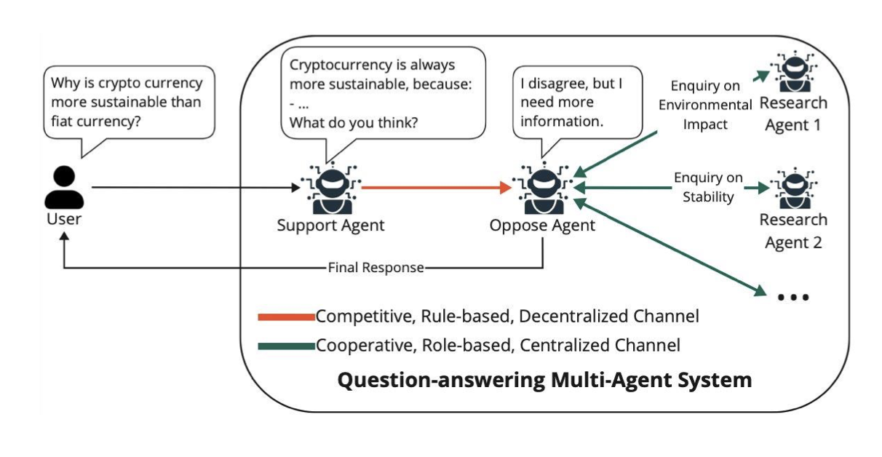
Proposed Solution
Multi-agent system (MAS) for iterative prompt refinement
Agents:
  Answerer LLM
  Prompt Optimizer Agent
  Judge Agent
Notes:
Ananya

Slide 9
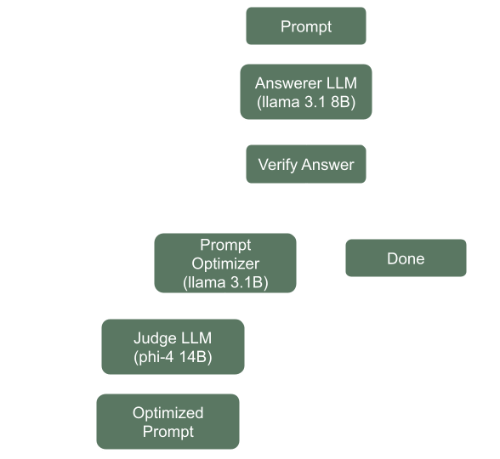
Implementation
Datasets:
Big Bench Hard (Boolean Expressions)
LiveBench Reasoning
Medical Reasoning
Notes:
Ananya

Slide 10
Collab Showcase
https://colab.research.google.com/drive/16uQeKKibUojkq137WSiG5xnKRrLsYal-#scrollTo=tmS1SR3IlA3h
Notes:
Daniel

Slide 11
Data Summary - Baseline
BHH
Med
METRIC | VALUE
Answered Correctly | 249
Answered Incorrectly | 1
Total Questions | 250
Accuracy | 99.6%
METRIC | VALUE
Answered Correctly | 21
Answered Incorrectly | 13
Total Questions | 34
Accuracy | 61.76%
Notes:
Ananya

Slide 12
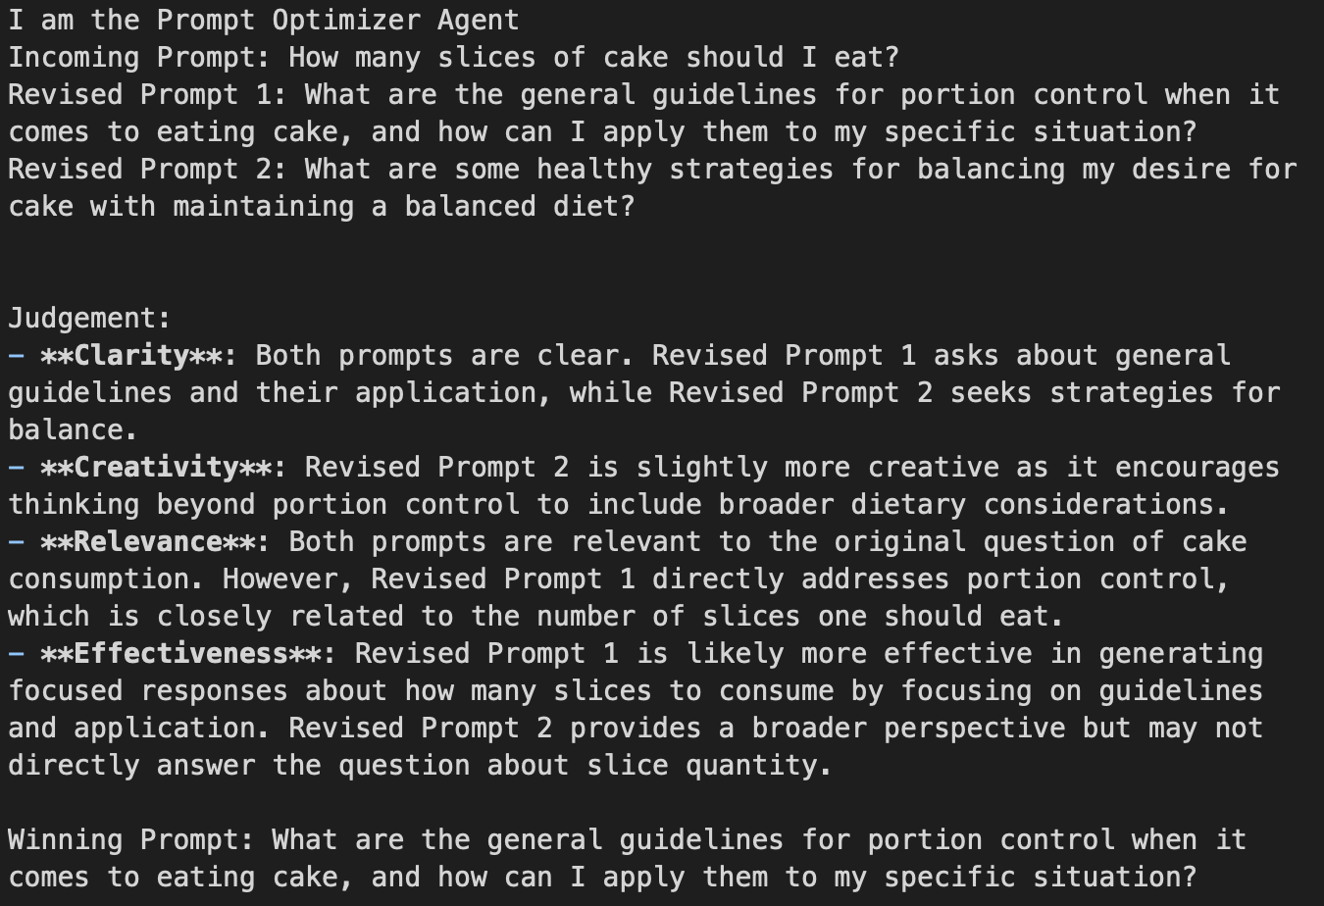
Experimental Results
The PO likes to add “Think Step By Step” to the front of the prompt, rather than back.
For the Medical Database, the new questions can sometimes successfully answer with the newly generated prompt!
Likes to add more “perspectives” to the prompt
Notes:
Daniel

Slide 13
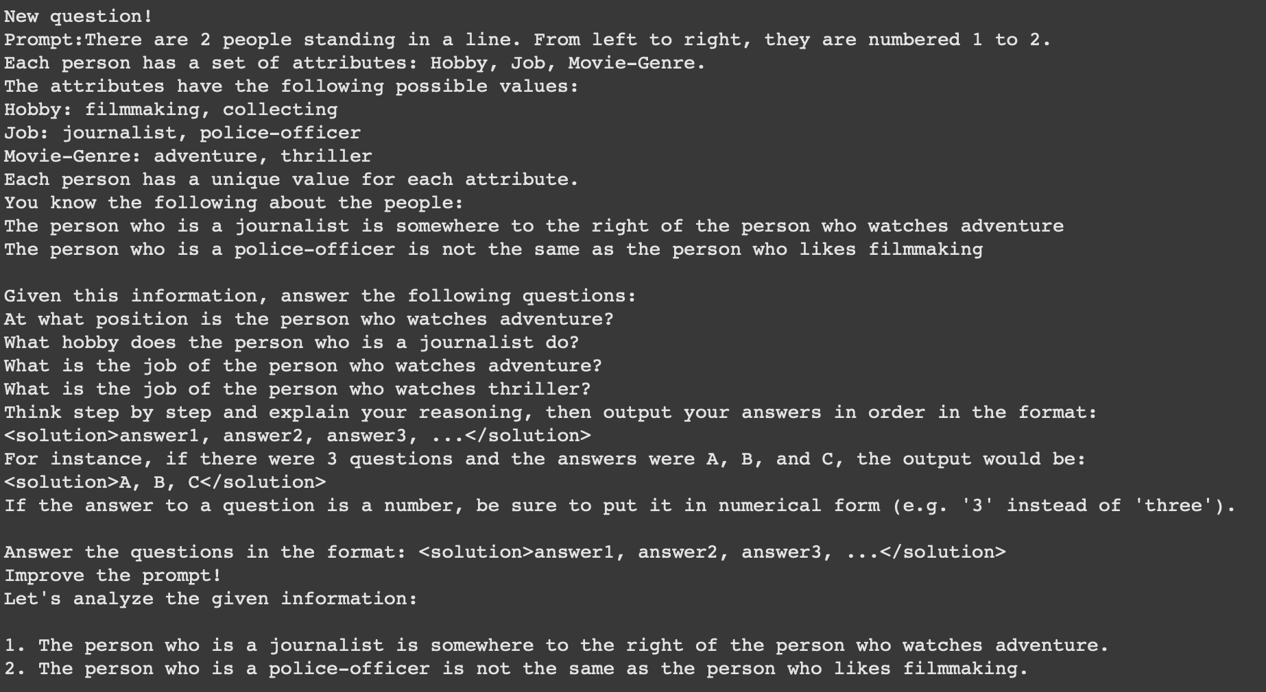
Challenges
Challenges
  Sometimes the agents would not follow their system role
    Answering Prompt
    Not using format
  Agents remaining silent, causing a break of the loop
  Computational Setbacks
Notes:
Daniel

Slide 14
Experimental Analysis
BHH (Boolean Expressions)
  Not ideal dataset since LLM already highly accurate on these types of problems
Medical Reasoning
  Outputted correct response within max iterations when testing
  Asked for more information that it did not need
  Sometimes would overgeneralize and revert to a step by step process rather than answering the question
Notes:
Ananya

Slide 15
Conclusion and Future Work
Conclusion
  Resampling the prompts with the MAS does lead to minor improvements in accuracy!
Future Work
  Add more tools to the Prompt Optimizer Agent
    Utilize more principles of Prompt Engineering as tools
  Create an LLM Verifier Agent for automatic verification
    Tooling for verification with the agent
  SFT + RL for PO and Judge Agents
  Experimenting with different LLM models
Notes:
Ananya

Slide 16
References
https://arxiv.org/pdf/2312.16171
https://medium.com/@abonia/running-ollama-in-google-colab-free-tier-545609258453
https://python.langchain.com/docs/how_to/sequence/
https://python.langchain.com/v0.1/docs/modules/agents/how_to/custom_agent/
https://arxiv.org/pdf/2501.06322

