Slide 1

DocAgent: Writing Assistant Agent
Akira Durham - Sahlar Salehi
5/9/2025

Slide 2
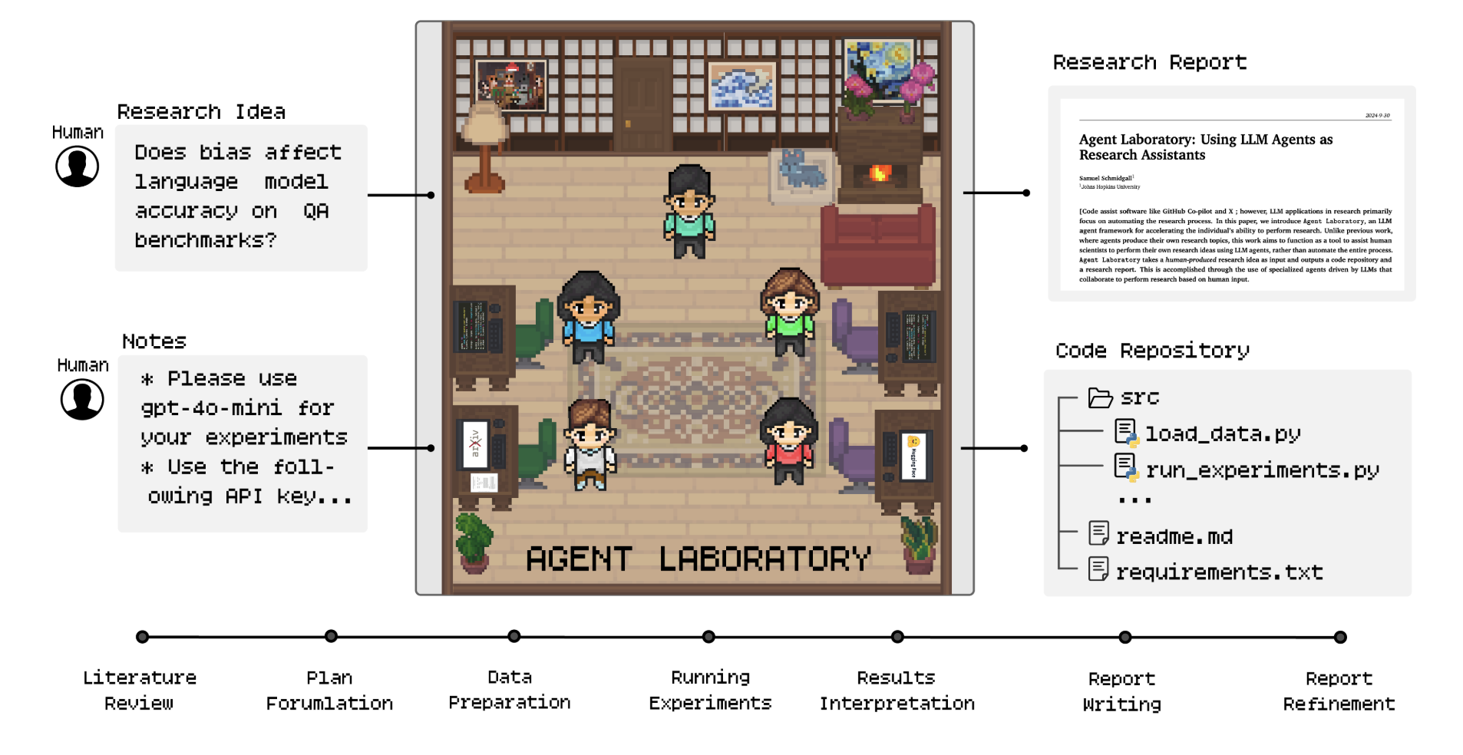
Motivation
Academic writing can be very tedious
  Finding related literature
  Synthesizing information
LLMs very powerful in writing domain
  Retrieve from multiple sources
  Assist in formatting, citations, grammar
  Draw meaningful and human conclusions
Balance AI efficiency + user control
Notes:
The motivation of this project

Slide 3
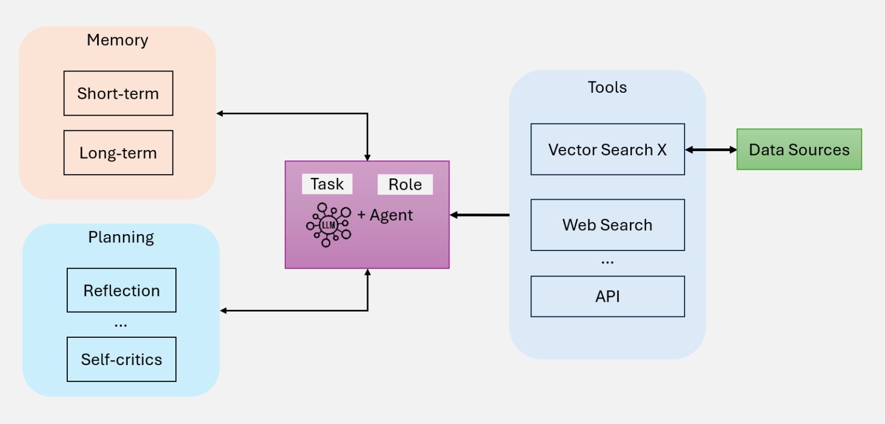

Background
AI Agents
  LLM powers reasoning
  Give model tools to complete tasks
  Making agents: LangChain/LangGraph
Retrieval Augmented Generation (RAG)
  Model generates based on retrieved sources
  Powerful for research/academia
LLM Writing Assistant
  Gather information and compose synthesized writings
  Human-LLM collaboration
3

Slide 4
Related Work
Agent Laboratory
  Utilizes multiple autonomous agents for research process
  Different personalities per agent, continuous collaboration
ResearchAgent
  Starts with core paper, finds more related information and papers
  Multiple reviewing agents for iterative revision process
NotebookLM
  25 million word recall across 50 uploaded sources
  Answers Q&As with citations from the source
Perplexity
  Provides answers to research questions with sources from web
  Information retrieval and dynamic searching interactions

Slide 5
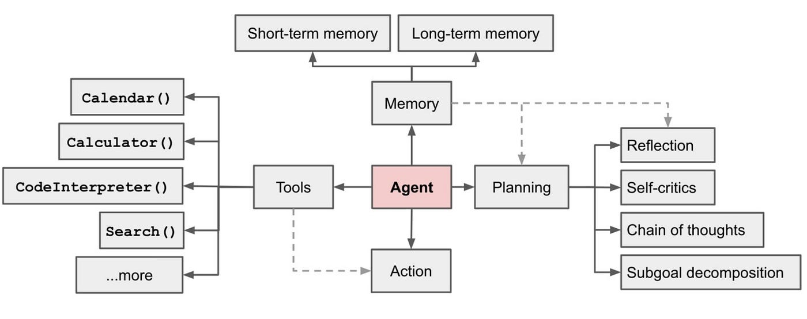
Claim / Target Task
Goals: Writing, Locating, Organization
Writing
  Create citations
  Create project outline + questions
  Generate key sections (Intro, Lit Review, etc)
  Update information based on new sources
Locating
  Find potential sources
Organization
  Change citation style
  Summarize sources
Notes:
Here, we make the claim of this project.

Slide 6



An Intuitive Figure Showing WHY Claim
Simplify basic tasks
Keep user control
Inexpensive
Prompt/Task
Tools
Web search
Document related functions
...
User
Agent
Response
Update document (citations, layout, content)
Document/Project
Notes:
Here, we make the claim of this project.

Slide 7
Proposed Solution
DocAgent
  User control via Google Docs & chat loop
  AI powered edits and research
    Gemini 2.0 flash
    SerpAPI web search
    Google Docs API
  Agent pulls doc and addresses prompt
Write LLM output directly to Google Doc
  With user approval of the changes
Notes:
Here is our proposed solution.

Slide 8






Implementation
Direct Edit to Docs
Google Cloud/Docs API
Chat Loop
LLM Edit Request
Query
Agent System
Codebase
Notes:
In the rest of this presentation, I’m going to talk about following contents:

Slide 9
Data Summary
Considering we are building an agent, not good data perspective
We created some example use cases
  Update document's information
  Create + include citations
  Locate scholarly articles
Focused heavily on research aspect
Subjective determination of agent output
  Agent has memory though, so can ask to improve, etc
Notes:
In the rest of this presentation, I’m going to talk about following contents:

Slide 10
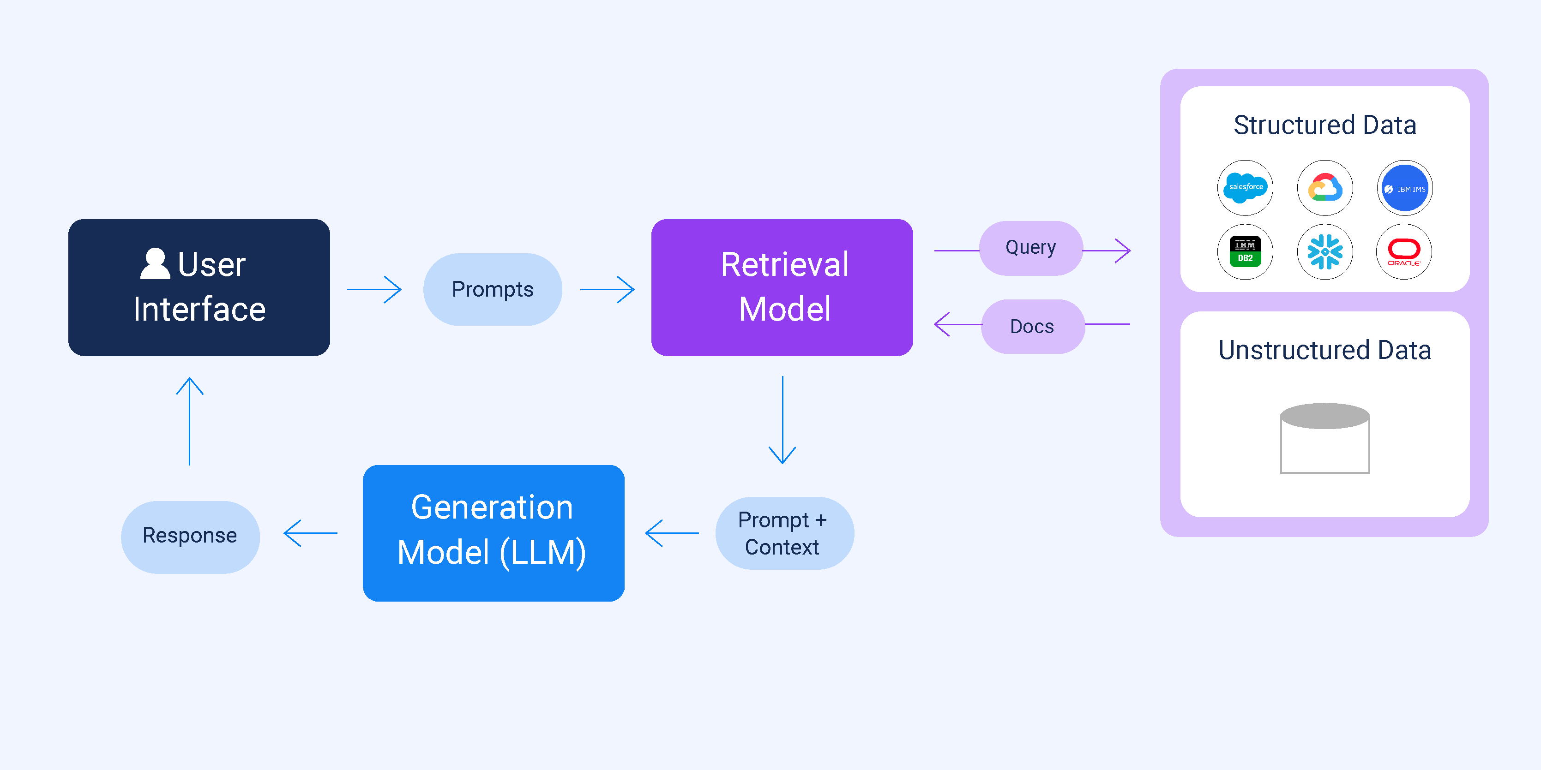
DEMO
Notes:
In the rest of this presentation, I’m going to talk about following contents:

Slide 11
Experimental Results
Document with example run throughs
  https://docs.google.com/document/d/1cUVpo9F9VRybbZcZmcndp1_X_84zVHkF0nZPp7cMCg4/edit?usp=sharing
  Labelled as initial text, prompt, and model output
Successfully pulls sources, integrates, cites, and edits
Biased towards research search
  Most likely due to key word matches on general search terms
Generally, quite fast unless hit model limits
Notes:
In the rest of this presentation, I’m going to talk about following contents:

Slide 12
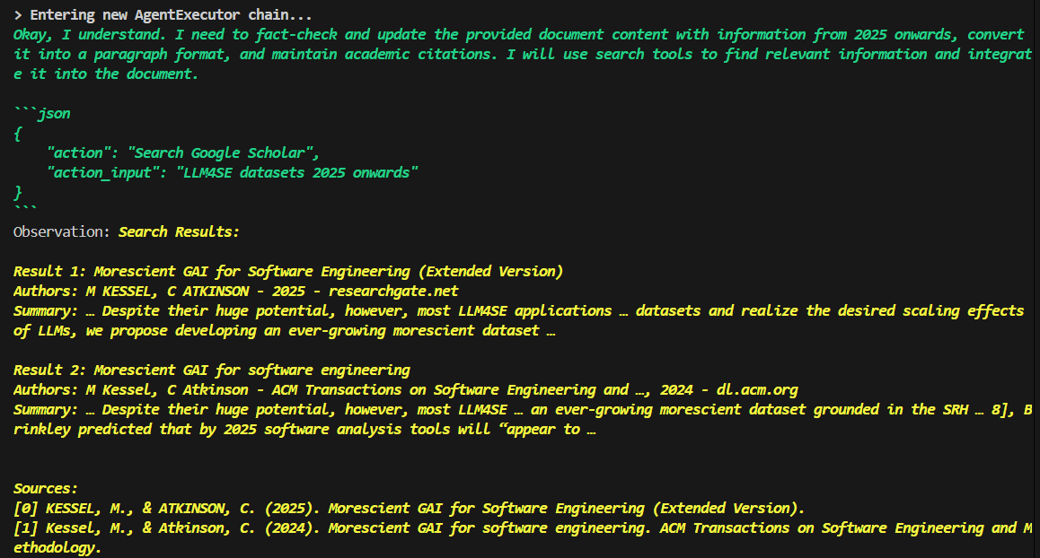
Experimental Analysis
Integration seems to be decent but could be better
Sources seem relevant on review
  Citation format also follows requested style
Struggles with long-context – model issue?
Notes:
In the rest of this presentation, I’m going to talk about following contents:

Slide 13
Conclusion and Future Work
Successful agent application
  Agent correctly accomplishes our goal tasks
  Model performance issues, could be solved with better model
  Clear step-by-step thought process by agent -> interpretability
  Edit vs. Research tasks handled differently
Future Steps
  Include ways to further refine sources and citations
  Improve model responses with better model
  Add in additional tools
    Google Doc formatting (another model?)
    Outlining – more planning orientated
  Create front-end
  Token limits will disrupt longer docs

Slide 14
References
Baek, J., Jauhar, S. K., Cucerzan, S., & Hwang, S. J. (2024). Researchagent: Iterative research idea generation over scientific literature with large language models. arXiv preprint arXiv:2404.07738.
Schmidgall, S., Su, Y., Wang, Z., Sun, X., Wu, J., Yu, X., ... & Barsoum, E. (2025). Agent laboratory: Using llm agents as research assistants. arXiv preprint arXiv:2501.04227.
https://notebooklm.google/
https://www.perplexity.ai/
https://serpapi.com/search-api
https://www.k2view.com/what-are-llm-agents/

