Slide 1

Blogpost Creation
Wenhao Xu, Chenxu Li

Slide 2
Motivation
Large Language Models (LLMs) like GPT-4 have shown strong capabilities in generating high-quality, human-like text.
These models can turn short prompts into coherent, structured content, making them ideal for blogpost generation.
Automated content creation is increasingly relevant in industries like marketing, journalism, and education.
Prompt-to-blog applications can significantly reduce the time and effort needed to brainstorm and draft posts.
Despite their strengths, LLMs still face challenges with factual accuracy, coherence across sections, and tone control.
This project explores building a GenAI tool that creates full blogposts from user prompts, with emphasis on usability and customization.
Notes:
The motivation of this project

Slide 3
Background
The rise of digital marketing and self-media drives content demand
Users’ expectations for high-quality, personalized content continue to rise
The transformation trend from traditional editing to intelligent creation
Development of LLM technology

Slide 4
Related Work
Navigating the Path of Writing: Outline-guided Text Generation with Large Language Models
Yukyung Lee, Soonwon Ka, Bokyung Son, Pilsung Kang, Jaewook Kang
Let's Get to the Point: LLM-Supported Planning, Drafting, and Revising of Research-Paper Blog Posts
Marissa Radensky, Daniel S. Weld, Joseph Chee Chang, Pao Siangliulue, Jonathan Bragg

Slide 5
Claim / Target Task
Target task
Automatic generation: Automatically generate a draft based on user input prompt
Style and theme customization: Support customized generation of multiple article styles and specific themes
Expected results
Reduce content production time and cost
Improve creation efficiency and article quality
Notes:
Here, we make the claim of this project.

Slide 6
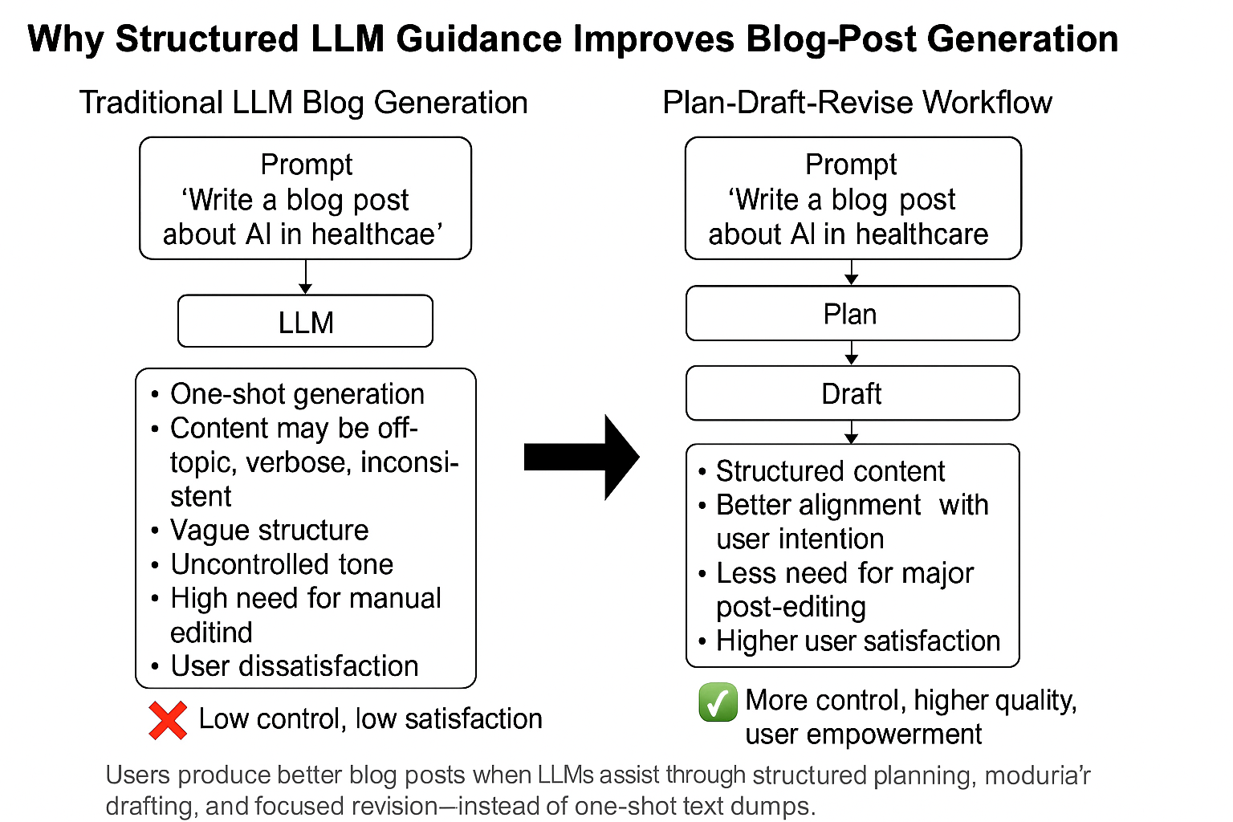
An Intuitive Figure Showing WHY Claim
Notes:
Here, we make the claim of this project.

Slide 7
Proposed Solution
Prompt Input Interface: Users provide a short prompt (e.g., “How GenAI is changing education”)
Planning Module:
  LLM generates an initial outline
  Users can adjust structure, key points
Drafting Module:
  Section-by-section generation using user-edited outlines
  Allows tone and style customization
Architecture Stack
  Frontend: React
  Backend: Node.js
  LLM API: OpenAI GPT-4.1
  Storage: ocal JSON for prototypes
Notes:
Here is our proposed solution.

Slide 8
Implementation
User Input Interface
  Topic: Free text input (e.g., "Best AI Tools for Blogging")
  Keywords: Optional list (e.g., "SEO-optimized", "ai blog writers")
  Background Info: Optional facts (e.g., technology, pricing, stats)
  Writing Style: Freeform tone input (e.g., "News/information review type")
  Word Count: Slider to select target length (e.g., 3000 words)
Frontend (React)
Form collects structured input
Sends input as a JSON object to backend via API
Backend (Node.js)
Notes:
In the rest of this presentation, I’m going to talk about following contents:

Slide 9
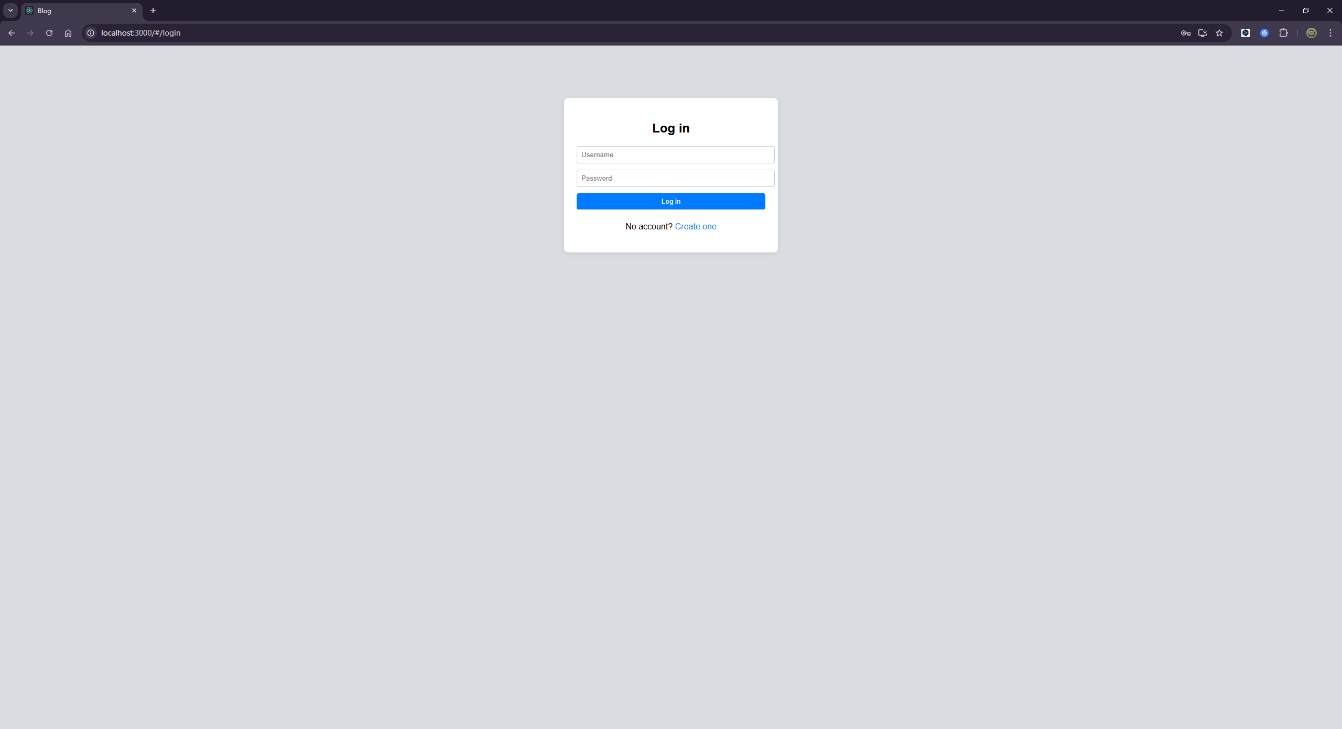
Experimental Results
Notes:
In the rest of this presentation, I’m going to talk about following contents:

Slide 10
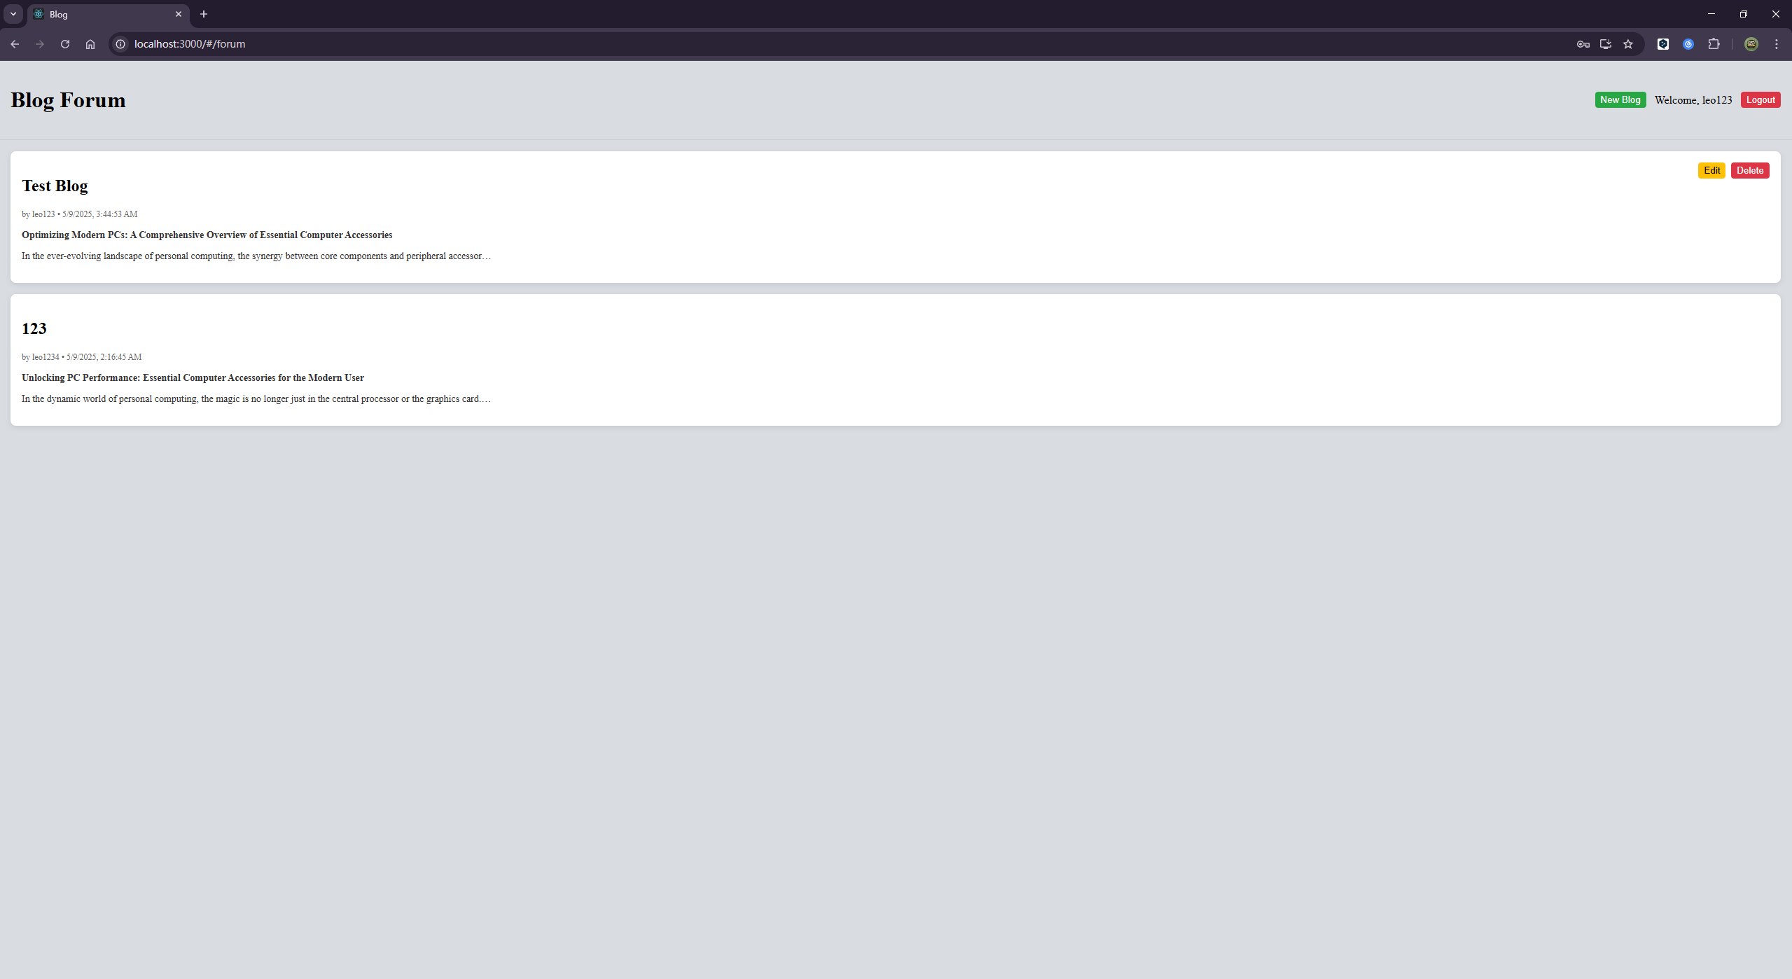
Experimental Results
Notes:
In the rest of this presentation, I’m going to talk about following contents:

Slide 11
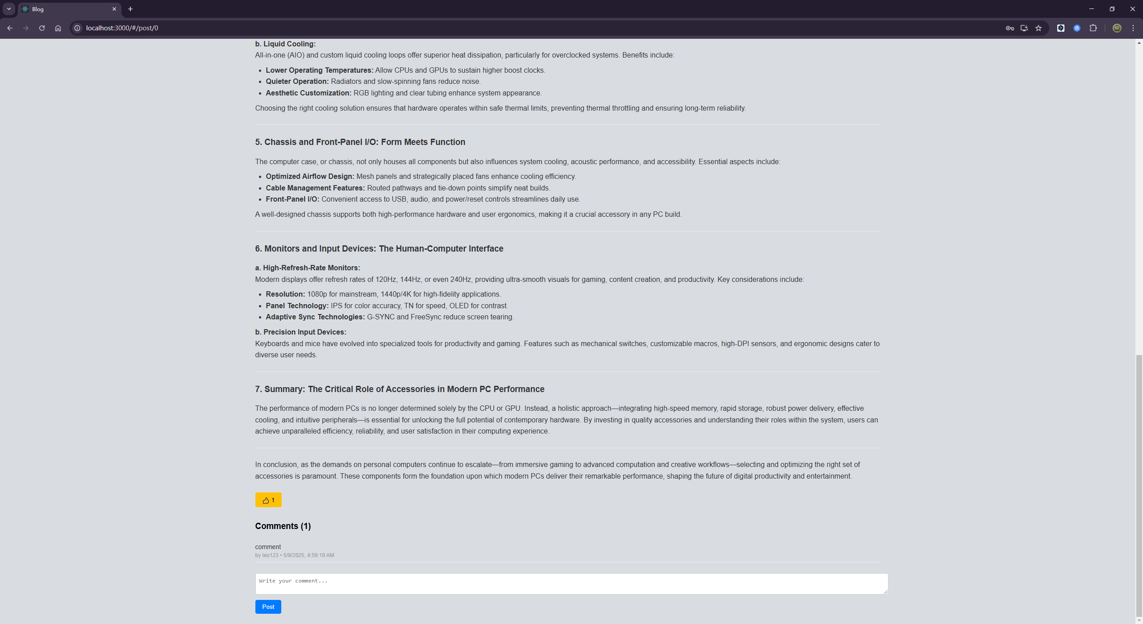
Experimental Results
Notes:
In the rest of this presentation, I’m going to talk about following contents:

Slide 12
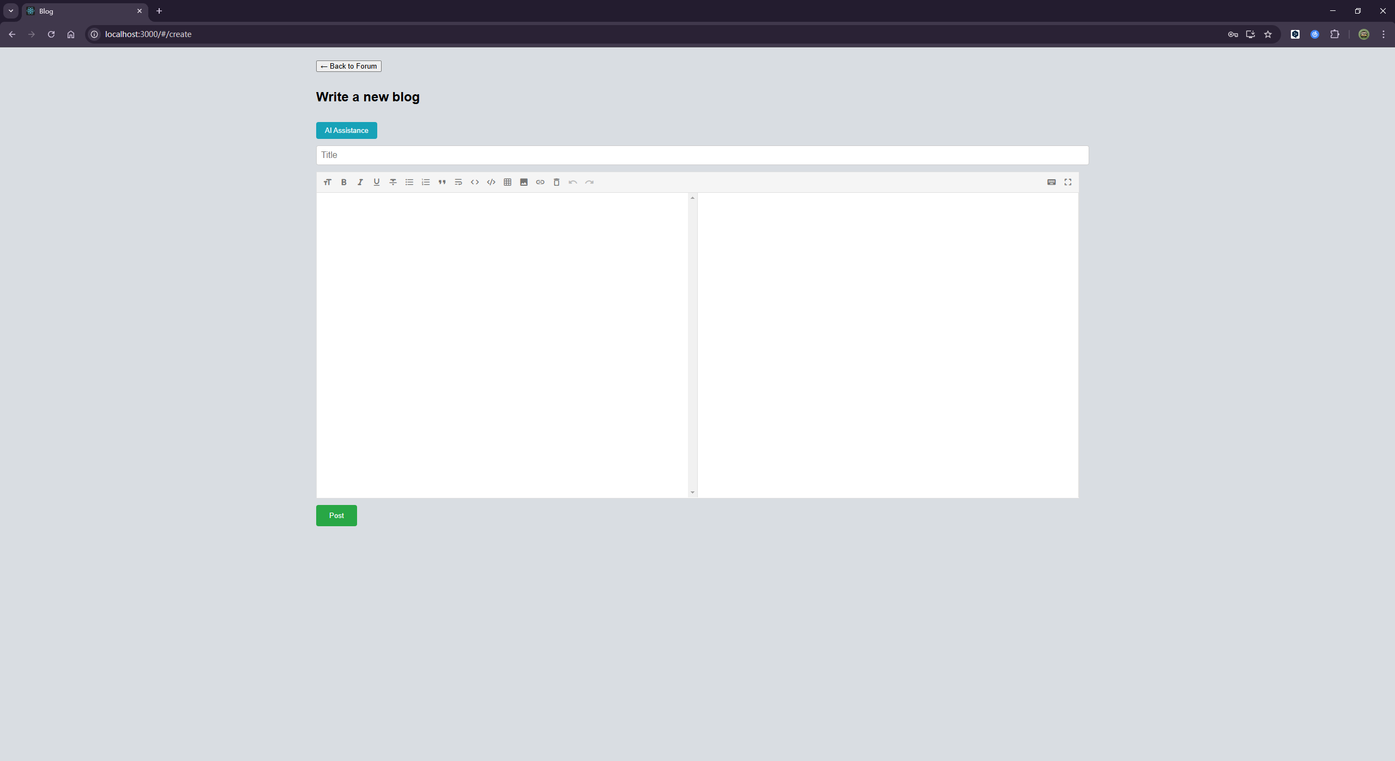
Experimental Results
Notes:
In the rest of this presentation, I’m going to talk about following contents:

Slide 13
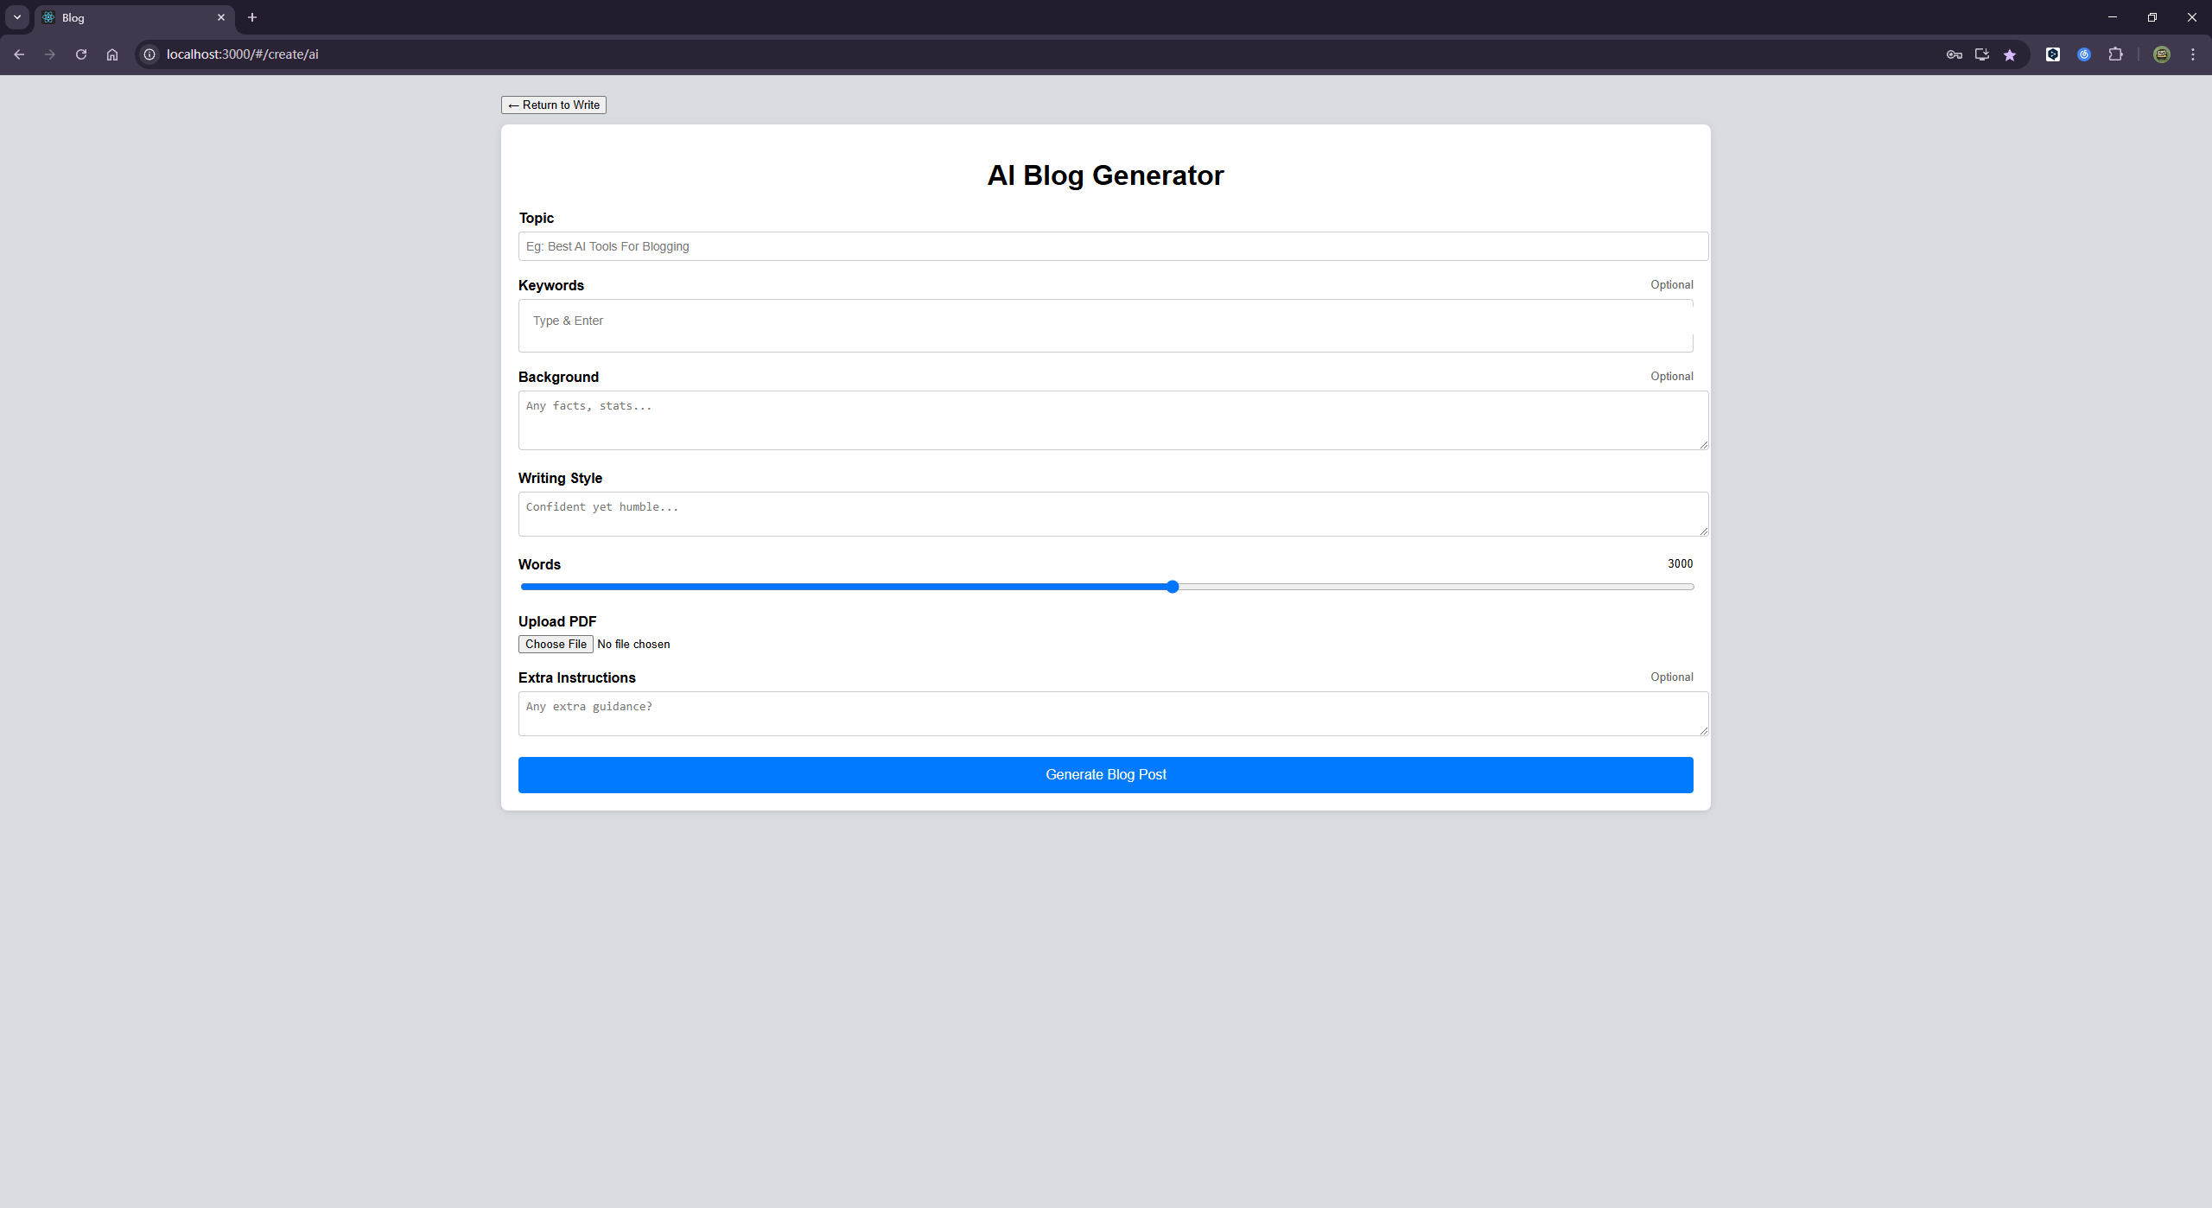
Experimental Results
Notes:
In the rest of this presentation, I’m going to talk about following contents:

Slide 14
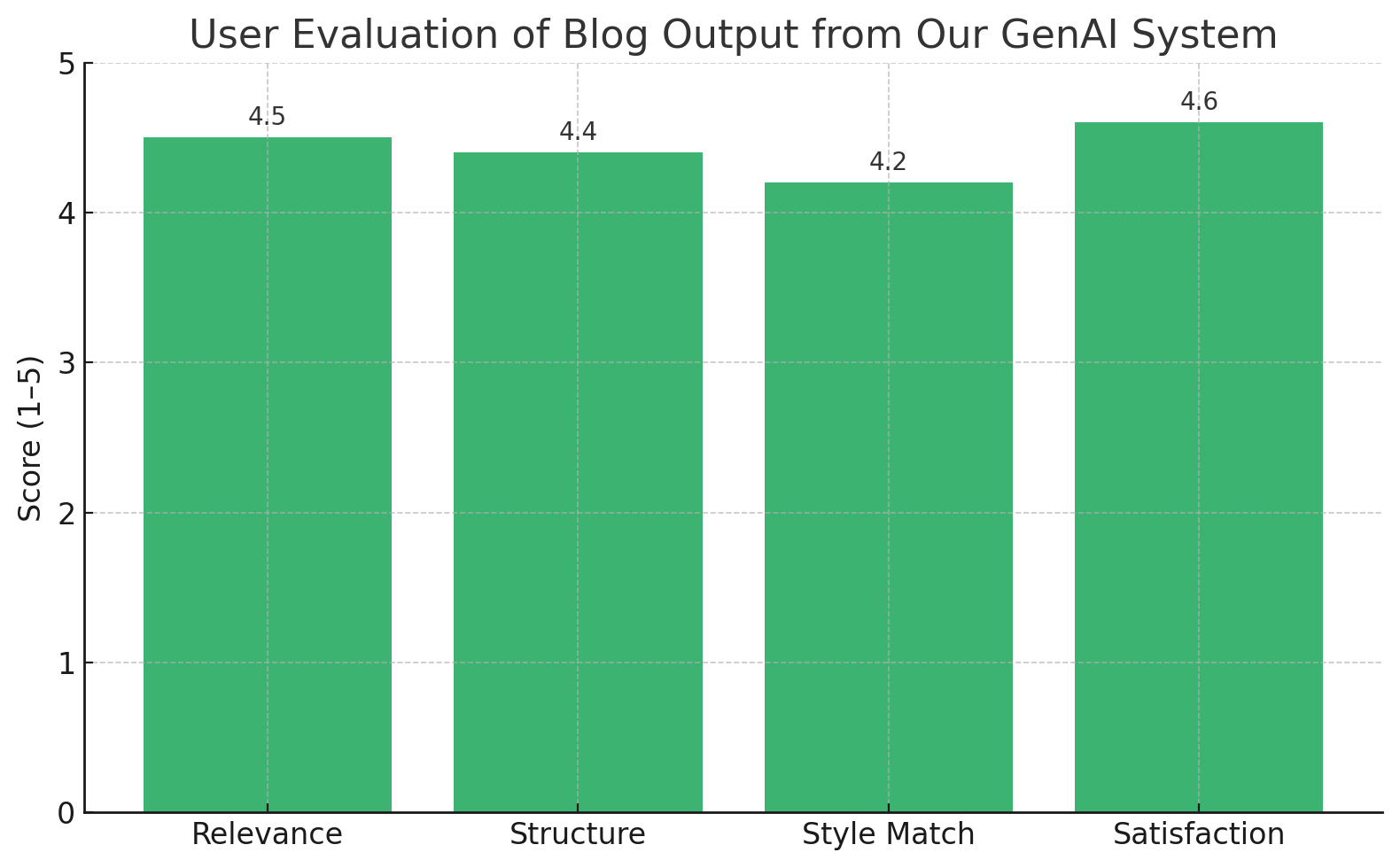
Experimental Results
Notes:
In the rest of this presentation, I’m going to talk about following contents:

Slide 15
Future Work
Outline Preview Feature: Allow users to view and adjust an auto-generated outline before full blog generation.
Tone Calibration Tool: Let users fine-tune tone dynamically (e.g., slider for formal vs. casual).
Multi-language Support: Expand to support non-English blog generation using multilingual LLMs.
Factual Consistency Checks: Integrate RAG (retrieval-augmented generation) to reduce hallucination in factual topics.
SEO Enhancements: Automatically embed meta descriptions, headings, and keywords for better discoverability.
User Feedback Loop: Collect post-generation feedback to fine-tune prompt templates and improve personalization.

