Slide 1

Benchmarking Large Language Models on Programming Tasks: An Evaluation on Code Generation
Aditya Kakkar, Aryan Sawhney
04/28/2025

Slide 2
Aditya Kakkar(zjq5mr)

Slide 3
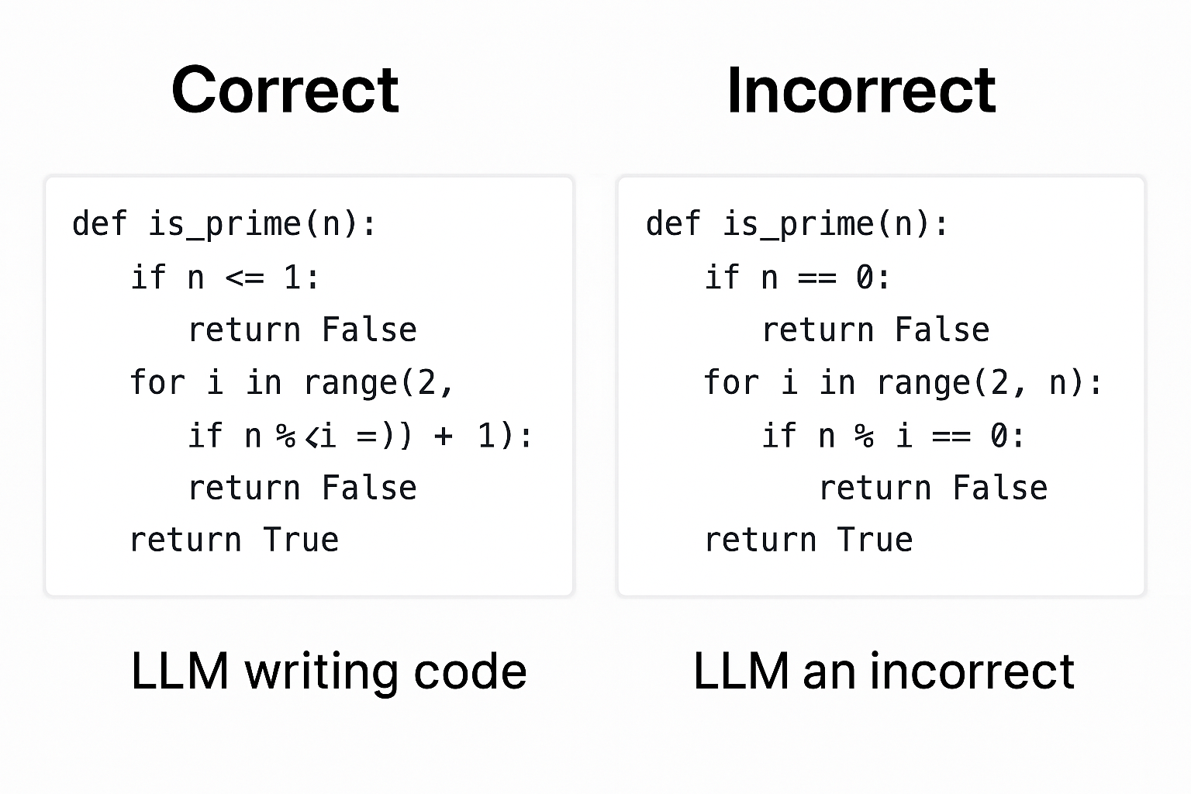
Motivation
The rise of LLMs has transformed how developers write code.
Developers and organizations want reliable tools — but which LLMs are actually best at coding?
Prior evaluations focus on older models, newer models haven’t been compared systematically.
We aim to provide a clear, reproducible, and up-to-date evaluation of cutting-edge models on real coding tasks.
Notes:
The motivation of this project

Slide 4
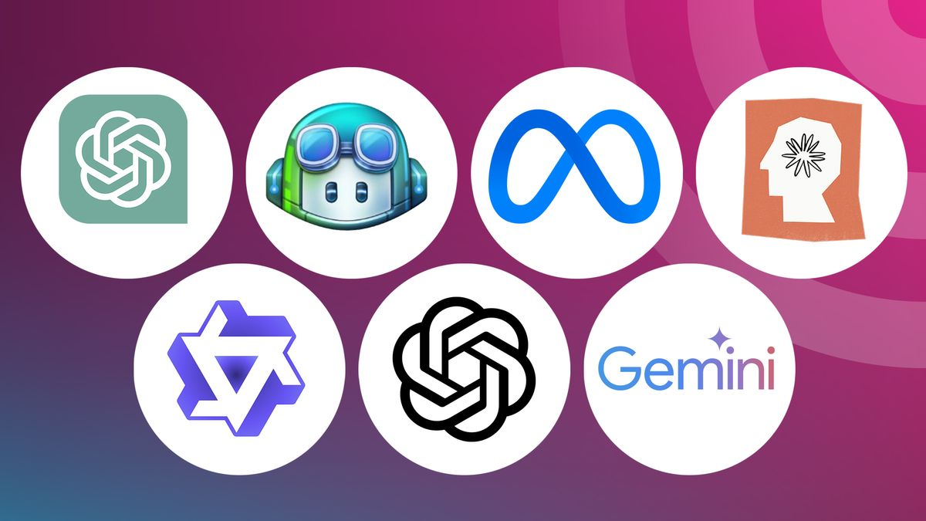
Background
Prior work has evaluated LLMs like Codex, GPT-4 Turbo, and Claude Opus, mostly using HumanEval and MBPP.
However, the latest models — GPT O3 mini/high, Claude 3.7 Sonnet, and Grok 3— haven’t been directly compared for code generation quality.
Most existing evaluations mix reasoning with coding — we isolate code generation only, using Python.
We will look at a mix of coding problems: Software Engineering, Competitive Programming, etc.

Slide 5
Related Work
HumanEval Benchmark (OpenAI, 2021) – A seminal Python code generation benchmark that uses unit tests to assess functional correctness, setting the standard for evaluating models on Python programming tasks. (HumanEval Benchmark, OpenAI 2021)
MBPP (Mostly Basic Python Problems, 2021) – A diverse collection of entry-level Python problems that complements HumanEval by testing practical coding skills in a broad range of basic scenarios. (MBPP, 2021)
OpenAI Codex Evaluation (2021) – Demonstrates how code-focused fine-tuning can dramatically boost model performance on code generation tasks, providing a foundational benchmark for subsequent models like GPT o3-mini-high. (OpenAI Codex Evaluation, 2021)

Slide 6
Related Work(continued)
Model | HumanEval, Pass@1 Score
O1 | 99.4
Sonnet–3.5 | 98.8
O3-mini | 98.8
GPT-4 | 96.3
GPT-4o-mini | 94.7

Slide 7
Claim / Target Task
The primary target task is code generation—specifically, evaluating how effectively large language models (LLMs) can transform natural language descriptions or problem prompts into correct, efficient, and readable code. This involves:
Generating Syntactically Correct Code: Ensuring the code follows the programming language's syntax.
Producing Semantically Accurate Solutions: Verifying that the generated code correctly implements the intended functionality.
Assessing Efficiency and Readability: Evaluating how optimized and maintainable the code is.
Notes:
Here, we make the claim of this project.

Slide 8

An Intuitive Figure Showing WHY Claim
Notes:
Here, we make the claim of this project.

Slide 9
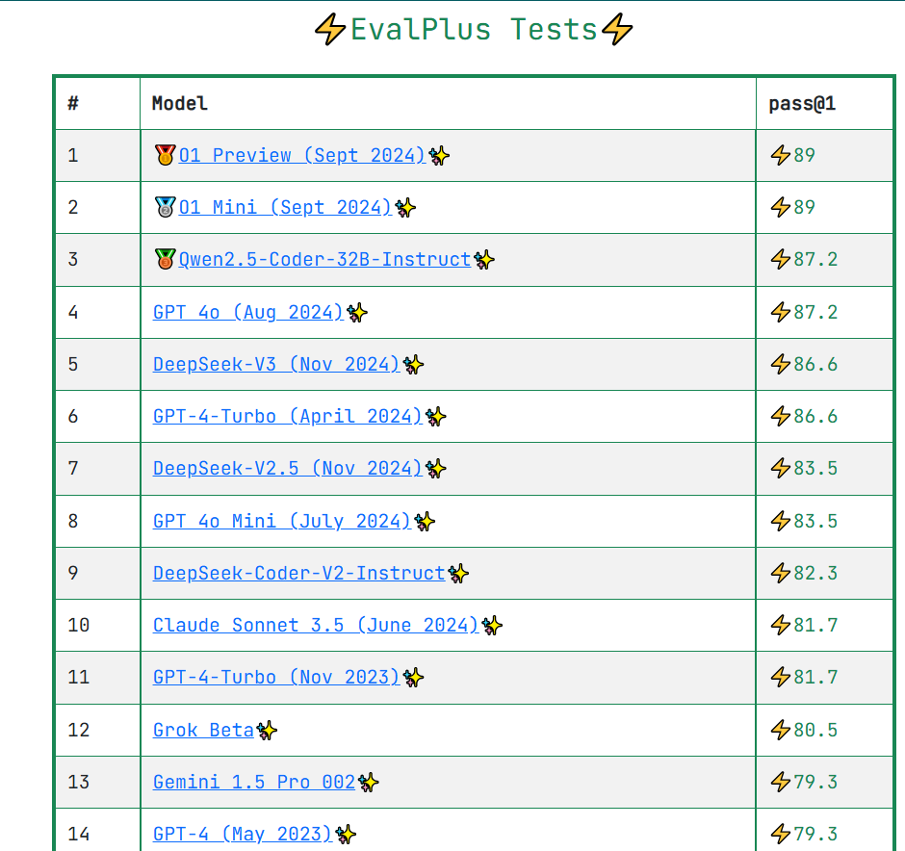
An Intuitive Figure Showing WHY Claim

Slide 10
Predictions
Aditya | Aryan
Claude 3.7 | Grok
2. Grok 3 | 2. Claude 3.7
3. O3 | 3. O3
Notes:
Here, we make the claim of this project.

Slide 11




Proposed Solution
Dataset & Prompts
  HumanEval+ (164 problems, ~80 tests each)
  Each problem provides the zero-shot code prompt
Only by combining a standardized dataset, multiple models, exhaustive tests, and accuracy metrics can we truly identify which LLM excels at code generation.
2. Models
  O3
  Claude Sonnet 3.7
  Grok 3
3. Execution & Testing
  Run generated code on HumanEval+ suites
  Sandboxed + 10 s timeout
4. Metrics
  Accuracy
  Readability

Slide 12
Aryan Sawhney (ryd2fx)

Slide 13
Implementation
Environment Setup Google Collab + Secrets Python 3.9 | Generate & Evaluate Generate: generate_code_[model](prompt) → raw code Extract: extract_code(response) removes markdown Test: write temp .py + .test.py, run with subprocess (10 s timeout) what does this mean
Data Loading Read HumanEval.jsonl & MBPP.jsonl from /content/files/ load_humaneval_data() → list of {task_id, prompt, test} dicts | Logging & Visualization Load into pandas DataFrame Inline visualization plots of Pass@1 in Colab
Notes:
“Our entire workflow lives in a Google Colab notebook:
We install the OpenAI, Anthropic, and xAI SDKs and configure API keys via Colab’s secrets.
We load the HumanEval.jsonl and MBPP.jsonl files from /content/files using a simple loader function.
For each problem, we call our wrapper functions—generate_code_o3, generate_code_claude, generate_code_grok3—to get raw code, strip out any markdown, compile it, and run the unit tests in isolated subprocesses with a 10-second timeout.
Finally, we aggregate results into JSON, load them into pandas, and render inline visualizations of Pass@1.”

Slide 14
Data Summary
Data Summary
Dataset: HumanEval (164 Python problems)
Test cases: ~80 unit tests per problem, covering basic functionality and edge cases
Prompt format: Zero-shot natural-language descriptions—no few-shot examples
Models evaluated:
  O3 via OpenAI Python SDK
  Claude 3.7 Sonnet via Anthropic SDK
  Grok 3 via xAI REST API
Environment: Google Colab (Python 3.9), 10 s timeout per test run

Slide 15
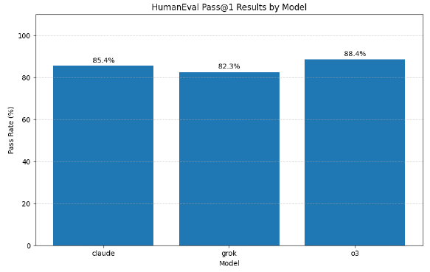
Experimental Results

Slide 16
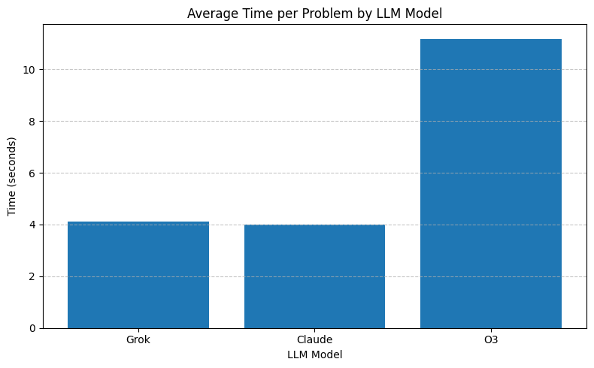
Experimental Results

Slide 17
Experimental Analysis
Accuracy vs. Speed Trade-Off
We evaluated Pass@1 accuracy and average inference time per problem across three models: Claude 3.7 Sonnet, Grok 3, and O3.
As shown in the figures:
O3 achieved the highest Pass@1 (88.4%), outperforming Claude (85.4%) and Grok (82.3%).
However, O3 is significantly slower, taking ~11.18 seconds per problem—nearly 3× slower than Claude (4.0s) and Grok (4.1s).
Claude 3.7 Sonnet offers the best trade-off between speed and accuracy.
Reliability & Failure Modes
Claude's performance showed low variance, suggesting consistent results across different prompts.
O3’s performance, though accurate, was more erratic, and timeouts occurred more frequently.
Common error types included:
  Off-by-one mistakes
  Missed edge cases (e.g., empty inputs, negatives)
  Execution timeouts, especially for O3
Efficiency Implications
Faster models (Claude, Grok) minimize API billing and runtime costs.
O3’s latency may limit its practical use in time-sensitive or large-batch applications, despite its high accuracy.

Slide 18
Conclusion and Future Work
Key Takeaways
O3 is currently the strongest code-generation LLM in terms of accuracy under zero-shot evaluation
Taking everything into consideration, Claude 3.7 is the best.
Cost and runtime are critical factors alongside accuracy
Future Directions
Expand to additional benchmarks (e.g., MBPP, Codeforces) for broader coverage
Explore iterative self-debugging or few-shot prompting to boost pass rates
Investigate cost-efficiency trade-offs, e.g., pass@k vs. token spend
Consider multilingual or multi-file code generation scenarios

Slide 19
Challenges
API Usage Costs
  Token‐based billing quickly adds up when calling LLMs hundreds of times
  164 tasks × 3 models → substantial expenses
Model Selection Trade-Offs
  Needed diversity but limited by budget
  Chose only O3, Claude 3.7 “Sonnet”, Grok 3 as representative leaders
Benchmark Scope Constraints
  Picked HumanEval (164 problems) to maximize coverage while controlling API calls
  Omitted larger/secondary datasets to keep costs in check
Compute & Time Overheads
  Generation → syntax check → test execution for each model/problem
  Leveraged Colab’s free GPU/CPU tiers and careful batching to reduce runtime
Notes:
“Cost was our biggest constraint—token-based billing can add up quickly when you’re making hundreds of API calls. To manage our budget, we limited ourselves to three models (O3, Claude 3.7 Sonnet, Grok 3) and the 164-problem HumanEval suite. We also used Colab’s free resources and batched our runs to minimize runtime.”

Slide 20
References
Chen, M. et al. (2021). “Evaluating Large Language Models Trained on Code.” arXiv:2107.03374.
Austin, J. et al. (2021). “Program Synthesis with Large Language Models.” arXiv:2108.07732.
OpenAI (2025). “Introducing OpenAI o3.” OpenAI Blog, April 16, 2025.
Anthropic (2025). “Claude 3.7 Sonnet Release.” Anthropic Blog, February 24, 2025.
xAI (2025). “Grok 3 Beta — The Age of Reasoning Agents.” xAI News, February 19, 2025.
6.Hunter, J. D. (2007). “Matplotlib: A 2D Graphics Environment.” Computing in Science & Engineering, 9(3), 90–95.
7. McKinney, W. (2010). “Data Structures for Statistical Computing in Python.” Proceedings of the 9th Python in Science Conference (SciPy 2010).
Notes:
“These are the key sources that guided our work—benchmark papers for HumanEval and MBPP, official releases for O3, Claude 3.7 Sonnet, and Grok 3, as well as the libraries we used: OpenAI’s Python SDK, Anthropic’s SDK, tqdm, matplotlib, and pandas.”

Slide 21
Questions?
Notes:
“That wraps up our presentation—thank you for listening! We’d love to hear your questions or feedback now.”

Slide 22

Thank You!

