Slide 1
Injecting LLM Commonsense into Causal DAG Discovery
An experimental study on integrating external knowledge into structure learning algorithms.
Yuriy Rusanov

Slide 2
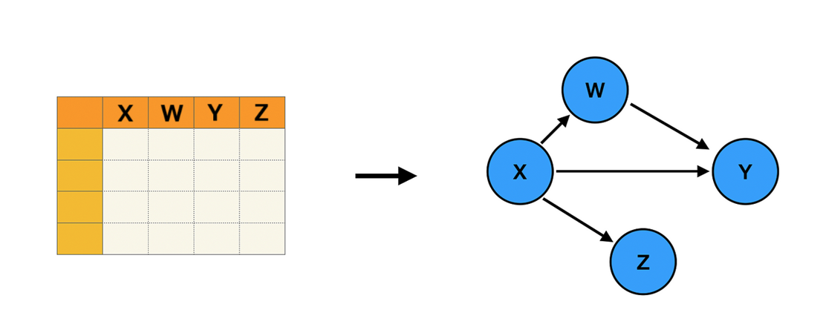
The Challenge of Discovering Causality
What is Causal Discovery? The process of identifying causal relationships from observational data. It moves beyond simple correlation ("what") to understand causation ("why").
The Core Problem: Discovering the true causal graph is an NP-hard problem. Algorithms can struggle with limited data, noise, and complex systems.
Project's Goal: To investigate if we can improve causal discovery by injecting "common-sense" knowledge into modern algorithms using Large Language Models (LLMs).

Slide 3
Causal Discovery Toolkit
Classic Baselines:
GES (Greedy Equivalence Search): A fast, score-based method.
PC (Peter-Clark): A classic constraint-based method using independence tests.
Neural Approach:
DAG-GNN: VAE based model that learns a adjacency matrix through continuous optimization.
Novel Hybrids:
DAG-GNN + Gemini: Our modified DAG-GNN guided by causal priors from Google's Gemini.
DAG-GNN + Claude: Our modified DAG-GNN guided by causal priors from Anthropic's Claude.

Slide 4
Giving "Common Sense" to an Algorithm
SYSTEMATIC QUERYING
PARSING THE VERDICT
INJECTING THE PRIOR
01
02
03
For every potential cause-and-effect pair of variables (A, B), we ask the LLM: "Based on general scientific knowledge, is 'A' a direct cause of 'B'?"
We automatically parse the LLM's reasoning to get a definitive "YES" or "NO" verdict.
A "YES" verdict gives the potential edge a stronger initial weight in the DAG-GNN model.
This guides the algorithm.

Slide 5
Experimental Setup - Datasets
ASIA - N2000
ASIA - N5000
SACHS
Discrete
Discrete
Continuous
A small, synthetic Bayesian network for medical diagnosis of lung conditions.
A small, synthetic Bayesian network for medical diagnosis of lung conditions.
Real-world data from a complex network of protein signaling in human immune cells.

Slide 6
Experimental Setup - Key Evaluation Metrics
F1 Score (Directed Edges)
F1 Skeleton
Structural Hamming Distance (SHD)
Measures the accuracy of learned cause-and-effect relationships. (Higher is Better)
Measures the accuracy of identifying which nodes are connected, regardless of edge direction. (Higher is Better)
Counts the number of errors (missing, extra, or reversed edges) in the graph structure. (Lower is Better)

Slide 7
Results
 |  | SHD | F1 Skeleton | F1 Strict Directed | Execution Time (seconds)
Asia N2000 | GES | 8 | 0.9333 | 0 | 0.46
 | PC | 8 | 0.7692 | 0 | 0.02
 | DAG-GNN | 4 | 0.7143 | 0.7143 | 123.85
 | DAG-GNN-GEMINI | 5 | 0.75 | 0.625 | 173.14
 | DAG-GNN-CLAUDE | 3 | 0.8571 | 0.7143 | 172.81
Asia N5000 | GES | 8 | 0.9333 | 0 | 0.47
 | PC | 8 | 0.7692 | 0 | 0.02
 | DAG-GNN | 3 | 0.8 | 0.8 | 307.26
 | DAG-GNN-GEMINI | 4 | 0.9412 | 0.5882 | 1984.74
 | DAG-GNN-CLAUDE | 5 | 0.6154 | 0.6154 | 676.04
Sachs | GES | 18 | 0.5714 | 0.16 | 0.81
 | PC | 19 | 0.625 | 0.2222 | 0.02
 | DAG-GNN | 13 | 0.6 | 0.5333 | 326.80
 | DAG-GNN-GEMINI | 28 | 0.5614 | 0.4561 | 42.84
 | DAG-GNN-CLAUDE | 14 | 0.6667 | 0.6154 | 90.05

Slide 8
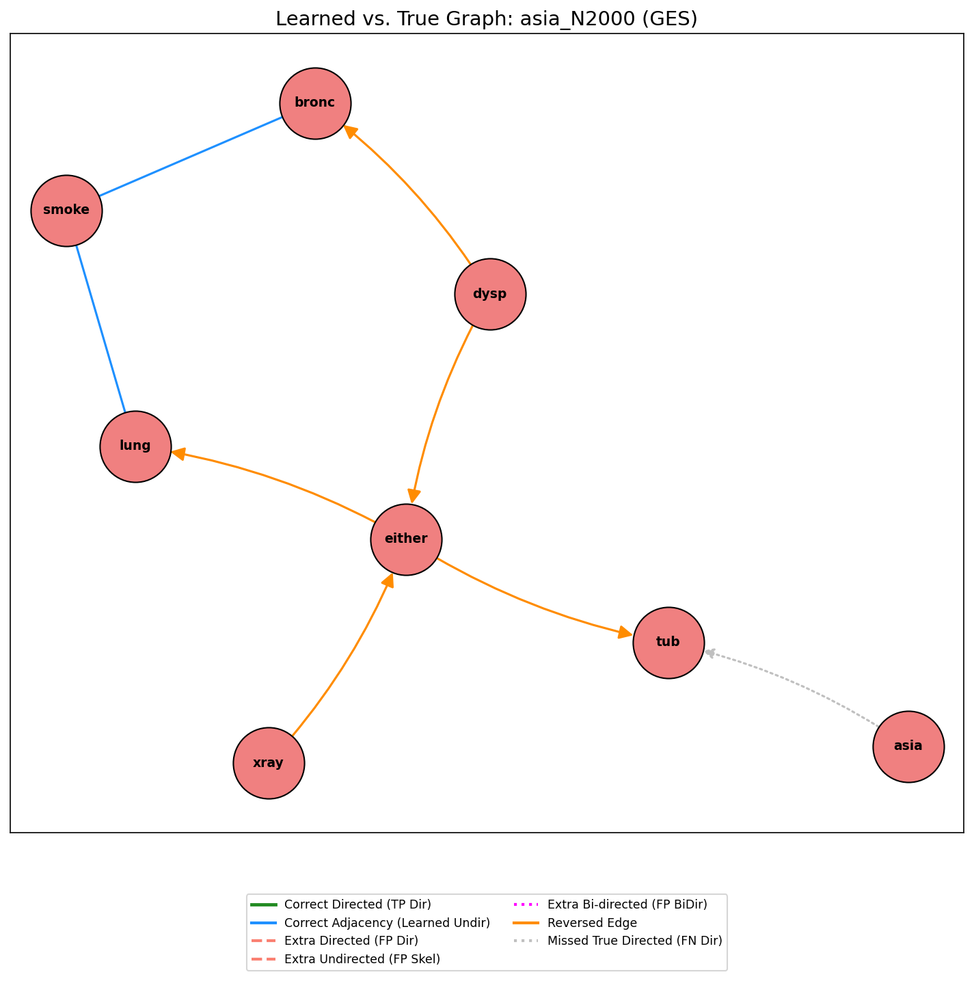
Qualitative Graph Comparison

Slide 9
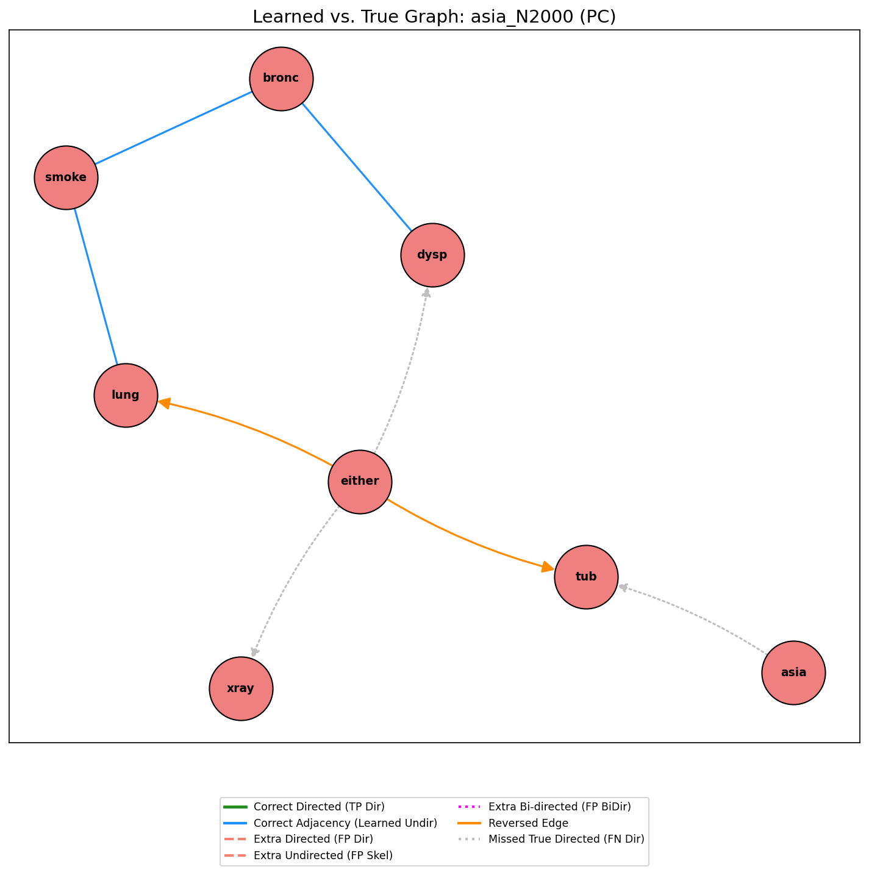
Qualitative Graph Comparison

Slide 10
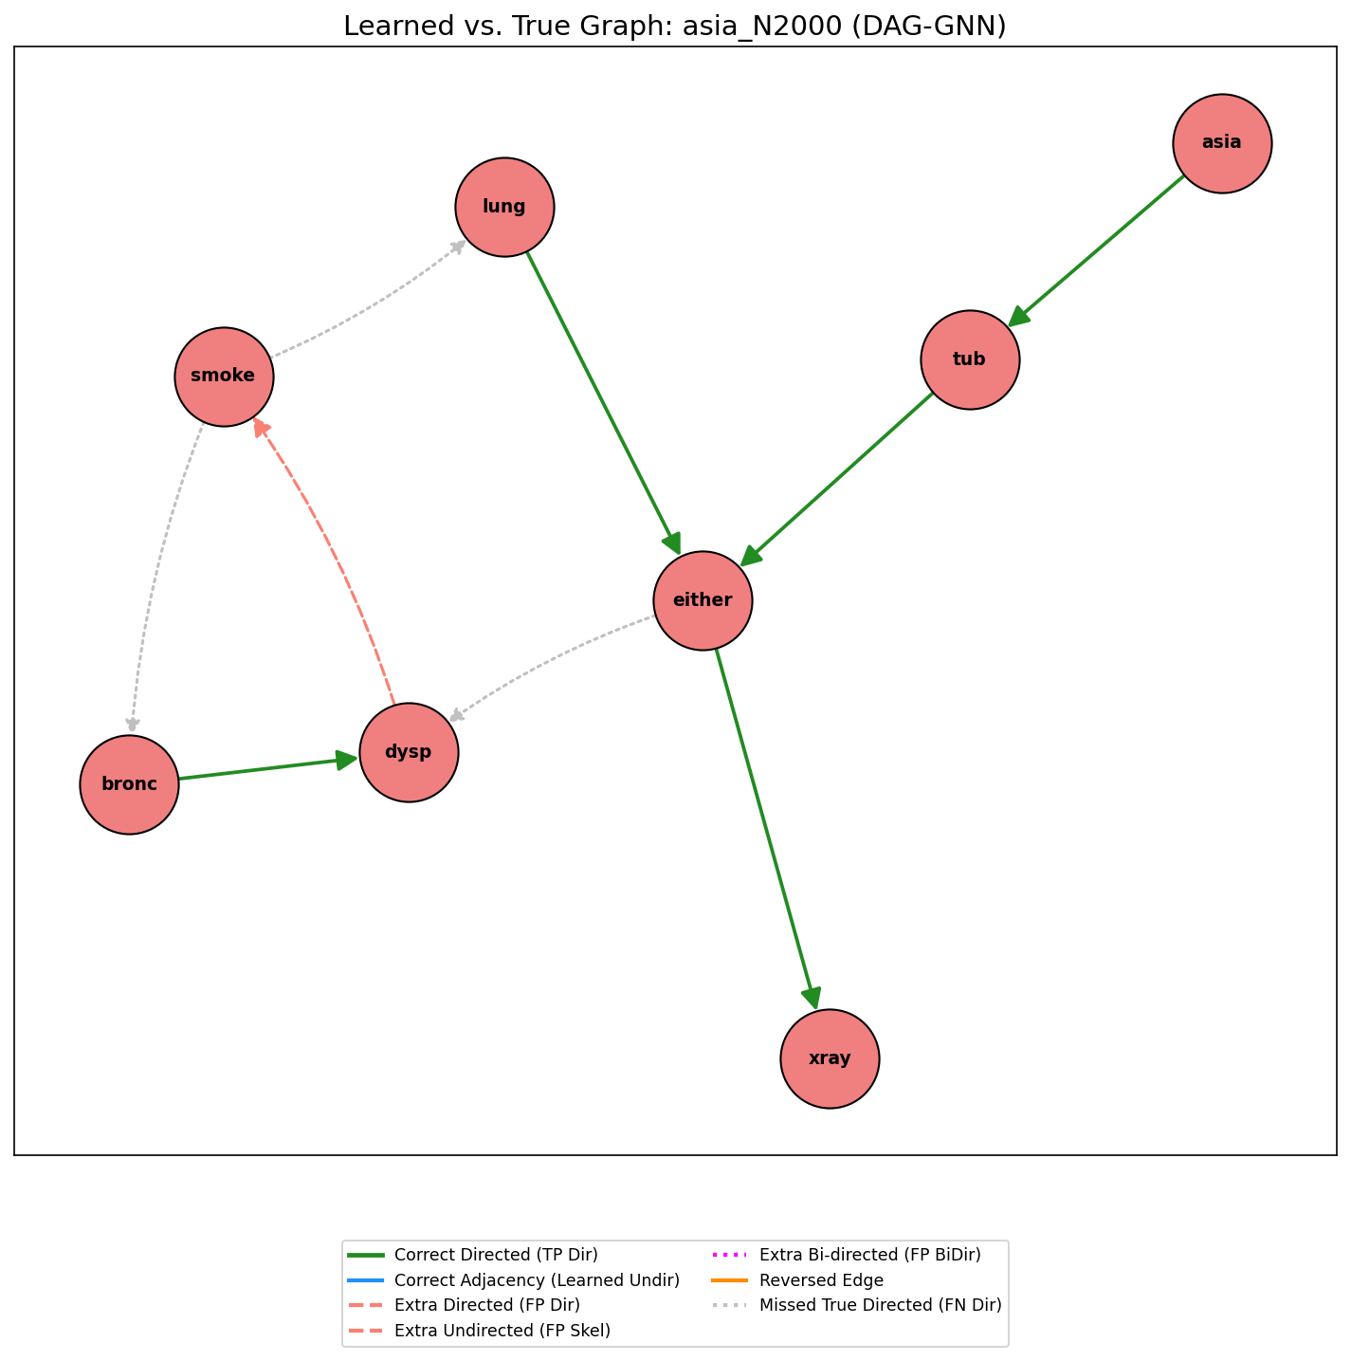
Qualitative Graph Comparison

Slide 11
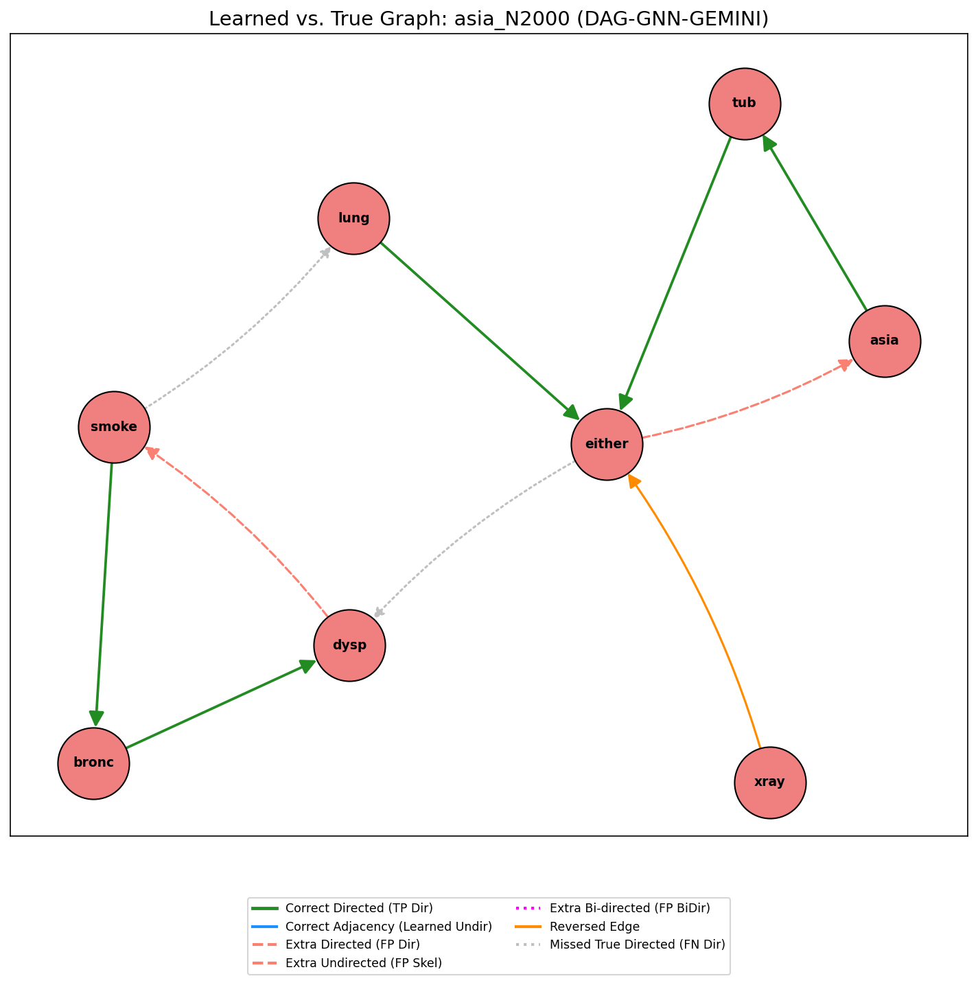
Qualitative Graph Comparison

Slide 12
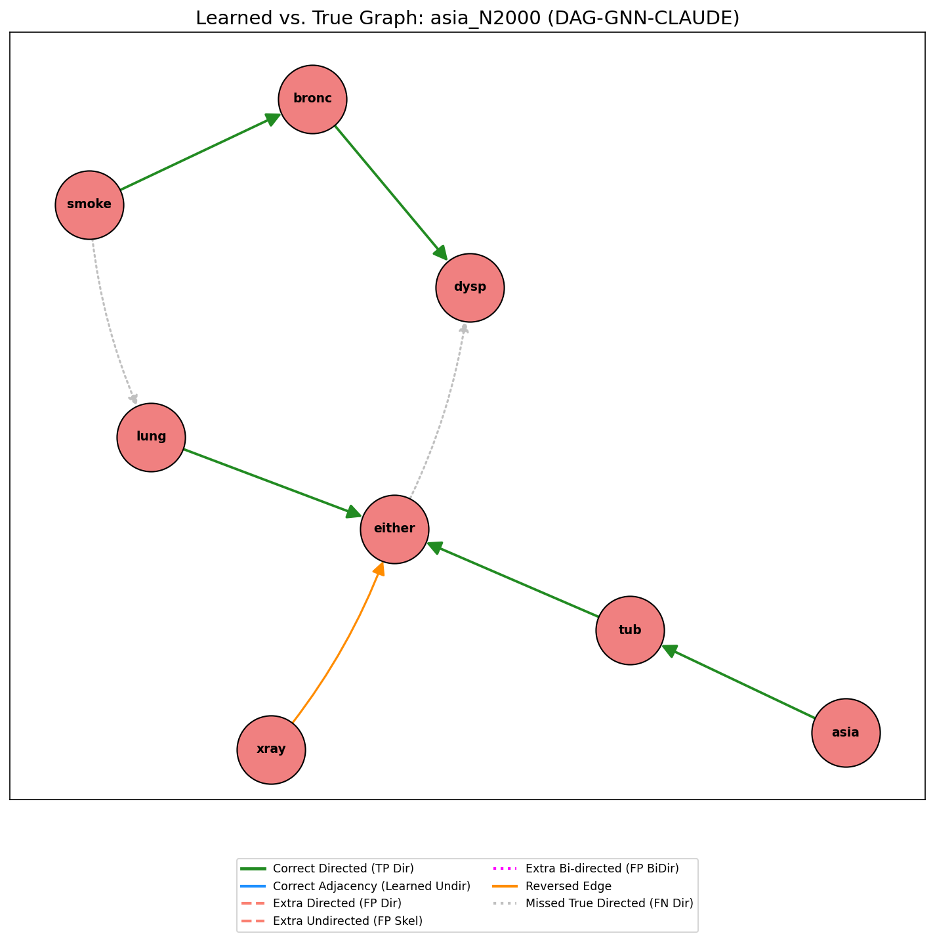
Qualitative Graph Comparison

Slide 13
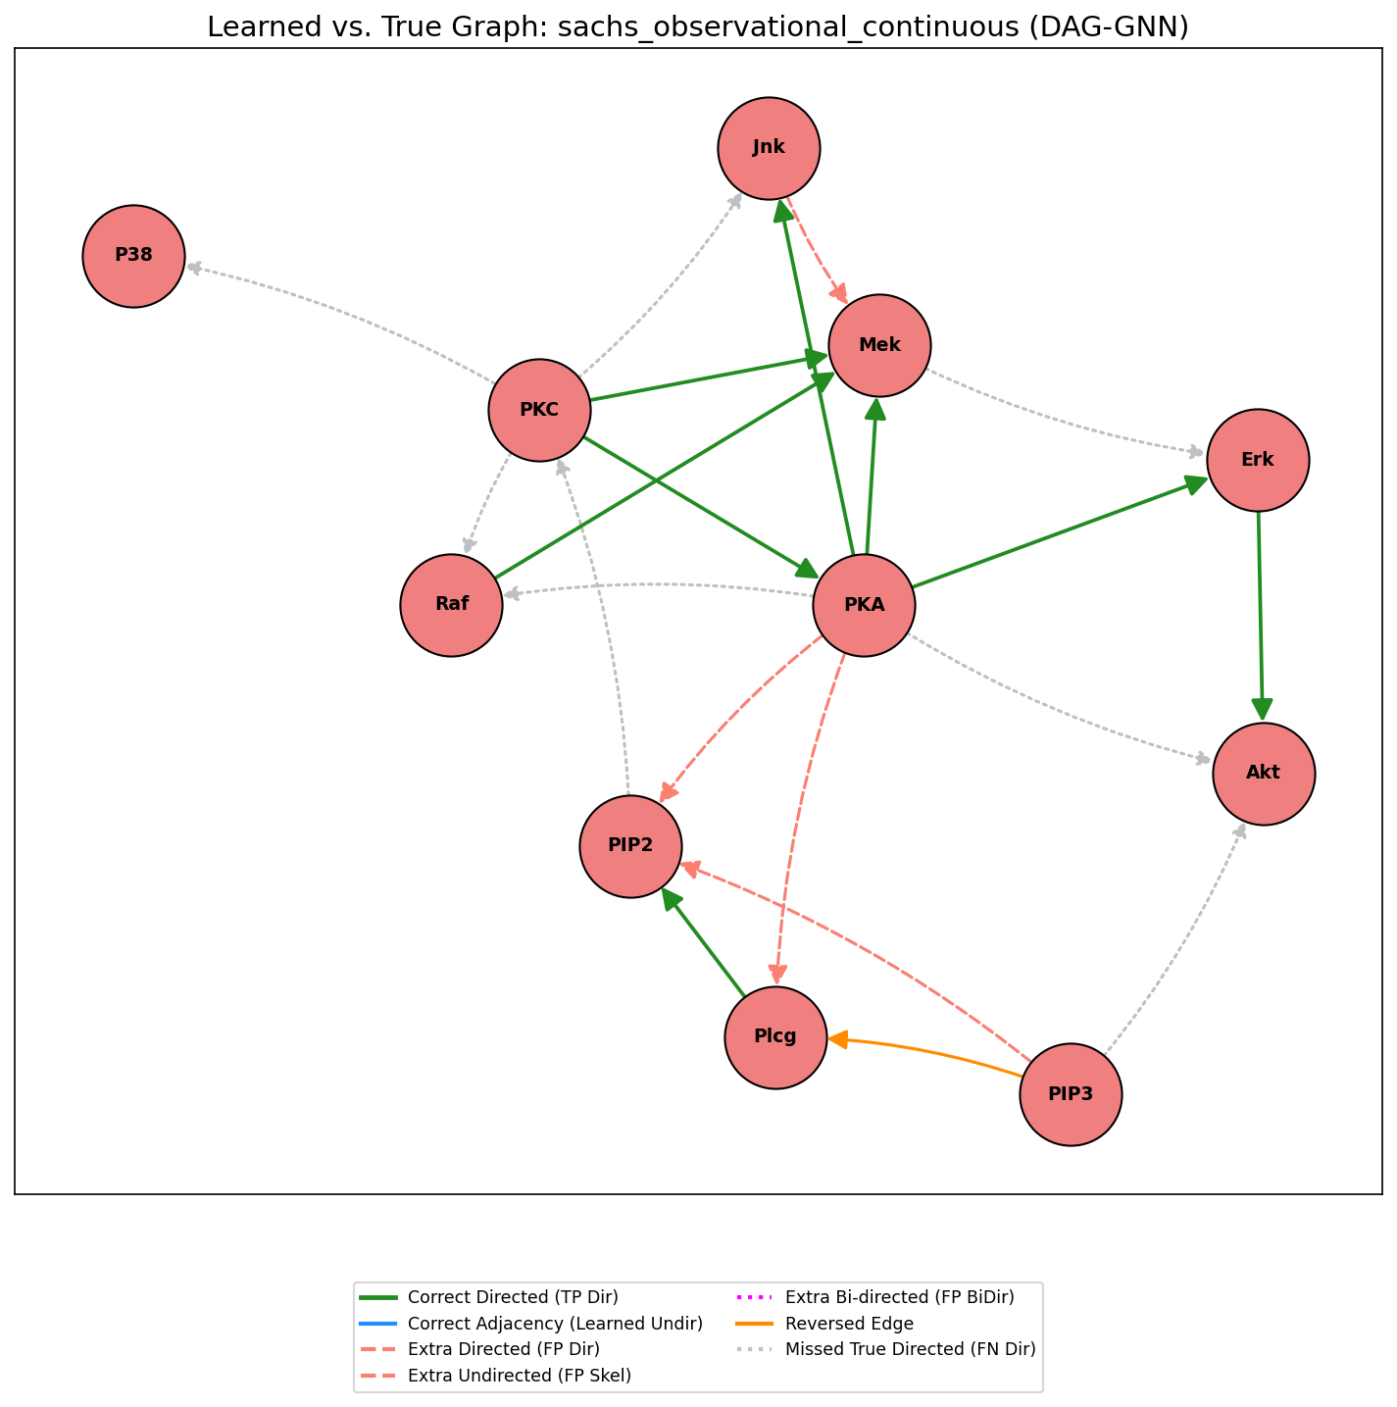
Qualitative Graph Comparison

Slide 14
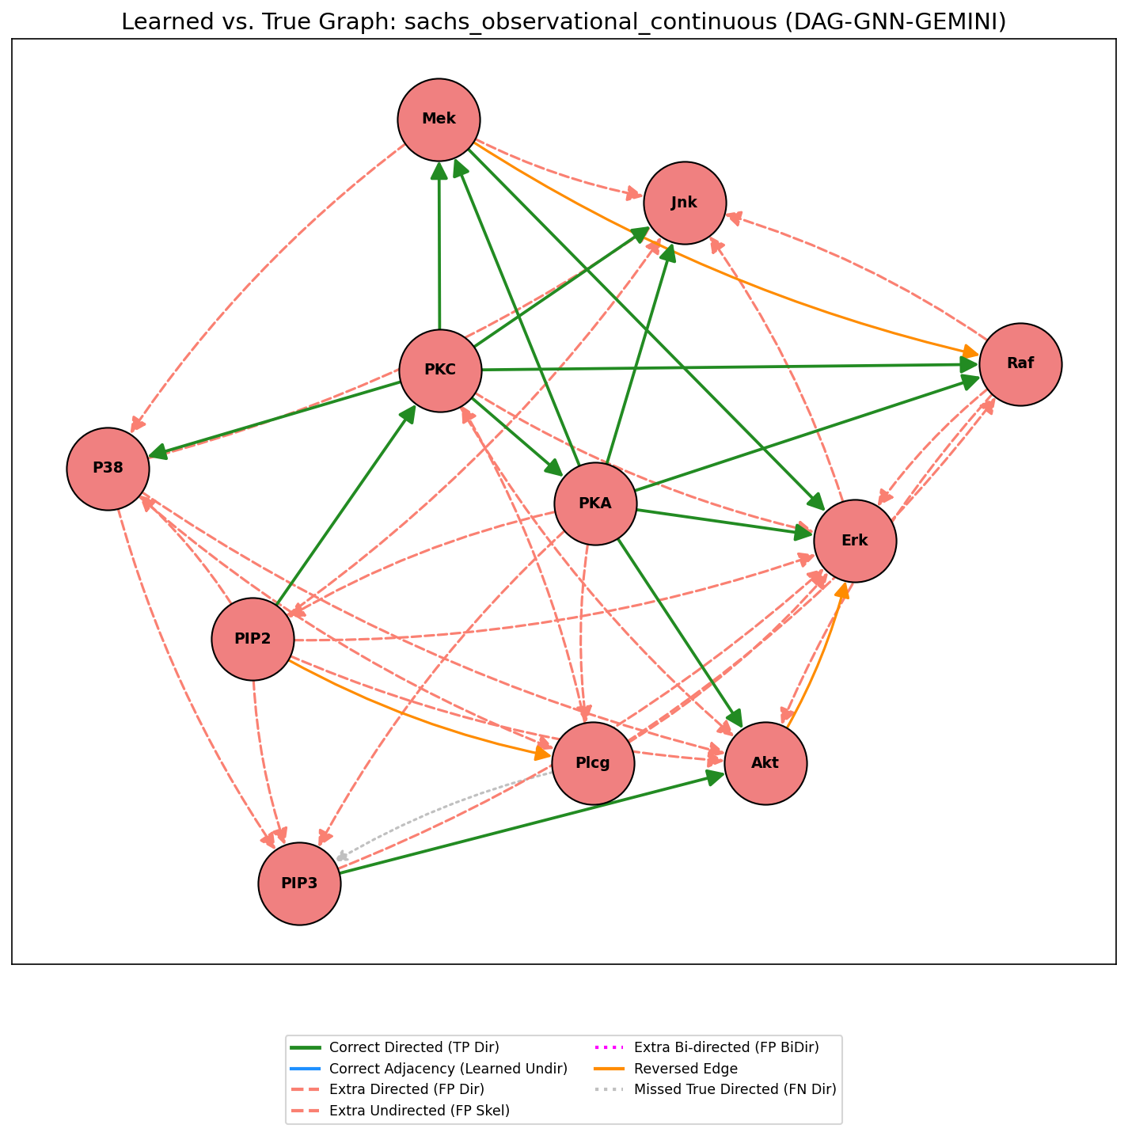
Qualitative Graph Comparison

Slide 15
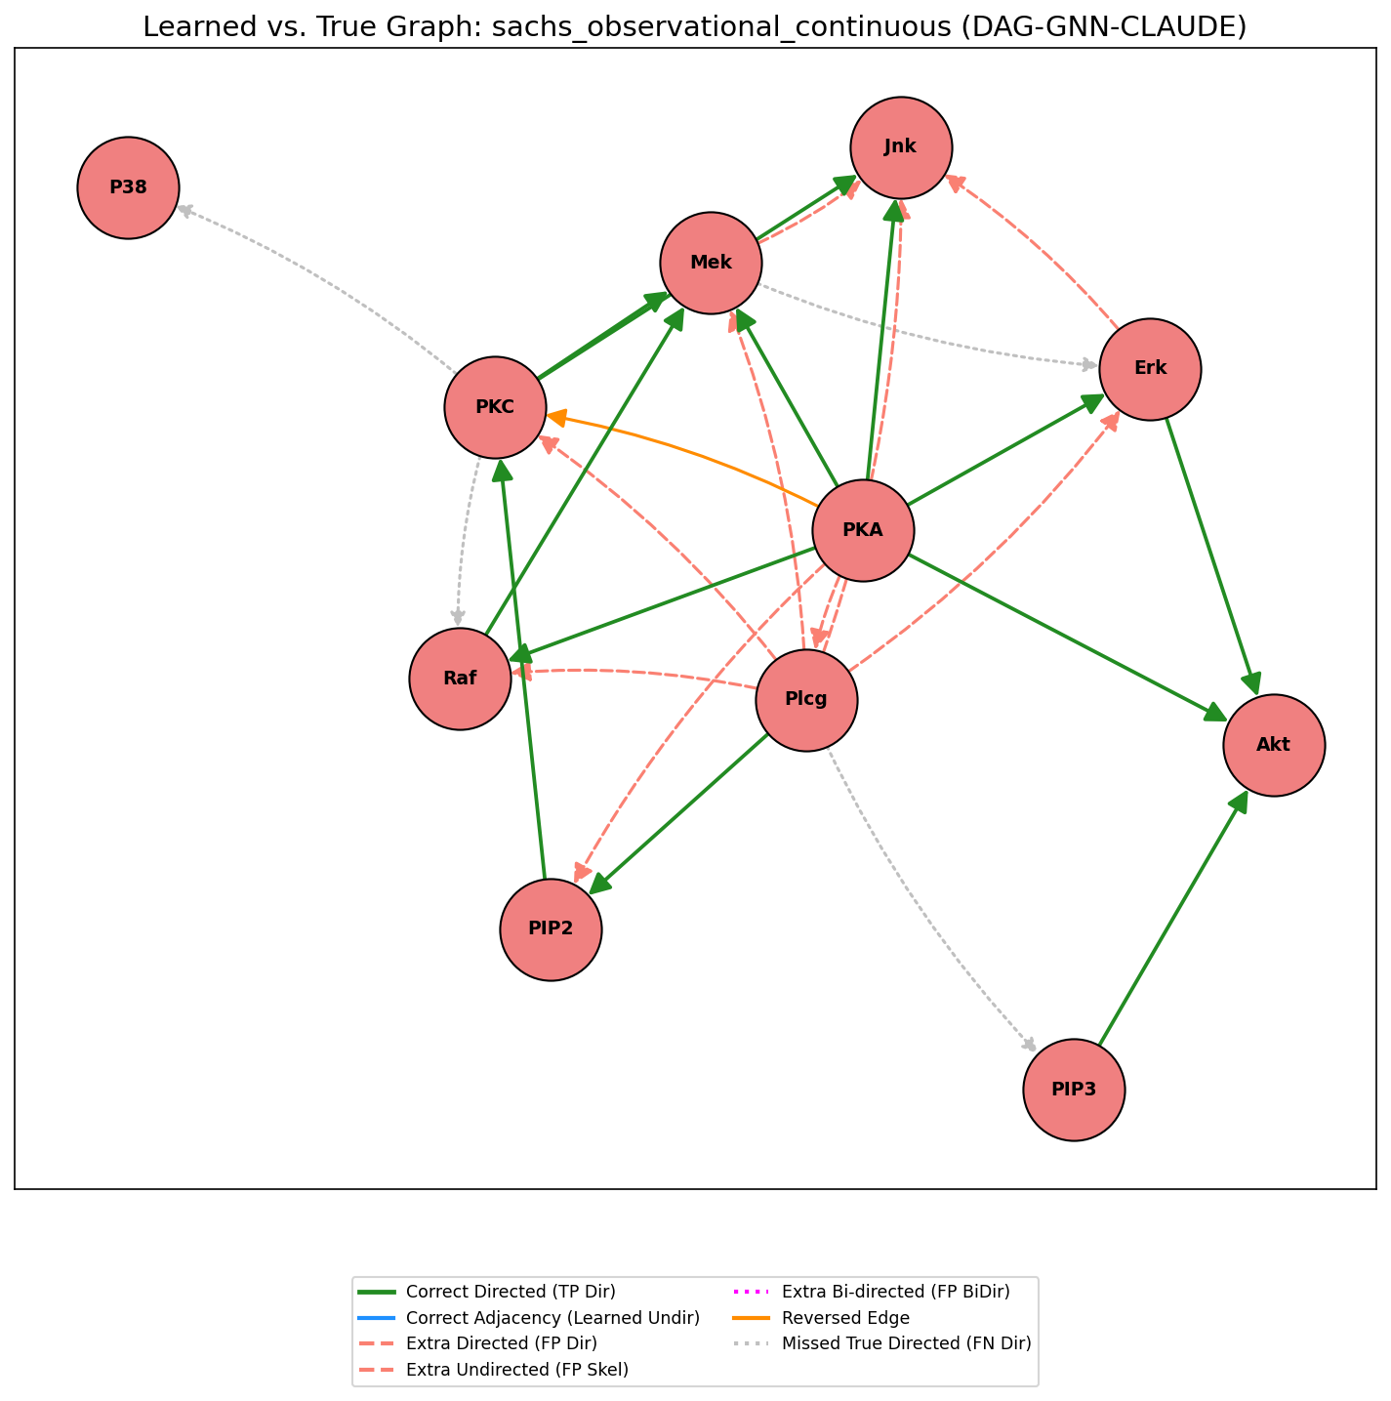
Qualitative Graph Comparison

Slide 16
Key Takeaways
Conclusion 1: LLM Priors Work Best in Semantic-Rich Domains.
For the real-world SACHS biological dataset, LLM guidance substantially improved causal discovery.
Conclusion 2: Not a Universal Fix.
The priors were less effective on the abstract ASIA dataset, highlighting the importance of domain context.
Conclusion 3: Performance Has a Cost.
The powerful DAG-GNN methods are significantly more computationally expensive than traditional algorithms like GES and PC.

Slide 17
Key Takeaways
Conclusion 1: LLM Priors Work Best in Semantic-Rich Domains.
For the real-world SACHS biological dataset, LLM guidance substantially improved causal discovery.
Conclusion 2: Not a Universal Fix.
The priors were less effective on the abstract ASIA dataset, highlighting the importance of domain context.
Conclusion 3: Performance Has a Cost.
The powerful DAG-GNN methods are significantly more computationally expensive than traditional algorithms like GES and PC.

Slide 18
Key Takeaways
LLM Priors Work Best in Semantic-Rich Domains.
Not a Universal Fix.
Performance Has a Cost.
For the real-world SACHS biological dataset, LLM guidance substantially improved causal discovery.
The priors were less effective on the abstract ASIA dataset, highlighting the importance of domain context.
The powerful DAG-GNN methods are significantly more computationally expensive than traditional algorithms like GES and PC.

Slide 19
Questions?

