Slide 1





HCDR Final Project
Group Number: 3
Team Name: FP_Group_3
Alicia Aaholm
Nicholas Chappell
Jaden Costa
Katia Torres Sanchez

Slide 2
Outline
Project Description
Phase 2 EDA and Pipelines
Phase 2 Results
Conclusion and Next Steps

Slide 3
Project Description
The HCDR project model aims to train a model to predict whether a lender would be able to pay off a loan.
Allow lending institutions to make smarter business decisions
Preventing however many hundreds or thousands of dollars from being lost due to poor investments.

Slide 4
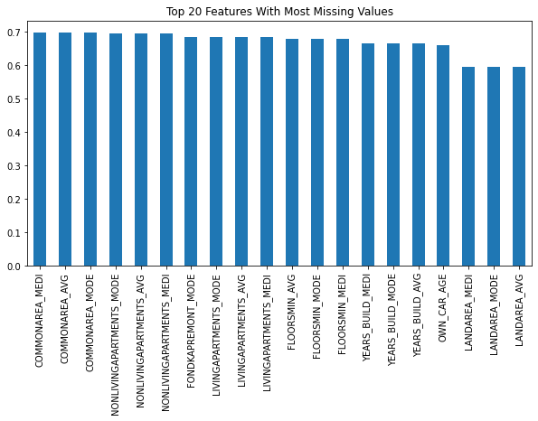
Phase 2 EDA and Pipelines
Phase 2 introduced the datasets from Kaggle into our test notebook, and initialized Github repo for teammates to collaborate
Missing values (see visual) accounted for in pipelines
Created pipelines using Logistic Regression, Random Forest, XGBoost, LightGBM, and CatBoost

Slide 5
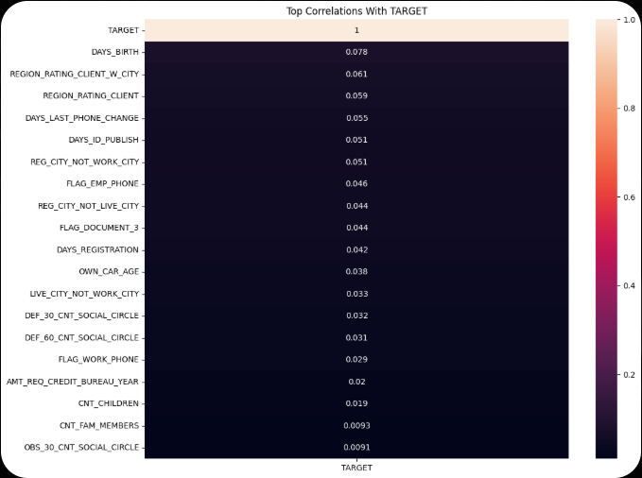
Phase 2 Key Steps & Results
Loaded all Home Credit datasets and set up a shared GitHub workflow.
Completed EDA on key tables; identified heavy missingness in property features and weak individual correlations with TARGET.
Found occupation and demographic trends (e.g., laborers highest default counts; age shows slight predictive value).
Built initial preprocessing + modeling pipelines (Logistic Regression, Random Forest, XGBoost, LightGBM, CatBoost).
Learned that the dataset is noisy, imbalanced, and requires strong feature engineering and aggregation for model performance.

Slide 6
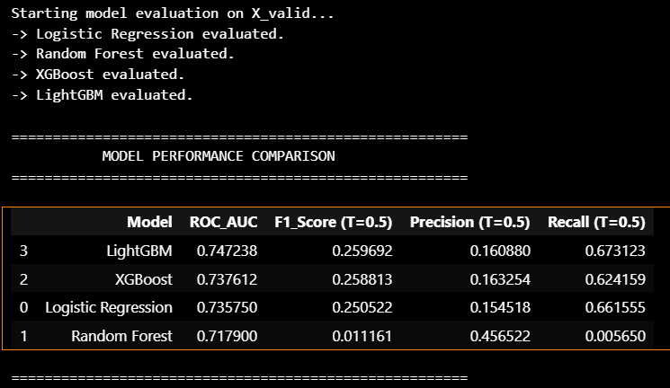
Model Evaluation Results
Compared four baseline models using the validation set.
LightGBM performed best with the highest ROC-AUC (0.747).
All models showed low F1 scores due to dataset imbalance, but LightGBM and XGBoost achieved the best recall.
Results indicate that gradient-boosting models handle the feature complexity better than linear or tree-based baselines.

Slide 7
Conclusion and Next Steps
We plan on conducting more feature engineering and hyperparameter tuning over the next 2 weeks and decide on adding additional features/methods.
Kernel crashes on some workstations
  Larger emphasis on memory utilization
Status update for these improvements in Phase 3

