Slide 1
2 step disentanglement
Better results (MNIST and SPRITES)
QhelDIV 闫星光

Slide 2
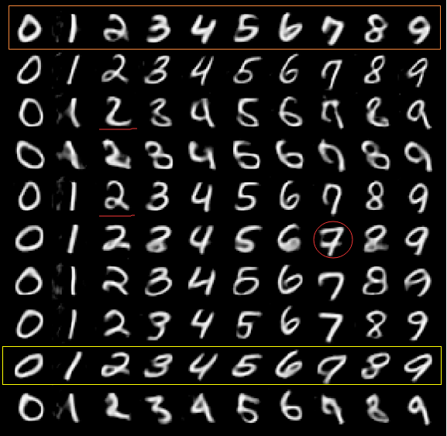
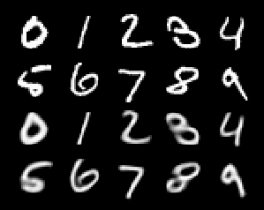
Notice the first row is very bold
Notice there are different types of 2
A very interesting type of 7
Some people will write 7 with a line
And the 7 in red circle is in this style
Reconstruction
Comparison

Slide 3
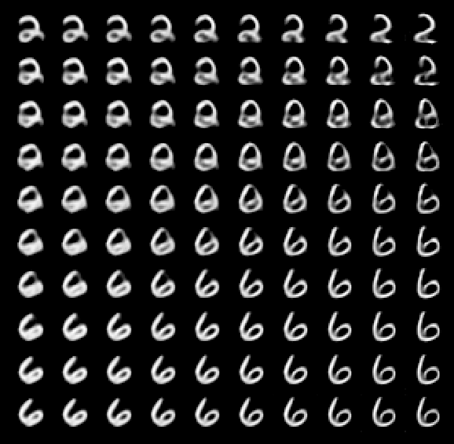
Thick 6
thin 2
Thick 6
Thin 6

Slide 4
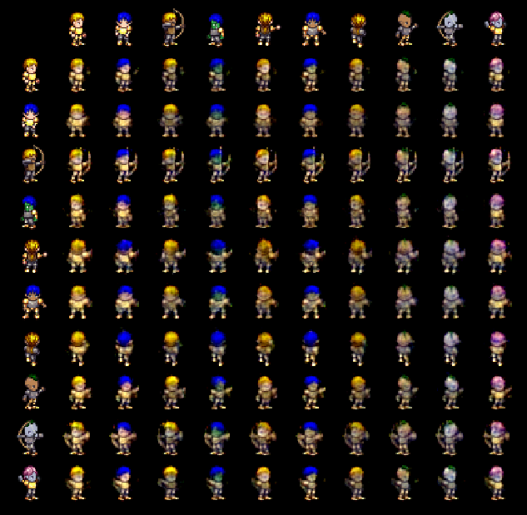

Reconstruction loss(MSE) is stuck at
0.007, I’ve tried various settings of parameters but failed to get lower loss.
Nevertheless, the disentanglement is clearly visible.

Slide 5
