Slide 1
Survival Analysis
Luonan Chen
Chinese Academy of Sciences

Slide 2
Overview
What is survival analysis?
Terminology and data structure.
Survival/hazard functions.
Parametric survival method
Semi-parametric method
Non-parametric method

Slide 3
What is survival analysis?
Model time to failure or time to event
  Unlike linear regression, survival analysis has a dichotomous (binary) outcome
  Unlike logistic regression, survival analysis analyzes the time to an event
    Why is that important?
Can account for censoring
Can compare survival between 2+ groups
Assess relationship between covariates and survival time
Notes:
Draw schematic of temporality.

Slide 4
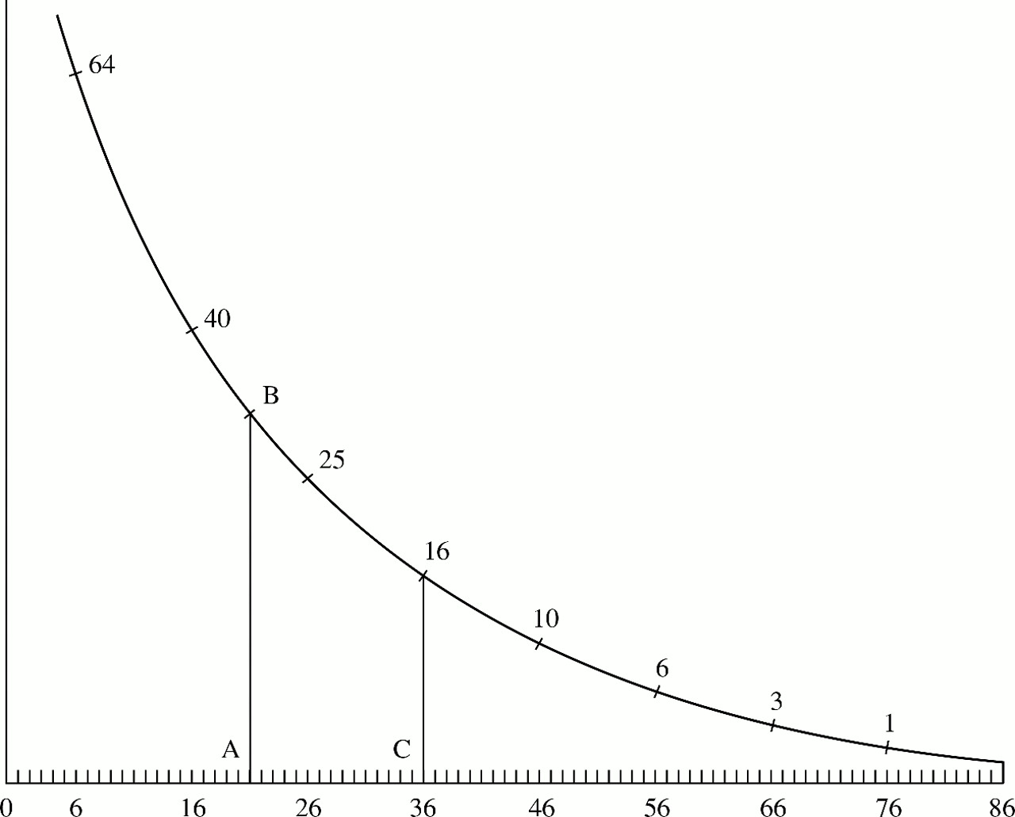
Early example of survival analysis
Roughly, what shape is this function?
percentage
What was a person’s chance of surviving past 20? Past 36?
This is survival analysis! We estimate this curve—only the outcome can be any binary event, not just death.

Slide 5
Survival analysis
Statistical methods: analyze longitudinal data on the occurrence of events.
Events: include death, injury, onset of illness, recovery from illness (binary variables) or transition above or below the clinical threshold of a meaningful continuous variable (e.g. CD4 counts).
Data: include randomized clinical trial or cohort study design.

Slide 6
Objectives of survival analysis
  Estimate time-to-event for a group of individuals, such as time until second heart-attack for a group of MI patients.
  To compare time-to-event between two or more groups, such as treated vs. placebo MI patients in a randomized controlled trial.
  To assess the relationship of co-variables to time-to-event, such as: does weight, insulin resistance, or cholesterol influence survival time of MI patients?
  Note: expected time-to-event = 1/incidence rate

Slide 7
Why use survival analysis?
1. Why not compare mean time-to-event between your groups using a t-test or linear regression?
-- ignores censoring
2. Why not compare proportion of events in your groups using risk/odds ratios or logistic regression?
--ignores time
Notes:
1. If no censoring (everyone followed to outcome-of-interest) than ttest on mean or median time to event is fine.
2. If time at-risk was the same for everyone, could just use proportions.

Slide 8
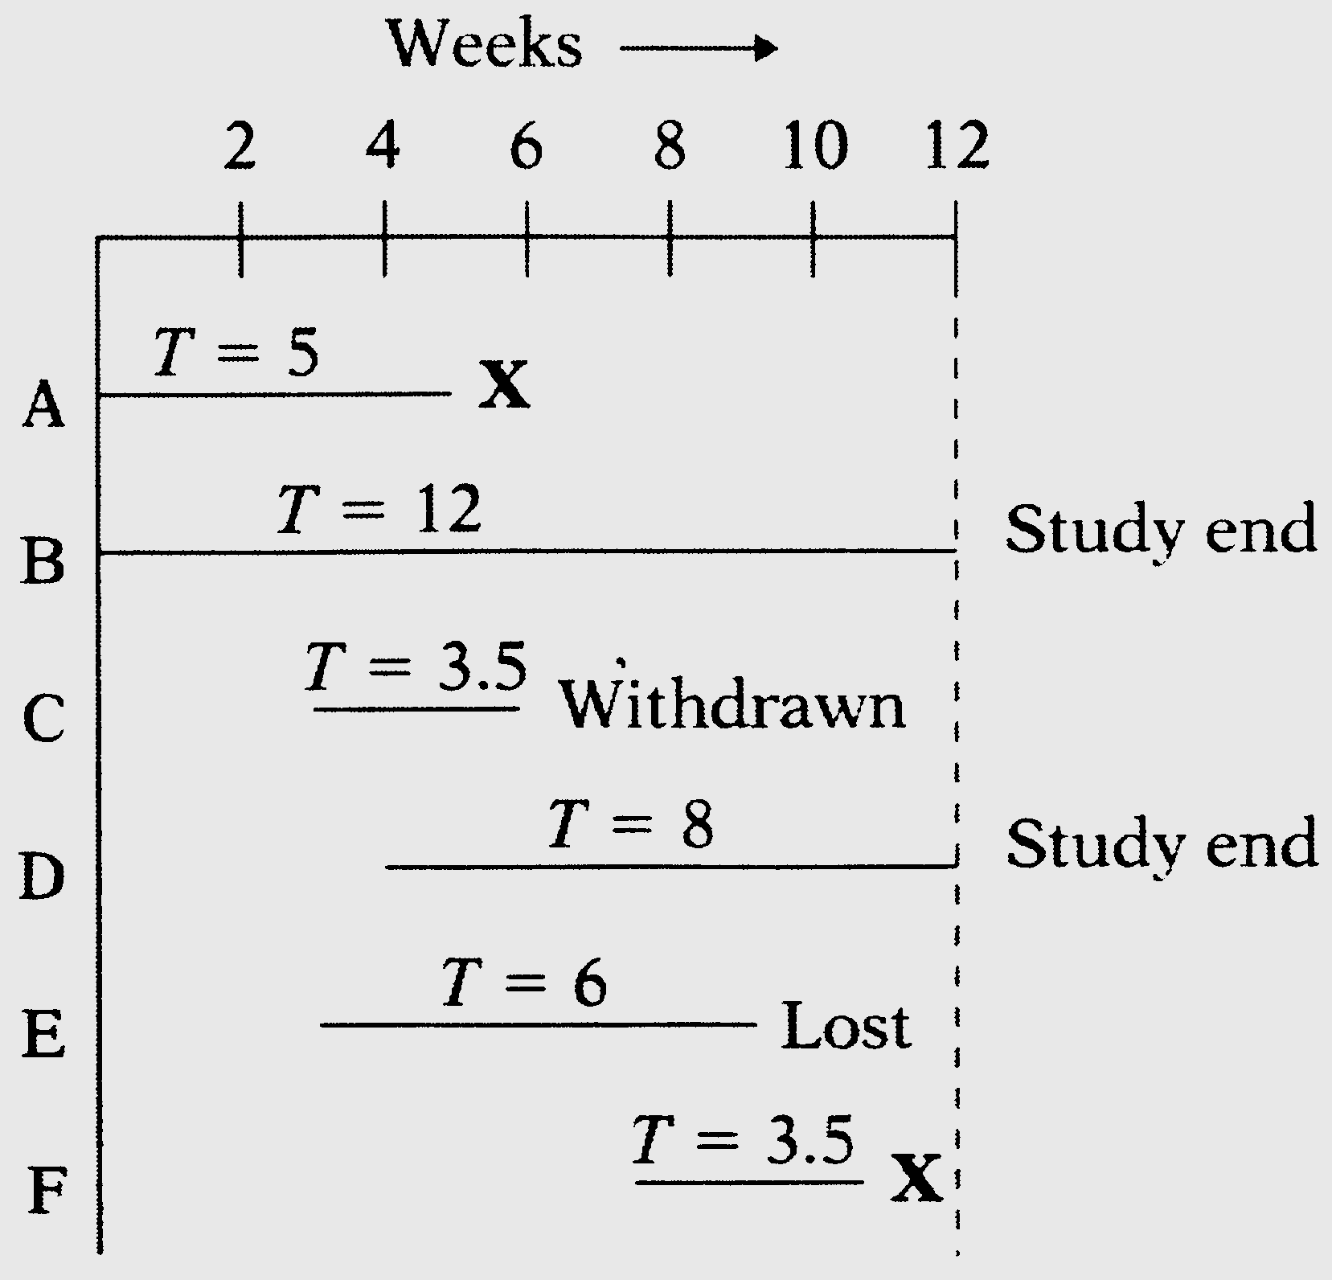
Types of censoring 截尾
Subject does not experience event of interest
Incomplete follow-up
  Lost to follow-up
  Withdraws from study
  Dies (if not being studied)
Left or right censored
Notes:
X = dies

Slide 9

Regression vs. Survival Analysis

Slide 10
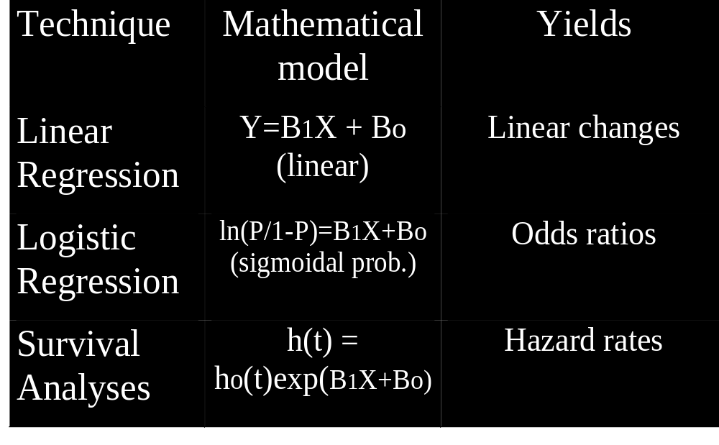
Regression vs. Survival Analysis

Slide 11
Basic methods for survival analysis
1．非参数法 Non-Parametric survival analysis ：不考虑数据的分布类型；有Kaplan-Meier法和寿命表法。
2．参数法 Parametric survival analysis ：要知道数据的分布类型。有指数分布法， Weibull分布法，对数正态回归分布法等。
3．半参数法 Semi-Parametric survival analysis ：具有参数和非参数的特点。如Cox模型法。

Slide 12
Survival Analysis(生存分析)
Terms
Time-to-event生存时间: The time from entry into a study until a subject has a particular outcome
Censoring截尾: Subjects are said to be censored if they are lost to follow up or drop out of the study, or if the study ends before they die or have an outcome of interest. They are counted as alive or disease-free for the time they were enrolled in the study.
  If dropout is related to both outcome and treatment, dropouts may bias the results
Notes:
PhD candidates who are most likely to take longest may be most likely to drop out, thereby biasing results.

Slide 13
Data Structure: survival analysis
Two-variable outcome :
Time variable: t_{i} = time at last disease-free observation or time at event
Censoring variable: c_{i} =1 if had the event; c_{i} =0 no event by time t_{i}

Slide 14
Right Censoring (T>t)
Common examples
Termination of the study
Death due to a cause that is not the event of interest
Loss to follow-up
We know that subject survived at least to time t.

Slide 15
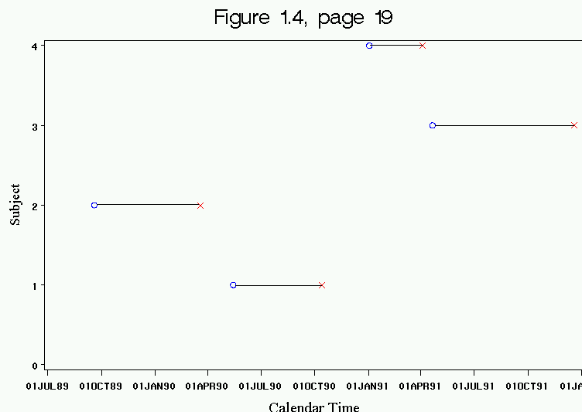
1. Choice of time of origin. Note varying start times.
不同时进入观察

Slide 16
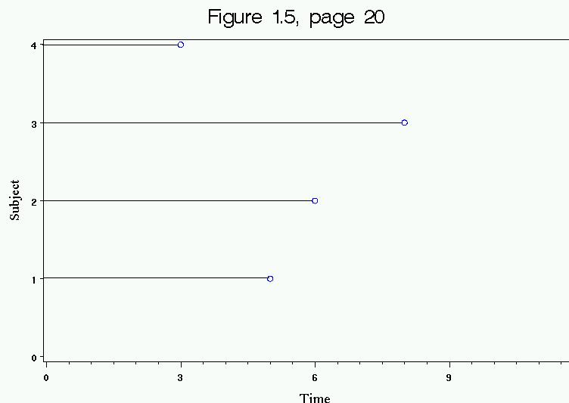
2. Count every subject’s time since their baseline data collection.
同时进入观察
Ｍａｋｅ ｂａｓｅｌｉｎｅ

Slide 17
Introduction to survival distributions
T_{i} the event time for an individual, is a random variable having a probability distribution.
Different models for survival data are distinguished by different choice of distribution for T_{i.}

Slide 18
Describing Survival Distributions
Parametric survival analysis is based on so-called “Waiting Time” distributions (ex: exponential probability distribution).
The idea:
Assume that times-to-event for individuals in your dataset follow a continuous probability distribution (which we may or may not be able to pin down mathematically).
For all possible times T_{i} after baseline, there is a certain probability that an individual will have an event at exactly time T_{i}. For example, human beings have a certain probability of dying at ages 3, 25, 80, and 140: P(T=3), P(T=25), P(T=80), P(T=140). These probabilities are obviously vastly different.

Slide 19
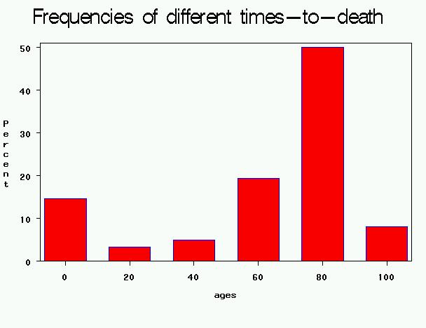
Probability density function: f(t)
In the case of human longevity, T_{i} is unlikely to follow a normal distribution, because the probability of death is not highest in the middle ages, but at the beginning and end of life.
Hypothetical data:
People have a high chance of dying in their 70’s and 80’s;
BUT they have a smaller chance of dying in their 90’s and 100’s, because few people make it long enough to die at these ages.

Slide 20
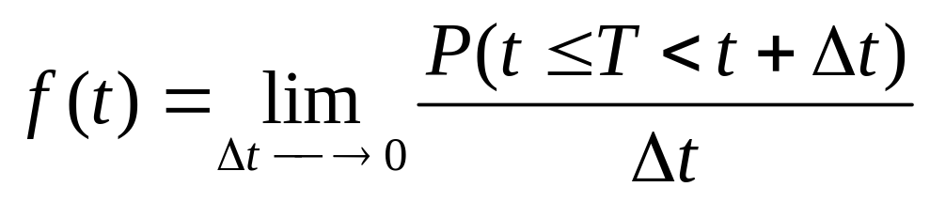
Probability density function: f(t)
The probability of the failure time occurring at exactly time t (out of the whole range of possible t’s).

Slide 21
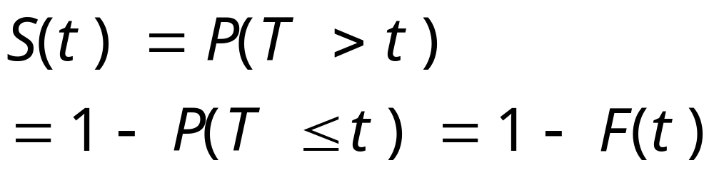
Survival function: 1-F(t)
The goal of survival analysis is to estimate and compare survival experiences of different groups.
Survival experience is described by the cumulative survival function:
F(t) is the CDF of f(t), and is “more interesting” than f(t).
Example: If t=100 years, S(t=100) = probability of surviving beyond 100 years.
CDF: cumulative distribution function

Slide 22
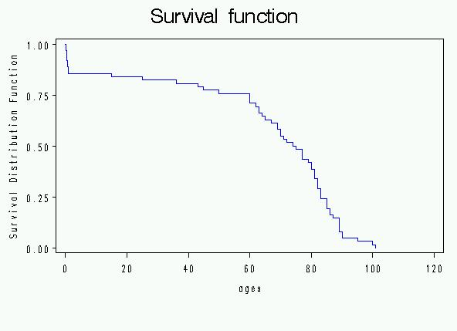
Cumulative survival
Same hypothetical data, plotted as cumulative distribution S(t) rather than density f(t):
Recall pdf:

Slide 23
Cumulative survival S(t)
P(T>20)
P(T>80)

Slide 24
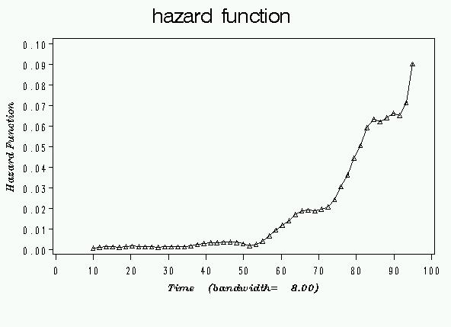
Hazard Function风险函数: new concept
Recall pdf:
Hazard rate is an instantaneous incidence rate.
AGES

Slide 25
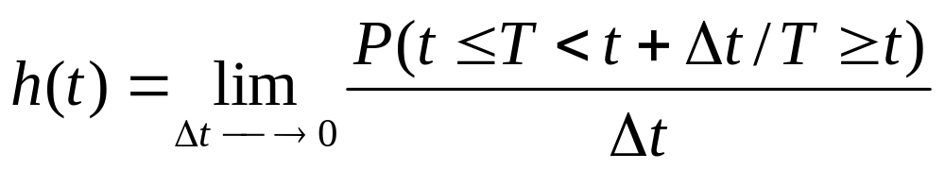
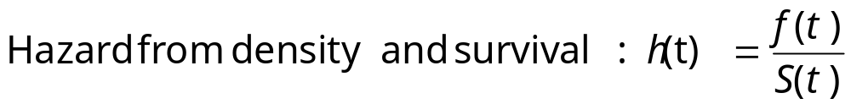
Hazard function
The probability that if you survive to t, you will succumb to the event in the next instant.
Derivation (Bayes’ rule):

Slide 26
Hazard vs. density
Conditional distribution
When you are born, you have a certain probability of dying at any age; that is the probability density (i.e., marginal probability)
  Example: a woman born today has, say, a 1% chance of dying at 80 years.
However, as you survive for awhile, your probabilities keep changing (i.e., conditional probability)
  Example, a woman who is 79 today has, say, a 5% chance of dying at 80 years.

Slide 27
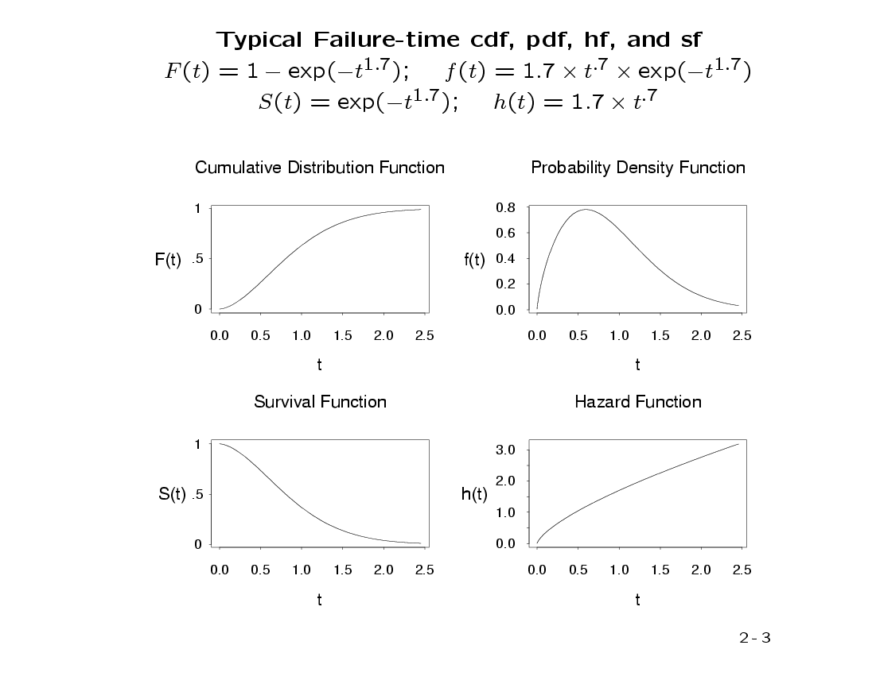
A possible set of probability density, failure, survival, and hazard functions.
f(t)=density function
F(t)=cumulative failure
S(t)=cumulative survival
h(t)=hazard function

Slide 28
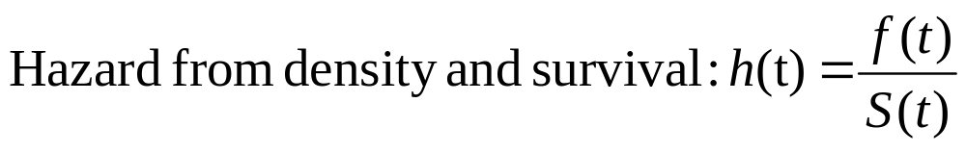
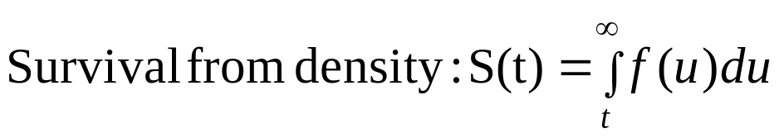
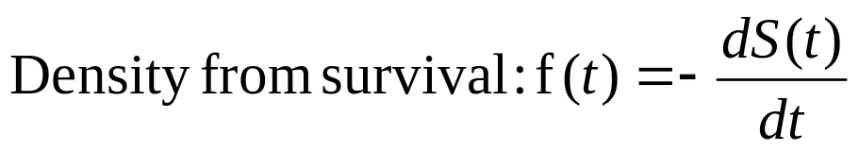
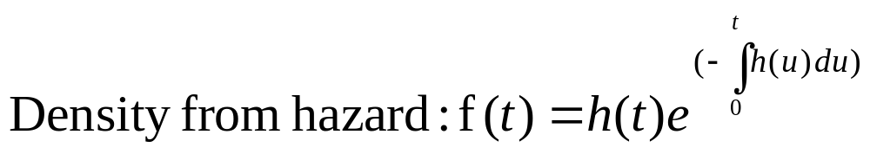
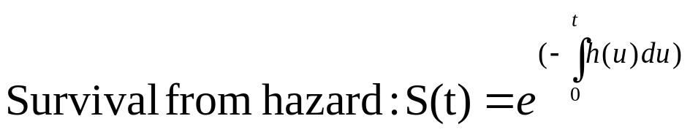
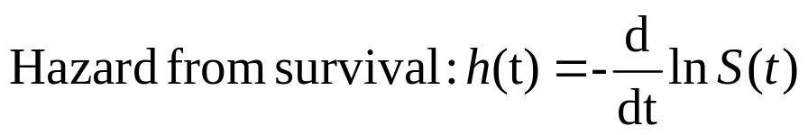
Functions
Notes:
If you know one, you can derive all the others.
We saw special case of 2 and 3 with exponential waiting times.

Slide 29
A probability density : the normal distribution
What do you think the hazard looks like for a normal distribution?
For example, suppose that times to complete the midterm exam follow a normal curve.
What’s your probability of finishing at any given time given that you’re still working on it?

Slide 30
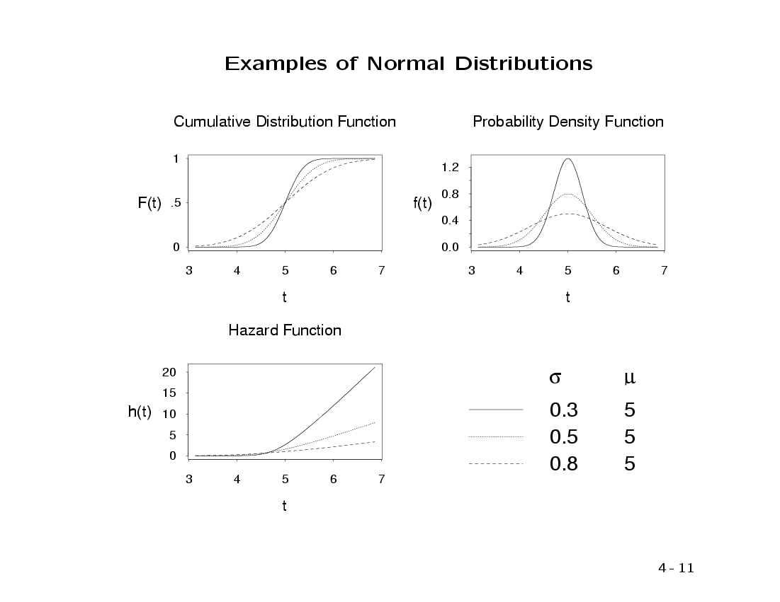
f(t), F(t), S(t), and h(t) for different normal distributions:

Slide 31
Examples: common functions to describe survival
Exponential (hazard is constant over time, simplest!)
Weibull (hazard function is increasing or decreasing over time)

Slide 32
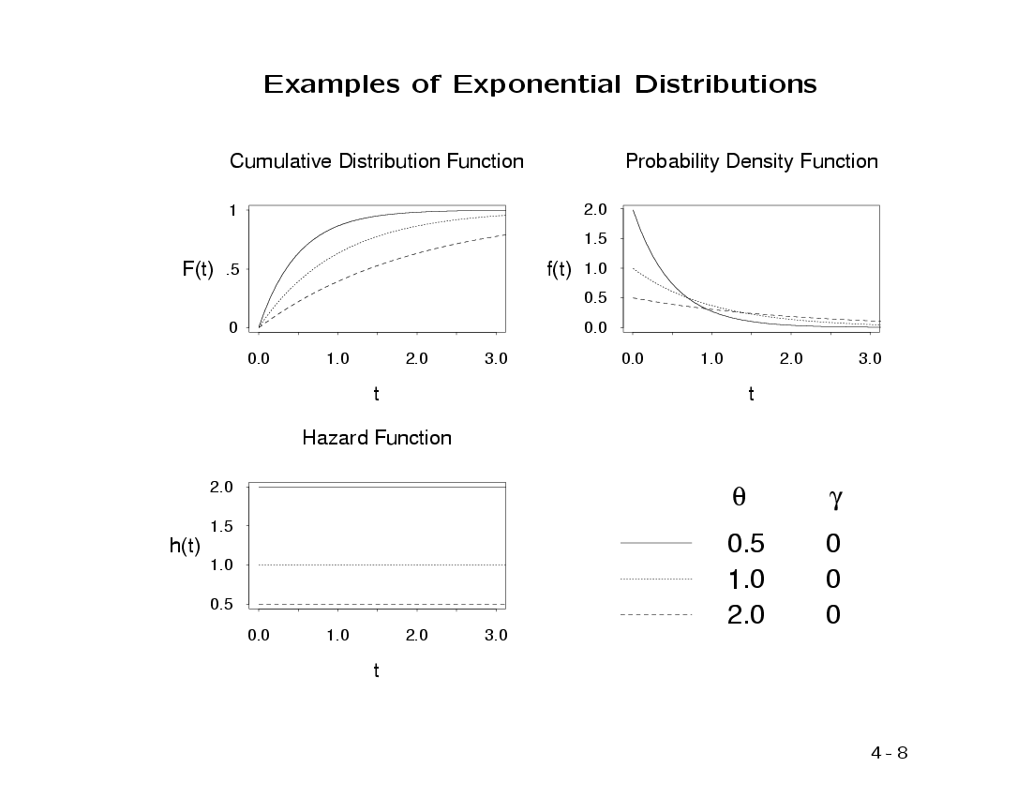
f(t), F(t), S(t), and h(t) for different exponential distributions:
λ

Slide 33
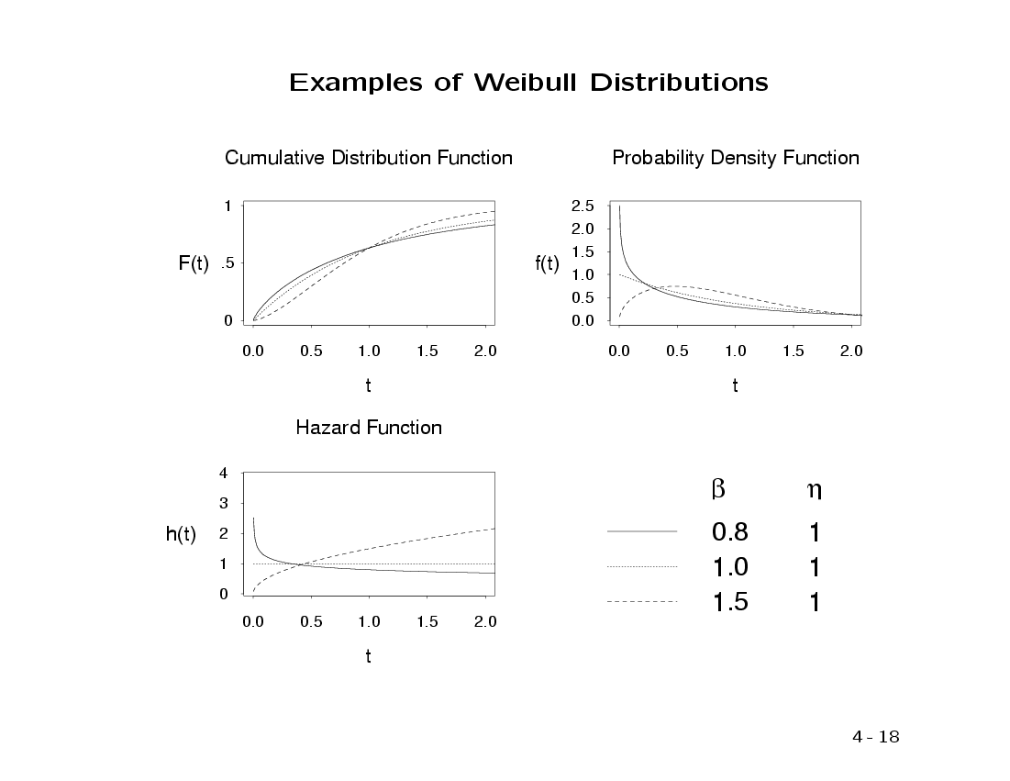
f(t), F(t), S(t), and h(t) for different Weibull distributions:
Parameters of the Weibull distribution

Slide 34
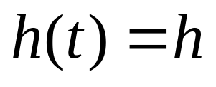
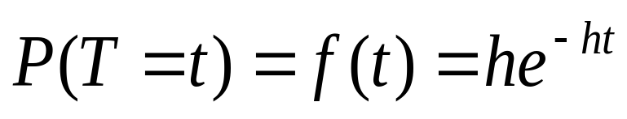
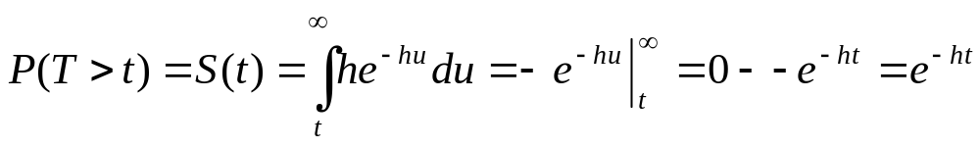
Exponential
Constant hazard function:
Exponential density function:
Survival function:

Slide 35
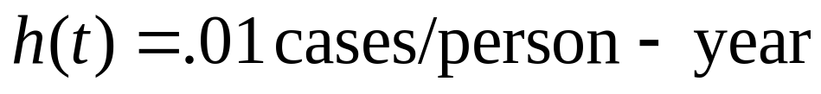
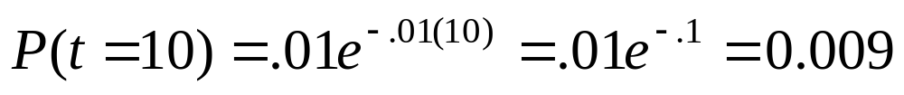
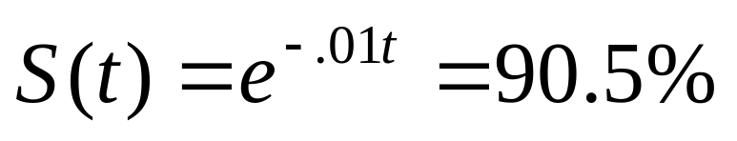
With numbers…
Why isn’t the cumulative probability of survival just 90% (rate of .01 for 10 years = 10% loss)?
Incidence rate (constant).
Probability of developing disease at year 10.
Probability of surviving past year 10.
(cumulative risk through year 10 is 9.5%)

Slide 36
Example…
Recall this graphic.
Does it look Normal, Weibull, exponential?

Slide 37
Example…
One way to describe the survival distribution here is:
P(T>76)=.01
P(T>36) = .16
P(T>20)=.20, etc.

Slide 38
Example…
Or, more compactly, try to describe this as an exponential probability function
Recall the exponential probability distribution:
If T ~ exp (h), then
P(T=t) = he^{-ht}
Where h is a constant rate.
Here:
Event time, T ~ exp (Rate)

Slide 39
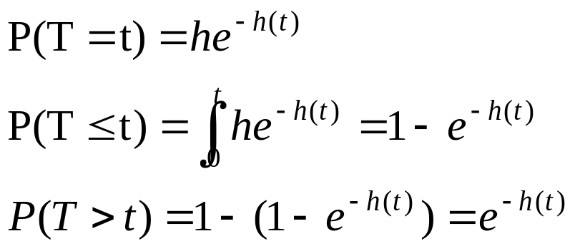
Example…
To get from the instantaneous probability (density), P(T=t) = he^{-ht}, to a cumulative probability of death, integrate:
Area to the left
Area to the right

Slide 40
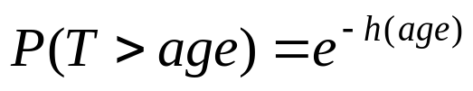
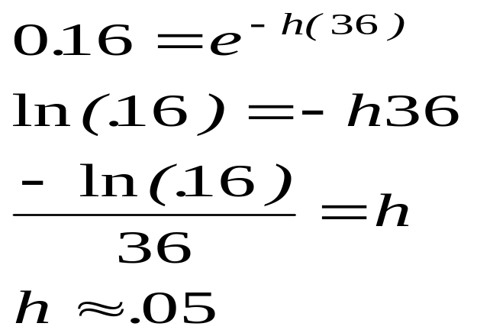
Example…
Solve for h:

Slide 41
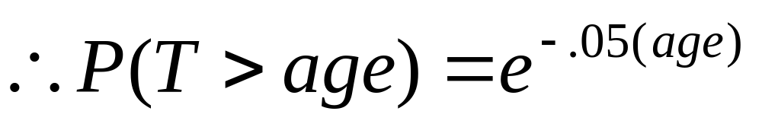
Example…
This is a “parametric” survivor function, since we’ve estimated the parameter h.

Slide 42
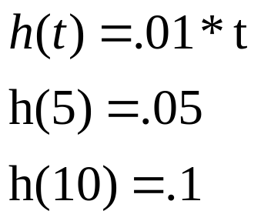
Hazard rates could also change over time
Example: Hazard rate increases linearly with time.

Slide 43
Functions
Notes:
If you know one, you can derive all the others.
We saw special case of 2 and 3 with exponential waiting times.

Slide 44
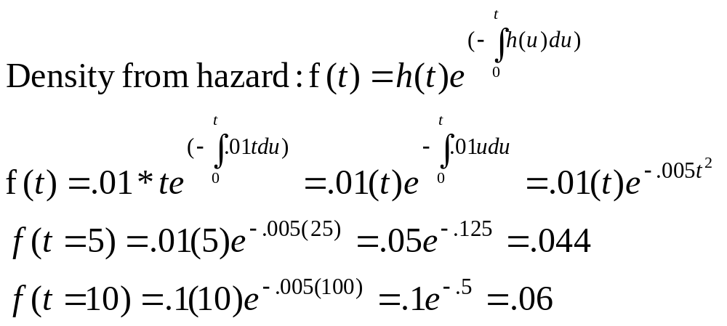
Getting density from hazard
Example: Hazard rate increases linearly with time.

Slide 45
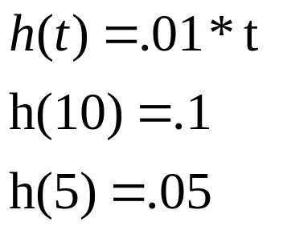
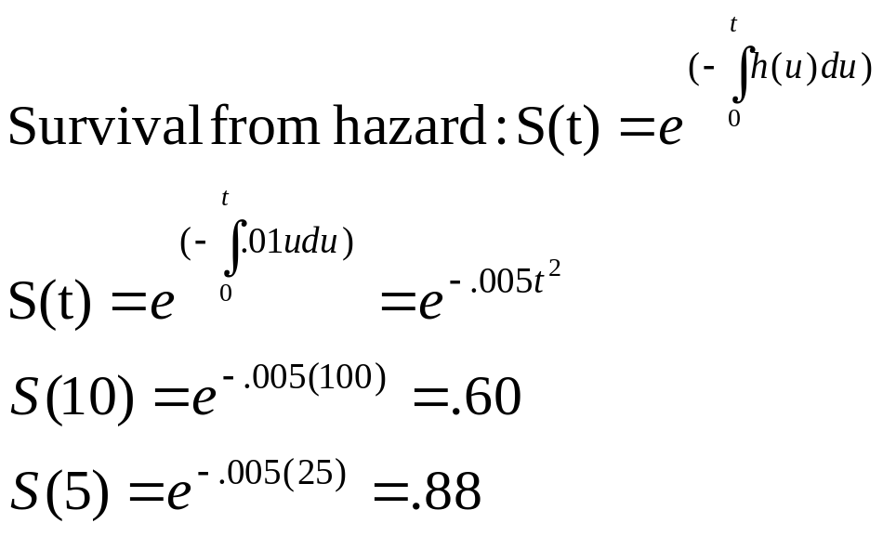
Getting survival from hazard

Slide 46
1. Parametric regression methods
Parametric multivariate regression techniques:
  Model the underlying hazard/survival function
  Assume that the dependent variable (time-to-event) takes on some known distribution, such as Weibull, exponential, or lognormal.
  Estimates parameters of these distributions (e.g., baseline hazard function)
  Estimates covariate-adjusted hazard ratios.
    A hazard ratio is a ratio of hazard rates
Many times we care more about comparing groups than about estimating absolute survival.

Slide 47
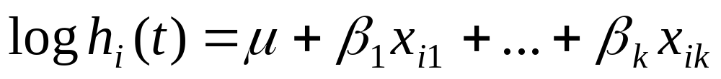
The model: parametric regression
Components:
A baseline hazard function (which may change over time).
A linear function of a set of k fixed covariates that when exponentiated gives the relative risk.
Exponential model assumes fixed baseline hazard that we can estimate.
Weibull model models the baseline hazard as a function of time. Two parameters (shape and scale) must be estimated to describe the underlying hazard function over time.

Slide 48
The model
When exponentiated, risk factor coefficients from both models give hazard ratios (relative risk).
Components:
A baseline hazard function
A linear function of a set of k fixed covariates that when exponentiated gives the relative risk.
Constant
(Exponential)
Increasing
(Weibull)

Slide 49
2. Semi-parametric method:
Cox Regression
Semi-parametric
Cox models the effect of predictors and covariates on the hazard rate but leaves the baseline hazard rate unspecified.
Also called proportional hazards regression
Does NOT assume knowledge of absolute risk.
Estimates relative rather than absolute risk.

Slide 50
Cox 比例风险回归模型的基本形式
1。生存分析的主要目的：是研究协变量X与观察
结果即生存函数之间的关系。该模型可以解决含
有截尾值的数据。这是以前不容易解决的困难。
2。该模型的协变量X的形式可以是多种多样的。
可以是计量资料，计数资料，等级资料等。
3。应用范围广泛，可以用于临床疗效分析，危
险因素分析，人群危险因素分析等等方面。

Slide 51
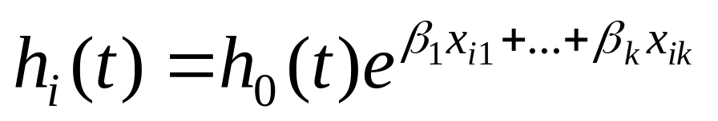
The model: Cox regression
Components:
A baseline hazard function that is left unspecified but must be positive (=the hazard when all covariates are 0)
A linear function of a set of k fixed covariates that is exponentiated. (=the relative risk)
Can take on any form

Slide 52

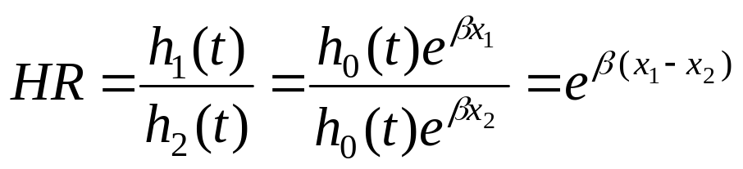
The model
The point is to compare the hazard rates of individuals who have different covariates:
Hence, called Proportional hazards:
Hazard functions should be strictly parallel.

Slide 53
Introduction to Kaplan-Meier
3. Non-parametric method:
No math assumptions!
(either about the underlying hazard function or about proportional hazards).
Simply, the empirical probability of surviving past certain times in the sample (taking into account censoring).

Slide 54
Introduction to Kaplan-Meier
Non-parametric estimate of the survival function.
Commonly used to describe survivorship of study populations.
Commonly used to compare two study populations.
Intuitive graphical presentation.

Slide 55
Survival Data (right-censored)
Subject A
Subject B
Subject C
Subject D
Subject E
X
1. subject E dies at 4 months
Beginning of study
End of study
→ Time in months →

Slide 56
Corresponding Kaplan-Meier Curve
100%
Probability of surviving to 4 months is 100% = 5/5
Fraction surviving this death = 4/5
Subject E dies at 4 months
→ Time in months →

Slide 57
Survival Data
Subject A
2. subject A drops out after 6 months
Subject B
Subject C
3. subject C dies at 7 months
X
Subject D
Subject E
X
1. subject E dies at 4 months
Beginning of study
End of study
→ Time in months →

Slide 58
Corresponding Kaplan-Meier Curve
100%
Fraction surviving this death = 2/3
subject C dies at 7 months
→ Time in months →

Slide 59
Survival Data
Subject A
2. subject A drops out after 6 months
Subject B
4. Subjects B and D survive for the whole year-long study period
Subject C
3. subject C dies at 7 months
X
Subject D
Subject E
X
1. subject E dies at 4 months
Beginning of study
End of study
→ Time in months →

Slide 60
Corresponding Kaplan-Meier Curve
100%
Rule from probability theory:
P(A&B)=P(A)*P(B) if A and B independent
In survival analysis: intervals are defined by failures (2 intervals leading to failures here).
P(surviving intervals 1 and 2)=P(surviving interval 1)*P(surviving interval 2)
∴Product limit estimate of survival =
P(surviving interval 1/at-risk up to failure 1) *
P(surviving interval 2/at-risk up to failure 2)
= 4/5 * 2/3= .5333
→ Time in months →

Slide 61
The product limit estimate
The probability of surviving in the entire year, taking into account censoring
S(whole year)= (4/5) (2/3) = 53%
NOTE: > 40% (2/5) because the one drop-out survived at least a portion of the year.
AND <60% (3/5) because we do not know if the one drop-out would have survived until the end of the year.

Slide 62
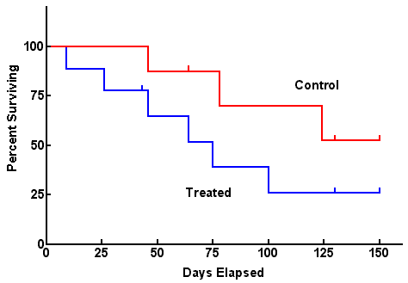
Comparing 2 groups
Use log-rank test to test the null hypothesis of no difference between survival functions of the two groups (more on this next time)

Slide 63
One problem
Survival estimates can be unreliable toward the end of a study when there are small numbers of subjects at risk of having an event.

Slide 64
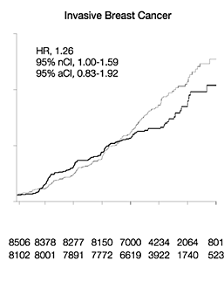
WHI and breast cancer
Women’s Health Initiative Writing Group. JAMA. 2002;288:321-333.
Small numbers left

Slide 65
Limitations of Kaplan-Meier
Mainly descriptive
No control for covariates
Require categorical predictors
Unable to accommodate time-dependent variables

