Slide 1
MULTIPLE TESTING:
POWER AND TYPE I ERROR
Andrew Morris
Wellcome Trust Centre for Human Genetics
March 7, 2003

Slide 2
Outline
Multiple testing.
Bonferonni correction.
Genome-wide association studies.
Randomisation procedures.
LOD scores and genome-wide significance levels for linkage.

Slide 3
Multiple testing: example
X X XX X X X X XXX X X X X X X X

Slide 4
Multiple testing: example
X X XX X X X X XXX X X X X X X X
Significant 5% level

Slide 5
Multiple testing
Significance level α.
Perform N independent tests of null hypothesis.
Number of tests in which null hypothesis is rejected, in samples ascertained from population in which null hypothesis is true, given by binomial distribution, parameters N and α.
Expect to see Nα rejections of null hypothesis by chance.

Slide 6
Example: multiple TDTs
Screen of genomic region for association of disease with 100 SNPs.
Simulate TDT values under null hypothesis of no association: chi-squared distribution with one degree of freedom.

Slide 7
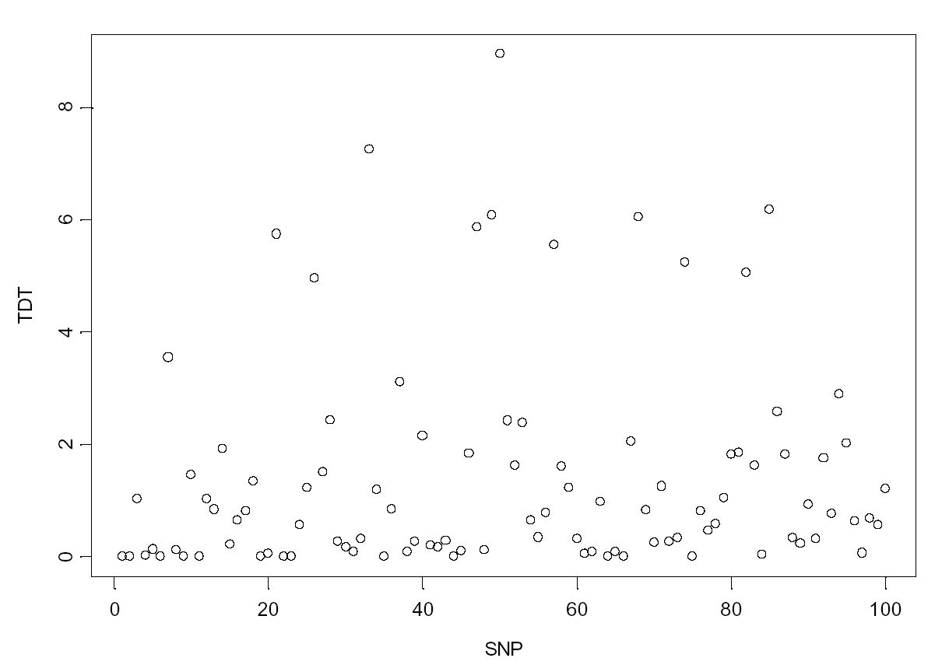

Slide 8
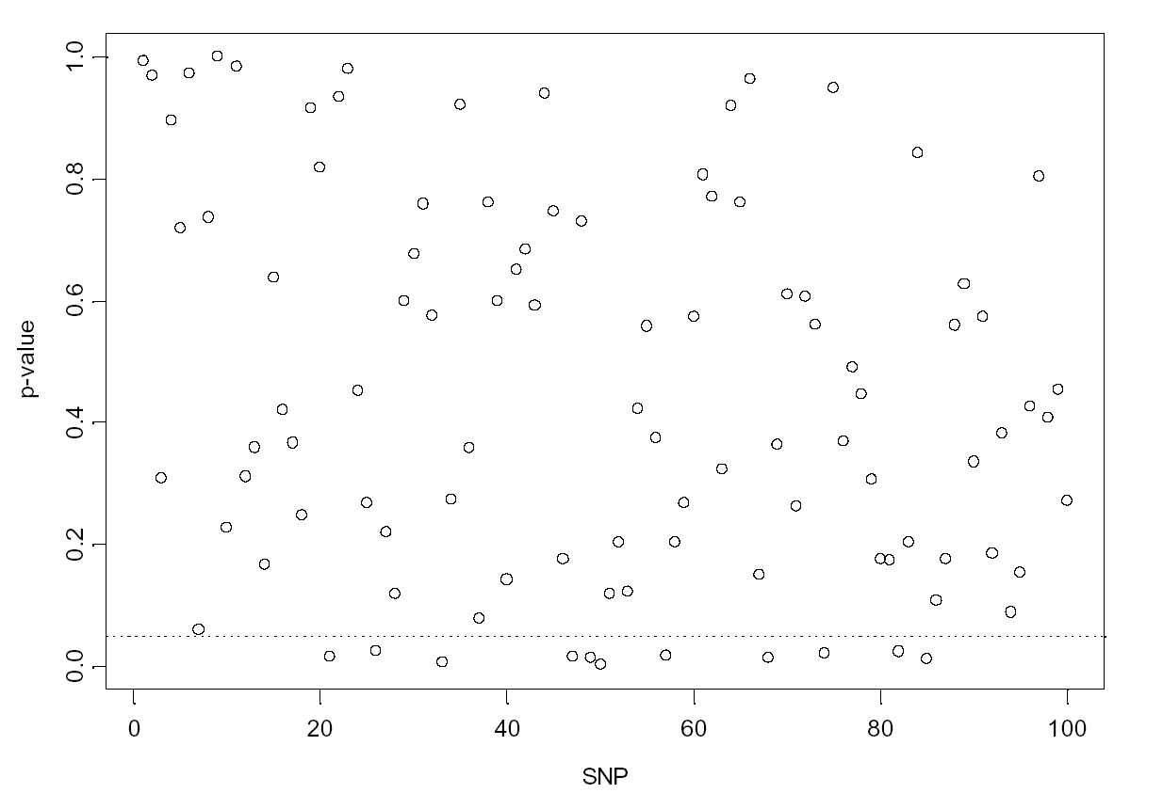

Slide 10
Bonferroni correction
Total number of rejections of null hypothesis over all tests denoted by R.
Pr(R>0) = 1-Pr(R=0)= 1-(1-α)^{N}
Need to set α’ = Pr(R>0) to required significance level over all tests. Referred to as the experimentwise error rate.
For TDT example, to achieve overall experimentwise significance level of α’=0.05:
0.05 = 1-(1-α)¹⁰⁰
-> α = 0.000513
Pointwise significance level of 0.05%.

Slide 11
Genome-wide association screens
Risch & Merikangas (1996).
100,000 genes.
Type 10 SNPs in each gene.
1 million tests of null hypothesis of no association.
To achieve experimentwise significance level of 5%, require pointwise p-value less than 5.129 x 10⁻⁸.

Slide 12
Bonferroni correction - problems
Assumes each test of the null hypothesis to be independent.
If not true, Bonferroni correction to significance level is conservative.
Loss of power to reject null hypothesis.
Example: genome-wide association screen across linked SNPs – correlation between tests due to LD between loci.

Slide 13
Solutions???
Focus on candidate genes to reduce the number of tests performed, requiring a less stringent significance level.
Increase power by multi-locus analyses of haplotypes: reduces number of tests.
Publish “near” significant associations and hope they can be replicated in independent studies.

Slide 14
Example: multi-allelic TDT (1)
Original TDT developed for di-allelic marker loci.
Various generalisations to multi-allelic systems: ETDT, GTDT, TDTMAX.
For TDTMAX, calculate TDT statistic for each allele in turn, and use maximum to test null hypothesis of no association between disease and marker.

Slide 15
Example: multi-allelic TDT (2)
T NT | 1 | 2 | 3 | 4 | 5
1 | 35 | 16 | 8 | 4 | 2
2 | 12 | 12 | 2 | 11 | 2
3 | 8 | 8 | 3 | 3 | 3
4 | 7 | 21 | 6 | 2 | 5
5 | 4 | 9 | 7 | 7 | 4

Slide 16
Example: multi-allelic TDT (2)
T NT | 1 | 2 | 3 | 4 | 5
1 | 35 | 16 | 8 | 4 | 2
2 | 12 | 12 | 2 | 11 | 2
3 | 8 | 8 | 3 | 3 | 3
4 | 7 | 21 | 6 | 2 | 5
5 | 4 | 9 | 7 | 7 | 4
Allele 1:
31 transmissions from heterozygous parents.
30 non-transmissions from heterozygous parents.
TDT1 = (31-30)²/(31+30)
= 0.016

Slide 17
Example: multi-allelic TDT (2)
T NT | 1 | 2 | 3 | 4 | 5
1 | 35 | 16 | 8 | 4 | 2
2 | 12 | 12 | 2 | 11 | 2
3 | 8 | 8 | 3 | 3 | 3
4 | 7 | 21 | 6 | 2 | 5
5 | 4 | 9 | 7 | 7 | 4
Allele 2:
54 transmissions from heterozygous parents.
27 non-transmissions from heterozygous parents.
TDT2 = (54-27)²/(54+27)
= 9.000

Slide 18
Example: multi-allelic TDT (3)
Allele | TDT | p-value
1 | 0.016 | 0.899
2 | 9.000 | 0.003
3 | 0.022 | 0.882
4 | 3.063 | 0.080
5 | 5.769 | 0.016

Slide 19
Example: multi-allelic TDT (3)
Allele | TDT | p-value
1 | 0.016 | 0.899
2 | 9.000 | 0.003
3 | 0.022 | 0.882
4 | 3.063 | 0.080
5 | 5.769 | 0.016
TDTMAX = 9.000.
p-value assuming chi-squared distribution with one degree of freedom is 0.003.
Five tests performed: Bonferroni corrected experimentwise significance level for overall 1% type I error rate is 0.002.
Cannot reject null hypothesis of no association between disease and marker locus.

Slide 20
Example: multi-allelic TDT (4)
Bonferonni correction conservative since TDTs for multiple alleles at same locus are correlated.
Generate null distribution of TDTMAX statistic by simulation.
Randomisation procedures…

Slide 21
Randomisation procedures
Calculate test statistic X_{OBS} for observed sample of data.
Generate R pseudo-samples of data from observed sample under null hypothesis.
Calculate test statistic X_{i} for each pseudo-sample.
p-value given by proportion of pseudo-samples for which X_{i} ≥ X_{OBS}.

Slide 22
Example: multi-allelic TDT (5)
Under null hypothesis of no association between disease and marker locus, alleles are transmitted at random from parents to affected offspring.
Generate pseudo-samples of data by permuting the transmitted and non-transmitted alleles of parents at random.
Calculate TDTMAX statistic for each pseudo sample.

Slide 23
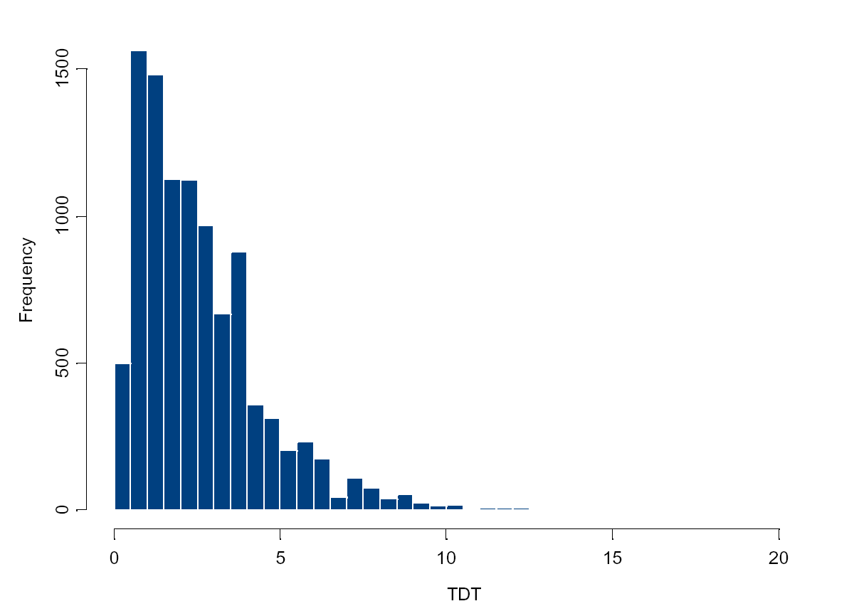

Slide 24
Observed TDT: 9.000
Exceeded 842 times in
100,000 pseudo samples.
p-value: 0.00842

Slide 25
Randomisation procedures - problems
Computationally intensive, so may not always be practical – combine permutation procedure and Bonferroni correction.
May not be clear how to simulate from null distribution.

Slide 26
Single locus LOD scores (1)
Results of linkage studies generally presented as LOD scores:
LOD = log₁₀[P(D|θ)_{MAX}/P(D|θ=0.5)]
Sample of data is 10^{LOD} times more likely to have been ascertained from population under alternative hypothesis of linkage than the null hypothesis of no linkage.
For single locus analysis, traditionally use LOD score of 3 as threshold for rejecting null hypothesis of no linkage.
Can convert LOD score to chi-squared statistic: X² = 4.6LOD, so LOD 3 corresponds to pointwise p-value of 0.0001 (1 df test).

Slide 27
Single locus LOD scores (2)
Why so stringent? Does not take account of prior probability of linkage…
Two loci are said to be linked if:
  they are on the same chromosome;
  they are separated by less than 30Mb.
Depends on total length of the genome (~3300Mb) and relative lengths of chromosomes.
Can be shown that prior probability of linkage is ~0.02.

Slide 28
Single locus LOD scores (3)
Posterior probability of linkage (L) given sample of data (D) calculated by Bayes’ Theorem:
P(L|D) = P(D|L)P(L) .
P(D|L)P(L)+P(D|NL)P(NL)
It then follows that P(L|D) = Z/(Z+λ), where Z = P(D|L)/P(D|NL) = 10^{LOD} and λ = P(NL)/P(L) is prior odds of no linkage.
For LOD score of 3, Z = 1000. For prior probability of linkage P(L) = 0.02, λ = 49. Thus P(L|D) = 0.95.
Mendelian diseases: can calculate P(D|L) exactly.

Slide 29
LOD scores: genome screen
Search of the genome for evidence of linkage using multiple markers.
Could adjust significance level by Bonferroni correction, but does not take account of the strong correlation between linked markers.
Lander & Kruglyak (1995) propose calculation of genome-wide significance level to allow for multiple testing.

Slide 30
Genome-wide significance level (1)
How often will a LOD score exceed some threshold T by chance in a whole genome screen?
The number of regions R of the genome in which the LOD score exceeds T is given by a Poisson distribution with mean:
μ(T) = [C+9.2ρGT]α_{P}(T)
where C is the number of chromosomes in the genome, G is the length of the genome (Morgans), α_{P}(T) is the pointwise significance level of T.
The parameter ρ is the crossover rate between genotypes being compared: depends on study design.
Genome-wide significance level:
α_{G}(T) = P(R>1) = 1-P(R=0) = 1-exp[-μ(T)] ≈ μ(T).

Slide 31
Genome-wide significance level (2)
Suggestive linkage: statistical evidence expected to occur once at random in genome scan, μ(T)=1.
Significant linkage: statistical evidence expected to occur 0.05 times in genome scan, μ(T) = 0.05.
Highly significant linkage: statistical evidence expected to occur 0.001 times in a genome scan, μ(T) = 0.001.

Slide 32
Genome-wide significance level (3)
Study design | Suggestive linkage LOD score | Significant linkage LOD score
Parametric | 1.9 | 3.3
Affected sib pair | 2.2 | 3.6
Affected first cousins | 2.3 | 3.7
Affected second cousins | 2.4 | 3.8

Slide 33
Genome-wide significance level (4)
Is the genome-wide significance level too stringent:
  Study only looked at a few markers? NO: likely that study stopped after first significant linkage – investigator may have continued until entire genome searched if no positive signals identified.
  Study involved sparse screen of genome? NO: likely that positive signals will be followed up by higher density searches.

Slide 34
Examples
IDDM
  96 sib pairs: average 10cM spacing.
  Followed up regions with LOD > 1, with additional sib pair sets.
  Significant linkage at HLA, suggestive linkage on 8q and X, near suggestive linkages on 11q and 6q.
Schizophrenia
  Near significant linkages on chromosome 6p in large collection of pedigrees.
  Replicated in two independent data sets.

Slide 35
Replication
Linkage and association signals must be replicated in independent studies to be credible.
Replication studies test an established prior hypothesis, so multiple testing problem not an issue.
Failure to replicate does not disprove the linkage or association, unless the power of the replication study is very high.
Competing results of several replication studies may reflect population heterogeneity, diagnostic differences, random sample variation.
Combined analysis or meta analysis…

Slide 36
Summary
Multiple testing inflates the type I error rate of hypothesis test.
Need stringent significance levels.
Bonferroni correction conservative.
Guidelines are available for genome-wide linkage studies.
Replication of results necessary for confirmation.

