Slide 1
ggplot2
陈梦婷，乐子薇，黄娟，程序，刘振

Slide 2
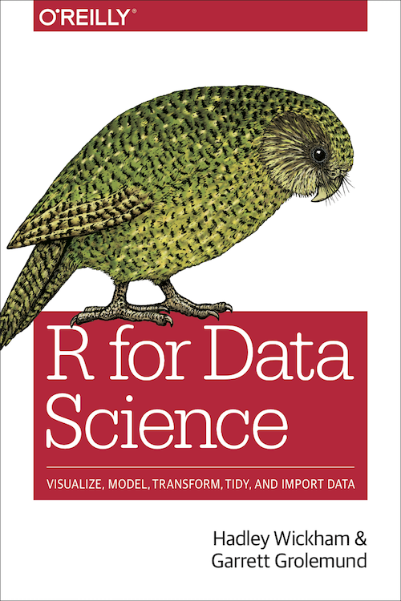
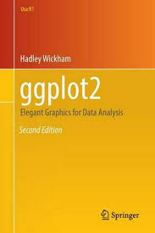
https://r4ds.had.co.nz/

Slide 3
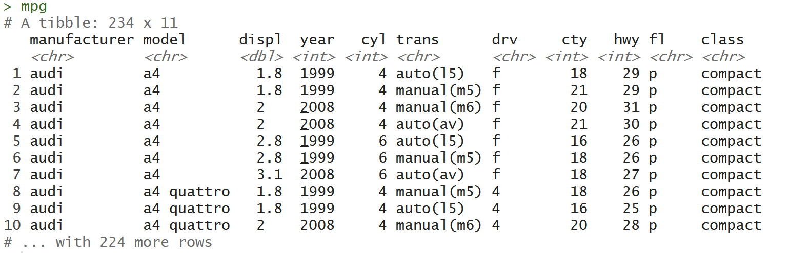
Case Study mpg data frame（ggplot2::mpg）
Displ: engine displacement, in litres
Cyl: number of cylinders
Hwy: highway miles per gallon
drv: f = front-wheel drive, r = rear wheel drive, 4 = 4wd

Slide 4
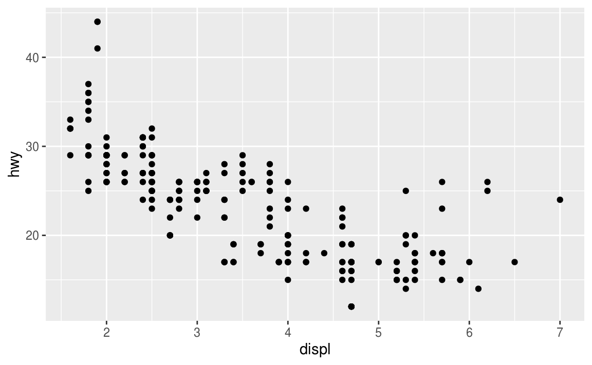
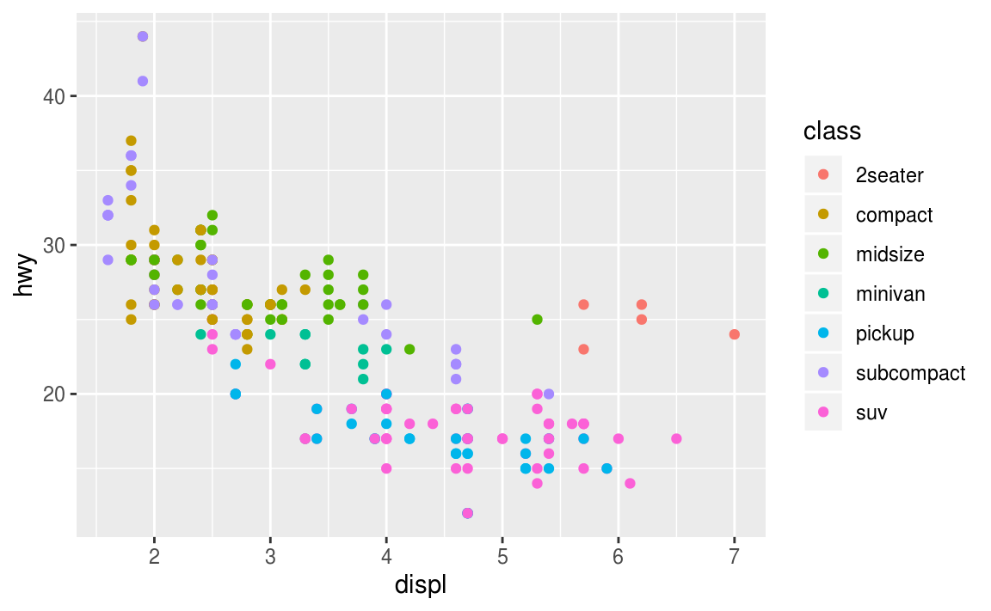
Aesthetic mappings
An aesthetic is a visual property of the objects in your plot. Aesthetics include things like the size, the shape, or the color of your points.
ggplot(data = mpg) +
geom_point(mapping = aes(x = displ, y = hwy))
ggplot(data = mpg) +
geom_point(mapping = aes(x = displ, y = hwy, color = class))
Notes:
“

Slide 5
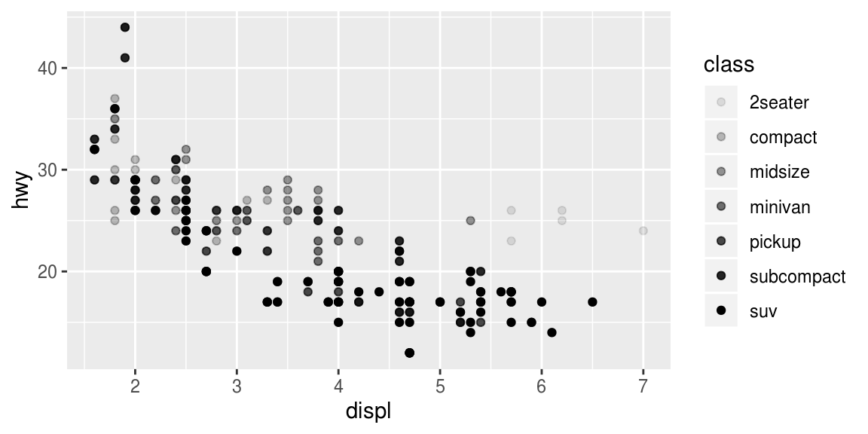
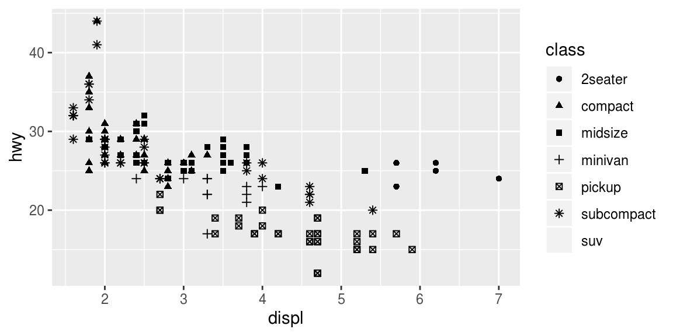
Aesthetic mappings
ggplot(data = mpg) +
geom_point(mapping = aes(x = displ, y = hwy, alpha = class))
ggplot(data = mpg) +
geom_point(mapping = aes(x = displ, y = hwy, shape = class))

Slide 6
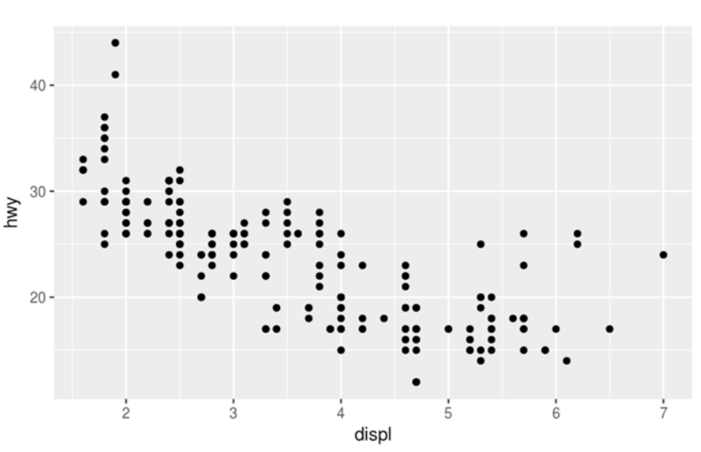
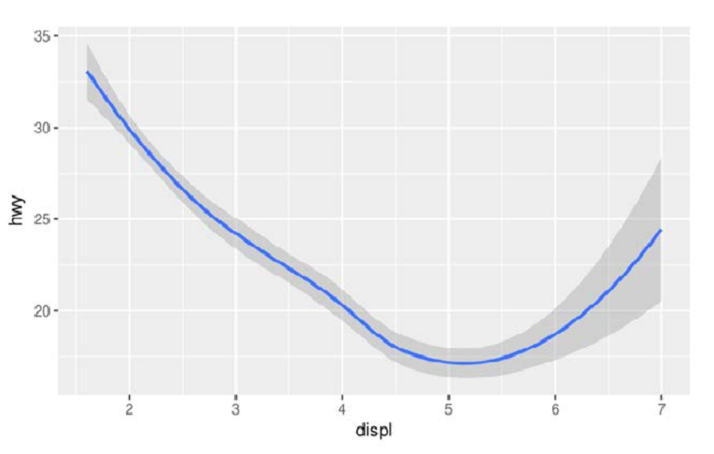
Geometric object
ggplot(data = mpg) +
geom_point(mapping = aes(x = displ, y = hwy))
ggplot(data = mpg) +
geom_smooth(mapping = aes(x = displ, y = hwy))

Slide 7
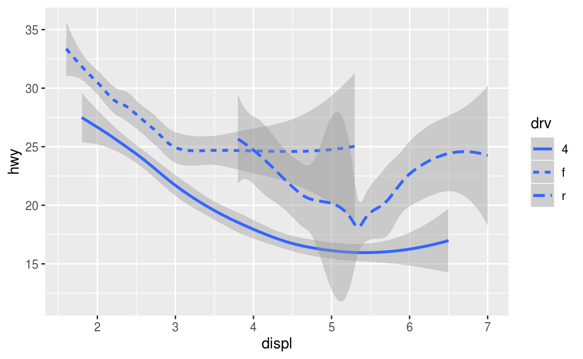
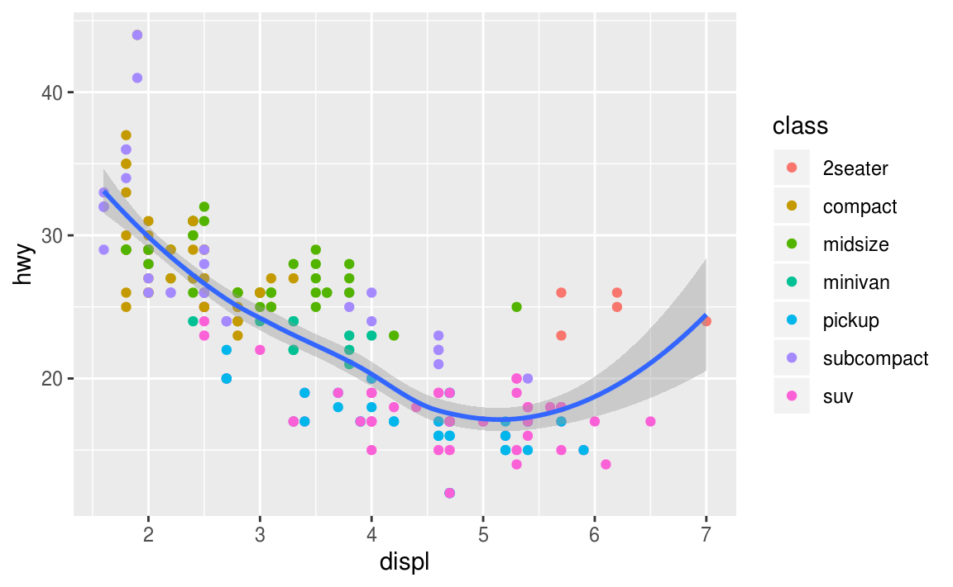
Geometric object
ggplot(data = mpg) +
geom_smooth(mapping = aes(x = displ, y = hwy, linetype = drv))
ggplot(data = mpg, mapping = aes(x = displ, y = hwy)) +
geom_point(mapping = aes(color = class)) +
geom_smooth()

Slide 8
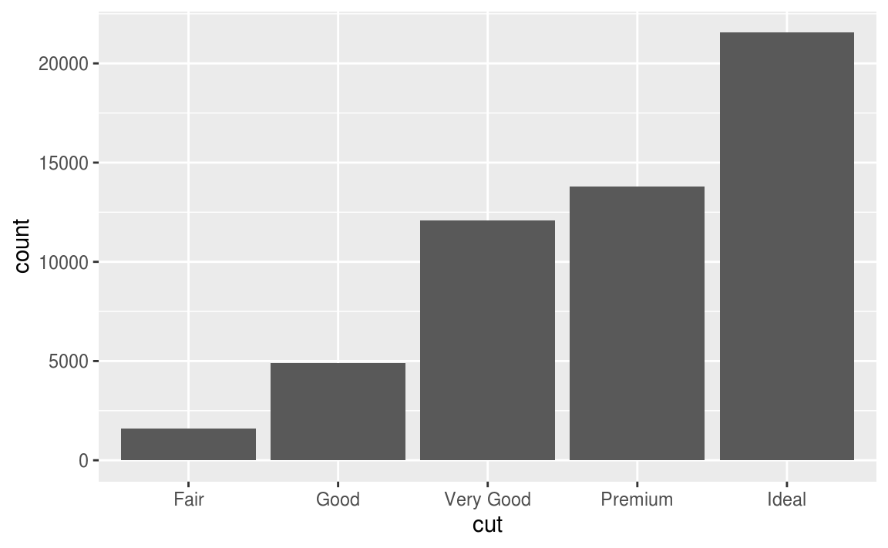
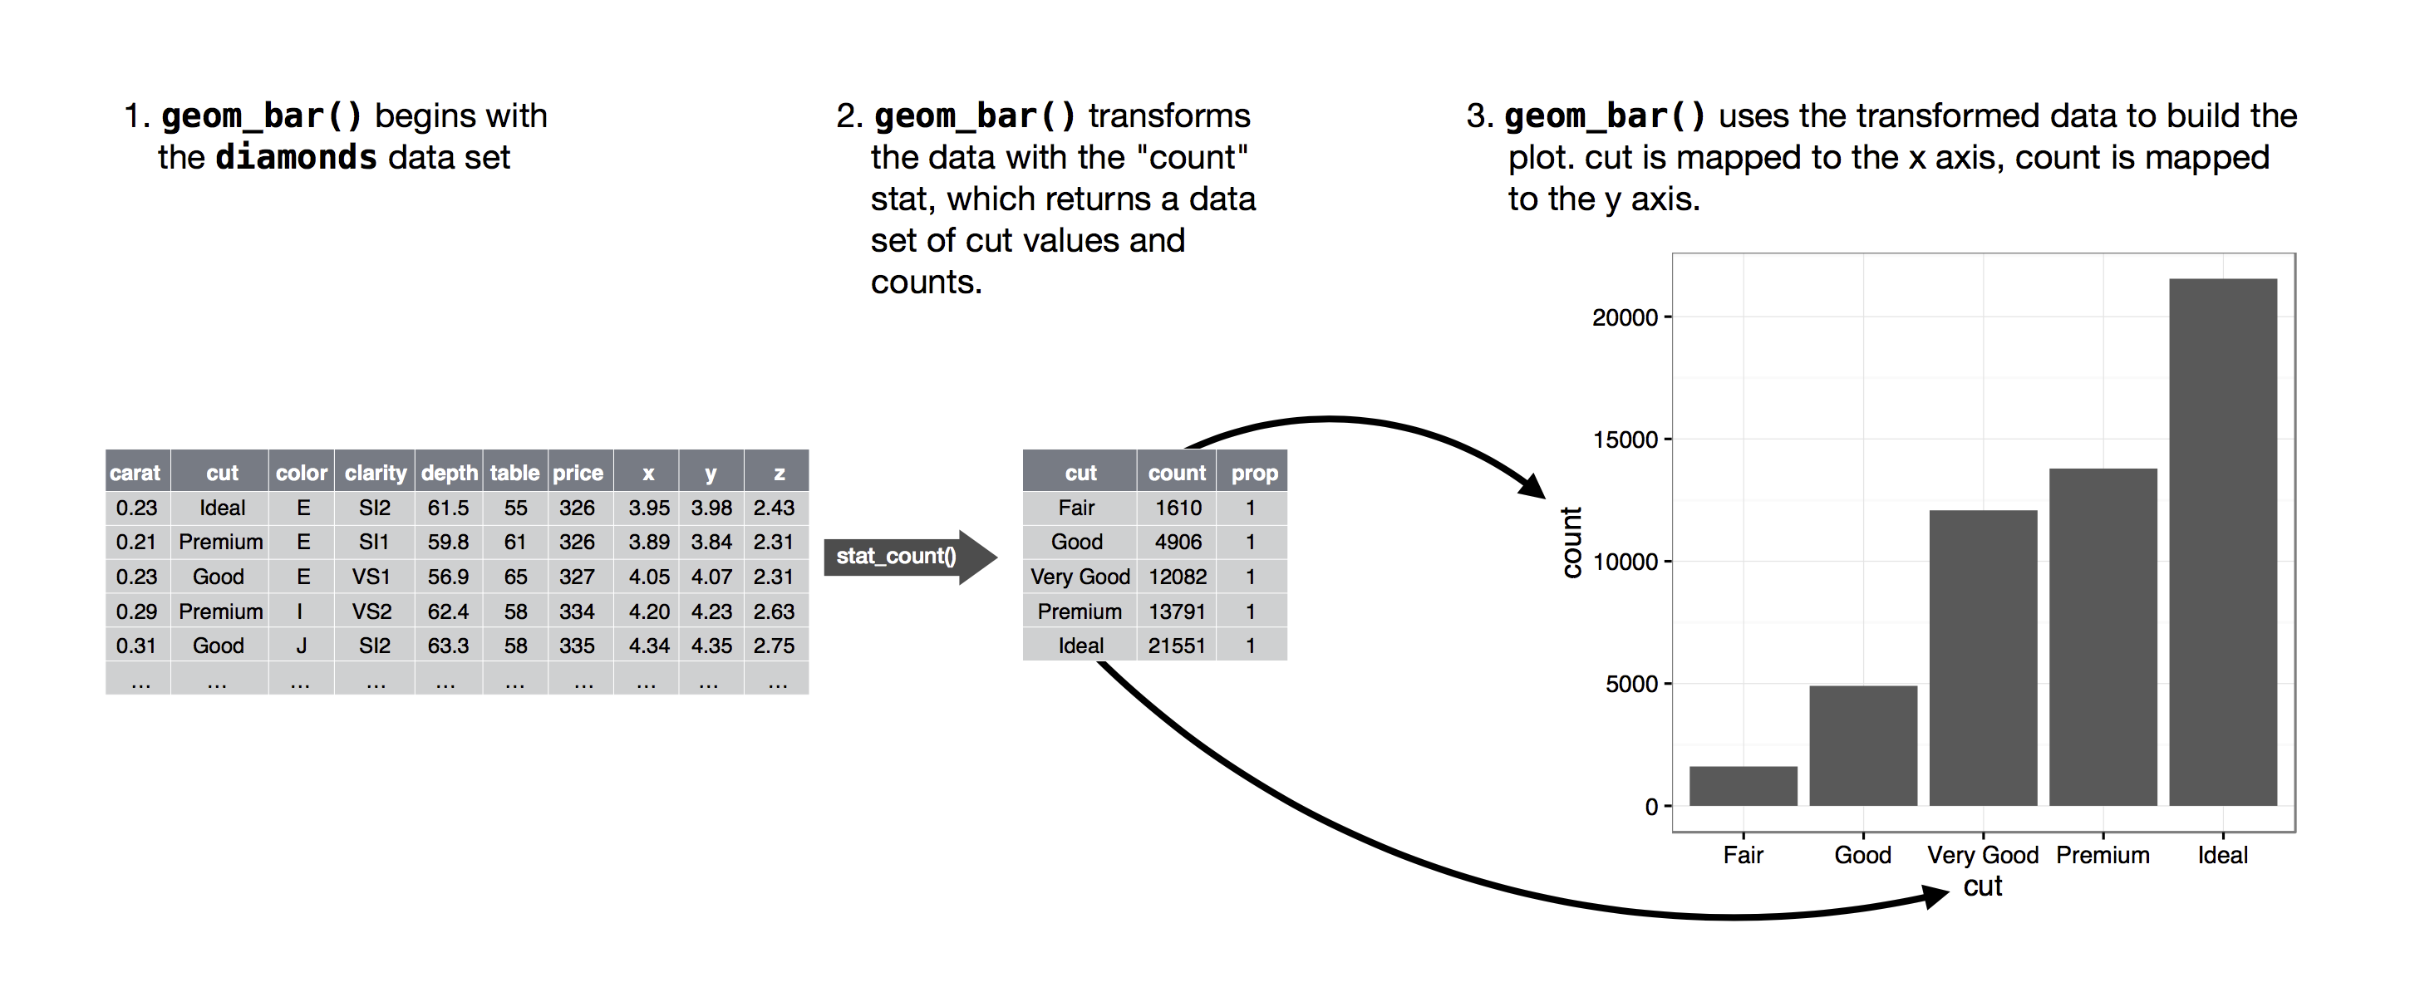
Statistical transformation
ggplot(data = diamonds) +
geom_bar(mapping = aes(x = cut, y = ..count..), stat = "count")

Slide 9
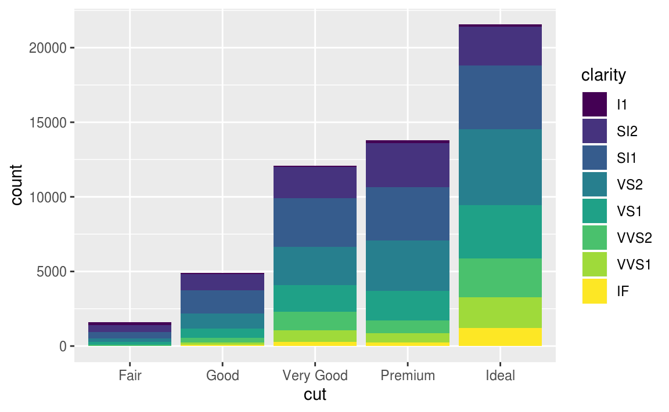
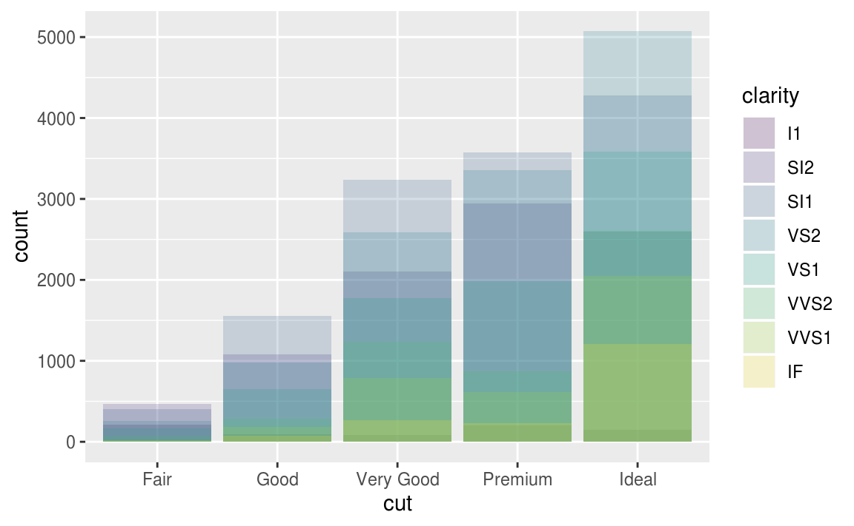
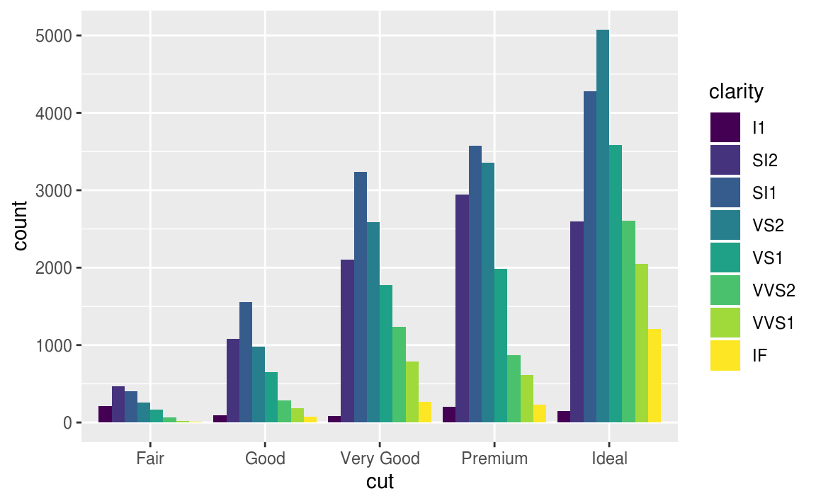
Position adjustment
ggplot(data = diamonds) +
geom_bar(mapping = aes(x = cut, y = ..count.., fill = clarity), stat = "count", position = "stack")

Slide 10
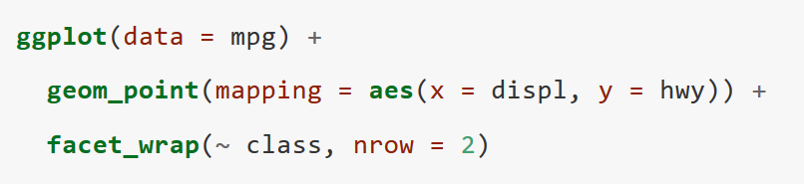
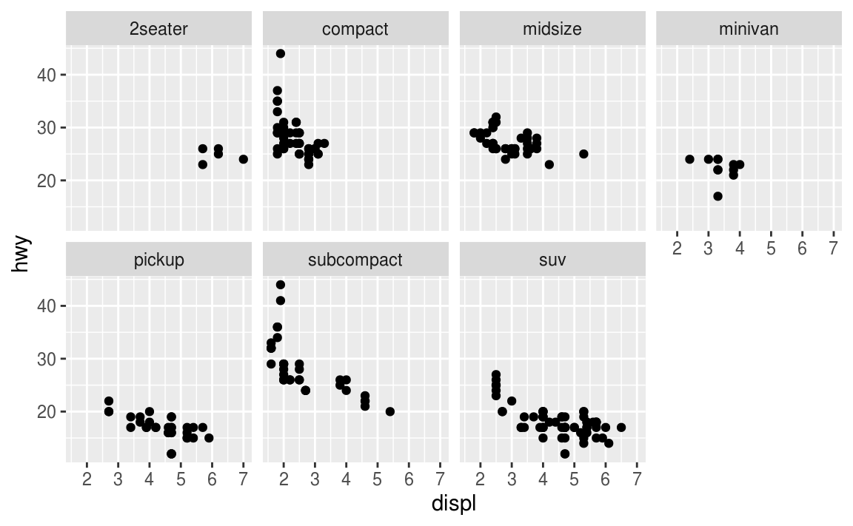
The layered grammar of graphics
ggplot(data = <DATA>) +
<GEOM_FUNCTION>(
mapping = aes(<MAPPINGS>),
stat = <STAT>,
position = <POSITION>
) +
<COORDINATE_FUNCTION> +
<FACET_FUNCTION>

Slide 11
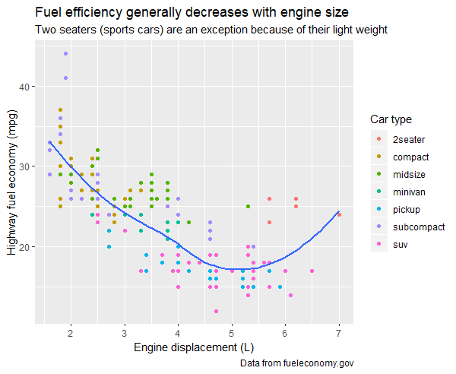
Label
ggplot(mpg, aes(displ, hwy)) +
geom_point(aes(color = class)) +
geom_smooth(se = FALSE) +
labs(
title = "Fuel efficiency generally decreases with engine size",
subtitle = "Two seaters (sports cars) are an exception because of their light weight",
caption = "Data from fueleconomy.gov",
x = "Engine displacement (L)",
y = "Highway fuel economy (mpg)",
colour = "Car type"
)

Slide 12
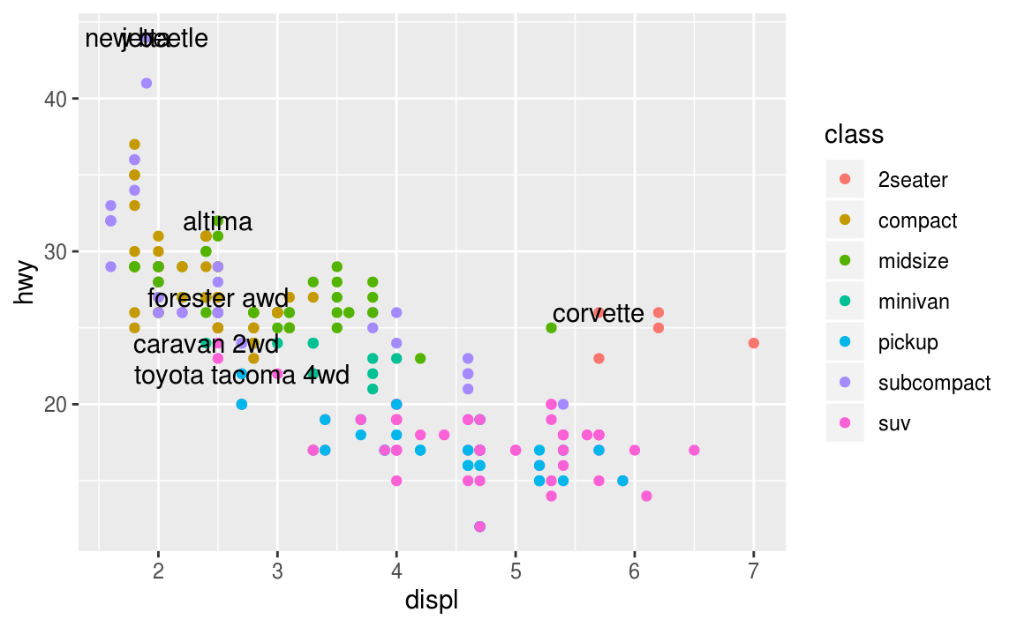
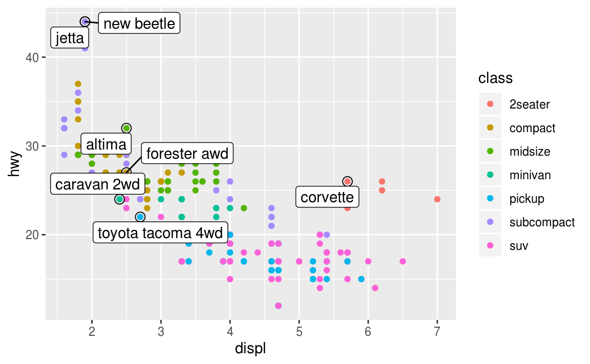
Annotation
best_in_class <- mpg %>%
group_by(class) %>%
filter(row_number(desc(hwy)) == 1)
ggplot(mpg, aes(displ, hwy)) +
geom_point(aes(colour = class)) +
geom_text(aes(label = model), data = best_in_class)
ggplot(mpg, aes(displ, hwy)) +
geom_point(aes(colour = class)) +
geom_point(size = 3, shape = 1, data = best_in_class) +
ggrepel::geom_label_repel(aes(label = model), data = best_in_class)

Slide 13

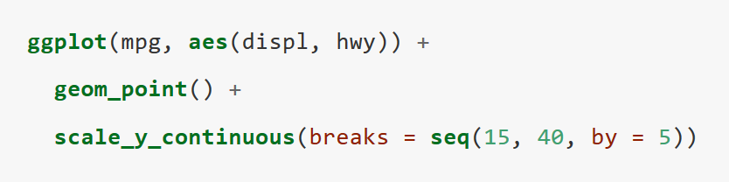
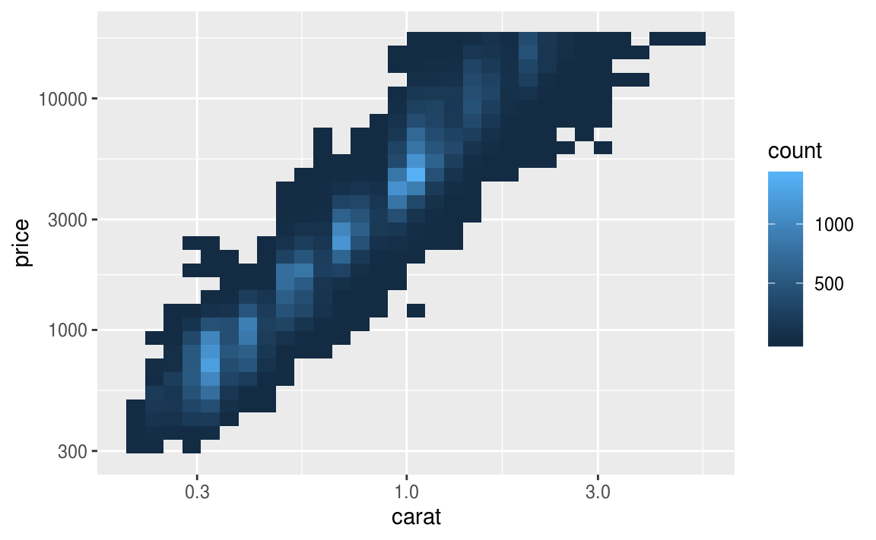
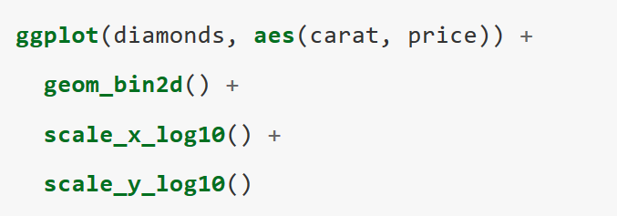
Scales

Slide 14
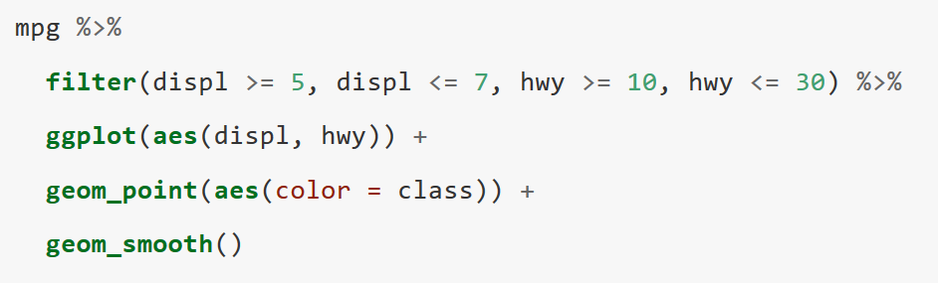
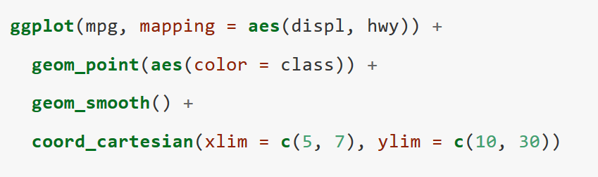
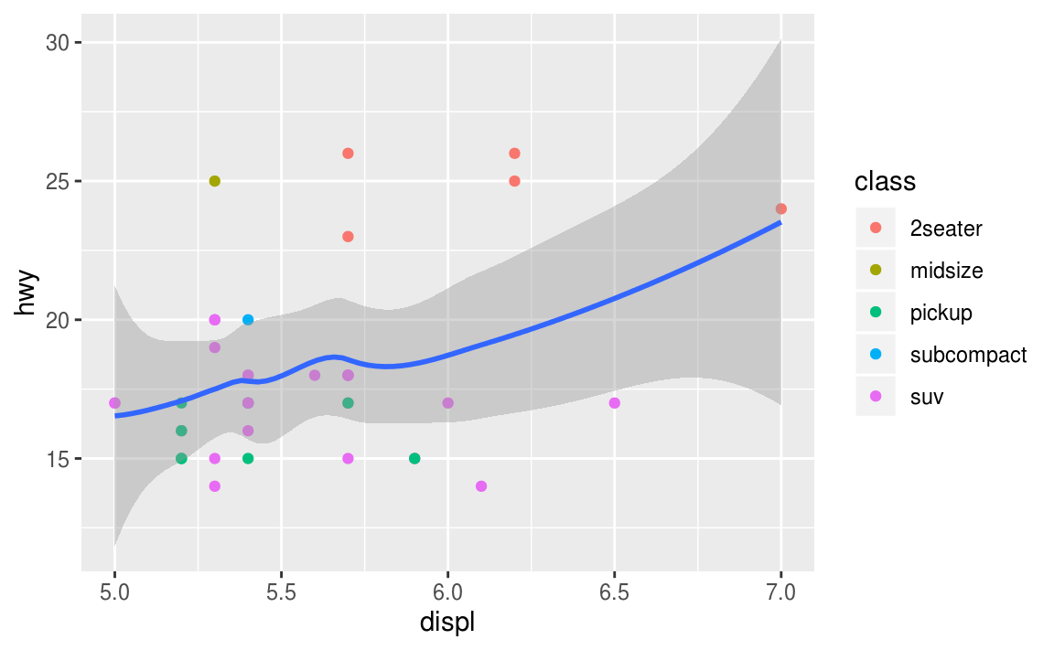
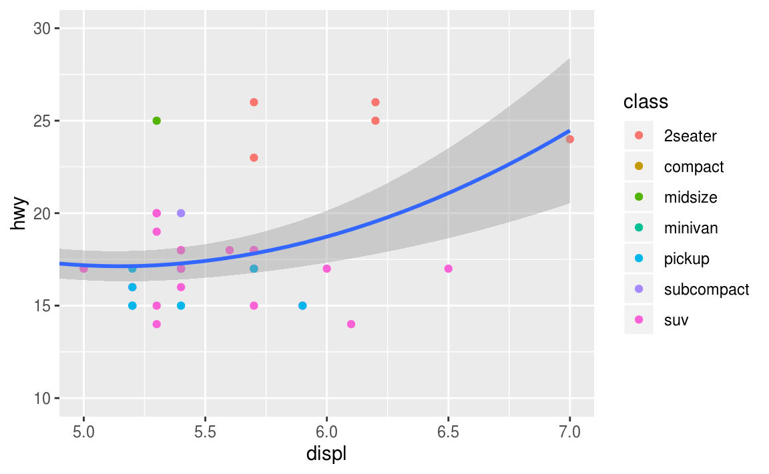
Zooming
There are three ways to control the plot limits:
Adjusting what data are plotted
Setting the limits in each scale
Setting xlim and ylim in coord_cartesian()

Slide 15
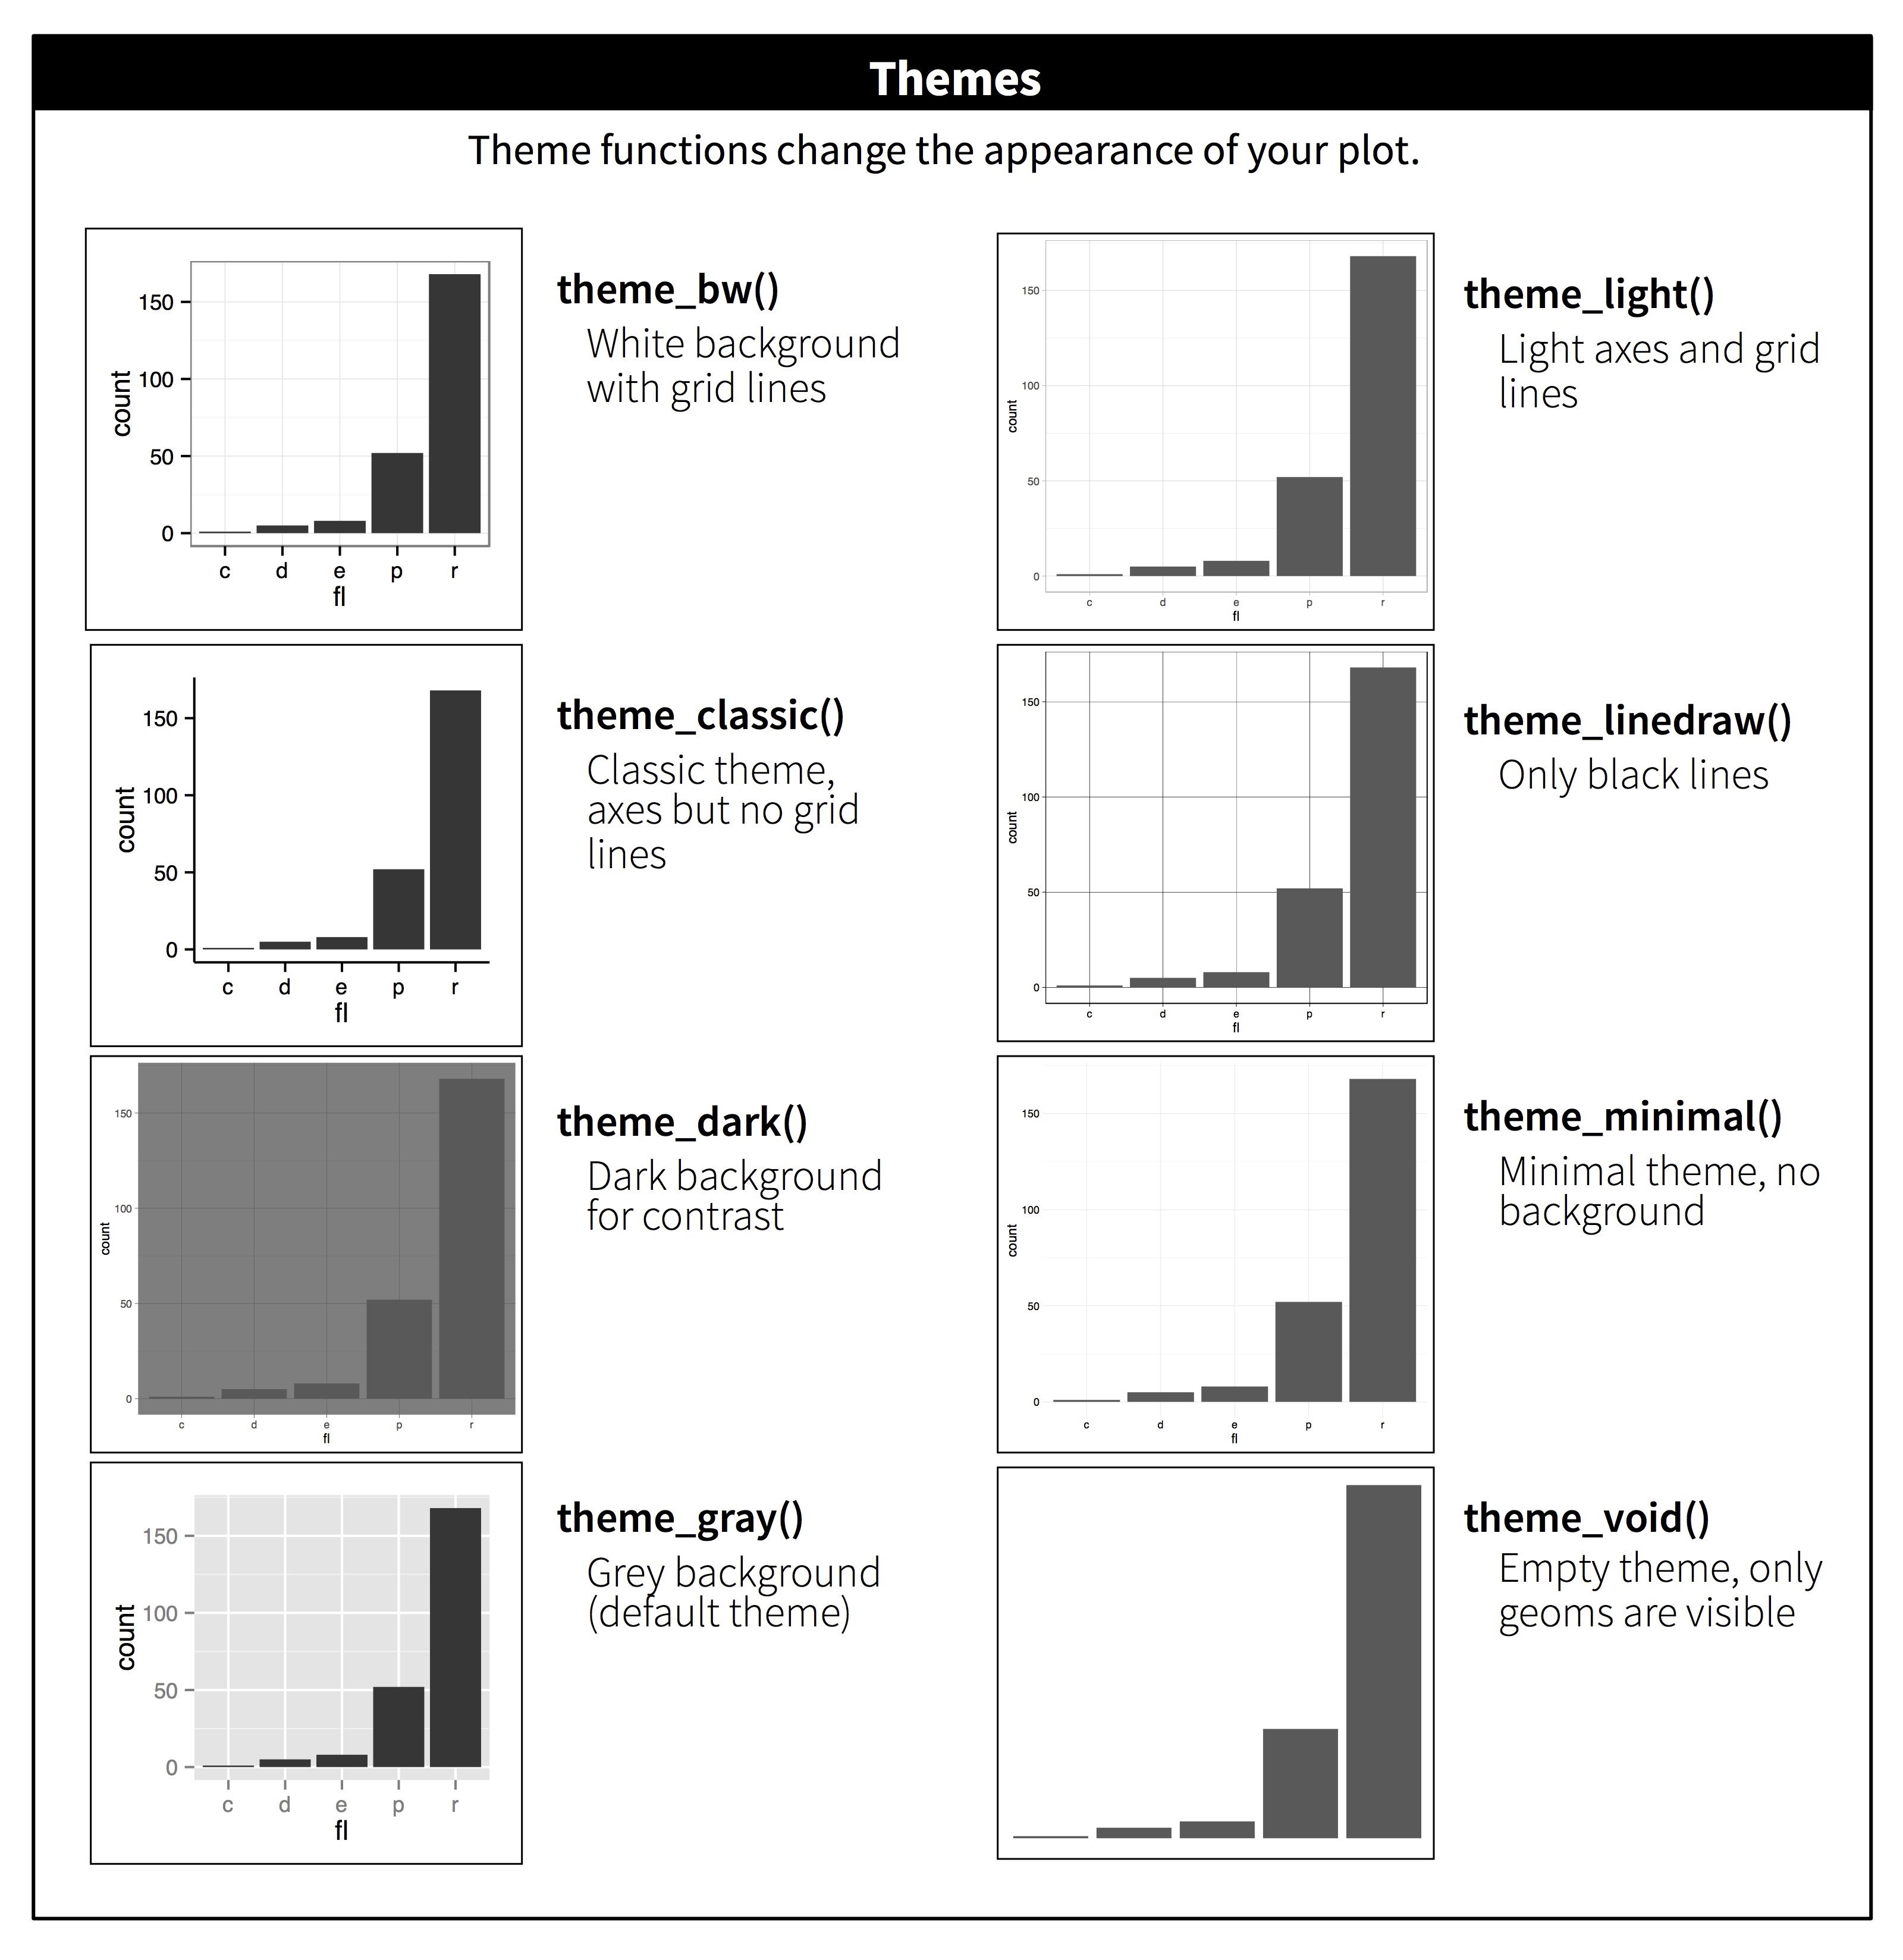
Themes

Slide 16
程序：Aesthetic mapping & Geometric object
黄娟：Statistical transformation & Position adjustment
陈梦婷：Label & Annotation
乐子薇：Scales & Zooming
刘振：Integration & Speaking

