Slide 1
Rare-Variant Kernel Machine Test
Qi Yan
Department of Pediatrics, Children’s Hospital of Pittsburgh of UPMC

Slide 2
Motivation
Phenotypes:
In many genetic studies, phenotypes are measured at multiple time points for each subject. It is expected that a method that is able to take into account all time points jointly in an association test could improve the power;
Family based designs have been widely used. Appropriately handling familial correlation can retain Type I error rate;
Genotypes:
MAF: Minor Allele Frequency
Common variants (MAF≥0.05): single marker test;
Rare variants (MAF<0.05): test at gene level (e.g. SKAT).

Slide 3
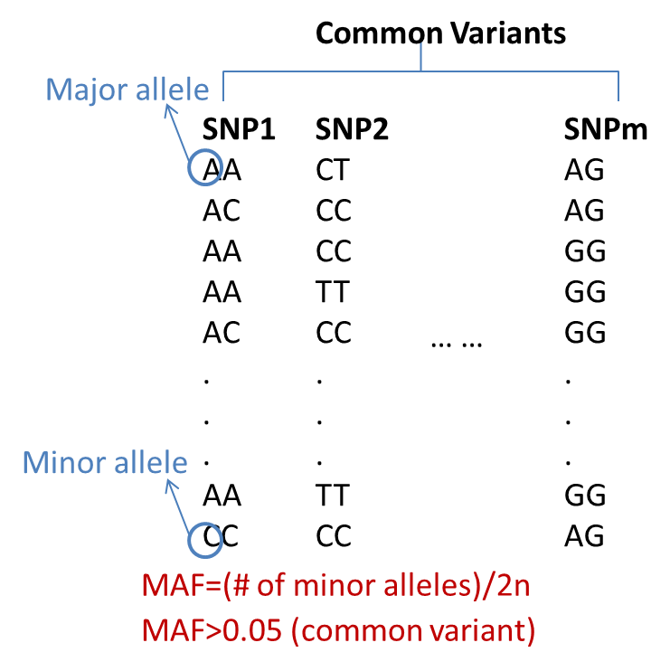
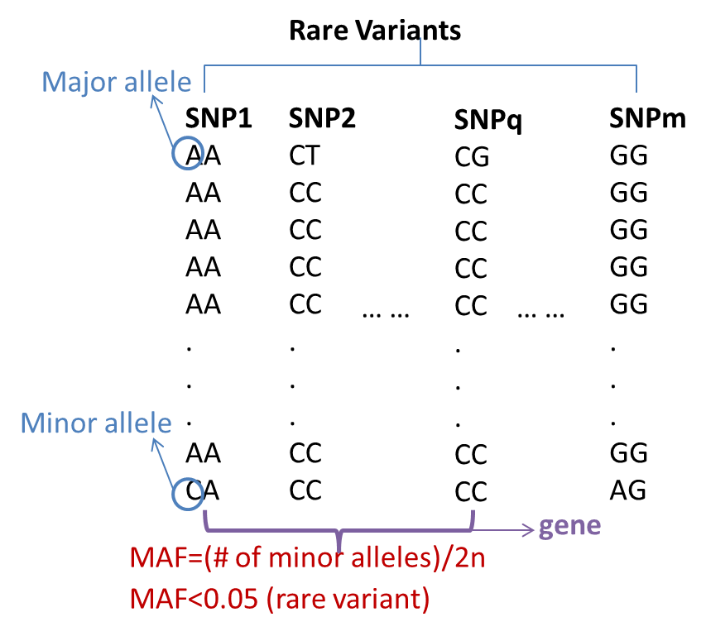
Motivation
Genotypes:
Common variants (e.g. MAF≥0.05): single marker test;
Rare variants (e.g. MAF<0.05): test at gene level (e.g. SKAT).

Slide 4
Aims
Gene-based rare variants test;
Handle multiple types of traits.

Slide 5



Methods
Sequence Kernel Association Test (SKAT):
Let there be n subjects with q genetic variants. The n × 1 vector of the quantitative trait y follows a linear mixed model:
$$y=Xβ+Gγ+ε$$
X is an n × p covariate matrix,
β is a p × 1 vector containing parameters for the fixed effects (an intercept and p – 1 covariates),
G is an n × q genotype matrix for the q rare genetic variants of interest,
γ is a q × 1 vector for the random effects of the q genetic variants,
ε is an n × 1 vector for the random error.
$$γ\sim N\left(0, τW\right)$$
$$ε\sim N\left(0, σ_{E}^{2}I\right)$$
where W is a predefined q × q diagonal weight matrix for each variant
Thus, the null hypothesis H₀: γ = 0 is equivalent to H₀: τ = 0, which can be tested with a variance component score test in the mixed model.

Slide 6






Methods
Sequence Kernel Association Test (SKAT):
Q: What makes mixed model different from linear regression model?
A: random variables in addition to random error.
$$y=Xβ+Gγ+ε$$
“linear mixed model”
Var(y)$=\text{τ}GWG^{′}+σ_{E}^{2}I$
SKAT test statistic following a mixture of Chi-square distribution is:
$${Q=\left(y−X\hat{β}\right)}^{′}{\hat{Σ}}^{−1}GWG^{′}{\hat{Σ}}^{−1}\left(y−X\hat{β}\right)$$
Called “kernel”.
Linear combination used here. Could be more flexible form.
where the parameters are estimated under H₀ (i.e., H₀: τ = 0)
Thus, under H₀:
$$y=Xβ+ε$$
“linear regression model, no longer mixed model”
$$\hat{Σ}={\hat{σ}}_{E}^{2}I$$
$$\hat{β}={\left(X^{′}{\hat{Σ}}^{−1}X\right)}^{−1}X^{′}{\hat{Σ}}^{−1}y$$
The “full model” of SKAT is a linear mixed model
The “null model” for the score test is a linear model

Slide 7

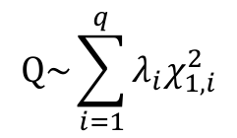
Methods
Sequence Kernel Association Test (SKAT):
Under null hypothesis, the variance of residual is
$$var\left(y−X\hat{β}\right)={\hat{σ}}_{E}^{2}−{\hat{σ}}_{E}^{2}X{\left(X^{′}X\right)}^{−1}X^{′}=P_{0}.$$
The statistic ${Q={\hat{σ}}_{E}^{−4}\left(y−X\hat{β}\right)}^{′}GWG^{′}\left(y−X\hat{β}\right)$ is a quadratic form of $\left(y−X\hat{β}\right)$ and follows a mixture of chi-square distributions under H₀. Thus,
$$Q\sim \sum_{i=1}^{q}{λ_{i}χ_{1,i}^{2}}$$
where $λ_{i}$ is the eigenvalues of the matrix ${\hat{σ}}_{E}^{−4}W^{\frac{1}{2}}G^{′}P_{0}GW^{\frac{1}{2}}$ .

Slide 8

Methods
Kernel Machine (KM) Regression for Linear Mixed Model:
With additional random effects (besides the genetic effects):
Let there be n subjects with q genetic variants. The n × 1 vector of the quantitative trait y follows a linear mixed model:
$$y=Xβ+Gγ+u+ε$$
X is an n × p covariate matrix,
β is a p × 1 vector containing parameters for the fixed effects (an intercept and p – 1 covariates),
G is an n × q genotype matrix for the q genetic variants of interest,
γ is a q × 1 vector for the random effects of the q genetic variants,
ε is an n × 1 vector for the random error,
u is an n × 1 vector for the random effects due to covariates (e.g., relatedness in families, multivariate traits or time for longitudinal data)

Slide 9


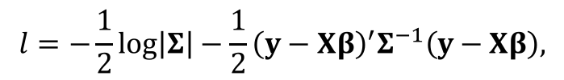


Methods
Kernel Machine (KM) Regression for Linear Mixed Model:
$$y=Xβ+Gγ+u+ε$$
$$γ\sim N\left(0, τW\right)$$
$$u\sim N\left(0, K\right)$$
$$ε\sim N\left(0, σ_{E}^{2}I\right)$$
where W is a predefined q × q diagonal weight matrix for each variant, and K is an n × n covariance matrix
For a linear mixed model, we use the log-likelihood
$$l=−\frac{1}{2}\log\left|Σ\right|−\frac{1}{2}{\left(y−Xβ\right)}^{′}Σ^{−1}\left(y−Xβ\right),$$
where $Σ=var\left(y\right)=τGWG^{′}+σ_{δ}^{2}Φ+σ_{E}^{2}I$. In the log-likelihood, the first term $−\frac{1}{2}\log\left|Σ\right|$ is fixed and independent of trait $y$ when replacing $Σ$ with its estimator.

Slide 10




Methods
Kernel Machine (KM) Regression for Linear Mixed Model:
Take the first derivative
$$\frac{dl}{dτ}=−\frac{1}{2}tr\left(Σ^{−1}GWG^{′}\right)+\frac{1}{2}{\left(y−Xβ\right)}^{′}Σ^{−1}GWG^{′}Σ^{−1}\left(y−Xβ\right),$$
The first term is fixed and independent of $y$. We take twice the second term to be derived as our test statistic $Q$.
$${Q=\left(y−X\hat{β}\right)}^{′}{\hat{Σ}}^{−1}GWG^{′}{\hat{Σ}}^{−1}\left(y−X\hat{β}\right)$$
where the parameters are estimated under H₀ (i.e., H₀: τ = 0)
Thus, under H₀:
$$y=Xβ+u+ε$$
“still a linear mixed model”
$$\hat{Σ}=\hat{K}+{\hat{σ}}_{E}^{2}I$$
$$\hat{β}={\left(X^{′}{\hat{Σ}}^{−1}X\right)}^{−1}X^{′}{\hat{Σ}}^{−1}y$$

Slide 11
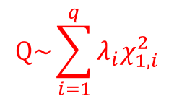
Methods
Kernel Machine (KM) Regression for Linear Mixed Model:
Under null hypothesis, the variance of residual is
$$var\left(y−X\hat{β}\right)=var\left(y−X{\left(X^{′}{\hat{Σ}}^{−1}X\right)}^{−1}X^{′}{\hat{Σ}}^{−1}y\right)=\hat{Σ}−X{\left(X^{′}{\hat{Σ}}^{−1}X\right)}^{−1}X^{′}=P_{0}.$$
The statistic $Q$ is a quadratic form of $\left(y−X\hat{β}\right)$ and follows a mixture of chi-square distributions under H₀. Thus,
$$Q\sim \sum_{i=1}^{q}{λ_{i}χ_{1,i}^{2}}$$
where $λ_{i}$ is the eigenvalues of the matrix $W^{\frac{1}{2}}G^{′}{\hat{Σ}}^{−1}P_{0}{\hat{Σ}}^{−1}GW^{\frac{1}{2}}$ .

Slide 12
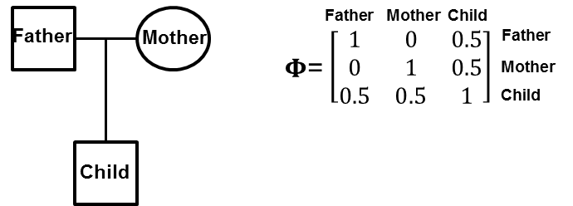





Methods (special case)
Family Sequence Kernel Association Test (famSKAT) for Quantitative Traits for Family Data:
The random variable for familial correlation
$$y=Xβ+Gγ+u+ε$$
$$γ\sim N\left(0, τW\right)$$
$$ε\sim N\left(0, σ_{E}^{2}I\right)$$
$$y=Xβ+Gγ+δ+ε$$
$$δ\sim N\left(0, σ_{δ}^{2}Φ\right)$$
Under the null hypothesis (τ = 0), $y=Xβ+δ+ε$

Slide 13


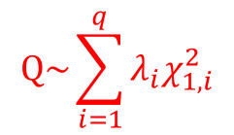

Methods (special case)
Family Sequence Kernel Association Test (famSKAT) for Quantitative Traits for Family Data:
We have test statistics:
$${Q=\left(y−X\hat{β}\right)}^{′}{\hat{Σ}}^{−1}GWG^{′}{\hat{Σ}}^{−1}\left(y−X\hat{β}\right)$$
$$\hat{β}={\left(X^{′}{\hat{Σ}}^{−1}X\right)}^{−1}X^{′}{\hat{Σ}}^{−1}y$$
$$\hat{Σ}={\hat{σ}}_{δ}^{2}Φ+{\hat{σ}}_{E}^{2}I$$
The statistic $Q$ is a quadratic form of $\left(y−X\hat{β}\right)$ and follows a mixture of chi-square distributions
$$Q\sim \sum_{i=1}^{q}{λ_{i}χ_{1,i}^{2}}$$
where $λ_{i}$ is the eigenvalues of the matrix $W^{\frac{1}{2}}G^{′}{\hat{Σ}}^{−1}P_{0}{\hat{Σ}}^{−1}GW^{\frac{1}{2}}$ .

Slide 14
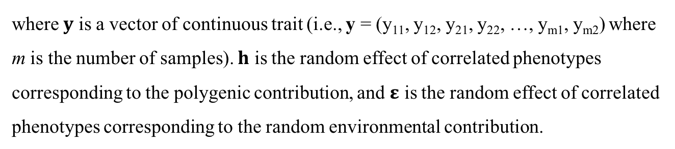

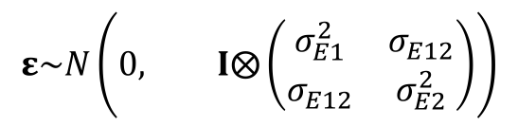
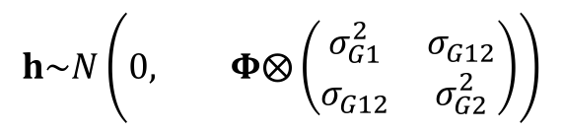
Methods (special case)
Multivariate Family Kernel Machine (MF-KM) regression for Quantitative Traits for Family Data:
We consider a data set containing m individuals and two correlated phenotypes for illustration. The model with correlation among phenotypes and familial correlation is
$$y=Xβ+Gγ+h+ε$$
where $y$ is a vector of continuous trait (i.e., y = (y₁₁, y₁₂, y₂₁, y₂₂, …, y_{m1}, y_{m2}) where m is the number of samples). $h$ is the random effect of correlated phenotypes corresponding to the polygenic contribution, and $ε$ is the random effect of correlated phenotypes corresponding to the random environmental contribution.
$$h\sim N\left(0, Φ⨂\left(\begin{matrix}σ_{G1}^{2} & σ_{G12} \\ σ_{G12} & σ_{G2}^{2}\end{matrix}\right)\right)$$
$$ε\sim N\left(0, I⨂\left(\begin{matrix}σ_{E1}^{2} & σ_{E12} \\ σ_{E12} & σ_{E2}^{2}\end{matrix}\right)\right)$$

Slide 15
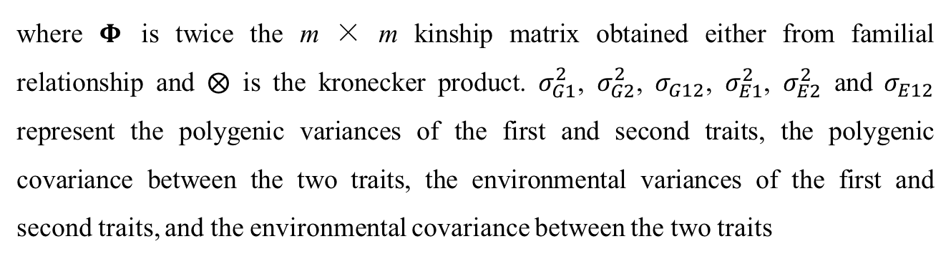
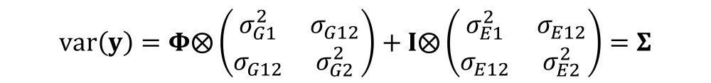
Methods (special case)
Multivariate Family Kernel Machine (MF-KM) regression for Quantitative Traits for Family Data:
Under the null hypothesis (τ = 0), $y=Xβ+h+ε$
$$var\left(y\right)=Φ⨂\left(\begin{matrix}σ_{G1}^{2} & σ_{G12} \\ σ_{G12} & σ_{G2}^{2}\end{matrix}\right)+I⨂\left(\begin{matrix}σ_{E1}^{2} & σ_{E12} \\ σ_{E12} & σ_{E2}^{2}\end{matrix}\right)=Σ$$
where $Φ$ is twice the m × m kinship matrix obtained either from familial relationship and $⨂$ is the kronecker product. $σ_{G1}^{2}$, $σ_{G2}^{2}$, $σ_{G12}$, $σ_{E1}^{2}$, $σ_{E2}^{2}$ and $σ_{E12}$ represent the polygenic variances of the first and second traits, the polygenic covariance between the two traits, the environmental variances of the first and second traits, and the environmental covariance between the two traits

Slide 16
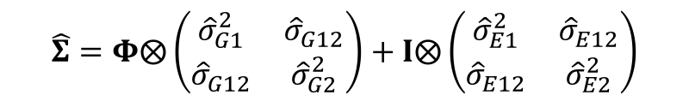


Methods (special case)
Multivariate Family Kernel Machine (MF-KM) regression for Quantitative Traits for Family Data:
We have test statistics:
$${Q=\left(y−X\hat{β}\right)}^{′}{\hat{Σ}}^{−1}GWG^{′}{\hat{Σ}}^{−1}\left(y−X\hat{β}\right)$$
$$\hat{β}={\left(X^{′}{\hat{Σ}}^{−1}X\right)}^{−1}X^{′}{\hat{Σ}}^{−1}y$$
$$\hat{Σ}=Φ⨂\left(\begin{matrix}{\hat{σ}}_{G1}^{2} & {\hat{σ}}_{G12} \\ {\hat{σ}}_{G12} & {\hat{σ}}_{G2}^{2}\end{matrix}\right)+I⨂\left(\begin{matrix}{\hat{σ}}_{E1}^{2} & {\hat{σ}}_{E12} \\ {\hat{σ}}_{E12} & {\hat{σ}}_{E2}^{2}\end{matrix}\right)$$
The statistic $Q$ is a quadratic form of $\left(y−X\hat{β}\right)$ and follows a mixture of chi-square distributions
$$Q\sim \sum_{i=1}^{q}{λ_{i}χ_{1,i}^{2}}$$
where $λ_{i}$ is the eigenvalues of the matrix $W^{\frac{1}{2}}G^{′}{\hat{Σ}}^{−1}P_{0}{\hat{Σ}}^{−1}GW^{\frac{1}{2}}$ .

Slide 17

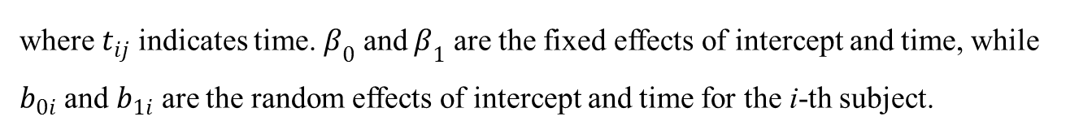
Methods (special case)
Longitudinal Kernel Machine (L-KM) regression for Quantitative Traits for Population Data:
With longitudinal studies, may treat intercept and (continuous) time (slope) as both fixed and random effects.
Different covariance structures such as compound symmetry, autoregressive, and Toeplitz, can be easily implemented under this framework.
Under the null hypothesis (τ = 0), the random intercept and time model for the i-th subject at time point j is
$$y_{ij}=β_{0}+t_{ij}β_{1}+b_{0i}+t_{ij}b_{1i}+ε_{ij}$$
where $t_{ij}$ indicates time. $β_{0}$ and $β_{1}$ are the fixed effects of intercept and time, while $b_{0i}$ and $b_{1i}$ are the random effects of intercept and time for the i-th subject.

Slide 18

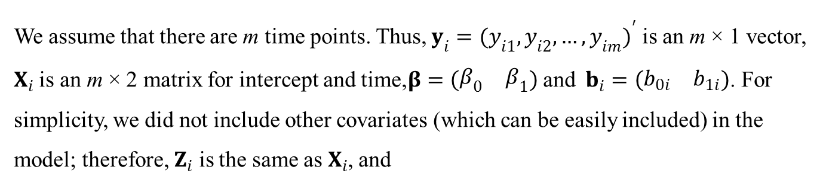


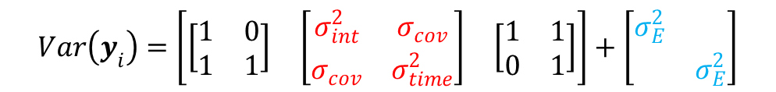


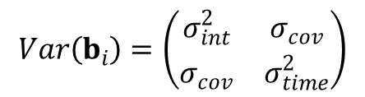

Methods (special case)
Longitudinal Kernel Machine (L-KM) regression for Quantitative Traits for Population Data:
For one subject, the null model can be rewritten as
$$y_{i}=X_{i}β+Z_{i}b_{i}+ε_{i}$$
We assume that there are m time points. Thus, $y_{i}={(y_{i1}, y_{i2}, …, y_{im})}^{′}$ is an m × 1 vector, $X_{i}$ is an m × 2 matrix for intercept and time,$β=\left(\begin{matrix}β_{0} & β_{1}\end{matrix}\right)$ and $b_{i}=\left(\begin{matrix}b_{0i} & b_{1i}\end{matrix}\right)$. For simplicity, we did not include other covariates (which can be easily included) in the model; therefore, $Z_{i}$ is the same as $X_{i}$, and
$$Var\left(b_{i}\right)=\left(\begin{matrix}σ_{int}^{2} & σ_{cov} \\ σ_{cov} & σ_{time}^{2}\end{matrix}\right)$$
$$Var\left(y_{i}\right)=Z_{i}Var\left(b_{i}\right){Z_{i}}^{′}+σ_{E}^{2}I_{m×m}$$
For example,
$$σ_{E}^{2}I_{m×m}$$
$$Z_{i}$$
$$Var\left(b_{i}\right)$$
$${Z_{i}}^{′}$$
$$Var\left(y_{i}\right)=\left[\begin{matrix}\left[\begin{matrix}1 & 0 \\ 1 & 1\end{matrix}\right] & \left[\begin{matrix}σ_{int}^{2} & σ_{cov} \\ σ_{cov} & σ_{time}^{2}\end{matrix}\right] & \left[\begin{matrix}1 & 1 \\ 0 & 1\end{matrix}\right]\end{matrix}\right]+\left[\begin{matrix}σ_{E}^{2} & \\ & σ_{E}^{2}\end{matrix}\right]$$

Slide 19




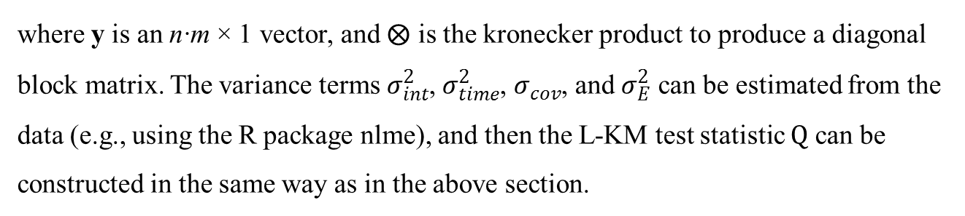
Methods (special case)
Longitudinal Kernel Machine (L-KM) regression for Quantitative Traits for Population Data:
For the whole data set, the variance term is:
$$Var\left(y\right)=I⨂Z_{i}Var\left(b_{i}\right){Z_{i}}^{′}+σ_{E}^{2}I=Σ$$
where y is an n∙m × 1 vector, and $⨂$ is the kronecker product to produce a diagonal block matrix. The variance terms $σ_{int}^{2}$, $σ_{time}^{2}$, $σ_{cov}$, and $σ_{E}^{2}$ can be estimated from the data (e.g., using the R package nlme), and then the L-KM test statistic $Q$ can be constructed in the same way as in the above section.
We have test statistics:
$${Q=\left(y−X\hat{β}\right)}^{′}{\hat{Σ}}^{−1}GWG^{′}{\hat{Σ}}^{−1}\left(y−X\hat{β}\right)$$
$$\hat{β}={\left(X^{′}{\hat{Σ}}^{−1}X\right)}^{−1}X^{′}{\hat{Σ}}^{−1}y$$
$$\hat{Σ}=I⨂Z_{i}{{\hat{Var\left(b_{i}\right)}Z}_{i}}^{′}+{\hat{σ}}_{E}^{2}I$$

Slide 20



Methods
Kernel Machine (KM) Regression for Generalized Linear Mixed Model:
With additional random effects (besides the genetic effects):
Let there be n subjects with q genetic variants. The n × 1 vector of the binary trait y follows a linear mixed model:
$$logit\left(P\left(y=1\right)\right)=logit\left(μ\right)=η=Xβ+Gγ+u$$
where $μ$ is the mean of $y$.
$$γ\sim N\left(0, τW\right)$$
$$u\sim N\left(0, K\right)$$
where W is a predefined q × q diagonal weight matrix for each variant, and K is an n × n covariance matrix

Slide 21
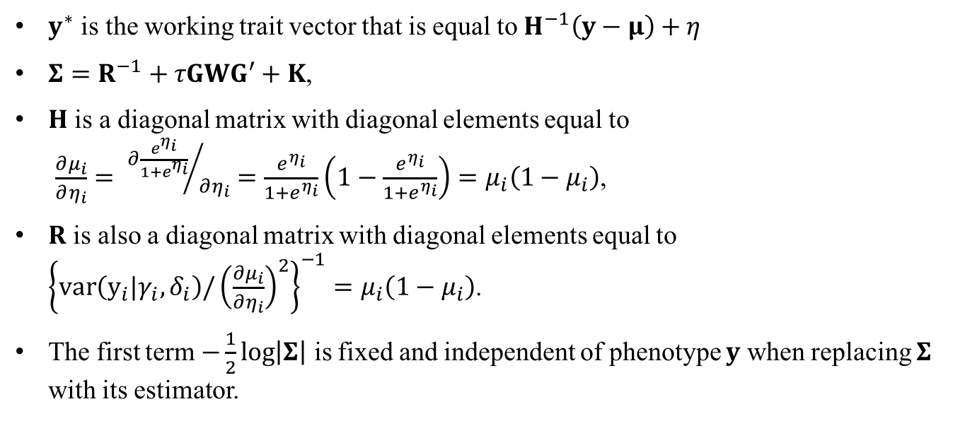
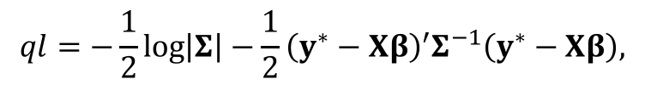
Methods
Kernel Machine (KM) Regression for Generalized Linear Mixed Model:
For a generalized linear mixed model, we use the quasi-likelihood
$$ql=−\frac{1}{2}\log\left|Σ\right|−\frac{1}{2}{\left(y^{∗}−Xβ\right)}^{′}Σ^{−1}\left(y^{∗}−Xβ\right),$$
$y^{∗}$ is the working trait vector that is equal to $H^{−1}\left(y−μ\right)+η$
$Σ=R^{−1}+τGWG^{′}+K$,
$H$ is a diagonal matrix with diagonal elements equal to
$\frac{∂μ_{i}}{∂η_{i}}= {∂\frac{e^{η_{i}}}{1+e^{η_{i}}}}/{∂η_{i}}=\frac{e^{η_{i}}}{1+e^{η_{i}}}\left(1−\frac{e^{η_{i}}}{1+e^{η_{i}}}\right)=μ_{i}\left(1−μ_{i}\right)$,
$R$ is also a diagonal matrix with diagonal elements equal to ${\left\{var\left(y_{i}|γ_{i},δ_{i}\right){/\left(\frac{∂μ_{i}}{∂η_{i}}\right)}^{2}\right\}}^{−1}=μ_{i}\left(1−μ_{i}\right)$.
The first term $−\frac{1}{2}\log\left|Σ\right|$ is fixed and independent of phenotype $y$ when replacing $Σ$ with its estimator.

Slide 22

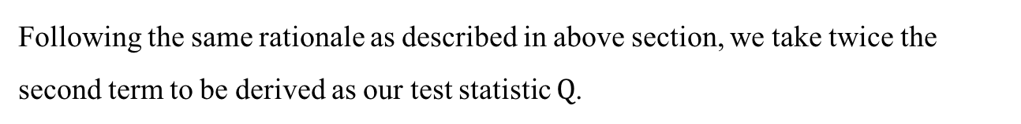







Methods
Kernel Machine (KM) Regression for Generalized Linear Mixed Model:
Take the first derivative
$$\frac{dql}{dτ}=−\frac{1}{2}tr\left(Σ^{−1}GWG^{′}\right)+\frac{1}{2}{\left(y^{∗}−Xβ\right)}^{′}Σ^{−1}GWG^{′}Σ^{−1}\left(y^{∗}−Xβ\right)$$
Following the same rationale as described in above section, we take twice the second term to be derived as our test statistic $Q$.
$$Q={\left(y^{∗}−X\hat{β}\right)}^{′}{\hat{Σ}}^{−1}GWG^{′}{\hat{Σ}}^{−1}\left(y^{∗}−X\hat{β}\right).$$
equivalent
Under H₀:
$$logit\left(P\left(y=1\right)\right)=Xβ+u$$
$$y^{∗}=Xβ+u+ε^{∗}$$
$$ε^{∗}\sim N\left(0, R^{−1}\right)$$
“a generalized linear mixed model”
$y^{∗}$ is the working trait vector
When final $y^{∗}$:
$$\hat{β}={\left(X^{′}{\hat{Σ}}^{−1}X\right)}^{−1}X^{′}{\hat{Σ}}^{−1}y^{∗};$$
$$\hat{Σ}=\hat{K}+{\hat{R}}^{−1}$$

Slide 23
Methods
Kernel Machine (KM) Regression for Generalized Linear Mixed Model:
Under null hypothesis, the variance of residual is
$$var\left(y^{∗}−X\hat{β}\right)=var\left(y^{∗}−X{\left(X^{′}{\hat{Σ}}^{−1}X\right)}^{−1}X^{′}{\hat{Σ}}^{−1}y^{∗}\right)=\hat{Σ}−X{\left(X^{′}{\hat{Σ}}^{−1}X\right)}^{−1}X^{′}=P_{0}.$$
The statistic $Q$ is a quadratic form of $\left(y^{∗}−X\hat{β}\right)$ and follows a mixture of chi-square distributions under H₀. Thus,
$$Q\sim \sum_{i=1}^{q}{λ_{i}χ_{1,i}^{2}}$$
where $λ_{i}$ is the eigenvalues of the matrix $W^{\frac{1}{2}}G^{′}{\hat{Σ}}^{−1}P_{0}{\hat{Σ}}^{−1}GW^{\frac{1}{2}}$ .

Slide 24




Methods (special case)
Family Sequence Kernel Association Test (F-SKAT) for Binary Traits for Family Data:
The random variable for familial correlation
$$logit\left(P\left(y=1\right)\right)=Xβ+Gγ+u$$
$$γ\sim N\left(0, τW\right)$$
$$logit\left(P\left(y=1\right)\right)=Xβ+Gγ+δ$$
$$δ\sim N\left(0, σ_{δ}^{2}Φ\right)$$
Under the null hypothesis (τ = 0), $logit\left(P\left(y=1\right)\right)=Xβ+δ$

Slide 25



Methods (special case)
Family Sequence Kernel Association Test (F-SKAT) for Binary Traits for Family Data:
We have test statistics:
$$Q={\left(y^{∗}−X\hat{β}\right)}^{′}{\hat{Σ}}^{−1}GWG^{′}{\hat{Σ}}^{−1}\left(y^{∗}−X\hat{β}\right).$$
$$\hat{β}={\left(X^{′}{\hat{Σ}}^{−1}X\right)}^{−1}X^{′}{\hat{Σ}}^{−1}y^{∗}$$
$$\hat{Σ}={\hat{σ}}_{δ}^{2}Φ+{\hat{R}}^{−1}$$
The statistic $Q$ is a quadratic form of $\left(y^{∗}−X\hat{β}\right)$ and follows a mixture of chi-square distributions
$$Q\sim \sum_{i=1}^{q}{λ_{i}χ_{1,i}^{2}}$$
where $λ_{i}$ is the eigenvalues of the matrix $W^{\frac{1}{2}}G^{′}{\hat{Σ}}^{−1}P_{0}{\hat{Σ}}^{−1}GW^{\frac{1}{2}}$ .
This can be simplified to SKAT for binary population data

Slide 26
Reference
Michael C. Wu, Seunggeun Lee, Tianxi Cai, Yun Li, Michael Boehnke, and Xihong Lin Rare-Variant Association Testing for Sequencing Data with the Sequence Kernel Association Test. Am J Hum Genet, 2011, 89(1):82-93.
Han Chen, James B. Meigs, and Josée Dupuis. “Sequence Kernel Association Test for Quantitative Traits in Family Samples”. Genet Epidemiol. 2013 Feb; 37(2): 196–204.
Qi Yan, Daniel E. Weeks, Hemant K. Tiwari, Nengjun Yi, Kui Zhang, Guimin Gao, Wan-Yu Lin, Xiang-Yang Lou, Wei Chen, and Nianjun Liu. “Rare-Variant Kernel Machine Test for Longitudinal Data from Population and Family Samples”. Human Heredity, 80:126-138.
Qi Yan, Daniel E. Weeks, Juan C. Celedon, Hemant K. Tiwari, Bingshan Li, Xiaojing Wang, Wan-Yu Lin, Wei Chen, and Nianjun Liu. “Associating Multivariate Quantitative Phenotypes with Genetic Variants in Family Samples with a Novel Kernel Machine Regression Method”. Genetics, 2015 Dec;201(4):1329-39.
Qi Yan, Hemant K. Tiwari, Nengjun Yi, Guimin Gao, Wan-Yu Lin, Xiang-Yang Lou, and Nianjun Liu. “Sequence Kernel Association Test for Dichotomous Traits in Family Sample under Generalized Linear Mixed Model”. Human Heredity, 2016, 79(2):60-68.

