Slide 1
Sound Drawing Tool:
A Synesthetic Audiovisual Instrument
N
Real-time performance system linking visuals and music
Qian Zhao

Slide 2
Concept Implementation
Mouse position → Musical pitch (horizontal mapping)
01
Drawing speed → Visual line rotation
02
Stroke release → Automatic playback
03
Three instrument modes: Piano, Violin, Guitar
04
-The Synesthetic Mapping

Slide 3
Technical Sophistication
Tone.js
Harmony generation
Performance optimization
Smart playback
Polyphonic synthesis (3 synth engines)
Detects multiple instruments, adds complementary notes
Efficient point storage & rendering
Synchronized multi-stroke replay

Slide 4
User Experience & Interface Design
Real-time visual & audio feedback
Status indicators & keyboard shortcuts
02
04
01
03
Crosshair cursor for precision
HTML replay button (pointer-events optimization)

Slide 5
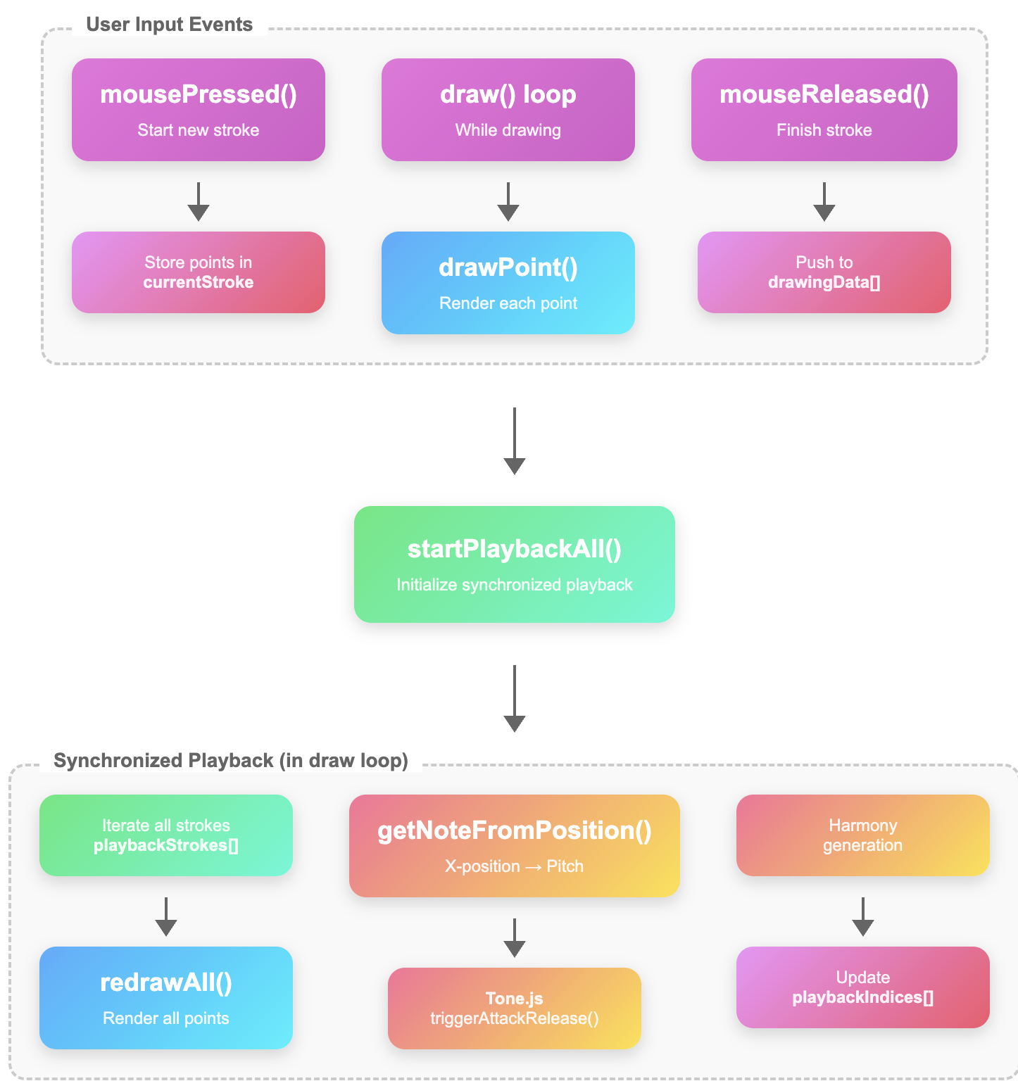
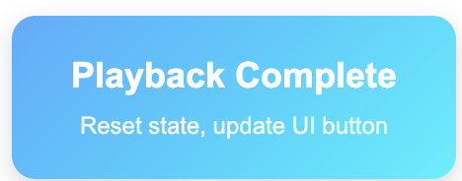
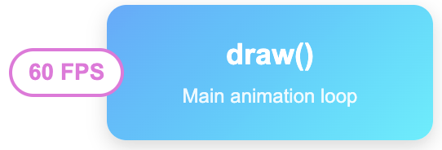
Code Quality & Organization

Slide 6
Summary & Impact
Concept
Technical
Result
Potential
Elegant fusion of drawing and music
Sophisticated synthesis & synchronization
Expressive audiovisual performance tool
Educational tool, creative expression, live performance

