Slide 1
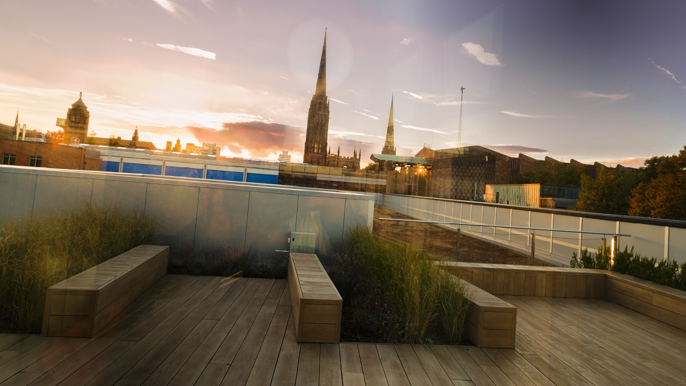

Royal Society Short Industry Fellowship
Dr Qian Lu

Slide 2
Content
Progress update
Plan for two weeks
Other activities

Slide 3
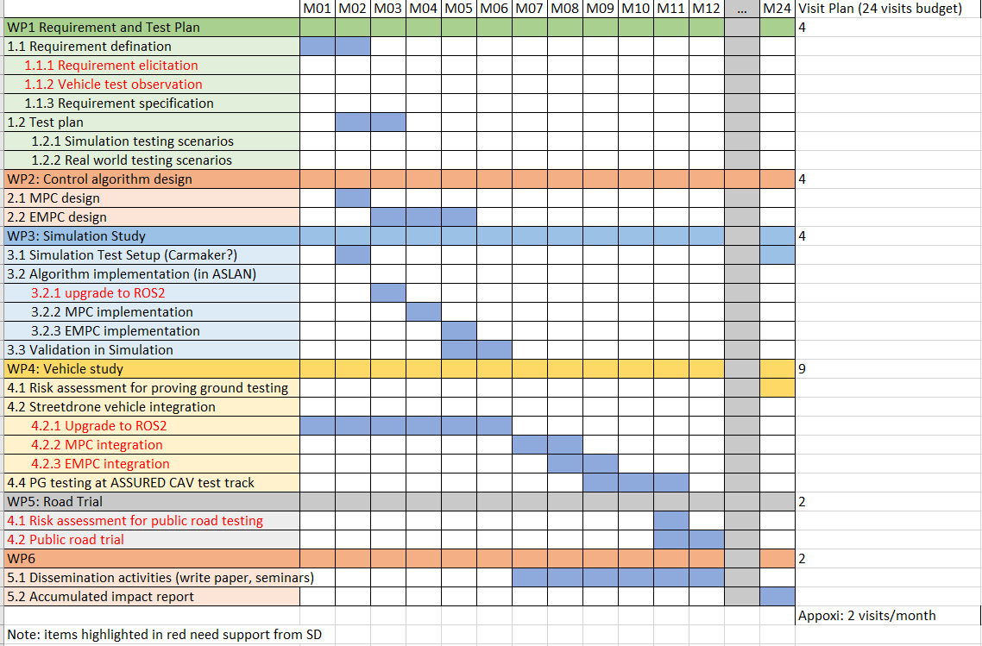
A summary of the research
Project Plan
Link to the project plan document

Slide 4
Progress Update
Simulation Preparation
  Carmaker ROS bridge bug fix
    Change datatype of intensity from 8 to 7
    Modify the carmker_tf.launch
      Baselink -> Fr1
      Fr_lidarRSI->velodyne
    Need to comment out ‘VehicleControl’ to follow defined trajectory
      VehicleControl.Gas = gas:
      VehicleControl.Brake = brake
      VehicleControl.Steering.Ang = steer_ang

Slide 5
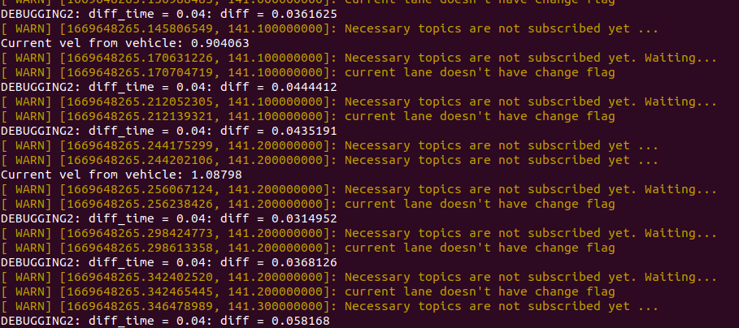
Progress Update
Hanging issues
Issue1: Need to launch baselink to localiser to set the localisation? Event the tf from baselink to velodyn can be established.
Issue2: Warnings, when launch ‘lane selection’

Slide 6
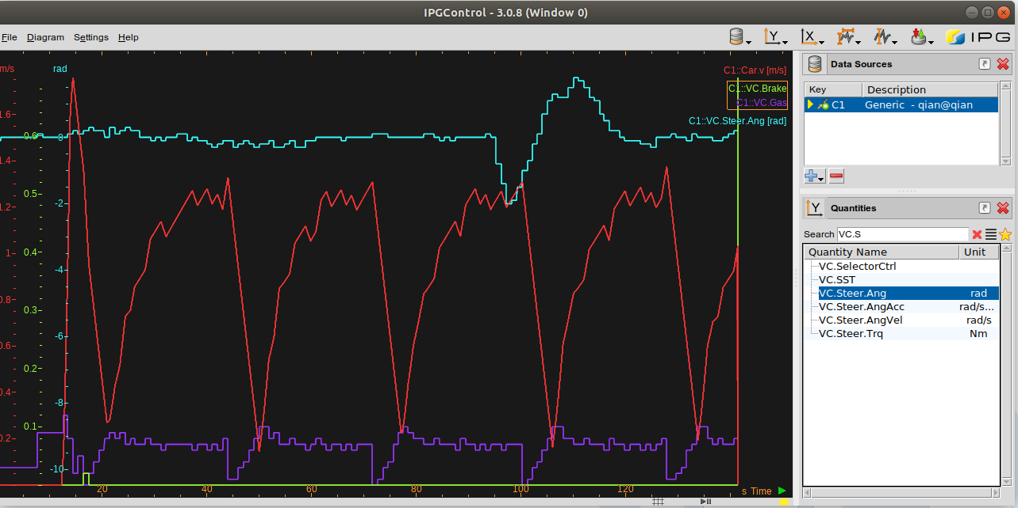
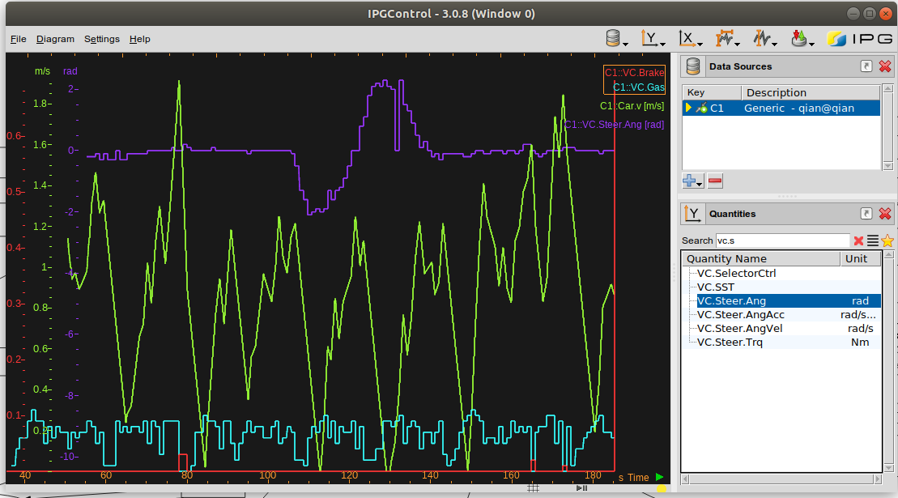
Progress Update
Hanging issues
  Issue3: Vehicle speed is too slow, target speed set at 50, following is the speed profile
    Need to look into sd_vehicle_interface package???
Speed Input: Carmaker_Speed
Speed Input: NDT_Localisation

Slide 7
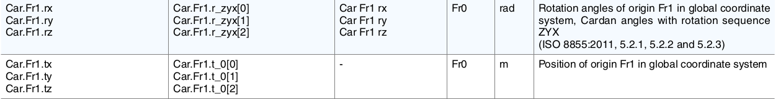
Progress Update
Simulation Preparation
  Use CM ground true of vehicle state/position as inputs
    Use topic /current_velocity_cm as input to /pure_pursuit
    Create new topic /current_pose_cm and use it as input to /pure_pursuit
      New topic /current_pose_cm publish the following CM quantities
    Need to modified the coordinate of /current_pose_cm to coordinate map
  /pure_pursuit uses only two elements position.x and position.y in message geometry_msgs/PoseStamped

Slide 8
Progress Update
Test scenes and scenarios
  Build MIRA AssuredHW track in Carmaker
    Carmaker only support .Xodr, .KML and Heremap format
    Use OpenStreetMap and convert it to opendrive (xodr)
    Use google map
    Use Carmaker model of the track developed by other project of CU (‘AssuredCAV’)
  other scenarios
    Single lane change
      Velocity variation: 20-60km/h
      Yaw rate variation:
    Double lane change
      Velocity variation: 20-60km/h
      Yaw rate variation:
    Simple turn
      Velocity variation: 20-60km/h
      Curvature variation: 0.6 – 4

Slide 9
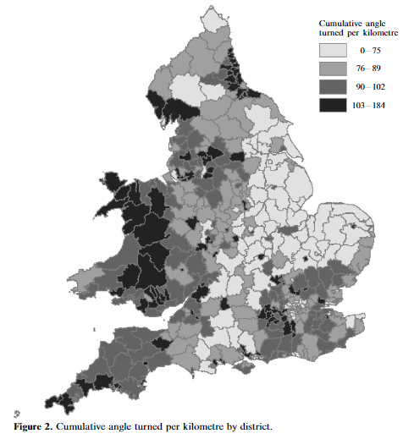
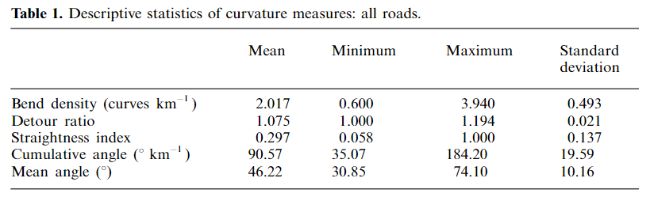
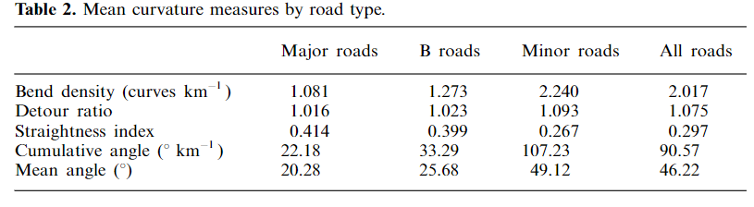
Road curvature in England and Wales

Slide 10
Other activities
Add FS news to SD Social Media

Slide 11
Other activities
Proposed three MSC projects to start from Jan
  Articulated vehicle automated parking control
    Efficient reverse manoeuvre control of tractor-trailer vehicle is very difficult because it is a complex mechatronic system with strong coupling and high nonlinearity. It is especially changelleging when manoeuvre through complex and narrow parking environment. The traditional control methods like PID control are difficult to achieved a satisfactory control performance when dealing with multiple constraints problem. However, model predictive control has been widely used in dealing with constraints issue on states and Input due to its many advantages, such as multi-constraint processing, rolling optimsation and good robustness. In this project, the student is expected to investigate into different control algorithm PID, MPC and explicit MPC and applied them into different challenging parking sceanrio of articulated vehicle, parallel, perpendicular parking, angle parking etc. The student need to analyse and make critical comparision on the performance of different of control mehtods on handling the parking scenario
  CAV Autonomous Planning and Navigation using Lanelet2 & OpenStreetMap
    Like human, autonomous vehicles need a map to plan and navigate the road network. OpenStreetMap is a map of the world, created by people like you and free to use under an open licence. Lanelet2 is a C++ library for handling map data for autonomous vehicle. This project aims to exploit the exisiting coversion tools to convert OpenStreetMap into Lanelet2 format, and integrate Lanelet 2 maps to an open-source software stack of autonomous vehicles (ASLAN) and design route planning algorithm on the Lanelet2 map. We will do this project on Simulation basis and however there is opportunity to deploy to the developed software to Coventry University's autonomous vehicle: StreetDrone.
  CAV Object detection and fusion between Lidar and Video data
    CAV use multiple sensors (camera, lidar, radars) to detect the environment. Similarly, the labotory autonomous vehicle 'Streetdrone' used by research centre CFTC has multiple sensors including Velodyne Lidar VLP32 and Stereo Camera ZED. In this project, we will exploiting the existing machine learning based object detection algorithm to detect road objects (e.g. vehicle, pedestrain, byciles) from video stream of ZED camera and fuse the result of detection from Velodyne Lidar.

Slide 12
Plan for the next
Simulation Preparation
  Modified the simulation to use CM group true for control
  Use CM generated trajectory instead of waypoint saver
Create Test scene and scenarios in Carmaker
  Build MIRA AssuredHW track in Carmaker
  Other test scenarios
Look into design and mathematical formulation of EMPC

Slide 13
Backups

Slide 14
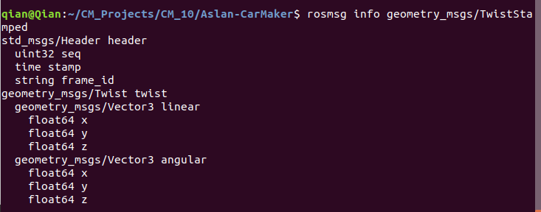
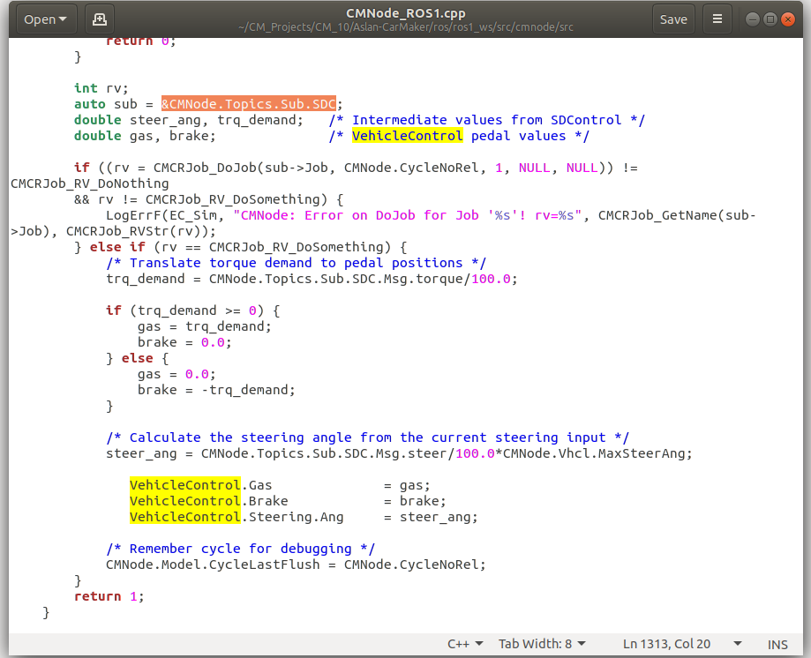

Slide 15
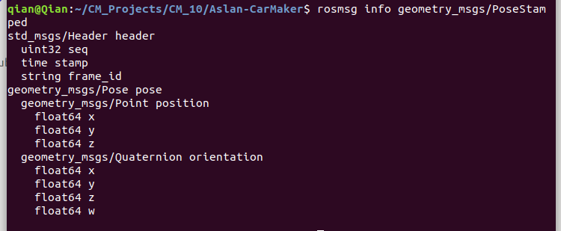
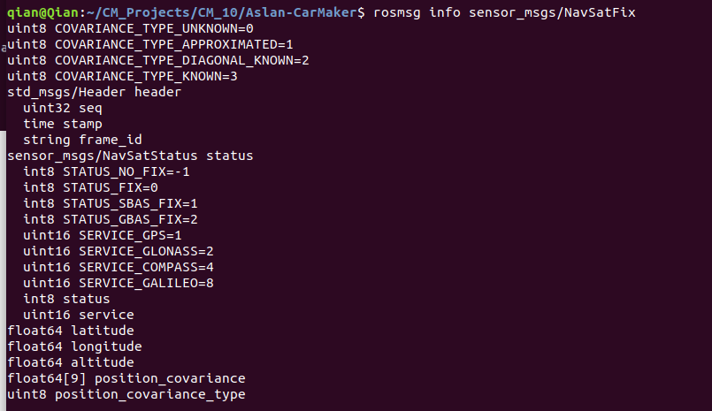

Slide 16
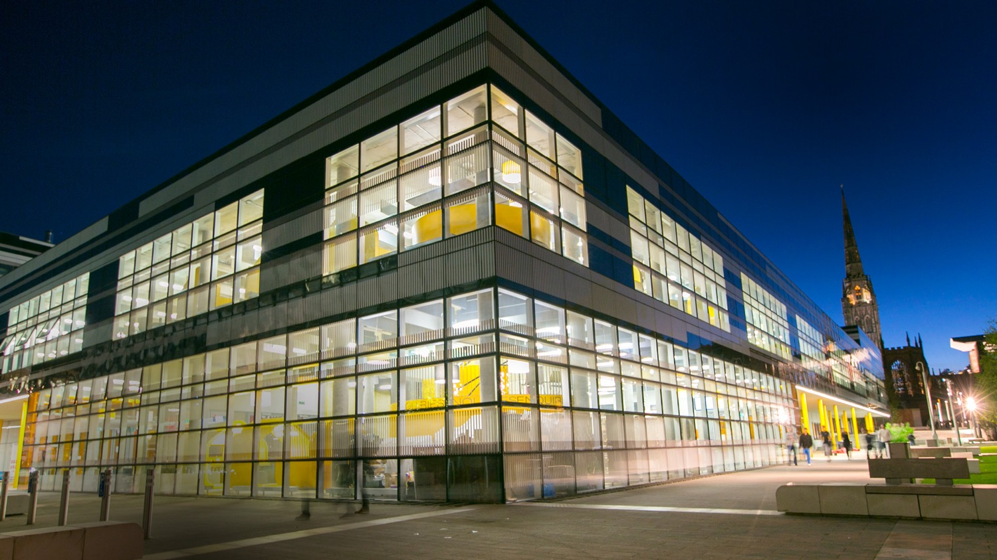
Thank you

