Slide 1


Royal Society Short Industry Fellowship
Dr Qian Lu

Slide 2
Content
Progress Update From 01/12/22-14/01/23: Controller design and initial validation in MATLAB
Next Steps
Other activities

Slide 3
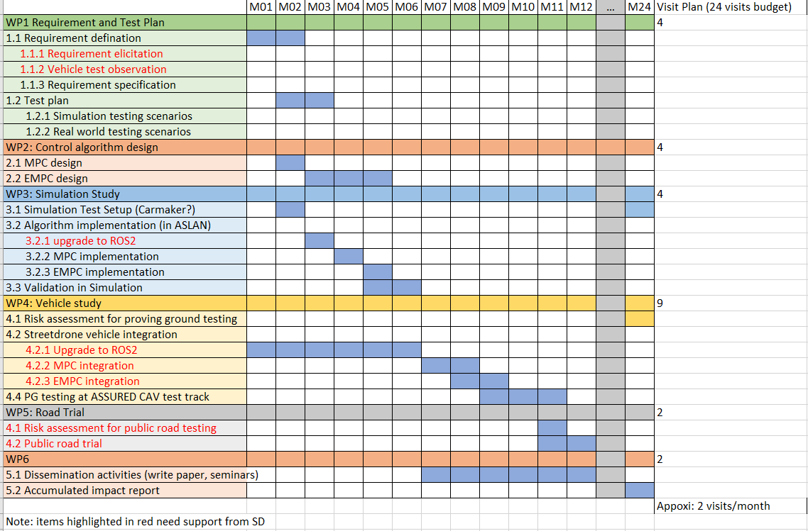
A summary of the research Project Plan
Link to the project plan document

Slide 4
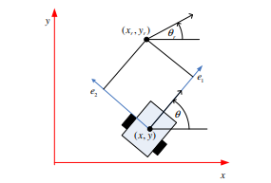
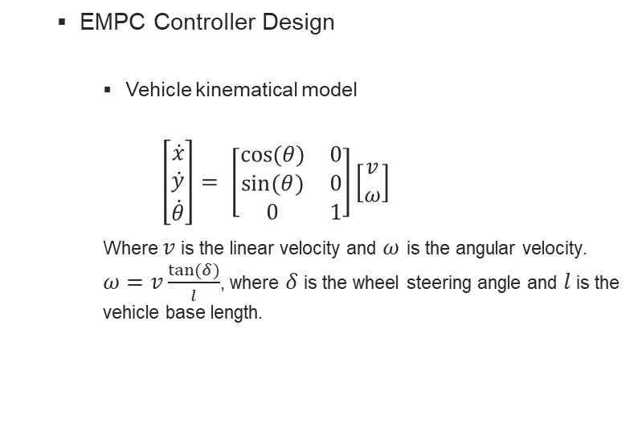
Progress Update
EMPC Controller Design
Vehicle kinematical model
$$\left[\begin{matrix}\dot{x} \\ \dot{y} \\ \dot{θ}\end{matrix}\right]= \left[\begin{matrix}cos⁡(θ) & 0 \\ sin⁡(θ) & 0 \\ 0 & 1\end{matrix}\right]\left[\begin{matrix}v \\ ω\end{matrix}\right]$$
Where $v$ is the linear velocity and $ω$ is the angular velocity. $ω=v\frac{tan⁡(δ)}{l}$, where $δ$ is the wheel steering angle and $l$ is the vehicle base length.
Fig. World frame and local coordinate system of the vehicle

Slide 5
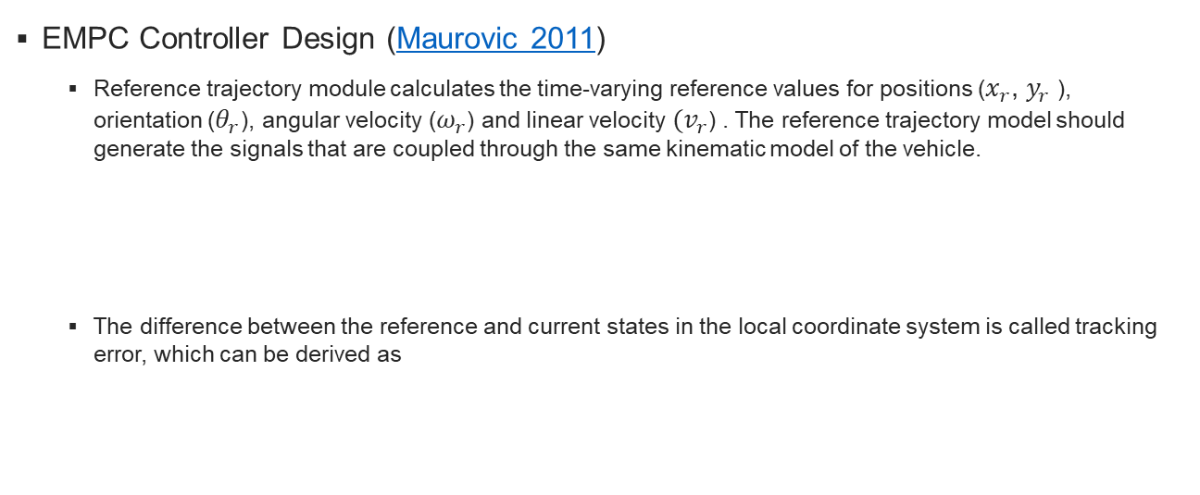
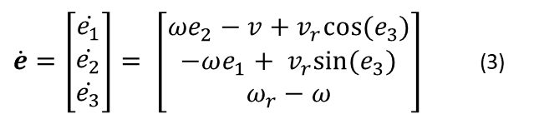
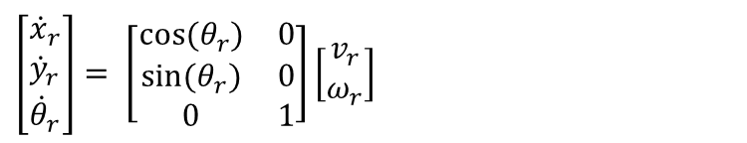
Progress Update
EMPC Controller Design (Maurovic 2011)
Reference trajectory module calculates the time-varying reference values for positions ($x_{r}$, $y_{r}$ ), orientation ($θ_{r}$), angular velocity ($ω_{r}$) and linear velocity ${(v}_{r}$) . The reference trajectory model should generate the signals that are coupled through the same kinematic model of the vehicle.
The difference between the reference and current states in the local coordinate system is called tracking error, which can be derived as
$$\left[\begin{matrix}{\dot{x}}_{r} \\ {\dot{y}}_{r} \\ {\dot{θ}}_{r}\end{matrix}\right]= \left[\begin{matrix}cos⁡(θ_{r}) & 0 \\ sin⁡(θ_{r}) & 0 \\ 0 & 1\end{matrix}\right]\left[\begin{matrix}v_{r} \\ ω_{r}\end{matrix}\right]$$
$\dot{e}=\left[\begin{matrix}\dot{e_{1}} \\ \dot{e_{2}} \\ \dot{e_{3}}\end{matrix}\right]= \left[\begin{matrix}ωe_{2}−v+v_{r}cos⁡(e_{3}) \\ −ωe_{1}+ v_{r}sin⁡(e_{3}) \\ ω_{r}−ω\end{matrix}\right]$ (3)

Slide 6
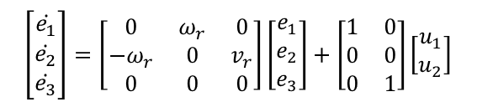


Progress Update
EMPC Controller Design (Maurovic 2011)
By introducing the controller outputs as the following
and linearising (3) around the equilibrium point ($e=0, u=0$), obtained linear tracking error model of the vehicle
$$u=\left[\begin{matrix}u_{1} \\ u_{2}\end{matrix}\right]= \left[\begin{matrix}v_{r}\cos\left(e_{3}\right)−v \\ ω_{r}−ω\end{matrix}\right]$$
$$\left[\begin{matrix}\dot{e_{1}} \\ \dot{e_{2}} \\ \dot{e_{3}}\end{matrix}\right]=\left[\begin{matrix}0 & ω_{r} & 0 \\ −ω_{r} & 0 & v_{r} \\ 0 & 0 & 0\end{matrix}\right]\left[\begin{matrix}e_{1} \\ e_{2} \\ e_{3}\end{matrix}\right]+\left[\begin{matrix}1 & 0 \\ 0 & 0 \\ 0 & 1\end{matrix}\right]\left[\begin{matrix}u_{1} \\ u_{2}\end{matrix}\right]$$

Slide 7
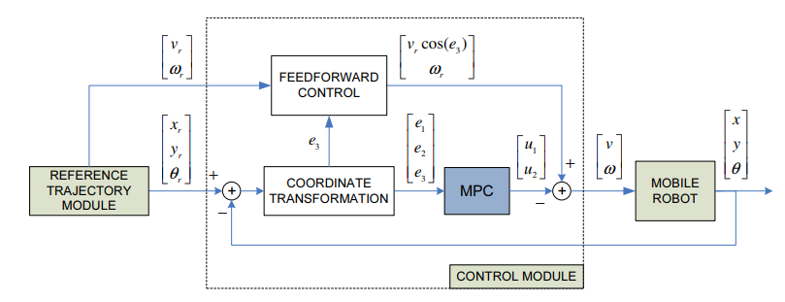

Progress Update
EMPC Controller Design(Maurovic 2011)
Overall control scheme
The actual control inputs to the vehicle are
$$\left[\begin{matrix}v \\ ω\end{matrix}\right]=\left[\begin{matrix}v_{r}cos⁡(e_{3}) \\ ω_{r}\end{matrix}\right]−\left[\begin{matrix}u_{1} \\ u_{2}\end{matrix}\right]$$

Slide 8
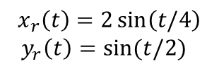
Progress Update
Testing it with a simple example in MATLAB
8 – shaped trajectory
$$x_{r}\left(t\right)=2\sin\left(t/4\right)$$
$y_{r}\left(t\right)=sin⁡(t/2)$

Slide 9
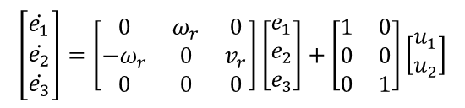

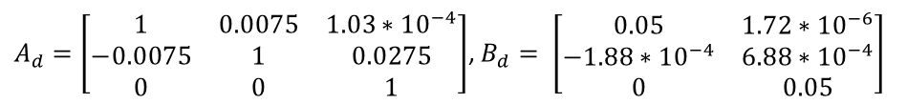
Progress Update
MPC design
Tracking error model is a linear parameter varying (LPV) model
For the simplicity, we used $v_{r}=0.55 m/s$, $ω_{r}=0.15 rad/s$ and used ZOH discretization and sampling time of 50 ms to obtain a linear discrete-time model
$$\left[\begin{matrix}\dot{e_{1}} \\ \dot{e_{2}} \\ \dot{e_{3}}\end{matrix}\right]=\left[\begin{matrix}0 & ω_{r} & 0 \\ −ω_{r} & 0 & v_{r} \\ 0 & 0 & 0\end{matrix}\right]\left[\begin{matrix}e_{1} \\ e_{2} \\ e_{3}\end{matrix}\right]+\left[\begin{matrix}1 & 0 \\ 0 & 0 \\ 0 & 1\end{matrix}\right]\left[\begin{matrix}u_{1} \\ u_{2}\end{matrix}\right]$$
$A_{d}=\left[\begin{matrix}1 & 0.0075 & 1.03∗{10}^{−4} \\ −0.0075 & 1 & 0.0275 \\ 0 & 0 & 1\end{matrix}\right]$, $B_{d}= \left[\begin{matrix}0.05 & 1.72∗{10}^{−6} \\ −1.88∗{10}^{−4} & 6.88∗{10}^{−4} \\ 0 & 0.05\end{matrix}\right]$

Slide 10
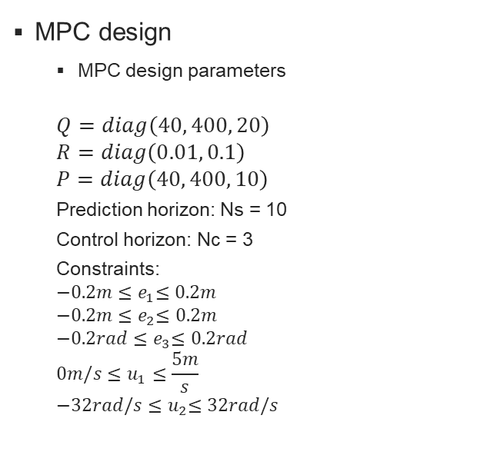
Progress Update
MPC design
MPC design parameters
$$Q=diag\left(40, 400, 20\right)$$
$$R=diag\left(0.01, 0.1\right)$$
$$P=diag\left(40, 400, 10\right)$$
Prediction horizon: Ns = 10
Control horizon: Nc = 3
Constraints:
$${−0.2m≤e}_{1}≤0.2m$$
$${−0.2m≤e}_{2}≤0.2m$$
$${−0.2rad≤e}_{3}≤0.2rad$$
$${0m/s≤u}_{1}≤\frac{5m}{s}$$
$${−32rad/s≤u}_{2}≤32rad/s$$
EMPC design
To avoid solve optimisation at every time step, MPC problem can be recast as a multi-parametric quadratic program (mpQP). The control solution is a continuous piecewise affine function in terms of parameter x. The parameter space of x is a convex polyhedron partitioned in to N numbers of polyhedral regions

Slide 11
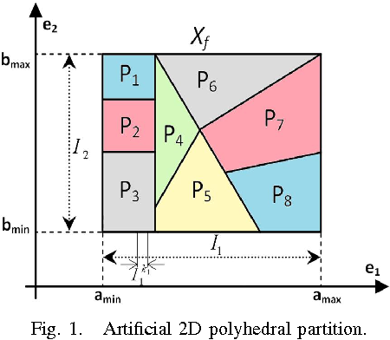
Progress Update
EMPC design
To avoid solving optimisation at every time step, MPC problem can be recast as a multi-parametric quadratic program (mpQP). The control solution is a continuous piecewise affine function in terms of state e. The parameter space of e is a convex polyhedron partitioned into N numbers of polyhedral regions
EMPC algorithm for calculating the solution has two steps
Step 1: Identify the region which contains the current state
Step 2: compute the control input from the corresponding affine function
We use MATLAB based Toolbox, MPT3 to solve the multi-parametric programming problem
https://www.mpt3.org/
The parameter space of e is partitioned into 155 regions (need to be reduced)
For illustration purposes, not the actually partion

Slide 12
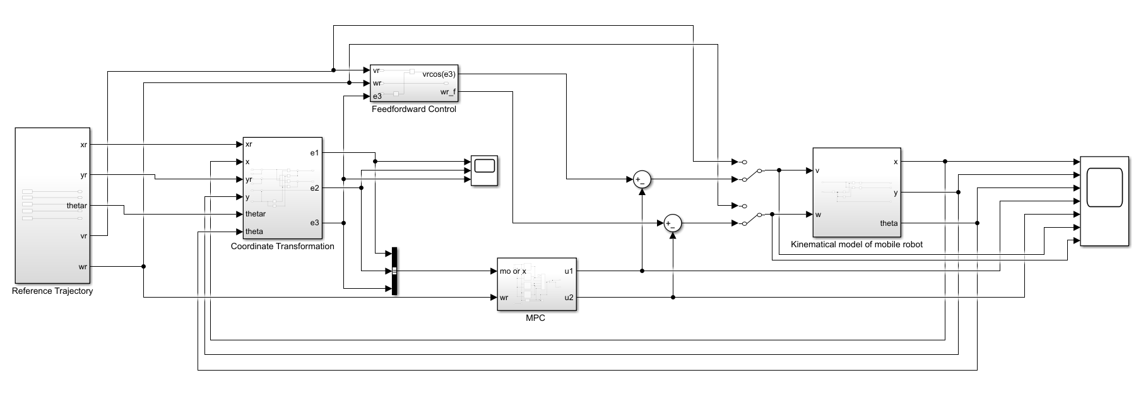
Progress Update
Overall control scheme implementation in Simulink

Slide 13
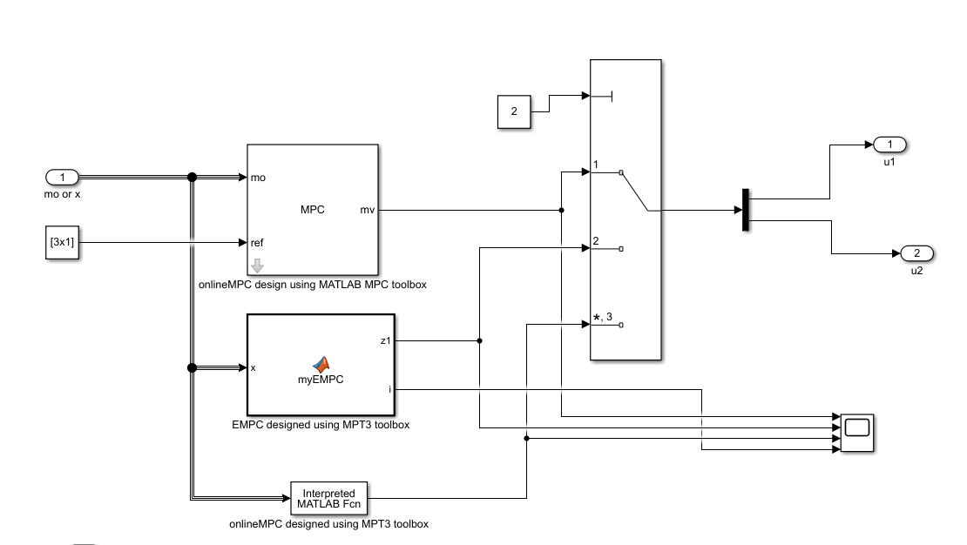
Progress Update
MPC and EMP implementation in Simulink

Slide 14
Progress Update
Results (open loop control only)
Initial state (e1 = 0, e2 = 0, e3 = 0.18)

Slide 15
Progress Update
Results (online MPC using MATLAB mpc tollbox)
Initial state (e1 = 0, e2 = 0, e3 = 0.18)

Slide 16
Progress Update
Results (EMPC designed using MPT3)
Initial state (e1 = 0, e2 = 0, e3 = 0.18)

Slide 17
Progress Update
Results (onlineMPC designed using MPT3)
Initial state (e1 = 0, e2 = 0, e3 = 0.18)

Slide 18
Next Steps
More testing and validation of MPT3 based design
Investigate the visualisation of polyhedral region
Consider how to define the control law when boundaries if violated.
Reduce the number of regions
Design a lateral motion control
Design a gain-scheduling control scheme to deal with varying wr and vr
MPC & EMPC implementation in ASLAN(open)

Slide 19
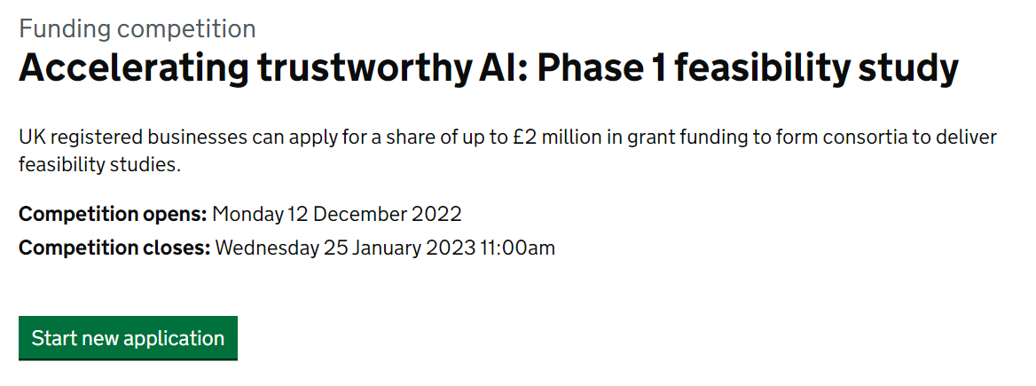
Other Activities
A coming call
https://apply-for-innovation-funding.service.gov.uk/competition/1408/overview/e8b03fe9-ca18-415a-852d-343f4231c442
Topics
Safely deploy reinforcement learning in CAV decision-making and control
Robust object detection and classification in poor weather conditions.

Slide 20
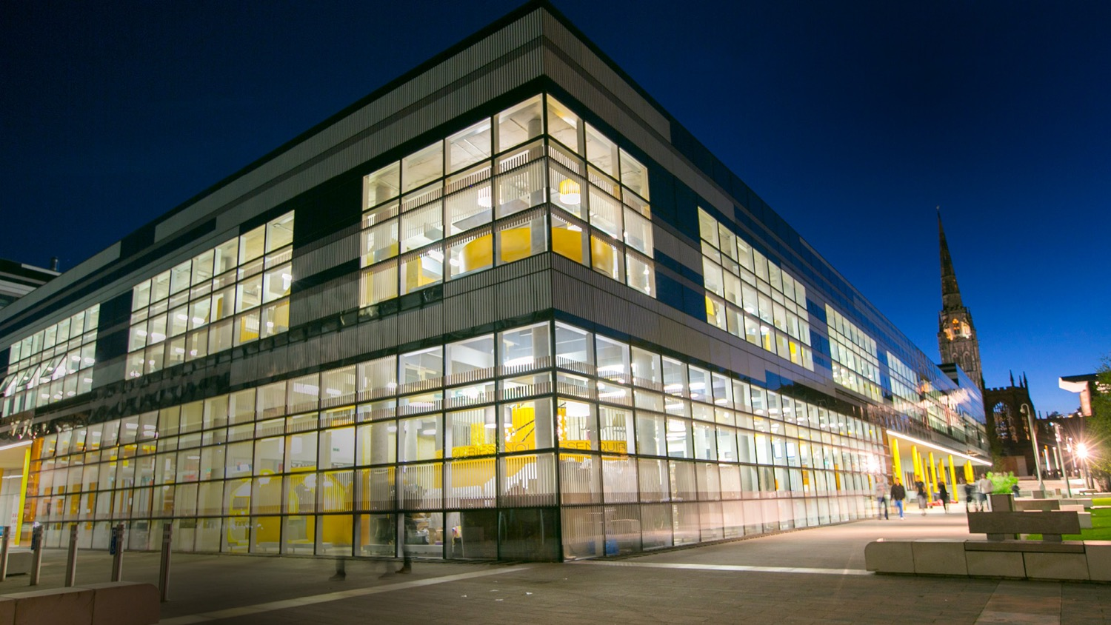
Thank you

