Slide 1


Royal Society Short Industry Fellowship
Dr Qian Lu

Slide 2
Content
Progress Update From 14/01/23 to: 03/02/23
Next Steps
Other activities

Slide 3
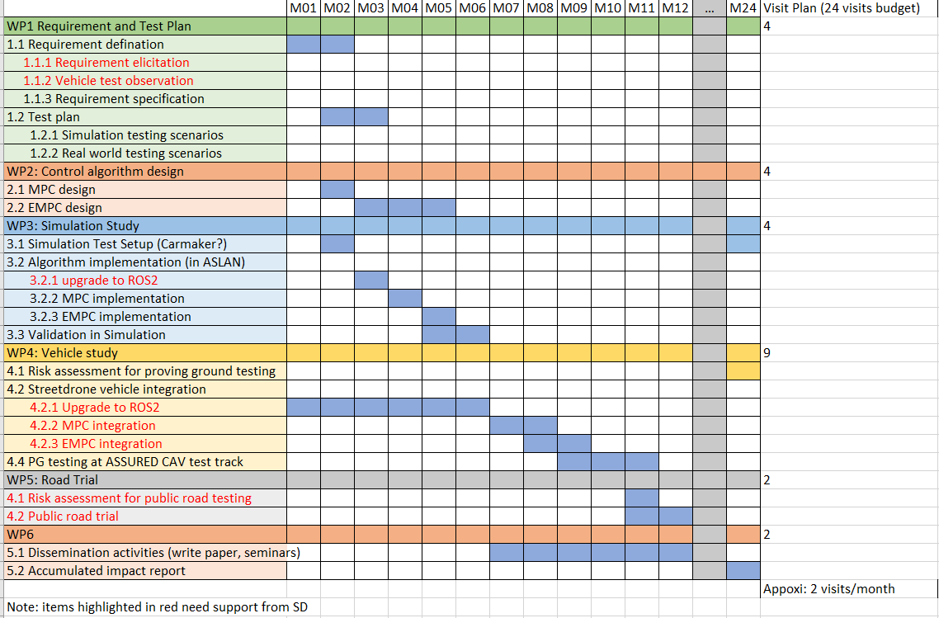
A summary of the research Project Plan
Link to the project plan document

Slide 4
Advantages of using MPC for motion control of CAV
Model predictive control (MPC) involves solving an optimization problem on demand and using the initial parts of the generated solution to plan or control the system for the next few time steps.
This technique is good for determining control inputs as it is aware of the dynamics of the modelled system, and thus can choose a control action that is optimal for not just the immediate state, but to also set up future states for success.

Slide 5
Advantages of using MPC for motion control of CAV
Model Predictive Control (MPC) has several advantages over pure pursuit when it comes to controlling autonomous vehicles. These include:
Handling of constraints: MPC can handle constraints on the vehicle's states, such as its speed and acceleration, as well as constraints on the control inputs, such as steering and throttle. Pure pursuit, on the other hand, does not have the ability to handle constraints.
Handling of dynamic environments: MPC can handle dynamic environments, such as other vehicles or obstacles, by predicting their future states and adjusting the control inputs accordingly. Pure pursuit, on the other hand, assumes that the environment is static and does not account for potential changes in the future.
Flexibility in choosing the reference trajectory: MPC allows for flexibility in choosing the reference trajectory for the vehicle to follow. Pure pursuit, on the other hand, requires that the reference trajectory be a point or a set of points.
Handling of nonlinear systems: MPC can handle nonlinear systems, such as those that describe the dynamics of an autonomous vehicle, by using a linearized model of the system in the optimization problem. Pure pursuit is typically limited to linear systems.
Handling of multi-objective: MPC can handle multiple objectives, such as minimizing fuel consumption while ensuring safety and comfort. Pure pursuit, on the other hand, typically has a single objective, such as minimizing the distance to a reference point.

Slide 6
Limitations of Online MPC
Solving optimization problems in real-time
Lack of reliable real-time optimisation solvers meeting safety requirements of Level 4 autonomous vehicle.

Slide 7
How to resolve reliable issue of online MPC
The real-time issue in online MPC can be resolved in several ways:
Using a fast optimization algorithm: Online MPC requires solving a optimization problem in real-time, which can be computationally demanding. To overcome this, companies may use fast optimization algorithms, such as Interior Point Method (IPM) or Sequential Quadratic Programming (SQP), which can solve the optimization problem quickly.
Using a simplified model of the system: Online MPC requires a model of the system that describes its dynamics. To reduce the computational burden, companies may use a simplified model that captures the essential dynamics of the system but is computationally less demanding.
Using parallel computation: To reduce the computation time, companies may use parallel computation, such as Graphic Processing Units (GPUs) or Field-Programmable Gate Array (FPGA) to speed up the computation process.
Model Predictive Control with receding horizon: Using receding horizon MPC, it allows the optimization problem to be solved over a shorter time horizon, which reduces the computation time and makes the control system more responsive.
Pre-computing and storing the solutions of the optimization problem: A company could pre-compute the solutions of the optimization problem for a range of possible initial conditions, and store them in a lookup table. This allows the control system to quickly look up the solution for the current initial condition, rather than having to solve the optimization problem in real-time.

Slide 8
Other potential solutions for resolving the reliability issue of online MPC
There are several optimization solvers that are capable of solving the Model Predictive Control (MPC) problem in real-time and can meet the safety requirements of level 4 autonomous vehicles. These solvers are based on different optimization algorithms and can be divided into three main categories:
Interior Point Methods (IPM): these are optimization algorithms that are based on the theory of convex optimization and are known for their fast convergence and robustness to ill-conditioned problems. Interior Point Methods are suitable for problems with a large number of variables and constraints and are widely used in MPC for autonomous vehicles.
Sequential Quadratic Programming (SQP): these are optimization algorithms that are based on the theory of nonlinear optimization and are known for their ability to handle nonlinear constraints and objectives. SQP methods are suitable for problems with a moderate number of variables and constraints and are widely used in MPC for autonomous vehicles.
Real-time Iterative Linear Quadratic Regulator (iLQR): these are optimization algorithms that are based on the theory of optimal control and are known for their ability to handle nonlinear dynamics and constraints. iLQR methods are suitable for problems with a moderate number of variables and constraints and are widely used in MPC for autonomous vehicles.

Slide 9
Requirements of vehicle motion control
Requirement relating to safe navigation at low speed (<=30mph) and high speed(>30mph)
The controller's responsibility for safe maneuvering then boils down to the following use case:
Given a set of inputs, the controller must be able to achieve the specified sequence of dynamic states with a bounded level of error
More specifically, given that a reference trajectory is a sequence of time-indexed dynamic states (e.g. poses, velocities, accelerations), the controller must be able to generate a series of actuation commands such that at each time step, the vehicle's actual dynamic state is within some error bound with respect to the reference dynamic state.
The dynamic state is assumed to have at least the following properties:
Position (at least x, y)
Velocity (at least longitudinal and lateral)

Slide 10
Runtime evaluation
Method 1:
start_time = clock;
my_computation;
runtime = etime(clock, start_time)
The time is different every time, sometime online is higher than explicit, sometime not. Need to evaluate based on fixed allocated resources.
Method 2:
https://uk.mathworks.com/matlabcentral/answers/1796810-mpc-toolbox-computation-time

Slide 11
Reduce number of regions
A number of factors influence the number of regions
Increasing the sampling time can reduce the regions
Reduce the prediction horizon can reduce the regions
Low number of constraints results in low number of regions
…

Slide 12
Start with a lateral control
Lateral control only generates steering angle command to regulate y and psi
Explore Autoware.auto implementation of this

Slide 13
Autoware.Auto MPC implementation for lateral control
Three different models
Kinematic with no delay
Kinematic model with 1-st order delay
Dynamics model
Reference for the models
https://www.ri.cmu.edu/pub_files/2009/2/Automatic_Steering_Methods_for_Autonomous_Automobile_Path_Tracking.pdf

Slide 14
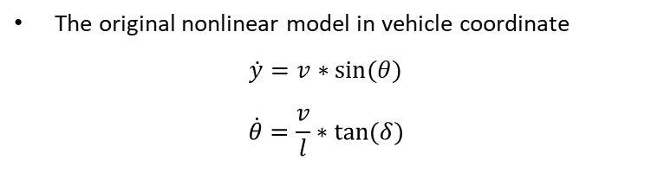
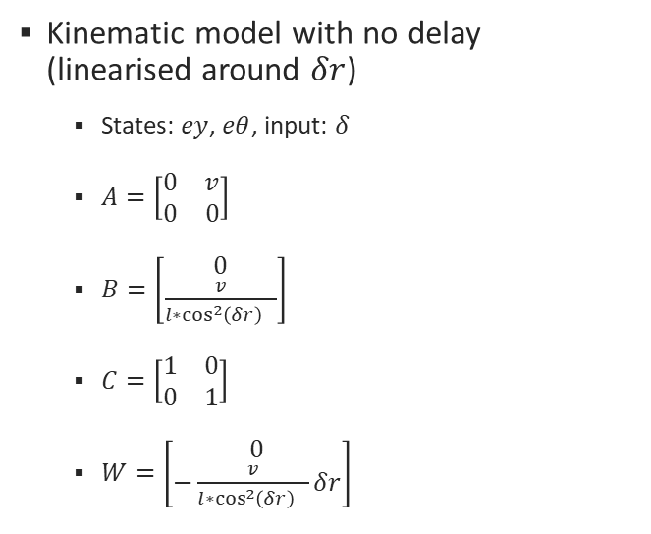
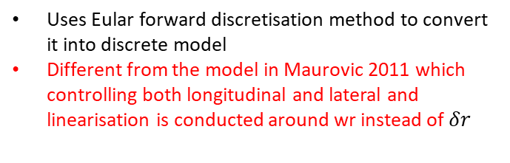
Autoware.Auto MPC implementation for lateral control Kinematic with no delay
Kinematic model with no delay (linearised around $δr$)
States: $ey$, $eθ$, input: $δ$
$A=\left[\begin{matrix}0 & v \\ 0 & 0\end{matrix}\right]$
$B=\left[\begin{matrix}0 \\ \frac{v}{l∗{\cos^{2}\left(δr\right)}^{}}\end{matrix}\right]$
$C=\left[\begin{matrix}1 & 0 \\ 0 & 1\end{matrix}\right]$
$W=\left[\begin{matrix}0 \\ −\frac{v}{l∗{\cos^{2}\left(δr\right)}^{}}δr\end{matrix}\right]$
The original nonlinear model in vehicle coordinate
$$\dot{y}=v∗sin⁡(θ)$$
$$\dot{θ}=\frac{v}{l}∗tan⁡(δ)$$
Uses Eular forward discretisation method to convert it into discrete model
Different from the model in Maurovic 2011 which controlling both longitudinal and lateral and linearisation is conducted around wr instead of $δr$

Slide 15

Autoware.Auto MPC implementation for lateral control Kinematic with with 1st order delay
Kinematic model with 1st order delay (linearised around $δr$)
States: $ey$, $eθ$, $\dot{eθ}$, input: $δ$
$A=\left[\begin{matrix}0 & v & 0 \\ 0 & 0 & \frac{v}{l∗{\cos^{2}\left(δr\right)}^{}} \\ 0 & 0 & −\frac{1}{τ}\end{matrix}\right]$
$B=\left[\begin{matrix}0 \\ 0 \\ \frac{1}{τ}\end{matrix}\right]$
$C=\left[\begin{matrix}1 & 0 & 0 \\ 0 & 1 & 0\end{matrix}\right]$
$W=\left[\begin{matrix}0 \\ −v∗Κ+\frac{v}{l}∗(tan\left(δr\right)−\frac{δr}{\cos^{2}\left(δr\right)} \\ 0\end{matrix})\right]$
Uses bilinear discretisation approach to convert it into a discrete model

Slide 16

Autoware.Auto MPC implementation for lateral control Dynamic model
States: $ey$, $\dot{ey}$, $eθ$, $\dot{eθ}$, input: $δ$
$A= \left[\begin{matrix}0 & 1 & 0 & 0 \\ 0 & −\frac{cf+cr}{m∗v} & \frac{cf+cr}{m} & −\frac{lf∗cf−lr∗cr}{m∗v} \\ 0 & 0 & 0 & 1 \\ 0 & −\frac{lf∗cf−lr∗cr}{Iz∗v} & \frac{lf∗cf−lr∗cr}{Iz} & −\frac{lf^{2}∗cf+lr^{2}∗cr}{Iz∗v}\end{matrix}\right]$
$B= \left[\begin{matrix}0 \\ \frac{cf}{m} \\ 0 \\ \frac{lf∗cf}{Iz}\end{matrix}\right]$
$C=\left[\begin{matrix}1 & 0 & 0 & 0 \\ 0 & 0 & 1 & 0\end{matrix}\right]$
$W= \left[\begin{matrix}0 \\ −\frac{lf∗cf−lr∗cr}{m∗v}−v \\ 0 \\ −\frac{lf^{2}∗cf+lr^{2}∗cr}{Iz∗v}\end{matrix}\right]∗v∗Κ$
Uses bilinear discretisation approach to convert it into a discrete model
This model is same as paper Lee 2018

Slide 17
Autoware.Auto MPC implementation for lateral control Constraints
Option1: No constraints
Option 2: Constraints on steering <+/-35degree

Slide 18
Autoware.Auto MPC implementation for lateral control QP Solver
Unconstraint-fast
QSQP for constraints
Link for QSQP library; https://osqp.org/

Slide 19
Validate Dynamic Model-Based Control in MATLAB/Simulink
Three controllers implemented in MATLAB
For speed = 10m/s, Ts = 0.05s, Prediction Horizon = 4.
Controller 1: An Online MPC using QSPQ solver
Controller 2: An Explicit MPC solved using MPT3 toolbox
Controller 3: An LQR controller designed using MATLAB
Number of regions of Explicit MPC
Constraints in all states: 441
Constraints on lateral error and heading error only: 283
Runtime (for 441 regions)
Online MPC: average 0.15s for 100 iterations simulation
Explicit MPC: average 0.07s for 100 iteration simulation

Slide 20
Validate Dynamic Model-Based Control in MATLAB/Simulink
Identical Performance between Online and Explicit MPC， very similar between LQR and Online MPC.

Slide 21
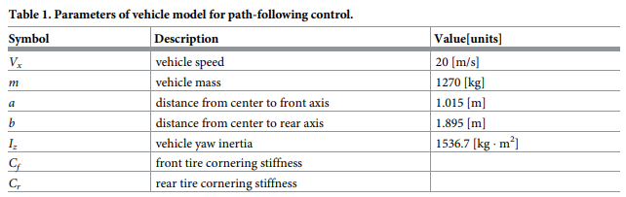
Questions
Is there some way we can know the model parameters of streetdrone vehicle?

Slide 22
Next Steps
MPC & EMPC implementation in ASLAN(open)
Evaluate the computing time and storage of EMPC and MPC after implementation in ASLAN
Possibly explore methods to reduce the number of regions of EMPC (to reduce compute time and storage)
Explore the approach for developing an EMPC for a range of vehicle speed
EMPC for LPV system: https://yalmip.github.io/example/explicitlpvampc/

Slide 23
Other Activities

Slide 24
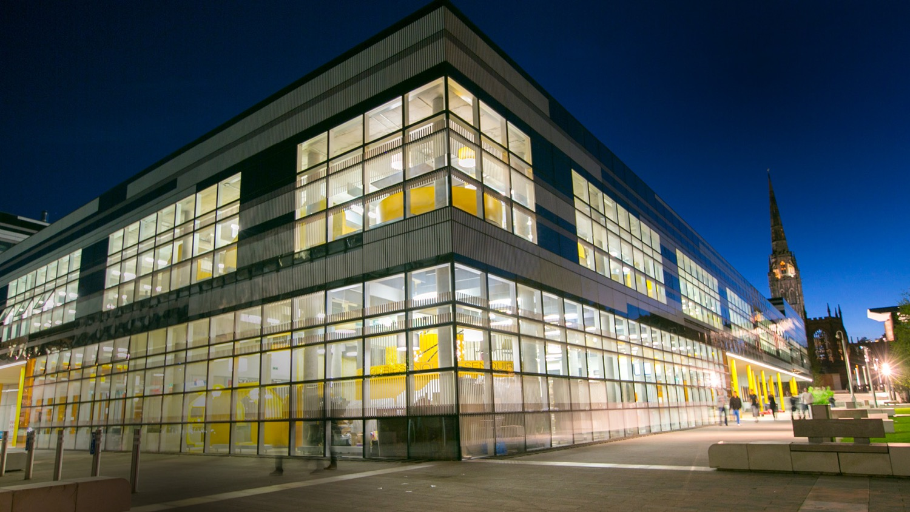
Thank you

