Slide 1
Royal Society Industrial Fellowship
Progress Update – 17 March 2023
- Autoware.AI MPC integration

Slide 2
Autoware.AI MPC controller Integration
At this stage, I was focusing on integrate Autoware.AI MPC into ASLAN stack. The following are the steps for this integration

Slide 3
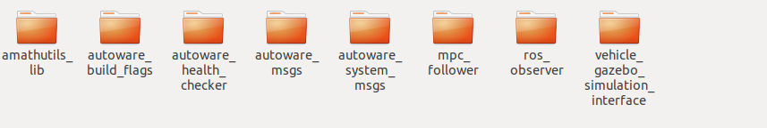
Packages Integrated
List of packages needed
1. MPC_follower:
Download from repository: https://github.com/autowarefoundation/autoware_ai_planning
2. MPC_follower dependencies:
These dependencies packaged can be downloaded from repository: https://github.com/orgs/autowarefoundation/repositories
3. You will also need solver package ‘qpoases_vendor’ which is a ros built in package. Use command line rosdep install <stacks-and-packages>...To download and install the dependencies of a given package or packages.

Slide 4
Messages Replaced
The autoware messages are used by mpc_follower. However they are the same messages as aslan messages. Therefore, I have replace them with aslan messages, see the followings
1. packageautoware_msg::Lane →aslan_msg::Lane
2. autoware_msgs::ControlCommandStamped→aslan_msgs::ControlCommandStamped
3. Another message autoware_msgs: VehicleStatus are used in mpc_follower package, however it doesn’t exist in aslan_msgs, need to create this message in aslan_msgs and then remove the dependency on autoware_msgs (TODO). Node vehicle_gazebo_info_publisher.cpp published a topic output_vehicle_status in message type autoware_msgs. This topic contain the vehicle steering information which is needed for mpc_follower package.

