Slide 1
Royal Society Short Industrial Fellowship
Progress Update – 19 April 2023
- MIRA test track simulation model
- Replace Lidar based Localisation with simulation ground truth

Slide 2
MIRA test track simulation model
1. Use the method from this link to convert OpenStreetMap (.OSM) to Gazebo World
https://pixllab.github.io/URSDocumentation/welcome/notes/2020/11/15/Gazebo-Map-Making.html
Step 1: Use osm2world tool to convert 3D models of the world (.obj files) from OpenStreetMap data
https://osm2world.org/
Step 2: Open OBJ files in blender and edit it and save the 3D model as .dae files
Step 3: Added the 3D model to local directory of gazebo models
- Create a new directory for the new model in models directionary of gazebo.
- Inside a directory inside named “meshes” and place .dae file inside meshed directory
- Create model.config and model.sdf files
2. Another tool for importing OpenStreetMap into Blender to create 3D model
https://prochitecture.gumroad.com/l/blender-osm

Slide 3
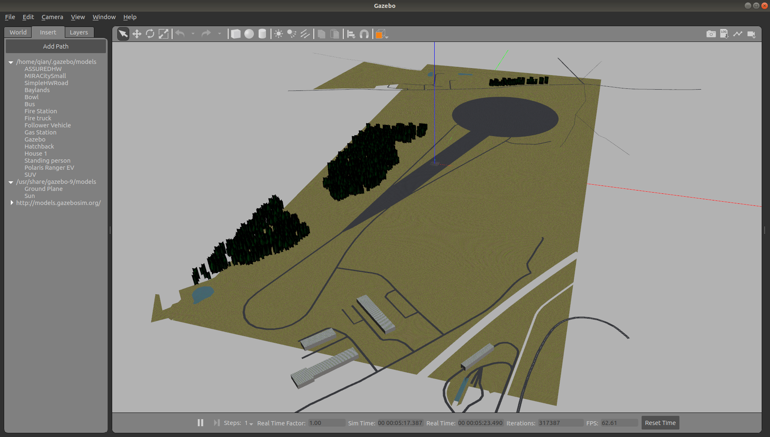
MIRA Test Track 1: ASSURED CAV Highway Circuit

Slide 4
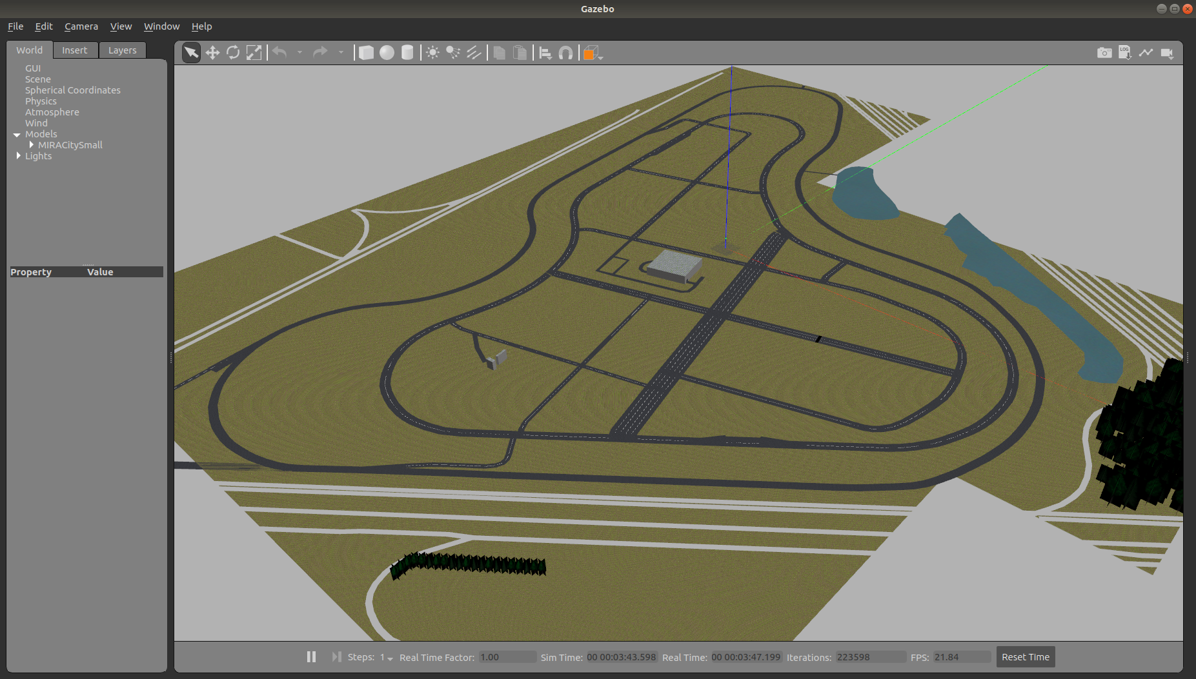
MIRA Test Track 2: ASSURED CAV City Circuit

Slide 5
Replace output of ndt_matching localisation with gazebo ground truth
1. Motion contoller (PP and MPC) subscribes to topics /current_pose and /current__velocity published from node /ndt_matching Instead of using node /ndt_matching, I let the the simulation interface node /vehicle_gazebo_info_publisher to publish the vehicle pose and velocity info into /current_pose and /current_velocity respectively.
This is done by change two topics names from gazebo_vehicle/pose and gazebo_vehicle/twist to / currrent_pose and /current_velocity.
2. Create and publish tf between world, map and baselink
Node vehicle_gazebo_simulation_interface need to launch and the parameter enable_base_link_tf will be set to true. In such way, this node will publish tf from world to map, map to baselink.
3. Errors fixing in simulation interface node /vehicle_gazebo_info_publisher
The following two places in file vehicle_gazebo_info_publisher are modified to match the names in streetdrone_model’ such that the vehicle pose and velocity are published properly
pnh_.param("ns", ns_, std::string("sd_twizy"));
if (input_msg->name.at(i) == std::string("front_right_steer_joint"))
steering_right_front_angle = input_msg->position.at(i);
if (input_msg->name.at(i) == std::string("front_left_steer_joint"))
steering_left_front_angle = input_msg->position.at(i);
if (input_msg->name.at(i) == std::string("rear_right_wheel_joint"))
wheel_right_rear_vel = input_msg->velocity.at(i);
if (input_msg->name.at(i) == std::string("rear_left_wheel_joint"))
wheel_left_rear_vel = input_msg->velocity.at(i);

