Slide 1
Royal Society Short Industrial Fellowship Project Progess Update
Update at 03 May 2023
- Lane change test case design
- Lane change trajecotries implementation
- Investigation of PP and MPC implementation
- Plot and compare the results of pp, mpc (different versions)
- Tuning guidance

Slide 2
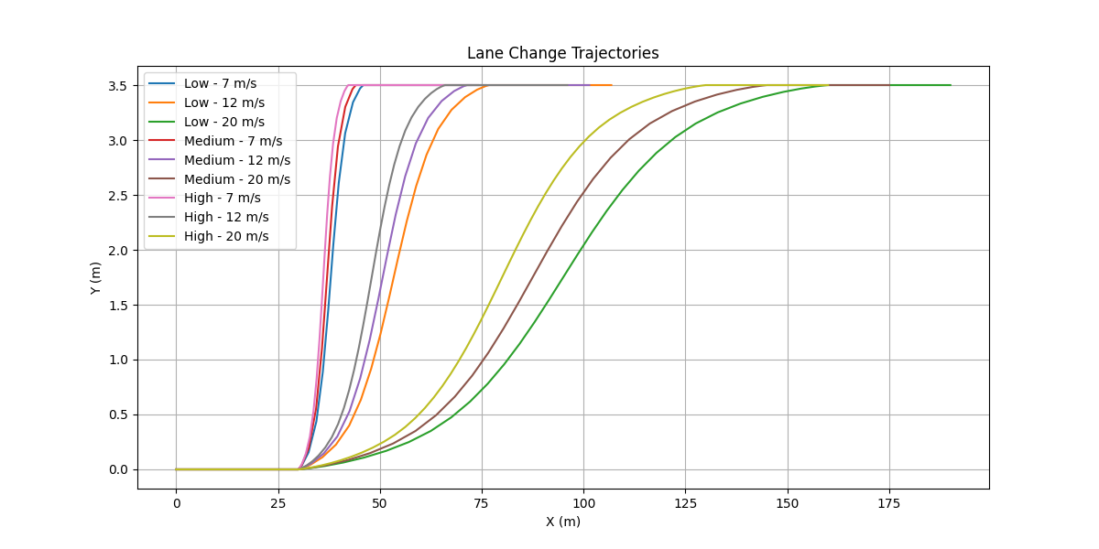
Lane change test case design
Design lane change trajecotries at different level of urgency at different speeds

Slide 3
Lane change trajecotries implementation
Implement a python script ‘lane_change_trajectory_generator.py’ to generate different lane change trajectories and save the trajetory in csv files
The csv file can be load by ‘way_point_loader’

Slide 4
Model parameters update
Model parameters | Description | Original value | Update value
vehicle_model_wheelbase | wheel base length [m] | 2.79 | 1.69
mass_fl | mass applied to front left tire [kg] | 600 | 108.75
mass_fr | mass applied to front right tire [kg] | 600 | 108.75
mass_rl | mass applied to rear left tire [kg] | 600 | 108.75
mass_rr | mass applied to rear right tire [kg] | 600 | 108.75
cf | front cornering power [N/rad] | 155494.663 | ? 30000
cr | rear cornering power [N/rad] | 155494.663 | ? 30000
vehicle_model_steer_tau | steering dynamics time constant (1d approximation) for vehicle model [s] | 0.3
steer_lim_deg | steering angle limit for vehicle model [deg]. This is also used for QP constraint. | 40
steering_gear_ratio | steering gear ratio | 20 (not used)
Cf and Cr tuning: Tuned by finding a set of desired weights for kinemtic model and apply the weight to dynamic and then found that the controller become oscillating, and then tune the cr and cr to make least osillating

Slide 5
MPC controller parameters tuning
MPC Parameters | Description | Original Value | Updated Value
mpc_prediction_horizon | prediction horizon step | 70
mpc_prediction_sampling_time | prediction horizon period [s] | 0.1s
mpc_weight_lat_error | lateral error weight in matrix Q | 0.1 | 0.3
mpc_weight_heading_error | heading error weight in matrix Q | 0
mpc_weight_heading_error_squared_vel_coeff | heading error * velocity weight in matrix Q | 0.3 | 0.0
mpc_weight_steering_input | steering error weight in matrix R | 1
mpc_weight_steering_input_squared_vel_coeff | steering error * velocity weight in matrix R | 0.25
mpc_weight_lat_jerk | lateral jerk weight in matrix R | 0
mpc_weight_terminal_lat_error | terminal lateral error weight in matrix Q to improve mpc stability | 1.0
mpc_weight_terminal_heading_error | terminal heading error weight in matrix Q to improve mpc stability | 0.1
mpc_zero_ff_steer_deg | threshold that feed-forward angle becomes zero | 2
qp_solver_type | optimization solver type. option is unconstraint_fast, unconstraint, and qpoases_hotstart | unconstraint_fast
qpoases_max_iter | max iteration number for quadratic programming | 500
vehicle_model_type | vehicle model type for mpc prediction. option is kinematics, kinematics_no_delay, and dynamics | kinematics

Slide 6
Other system parameters
Parameters | Description | Original Value | Updated Value
ctrl_period | control period [s] | 0.03
traj_resample_dist | distance of waypoints in resampling [m] | 0.1
enable_yaw_recalculation | flag for recalculation of yaw angle after resampling | true
enable_path_smoothing | path smoothing flag. This should be true when uses path resampling to reduce resampling noise. | true
path_smoothing_times | number of times of applying path smoothing filter | 1
path_filter_moving_ave_num | number of data points moving average filter for path smoothing | 35
curvature_smoothing_num | point-to-point index distance used in curvature calculation : curvature is calculated from three points p(i-num), p(i), p(i+num) | 35
steering_lpf_cutoff_hz | cutoff frequency of lowpass filter for steering output command [hz] | 3.0
admisible_position_error | stop vehicle when following position error is larger than this value [m]. | 5
admisible_yaw_error_deg | stop vehicle when following yaw angle error is larger than this value [deg]. | 90

Slide 7
Topics to log for analysis
/ctrl_cmd: command steering angle in degree
/current_pose: x, y
/current_velocity: actual velocity
/sd_control: commad steering in perceptage
/twist_cmd: filtered command linear and angular velocity
/twist_raw: unfilter command linear and angular velocity
/vehicle_status
A python script is created to plot the logged data for visualise and compare the results

Slide 8
How to tune MPC parameters
Set appropriate vehicle kinematics parameters for distance to front and rear axle, and steer_lim_deg. Also check that the input VehicleKinematicState has appropriate values (speed: vehicle rear-wheels-center velocity [km/h], angle: steering (tire) angle [rad]). These values give a vehicle information to the controller for path following. Errors in these values cause fundamental tracking error.
Set appropriate vehicle dynamics parameters of steering_tau, which is the approximated delay from steering angle command to actual steering angle.
Set weight_steering_input = 1.0, weight_lat_error = 0.1, and other weights to 0. If the vehicle oscillates when driving with low speed, set weight_lat_error smaller.
Adjust other weights. One of the simple way for tuning is to increase weight_lat_error until oscillation occurs. If the vehicle is unstable with very small weight_lat_error, increase terminal weight : weight_terminal_lat_error and weight_terminal_heading_error to improve tracking stability. Larger prediction_horizon and smaller prediction_sampling_time is effective for tracking performance, but it is a trade-off between computational costs. Other parameters can be adjusted like below.
weight_lat_error: Reduce lateral tracking error. This acts like P gain in PID.
weight_heading_error: Make a drive straight. This acts like D gain in PID.
weight_heading_error_squared_vel_coeff : Make a drive straight in high speed range.
weight_steering_input: Reduce oscillation of tracking.
weight_steering_input_squared_vel_coeff: Reduce oscillation of tracking in high speed range.
weight_lat_jerk: Reduce lateral jerk.
weight_terminal_lat_error: Preferable to set a higher value than normal lateral weight weight_lat_error for stability.
weight_terminal_heading_error: Preferable to set a higher value than normal heading weight weight_heading_error for stability.

Slide 9
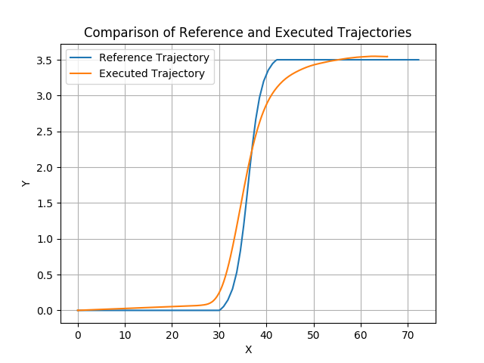
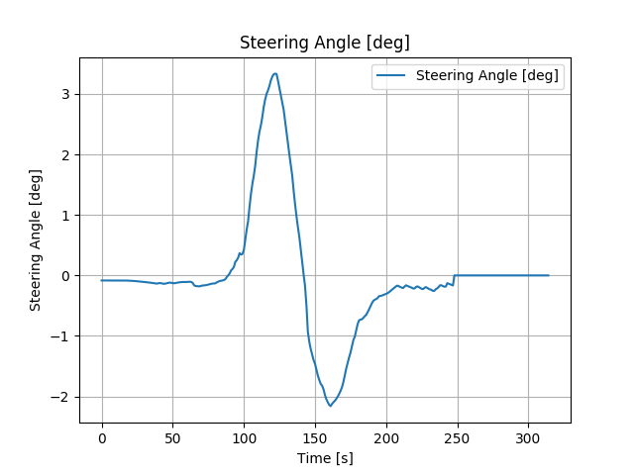
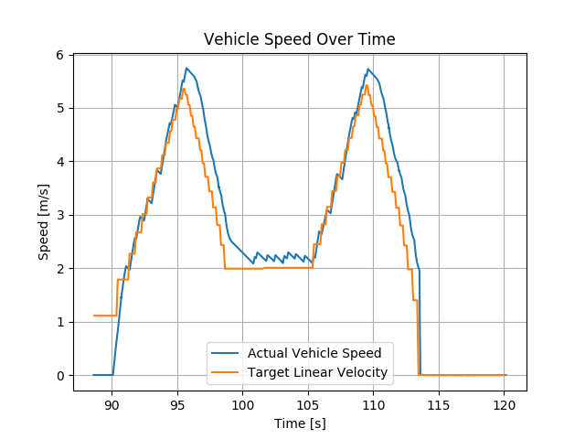
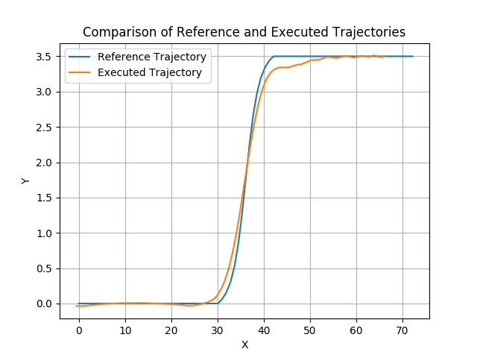
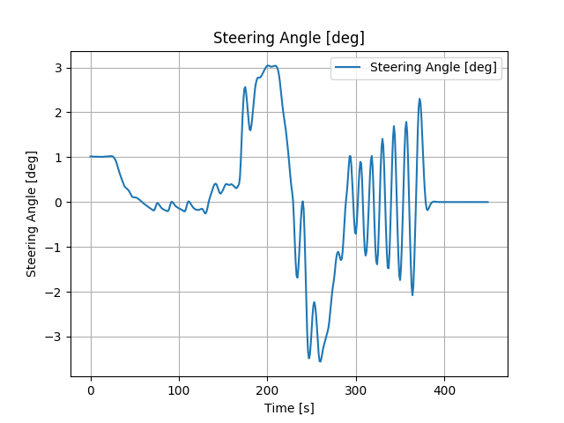
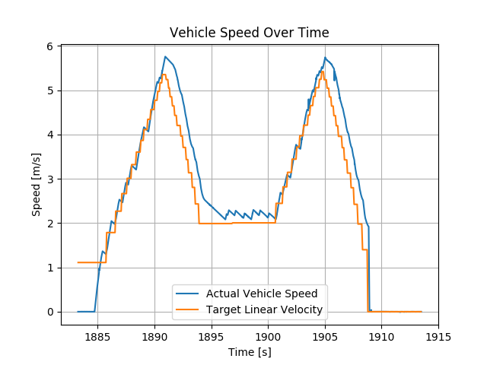
Simulation Results: 7m/s high urgency
mpc_weight_lat_error = 0.3, mpc_weight_steering_input = 1, mpc_weight_steering_input_squared_vel_coeff =0.25
PP
PP
MPC_kinematic

Slide 10
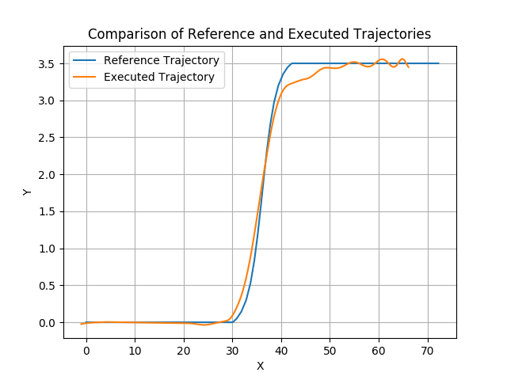
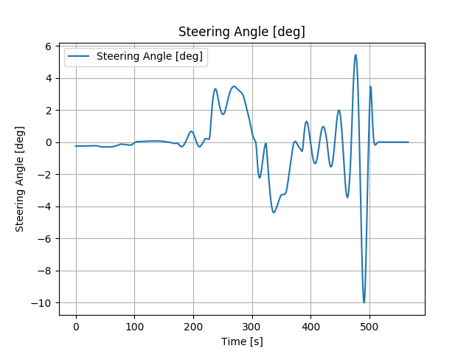
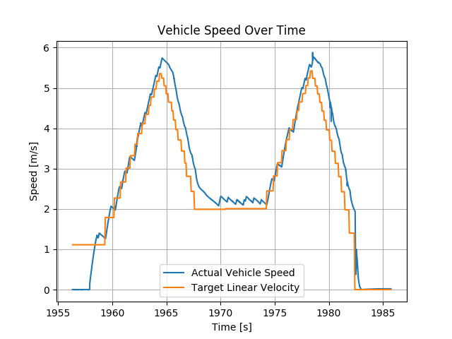
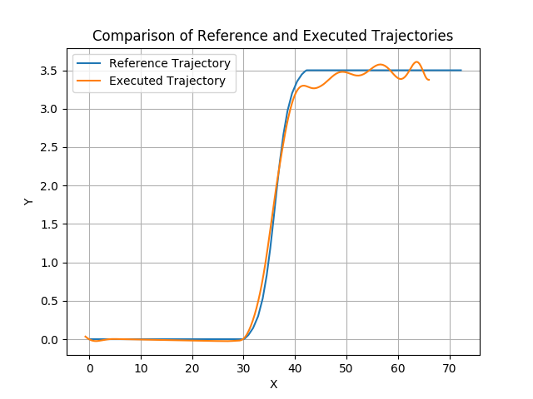
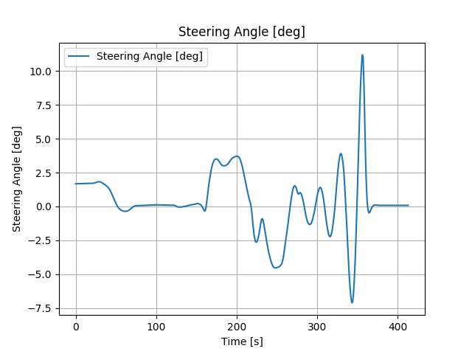
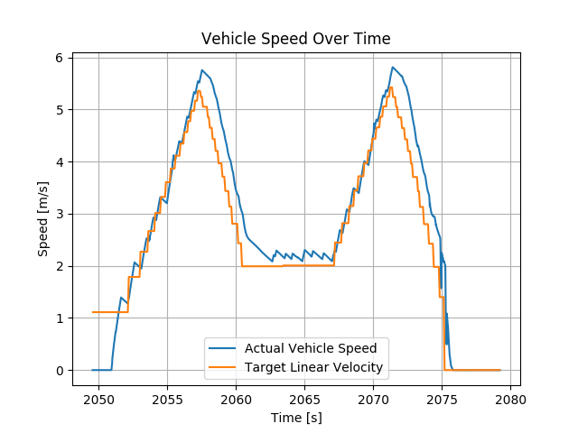
Simulation Results: 7m/s high urgency
mpc_weight_lat_error = 0.3, mpc_weight_steering_input = 1, mpc_weight_steering_input_squared_vel_coeff =0.25
MPC_kinemetic_nodelay
MPC_dynamic

Slide 11
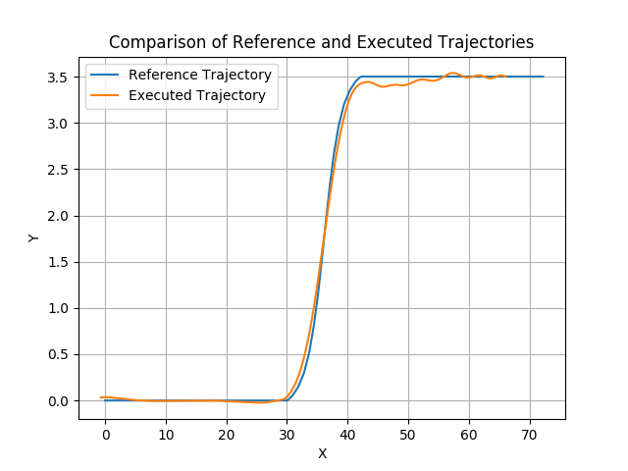
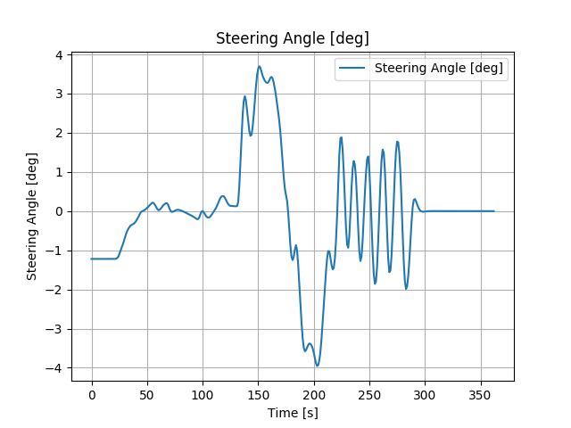
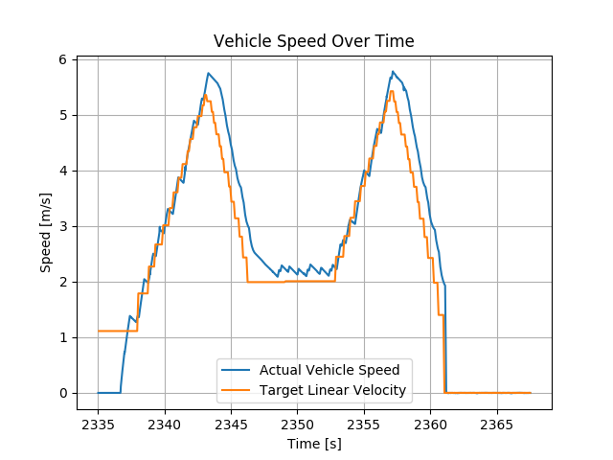
Simulation Results: 7m/s high urgency
mpc_weight_lat_error = 0.3, mpc_weight_steering_input = 1, mpc_weight_steering_input_squared_vel_coeff =0.25
MPC_dynamics_with_delay

Slide 12
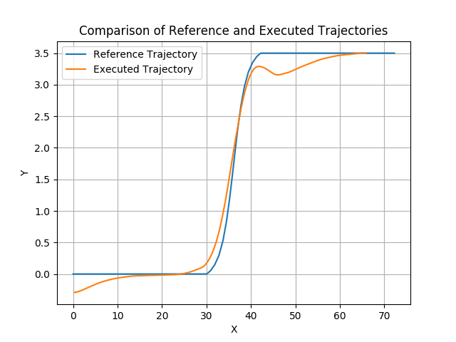
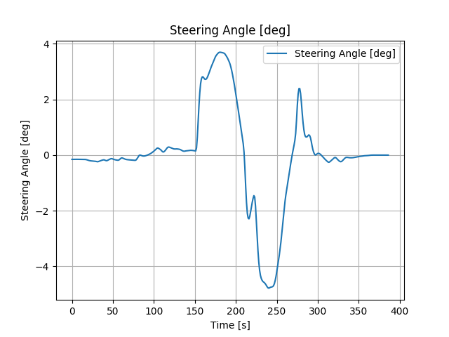
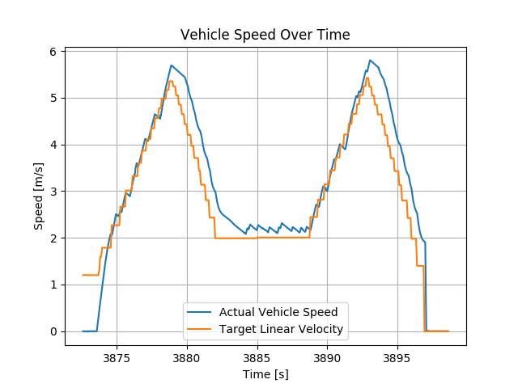
Simulation Results: 7m/s high urgency
mpc_weight_lat_error = 0.03, mpc_weight_steering_input = 1, mpc_weight_steering_input_squared_vel_coeff =0.25
PP
PP
MPC_kinematic

Slide 13
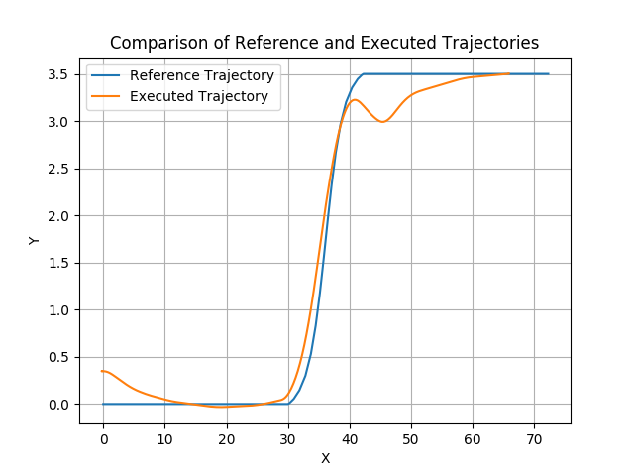
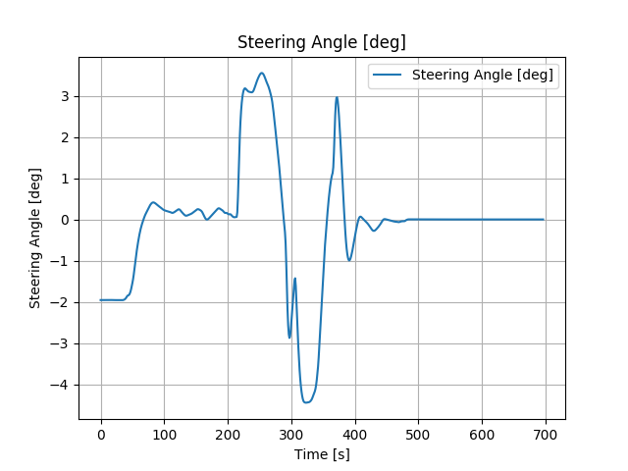
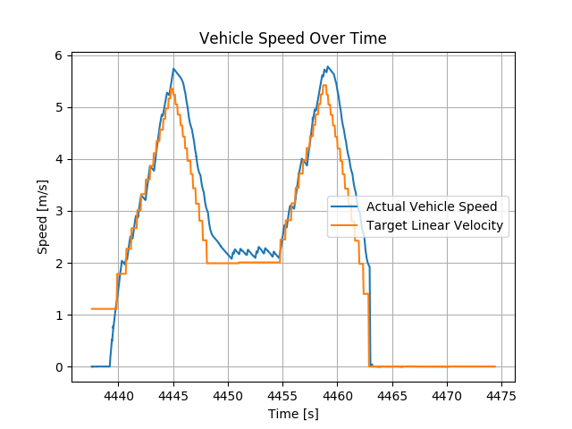
Simulation Results: 7m/s high urgency
mpc_weight_lat_error = 0.03, mpc_weight_steering_input = 1, mpc_weight_steering_input_squared_vel_coeff =0.25
MPC_kinemetic_nodelay
MPC_dynamic

Slide 14
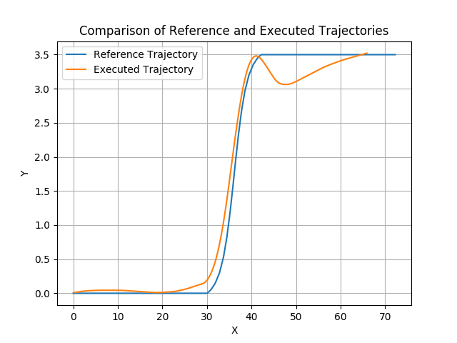
Simulation Results: 7m/s high urgency
mpc_weight_lat_error = 0.3, mpc_weight_steering_input = 100, mpc_weight_steering_input_squared_vel_coeff =0.25
PP
PP
MPC_kinematic

Slide 15

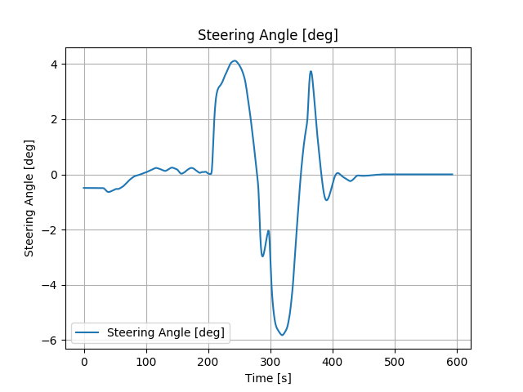
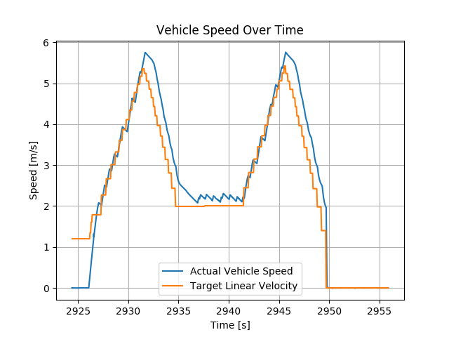
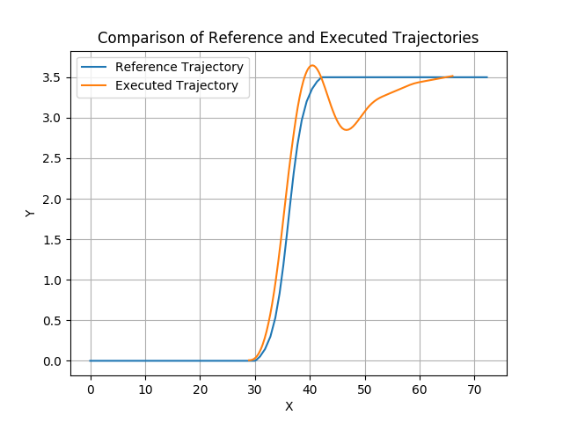
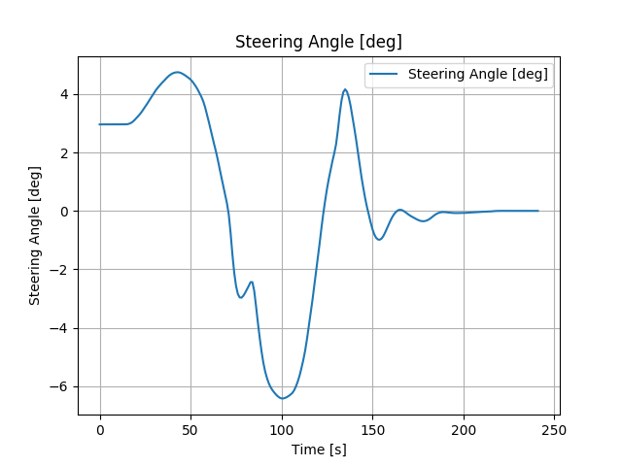
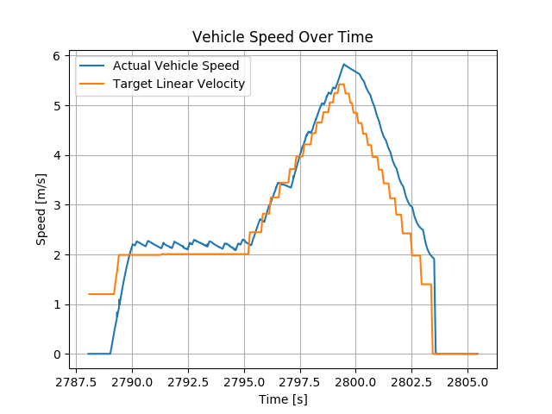
Simulation Results: 7m/s high urgency
mpc_weight_lat_error = 0.3, mpc_weight_steering_input = 100, mpc_weight_steering_input_squared_vel_coeff =0.25
MPC_kinemetic_nodelay
MPC_dynamic

Slide 16
Next Step
Steering delay has large impact, will model steering delay into dynamic model
Refine and implement explicit MPC for dynamic model with steering delay.
Compare the computation between MPC_dyn and EMPC_dyn
Others
Msc project on MPC based control for articulated vehicle
  Reverse
  Corning
  Optimisation trajoery of the trailer
Vehicle testing: purchase RTK for localisation on the test track
CI
  G test for test one function
  Unit test for function
  Launch test for integeration
  Catkin testin
  Ros test

Slide 17
Useful Command lines
rosrun vehicle_gazebo_simulation_interface vehicle_gazebo_info_publisher _enable_base_link_tf:=true
python compare_csv_rosbag_trajectories.py --csv /home/qian/Aslan/testruns/Empty/LCTrajectories/trajectory_High_7mps.csv --rosbag /home/qian/Aslan/testruns/Empty/LC_test_logs/LC_HighUrgency_7mps_MPC/LC_HighUrgency_7mps_MPC.bag --output /home/qian/Aslan/testruns/Empty/LC_test_logs/LC_HighUrgency_7mps_MPC

Slide 18
Investigation of PP and MPC implementation
purepursuit module:
Input:
Output: target linear and angluar velocity via topic/twist_raw
mpc_waypoints_converter module:
Publications:
* /mpc_waypoints [aslan_msgs/Lane]
Subscriptions:
* /base_waypoints [aslan_msgs/Lane]
* /closest_waypoint [std_msgs/Int32]
* /final_waypoints [aslan_msgs/Lane]
mpc_follower module:
Publications:
* /ctrl_raw [aslan_msgs/ControlCommandStamped]
* /twist_raw [geometry_msgs/TwistStamped]
Subscriptions:
* /current_pose [geometry_msgs/PoseStamped]
* /estimate_twist [unknown type]
* /mpc_waypoints [aslan_msgs/Lane]
* /vehicle_status [autoware_msgs/VehicleStatus]

Slide 19
Investigation of sd_vehicle_interface module
This function, CalculateTorqueRequestTwizy, calculates the required torque to achieve a given target linear velocity (TargetLinearVelocity_Mps) while considering the current linear velocity (CurrentLinearVelocity_Mps). It uses a PID controller with feedforward (FF) and anti-windup strategies to determine the appropriate torque.
This function, CalculateSteerRequest, calculates the required steering angle to achieve a given target angular velocity (TargetAngularVelocity_Dps) at a given linear speed (CurrentTwistLinear_Mps). It uses a steering angle table (steer_map) to determine the appropriate steering angle based on the inputs.

Slide 20
Investigation of mpc_follower_core.cpp
What is the difference between ctrl_period_ and xx?
Adaptive Q and R based on
  Q and R are initialized as constant weight matrices. However, they are adapted during the iteration over the prediction horizon to form Q_adaptive and R_adaptive. The adaptations made in the code are based on the reference longitudinal velocity (ref_vx) and the MPC parameters:
  For Q_adaptive, the weight for heading error is increased by the square of the reference velocity multiplied by a coefficient. If the current step is the last step of the prediction horizon (i == N - 1), the weights for terminal lateral error and terminal heading error are used instead of the regular weights.
  For R_adaptive, the weight for steering input is increased by the square of the reference velocity multiplied by a coefficient.
MPCUtils::calcNearestPoseInterp(ref_traj_, vehicle_status_.pose, nearest_pose, nearest_index, dist_err, yaw_err, nearest_traj_time)
  This code defines a function calcNearestPoseInterp() that finds the nearest pose (position and orientation) on a given trajectory (traj) to the current ego vehicle's pose (self_pose). The function interpolates between two neighboring points on the trajectory to estimate the nearest pose. It returns the nearest pose (nearest_pose), its index in the trajectory (nearest_index), the distance error (min_dist_error), the yaw error (nearest_yaw_error), and the interpolated time (nearest_time). The function returns a boolean value, which is true if the nearest pose is successfully found and false otherwise.

Slide 21
Investigation of mpc_follower_core.cpp
Steering angle limit: 40 degree

