Slide 1
Royal Society Short Industrial Fellowship Project Progess Update
Update at 03 May 2023
- Implement 1st order delay to dynamic model
- issue with steering map
- qp optimsation reformation and add constraint to lateral error
- issue with discretisation of KinematicsBicycleModel(withDelay)
- Compute EMPC in Matlab using MPT3 toolbox
- Implement EMPC into C++ and integrate into Autoware.AI mpc package

Slide 2
Implement 1st delay steering delay to dynamic model based MPC

Slide 3
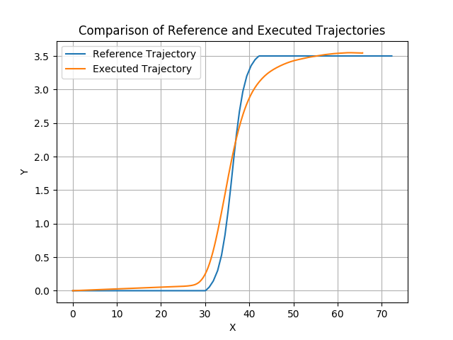
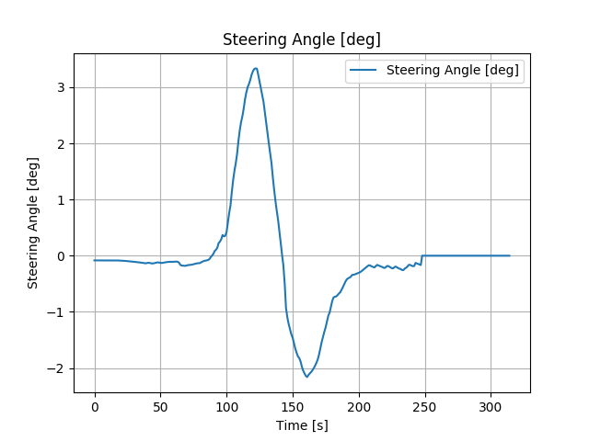
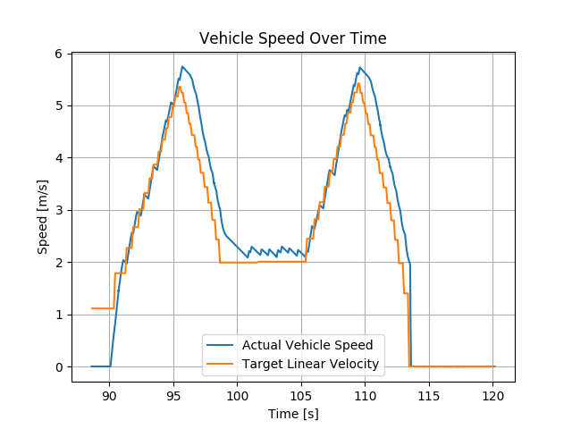
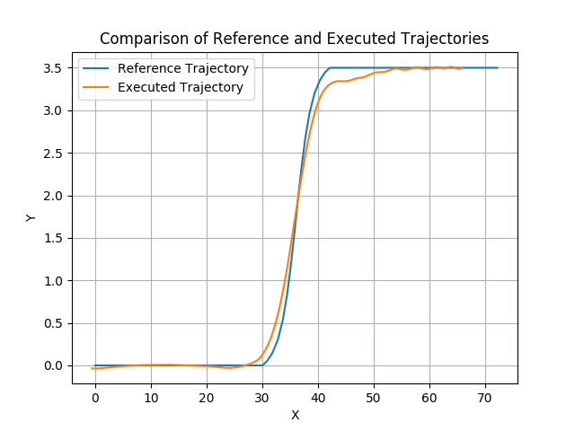
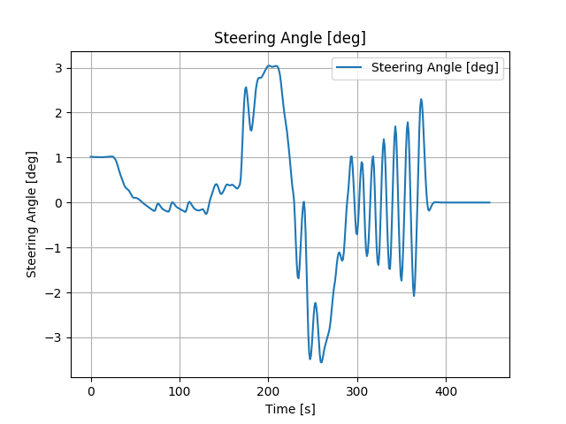
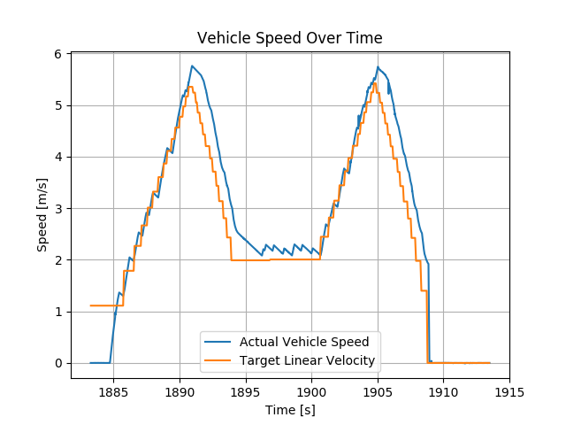
Simulation Results: 7m/s high urgency
mpc_weight_lat_error = 0.3, mpc_weight_steering_input = 1, mpc_weight_steering_input_squared_vel_coeff =0.25
PP
PP
MPC_kinematic

Slide 4
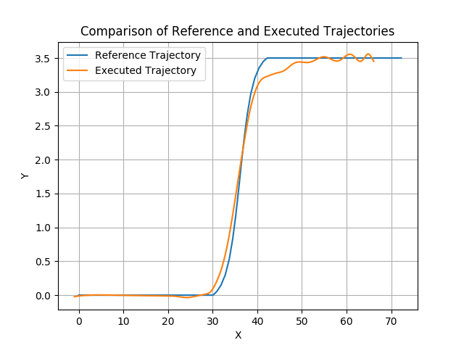
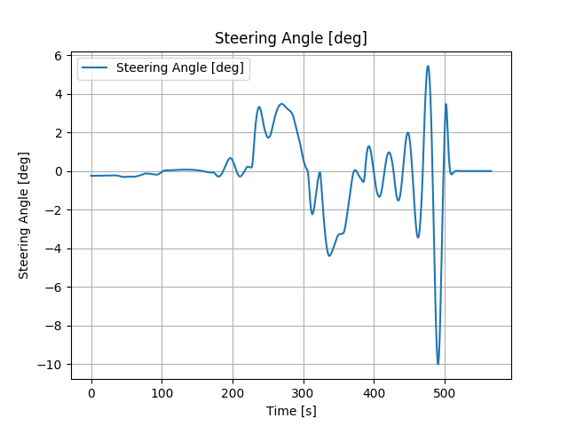
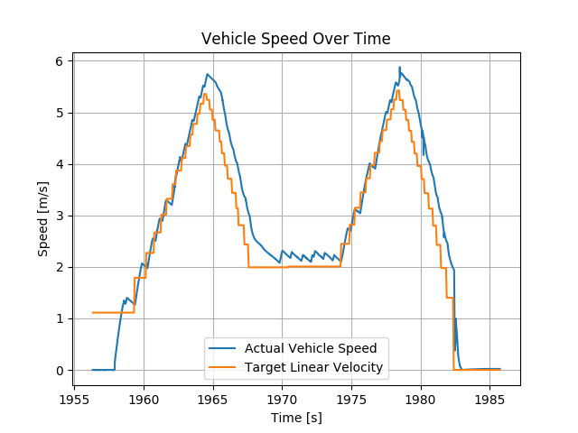
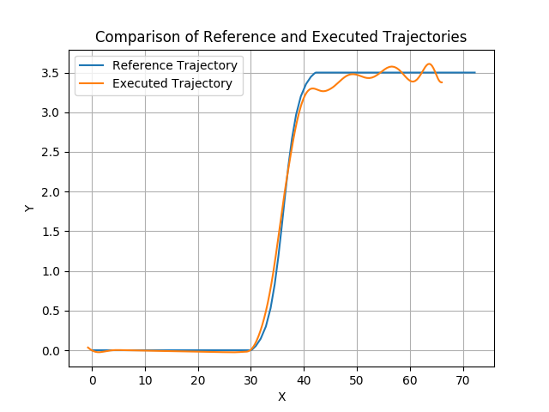
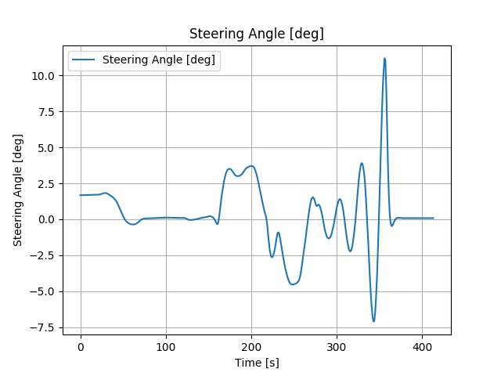
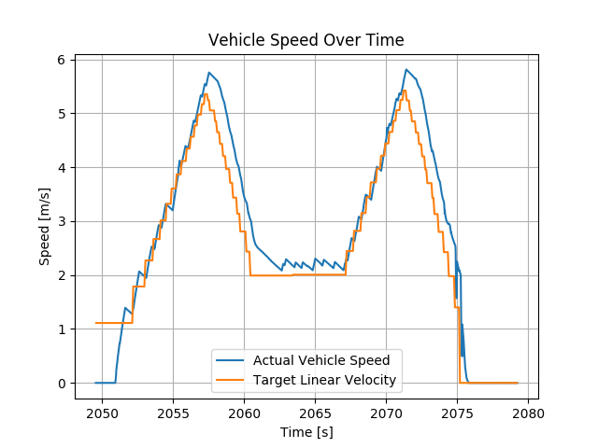
Simulation Results: 7m/s high urgency
mpc_weight_lat_error = 0.3, mpc_weight_steering_input = 1, mpc_weight_steering_input_squared_vel_coeff =0.25
MPC_kinemetic_nodelay
MPC_dynamic

Slide 5
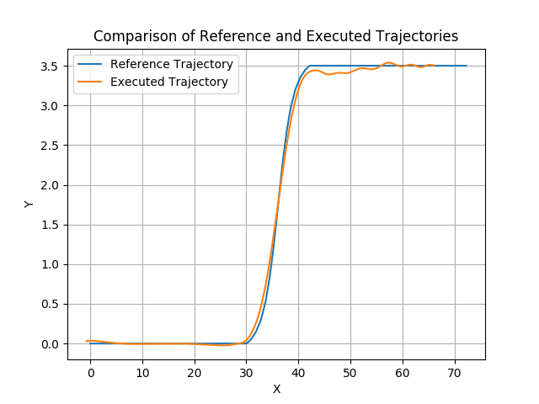
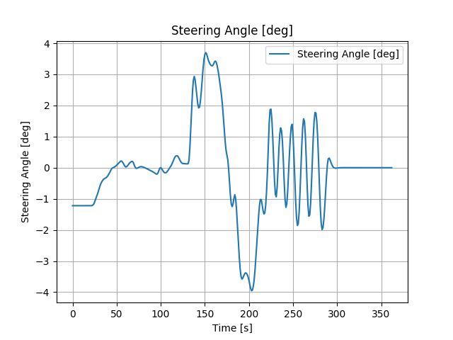
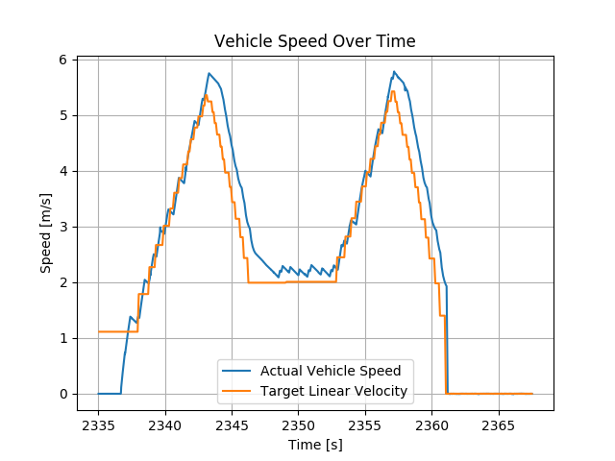
Simulation Results: 7m/s high urgency
mpc_weight_lat_error = 0.3, mpc_weight_steering_input = 1, mpc_weight_steering_input_squared_vel_coeff =0.25
MPC_dynamics_with_delay

Slide 6
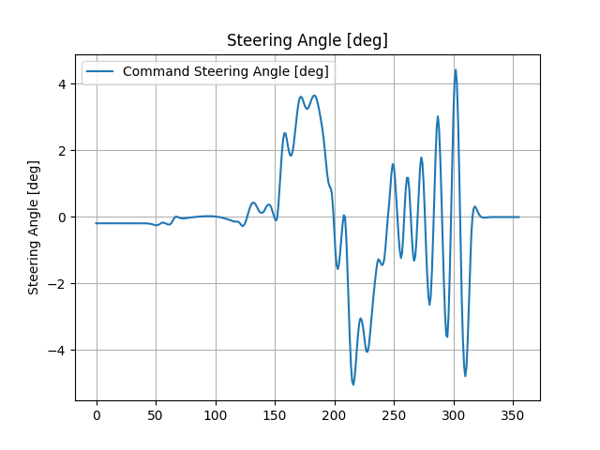
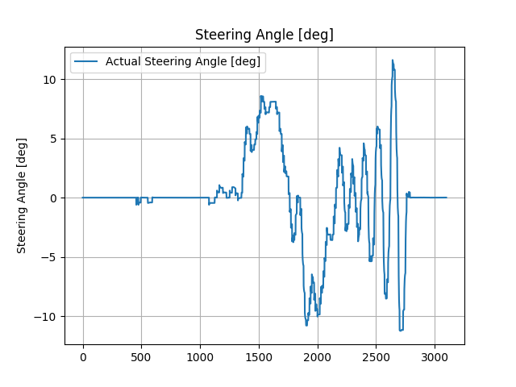
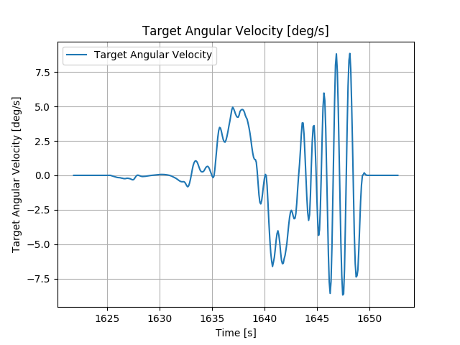
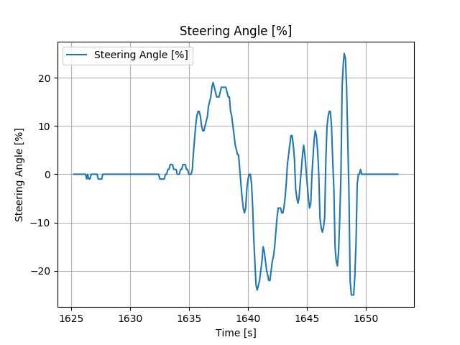
Issue with the steering map
MPC_dynamics_with_delay

Slide 7
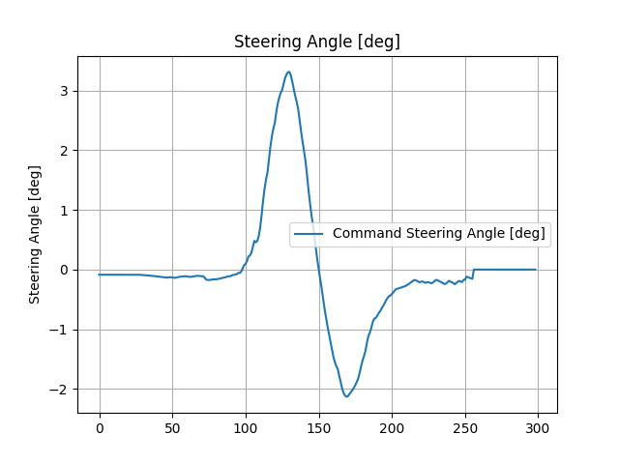
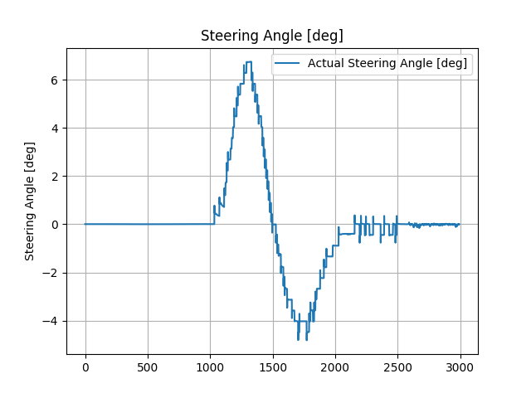
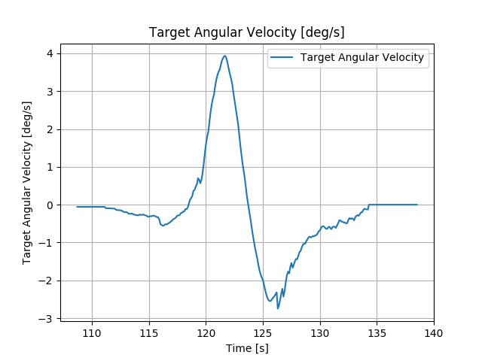
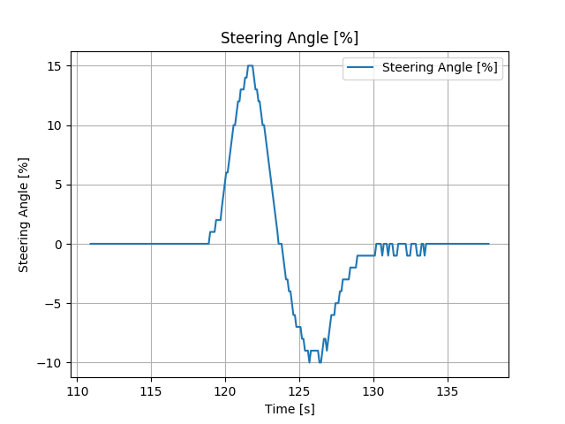
Issue with the steering map
PP

Slide 8
Issue with steering map
Following explains how the steering angle is processed to command the vehicle in gazebo
mpc_follower_core and purpersuit ouput both command steering and command angluar velocity
steer_cmd [rad]. Angluar velocity is calculated using functio below
  PP
    steer_cmd = atan(wheel_base * kappa);
    ts.twist.angular.z = kappa * ts.twist.linear.x;
  MPC
    steer_cmd is cacluated by MPC optimsiation solver
    omega_cmd = vehicle_status_.twist.linear.x * std::tan(steer_cmd) / wheelbase_; [rad/s] --- equation 1
sd_control.cpp calculate the command steer angle [%] that will achieve a given angluar velocity at given speed based on the vehicle speed based on a map
  I supose this map should be derived based on above equation 1 (based parameter “wheelbase_ = 1.68m”) and “max_steer = 45 deg”
In sd_control_plugin.cpp, command steer angle [%] will be converted into command steer angle [rad]
  After this, it should get the same command steer angle as the one calculated in mpc_follower_core.However the result in the previous slid shows that the magnitude betwee the command steering from mpc_follower_core is largely different from the command steer in sd_control_plugin.The steering map need to be checked. There should be at least two steering map, one for twizy and one for ENV200 as the wheelbase length is different.
Overall, at higher speed 7m/s the steering anlge at least > 70% of the max_steer (45 deg), therefore the steer will never valiating the steering constraint, therefore need to test it in lower speed and higher angluar velocity (>15 deg/s) to get it into the scenarios where the steering will saturate.

Slide 9
Autoware.AI’s costomised QP formulation
/////////////// generate mpc matrix ///////////////
/*
* predict equation: Xex = Aex * x0 + Bex * Uex + Wex, Yex = Cex * Xex
* cost function: J = Yex' * Qex * Yex + (Uex - Urefex)' * Rex * (Uex - Urefex)
* Qex = diag([Q,Q,...]), Rex = diag([R,R,...])
*/
{/////////////// qp formulation 1 ///////////////
/*this is very strange formulation of qp problem. it substitutes prediction equation into cost function and leaving Uex as the only the optimsation variable*/
/* cost function: 1/2 * Uex' * H * Uex + f' * Uex
* H = (Cex * Bex)' * Qex * (Cex * Bex) + Rex
* f' = (Cex * (Aex * x0 + Wex))' * Qex * (Cex * Bex) - Urefex' * Rex
*/
/* constraint matrix : lb < Uex < ub, lbA < A * Uex < ubA
* lb = [-u_lim; -u_lim; ... ; -u_lim]
* ub = [u_lim; u_lim; ... ; u_lim]
* A = Bex
* lbA = [-x_lim; -x_lim; ... ; -x_lim] - Aex * x0 - Wex
* ubA = [x_lim; x_lim; ... ; x_lim] - Aex * x0 - Wex
*/
  For kinematic model, f is function of x0, vehicle speed and curvature, there should be one EMPC for each pair of vehicle speed and curvature (in another reference angluar velocity)
  For dynamic model, f is a function of x0, vehicle speed and curvature, there should be one EMPC for each pair of vehicle speed and curvature (in another reference angluar velocity)

Slide 10
QP reformulation and adding constraints to lateral error
qp problem are reformulated as follows.
/////////////// qp formulation 2 ///////////////
/*Reformulate the qp optimisation such that it is possible to apply constrain on laterel error*/
/* solve quadratic optimization.
* cost function: 1/2 * Zex' * H * Zex + f' * Zex, Zex = [Xex; Uex]
* H = [Cex' * Qex * Cex 0
* 0 Rex]
* f' = [0; -Uref' * Rex]
*/
/* constraint matrix : lb < Zex < ub, lbA = A*Zex = ubA
* A = [-I, Bex]
* lbA = -Aex * x0 - Wex
* ubA = lbAeq
* lb = [-xlim; -xlim; ... ; -xlim; -u_lim; -u_lim; ... ; -u_lim]
* ub = [xlim; xlim; ... ; xlim; u_lim; u_lim; ... ; u_lim]
*/
????The solution of this qp is different to the one implemented by Autoware, it cannot control the vehicle stably yet. Need further investgation on this

Slide 11
Potentional Error in Discretisation of KinematicBicycleModelWithDelay
Its use bilinear discretisation for discretisating Ad, whereas use Eular Forward discretisation for Bd and Wd, see below
  Ad = (I - dt * 0.5 * Ad).inverse() * (I + dt * 0.5 * Ad); // bilinear discretization
  Bd *= dt;
  Wd *= dt;

Slide 12
Potentional errors in defining limit for KinematicsBicycleModelWith Delay
The third element of the system state is steering angle which is bounded to a limit. However in the Autoware.ai implementation, such constraint is not considered. Only the input constraint (steering angle) is considered.

Slide 13
Issue with installing qpOASES solver in MATLAB
I am having issue installing qpOASES solver in MATLAB
Currently I am using MATLAB built in solver ‘quadprog’ for solving QP problem with linear constraints. After implementing both QP formulations in MATLAB, I found that they can both be solved with identifical solution. This result is different from when running them in Aslan. Need to further investigate this

Slide 14
EMPC calculation
The same formulation (all process steps and two QP formulations) of MPC is replicated in MATLAB code.
EMPC is calculated using MPT3 toolbox https://www.mpt3.org/ParOpt/ParOpt
EMPC is calcluated for each modelType (‘KinematicsBicycleModel’, ‘KinematicsBicycleModelWithDelay’, ‘DynamicsBicycleModel’, ‘DynamicsBicycleModelWithDelay’) using N = 10, Lateral_error_lim = 1m, Heading_error_lim = 40 deg, Curvature = 0.1, Velocity = 7m/s, the ciritical region number are as below
    KinematicsBicycleModel: qQP1 = 34, qQP2 = 34
    KinematicsBicycleModelWithDelay: qQP1 = 172, qQP2 = 171
    DynamicsBicycleModel: qQP1 = 713, qQP2 = 714
    DynamicsBicycleModelWithDelay: qQP1 = 3597, qQP2 = 3600
The number of region increase significantly when increase of model dimesion, prediction horizon.

Slide 15
EMPC calculation (feedforward and feedback formulation)
It can be observed a reference steering angle can be calculated using the following formula
After adjusting the models, a model with pertubabed input can be derived.
MPC and EMPC can be applied to the model with pertubabed input and the full steering command can be applied by adding reference steering input to pertubaded input. The reference steering input is there fore tracking the reference trajectory and pertubaded input can be used for correct the tracking error due to any disturbance and modelling error.

Slide 16
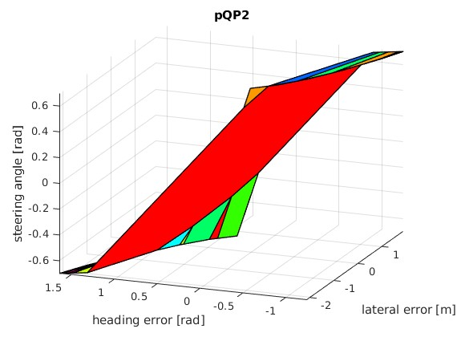
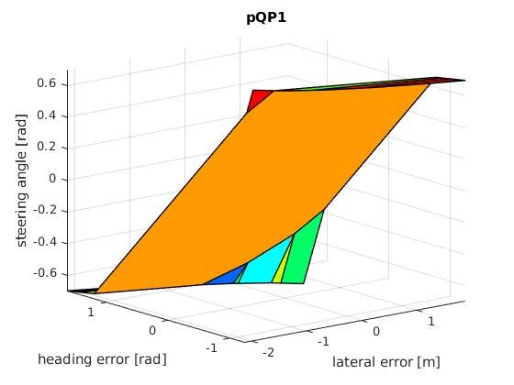
EMPC calculation
EMPC solution for ‘KinematicsBicycleModel’

Slide 17
Some observation of MPC and EMPC performance based on MATLAB implementation
Both ‘quadprog’ and empc cannot produce valid solution for ‘KinematicsBicycleModel’ when initial deviation is large, whereas they can tolerate bigger initial deviation for other models.

