Slide 1
Royal Society Short Industrial Fellowship Project Progess Update
Update at 06 July 2023
- Implement EMPC into C++ and integrate into Autoware.AI mpc package
- Add recent work into github repository
- Other work to be done

Slide 2
EMPC implementation
EMPC design procedure
  Decide the operation condition for this EMPC to work on (speed and curvature)
  Decide the vehicle model, model parameters and constraints to use
    Kinematic model for low speed
    Dynamic model for high speed
    Decide the constraints
  Decide the MPC design parameters
    N - prediction horizon
    Q – weight on states
    R – weight on control
  Use the MPT3 toolbox to compute the EMPC controller.
    A MATLAB script is provided to do this
    calculateEMPC(modelType, model_param_, mpc_param_, operat_cond_, dt)
    It outputs a EMPC function in C++ ’empc_solution.cpp’ empc_solution_pQP1_ff_KinematicsBicycleModelWithDelay(const Eigen::VectorXd& x, const Eigen::MatrixXd& H, const std::vector<int>& ni, const Eigen::MatrixXd& fF, const Eigen::MatrixXd& tF, const std::vector<double>& tg, const Eigen::MatrixXd& tH, const Eigen::MatrixXd& fg, const int nz, const int nr)
    Inputs to the EMPC function are system states (eg. lateral deviation, heading error, steering angle …) and a set of pre-computed parameters (i.e. H, ni, fF, tF, tg, tH, fg, nz, nr..) which are generated by ‘calculateEMPC’ script and saved in csv files.
  Move ‘empc_solution.cpp’ and folder ‘empc_data’ which contains the pre-computed empc parameters to ASLAN’s corresponding folders
  Build ASLAN and ready to go
Current Design
  Operation condition:
    Speed 3 m/s
    Curvature 0.01 1/m
  Kinematic model with steering delay
  Constraints
    Steering limit <40 deg
    Lateral error < 1 m
  MPC design parameters
    N = 70
    Q = 0.1
    R = 1
    Sampling time = 0.1s
  EMPC region numbers: 438
  Estimated storage size: ???

Slide 3
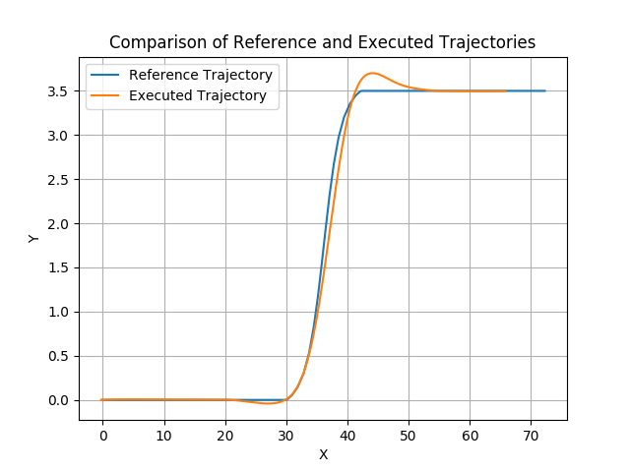
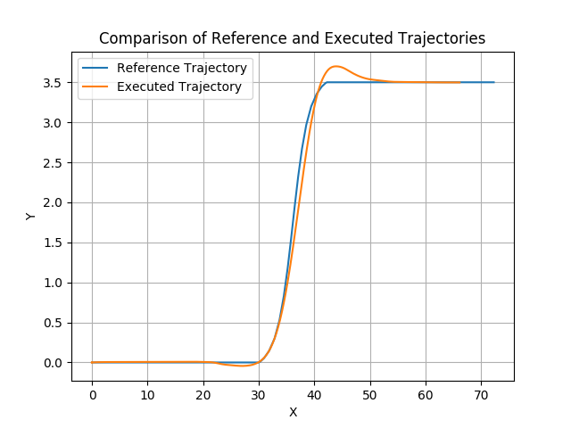
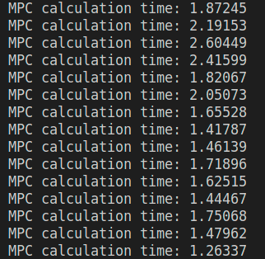
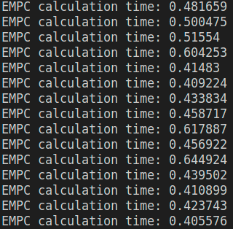
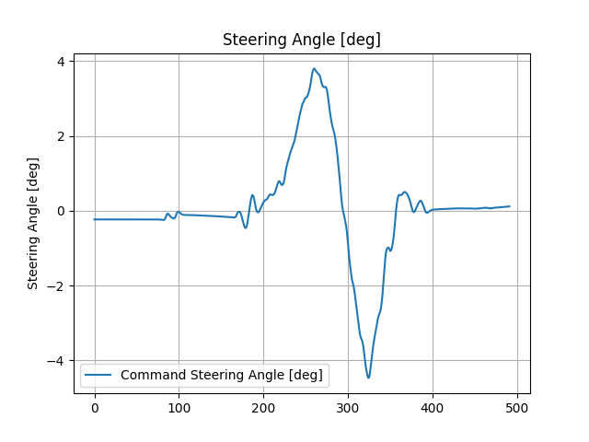
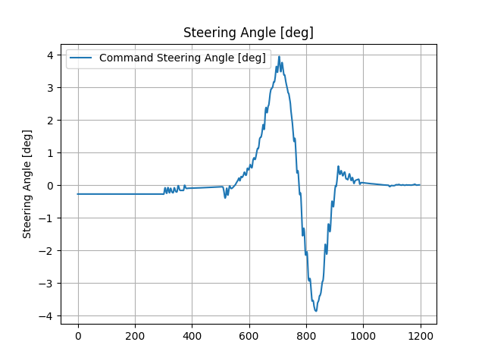
MPC and EMPC results comparision
Online MPC
EMPC

Slide 4
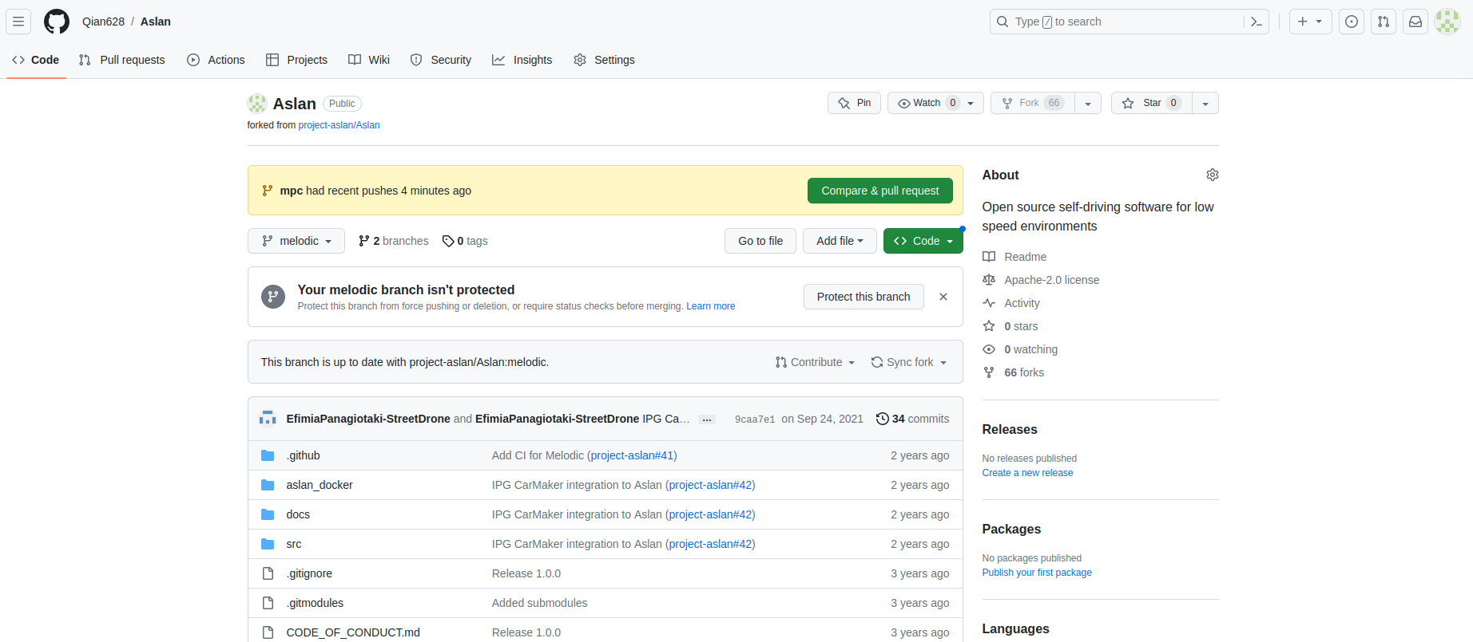
Github repository
Created a forked repository of Aslan in my Github account
Create a branch named mpc_test
  In the mpc_test branch, I uses the ground truth of vehicle pos as inputs. After testing, will create a new branch name ‘mpc’ which use inputs from NDT localisation as it is original Aslan
Push the all my recent work to mpc_test branch
https://github.com/Qian628/Aslan.git

Slide 5
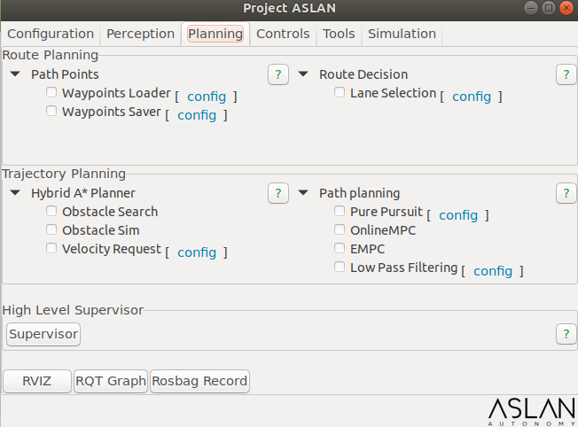
Add MPC and EMPC option into Aslan GUI

Slide 6
Other work to be done
Design EMPC for other operation conditions (speed vs curvature)
Estimate the storage size for full EMPC for all operation conditions
Restore the inputs to MPC/EMPC to NDT localisation outputs
Test them at MIRA test track
Documentation
  Include add readme file to the repository
Merge the work to Aslan
Support needs from SD
  A measurement of steering position is to be added to the vehicle interface
  To check the current lidar logs taken from MIRA tracks to see if a useable map can be created.

