Slide 1
Topics in Wireless Communication
Faculty advisor: Dr. P. Ubaidulla
By Ayush Kumar Dwivedi
SPCRC, iiit hyderabad
Project Presentation 30 Nov 2019

Slide 2
Base Paper
Hien Quoc Ngo, Erik G. Larsson and Thomas L. Marzetta, ‘Energy and Spectral Efficiency of Very Large Multiuser MIMO Systems’, in proc. at IEEE Transactions on Communication, April 2013

Slide 3





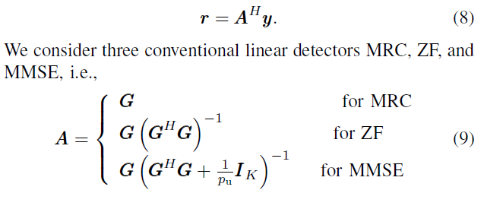
System Model
or
The received vector after using the linear detector is given by:
The received signal at the k^{th} user is given by:
For separation into streams:

Slide 4
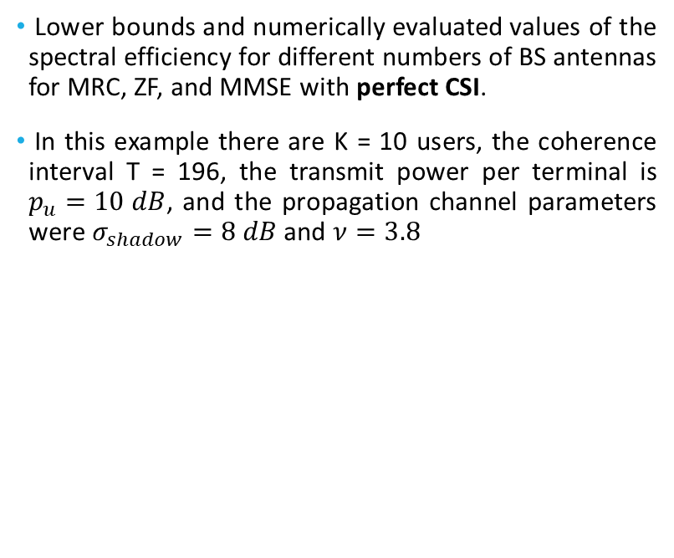
Spectral Efficiency vs No. of BS Antennas - PCSI
Lower bounds and numerically evaluated values of the spectral efficiency for different numbers of BS antennas for MRC, ZF, and MMSE with perfect CSI.
In this example there are K = 10 users, the coherence interval T = 196, the transmit power per terminal is $p_{u}=10 dB$, and the propagation channel parameters were $σ_{shadow}=8 dB$ and $ν=3.8$

Slide 5
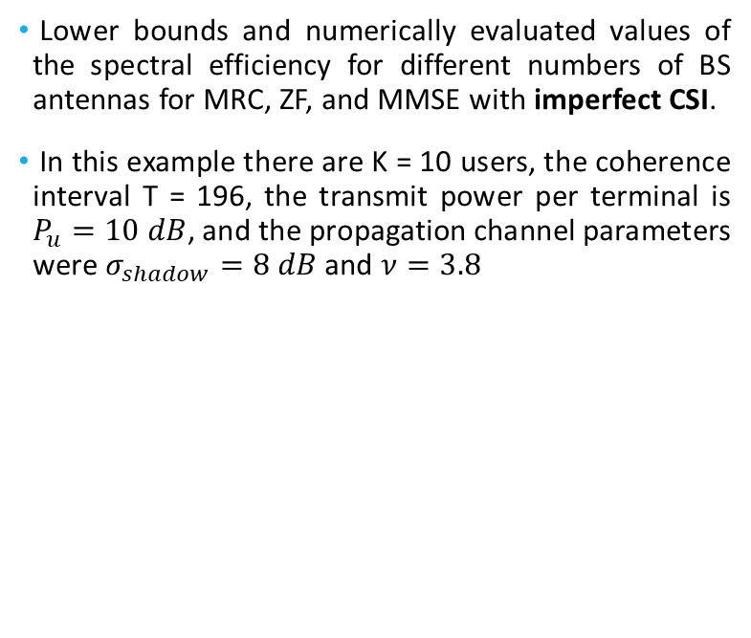
Spectral Efficiency vs No. of BS Antennas - IPCSI
Lower bounds and numerically evaluated values of the spectral efficiency for different numbers of BS antennas for MRC, ZF, and MMSE with imperfect CSI.
In this example there are K = 10 users, the coherence interval T = 196, the transmit power per terminal is $P_{u}=10 dB$, and the propagation channel parameters were $σ_{shadow}=8 dB$ and $ν=3.8$

Slide 6
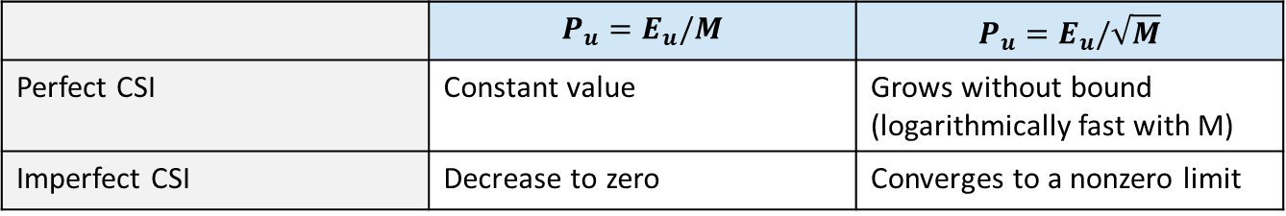

Inference
As M increases : spectral efficiency takes following trend for the two cases of power scaling
These results confirm that we can scale down the transmitted power of each user as $E_{u}/M$ for the perfect CSI case, and as $E_{u}/\sqrt{M}$ for the imperfect CSI case when M is large.
Performance of :
ZF is better at high SNR
MRC is better at low SNR
 | $$P_{u}=E_{u}/M$$ | $$P_{u}=E_{u}/\sqrt{M}$$
Perfect CSI | Constant value | Grows without bound (logarithmically fast with M)
Imperfect CSI | Decrease to zero | Converges to a nonzero limit

Slide 7
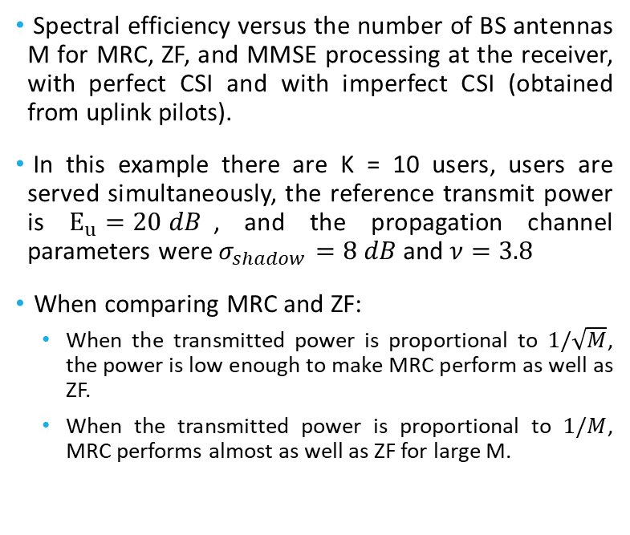
Spectral Efficiency vs No. of BS Antennas
Spectral efficiency versus the number of BS antennas M for MRC, ZF, and MMSE processing at the receiver, with perfect CSI and with imperfect CSI (obtained from uplink pilots).
In this example there are K = 10 users, users are served simultaneously, the reference transmit power is $E_{u}=20 dB$, and the propagation channel parameters were $σ_{shadow}=8 dB$ and $ν=3.8$
When comparing MRC and ZF:
When the transmitted power is proportional to $1/\sqrt{M}$, the power is low enough to make MRC perform as well as ZF.
When the transmitted power is proportional to $1/M$, MRC performs almost as well as ZF for large M.

Slide 8
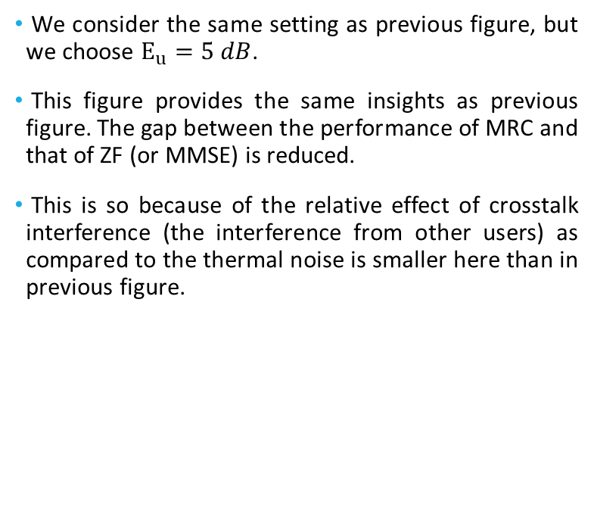
Spectral Efficiency vs No. of BS Antennas
We consider the same setting as previous figure, but we choose $E_{u}=5 dB$.
This figure provides the same insights as previous figure. The gap between the performance of MRC and that of ZF (or MMSE) is reduced.
This is so because of the relative effect of crosstalk interference (the interference from other users) as compared to the thermal noise is smaller here than in previous figure.

Slide 9
Thank you.

