Slide 1

Easy Move Website
PHP team project
by Roman Shaiko, Qian Gao, Dongfan Zhang

Slide 2
Solution overview
Ordering
Invoicing
Payments
Scheduling
Database
Presentation
Information
Preordering
Availability
Desktop Application
Website

Slide 3
Content structure
content\
index.php
home.php
about.php
FR
…..
EN
css\
js\
functions\
fonts\
images\
……..
content \ en\
indexen.php
home.php
home.php
…..
…..
…..
…..
about.php
about.php
home.php
…..
…..
about.php
…..

Slide 4



Content management
Only link format: index.php?content=page_name OR indexen.php?content=page_name
<head>
function returns ARRAY of PHP files (styles, scripts)
<nav>
<main>

Slide 5
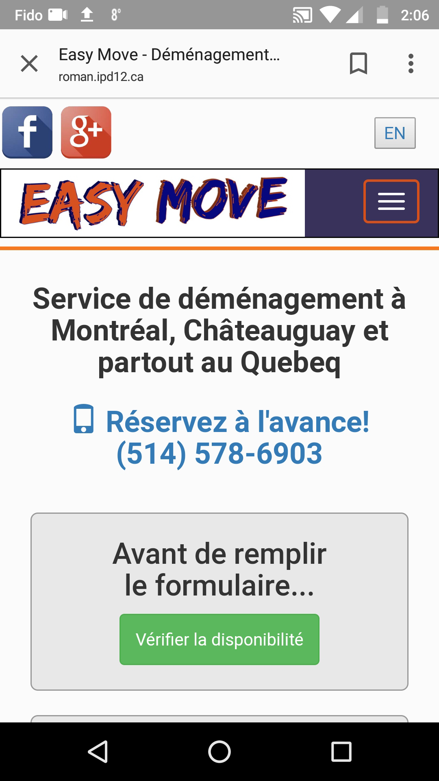

Responsive design

Slide 6
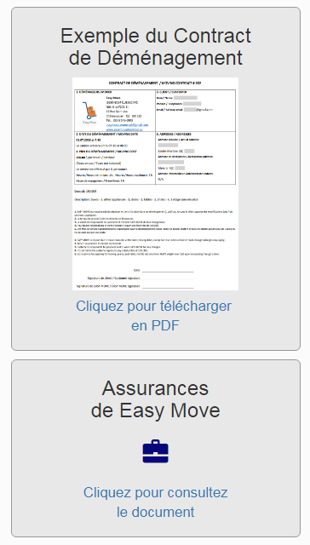
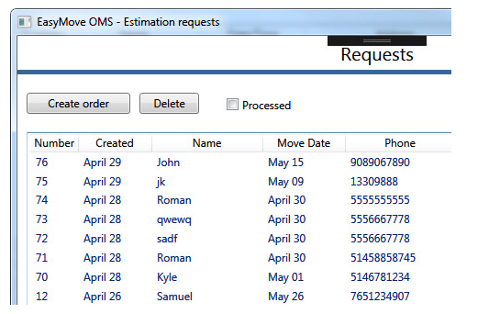
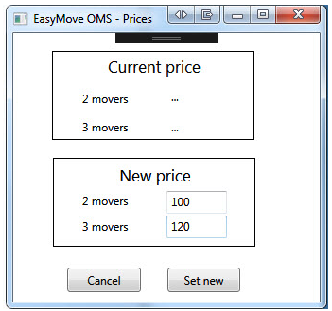
Problems solved
✓ Provide information
✓ Interacting with desktop application
Processing estimation requests
Update prices

Slide 7
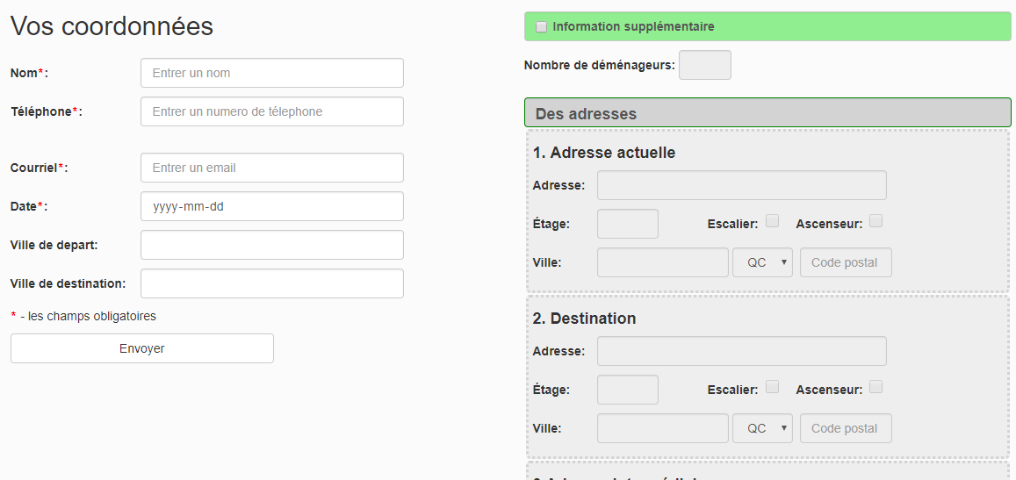
Estimation request – form processing

Slide 8
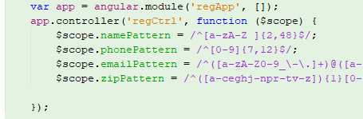
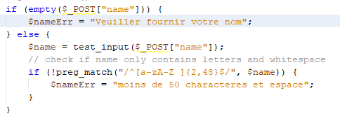

Form validation - client side / server side
If there are data to be corrected, whatever user entered will stay, so user just need to correct fields where need to be corrected. To do this, have add below PHP code into HTML tag

Slide 9
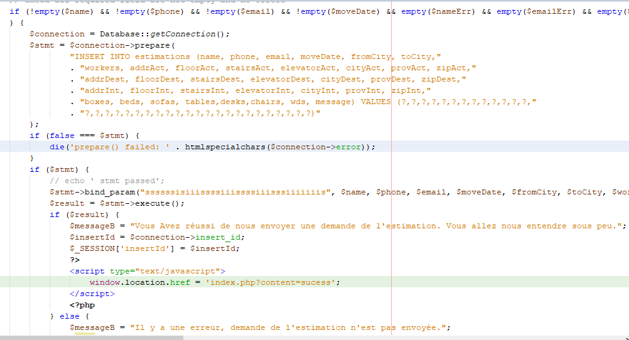
Saving into database and validations

Slide 10
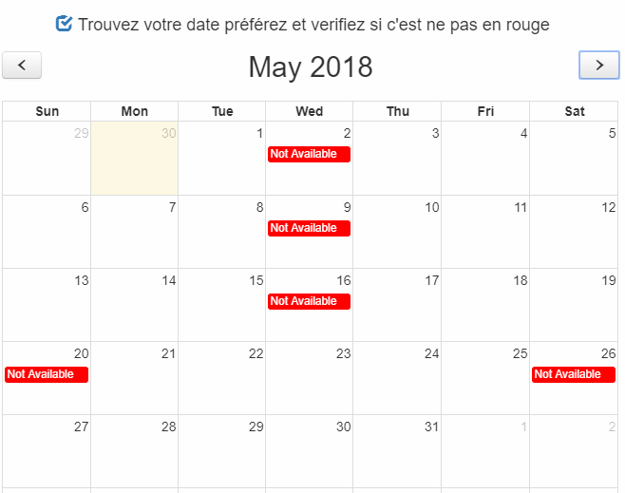
Dynamic calendar
fetching the data from database and displaying the unavailable dates

Slide 11
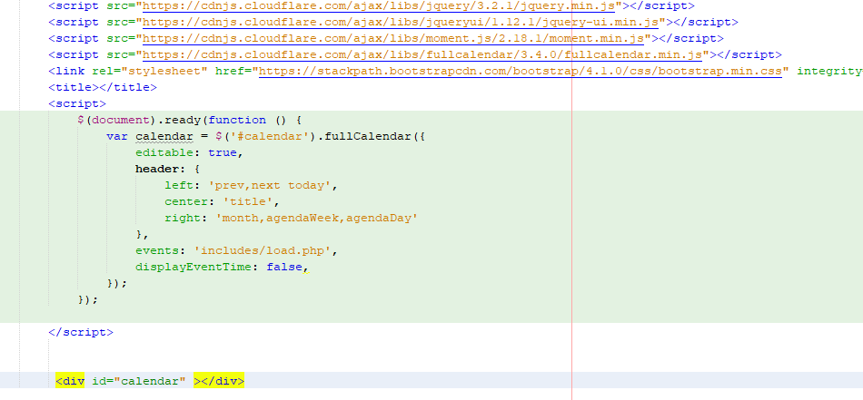
Calendar – used Fullcalendar plugin

Slide 12
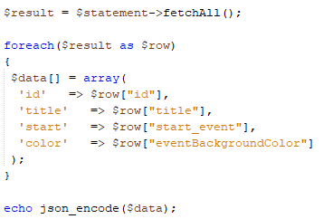
Calendar
How to pass data fetched from database by PHP to JQuery script?
Here is the little trick:

Slide 13
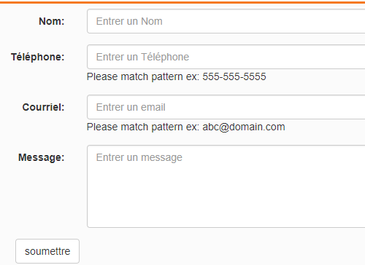
Contact form

Slide 14
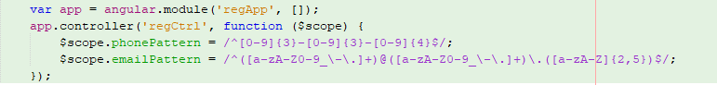
Contact form – validation by Angular
HTML mark up
Script with Angular

Slide 15
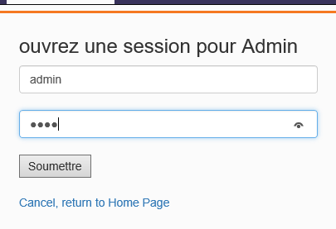
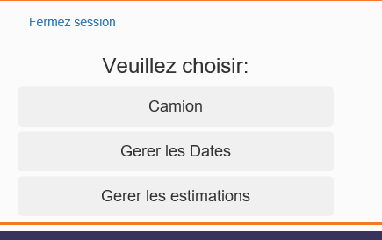
Admin login page
User authentication – verify information with database
Redirect page to Admin section

Slide 16
Future improvements
Complete all the web-pages French and English
Enable user to schedule a moving appointment
When an estimation request was submitted, user will get an email
Implement site security control: when form is submitted, there need to be matched token from session and from the form hidden input tag of the form
Write an .htaccess to prohibit unauthorized access to internal files.
Implement Admin pages to manager trucks, estimations, orders, prices, etc.

Slide 17
Summary
Combined several technologies to realize this project:
MySQL Database, PHP, CSS, JavaScript, JQuery, Angular, HTML, Bootstrap, Fullcalendar plugin, desktop application(C#)
Through this project, finally obtained a clearer idea from the front end to back end and connected some dots.

