Slide 1
Ggplot2 Elegant Graphics for Data analysis
Yufei Yang

Slide 2
What is ggplot2
An implementation of Grammar of Graphics.
“In brief, the grammar tells us that a statistical graphic is a mapping from data to aesthetic attributes (colour, shape, size) of geometric objects (points, lines, bars).”

Slide 3
install.packages(“ggplot2”)
library(“ggplot2”)

Slide 4
How to get help
ggplot2 is well documented at http://docs.ggplot2.org/current/
Hadley Wickham’s ggplot2 book and paper

Slide 5
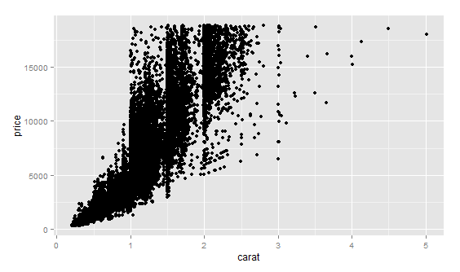
“Hello world” in ggplot2
qplot(carat,price,data=diamonds)
x coordinate
y coordinate
data frame

Slide 6
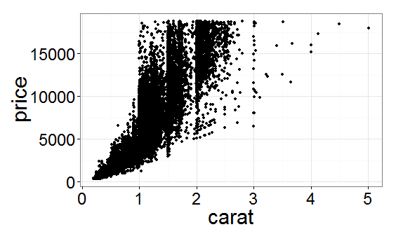
changing theme
the <- theme_bw(base_size=30)
qplot(carat,price,data=diamonds) + the

Slide 7
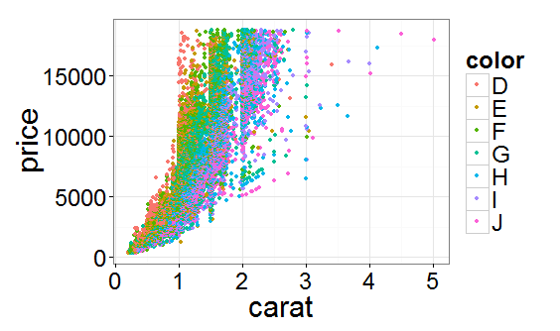
Modifying aesthetics
qplot(carat,price,data=diamonds,colour=color) + the

Slide 8
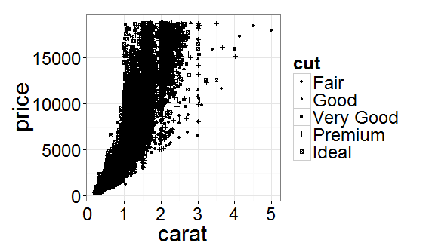
Modifying aesthetics
qplot(carat,price,data=diamonds,shape=cut)+the

Slide 9
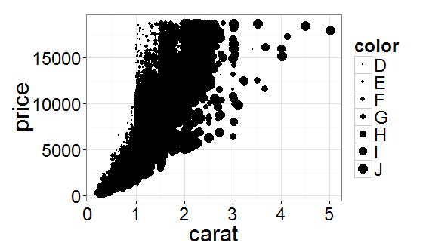
Modifying aesthetics
qplot(carat,price,data=diamonds,size=color)+the

Slide 10
alpha
To produce a semi-transparent colour
alpha(colour, transparency)
Transparency is a value between 0 (completely transparent) and 1 (complete opaque). It's often useful to specify the transparency as a fraction, e.g. 1/10.
The denominator specifies the number of points that must overplot to get a completely opaque colour.

Slide 11
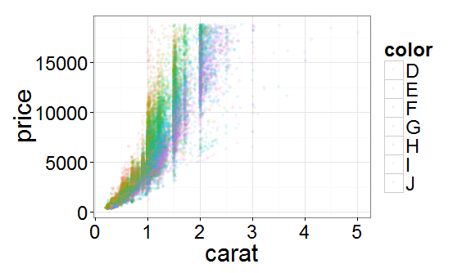
alpha
qplot(carat,price,data=diamonds,colour=color,alpha=I(1/10))+the
manually set the aesthetics

Slide 12
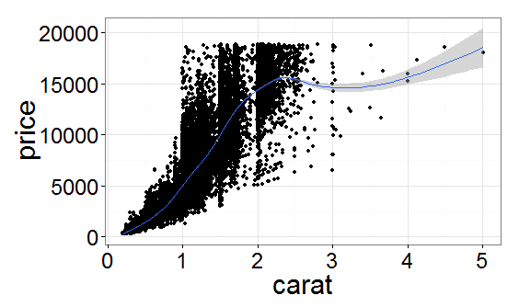
Adding a geom
qplot(carat,price,data=diamonds,colour=color,geom=c(“point”,”smooth”)) +the

Slide 13
Facet
Faceting creates tables of graphics by splitting the data into subsets and displaying the same graph for each subset in an arrangement that facilitates comparison.
facets=RowVar ~ColVar
RowVar~.
.~ColVar

Slide 14
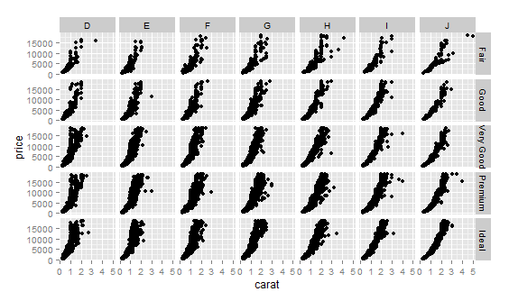
qplot(carat,price,data=diamonds,facets=cut~color)

Slide 15
plot name | geom
Scatter plot | geom=“point”
Smooth line | geom=“smooth”
Histogram | geom=“histogram”
Density curve | geom=“density”
Jitter plot | geom=“jitter”
Boxplot | geom=“boxplot”

Slide 16
Practice 1
useful functions:
data.frame, as.factor, rep
data: mpg
plot
Displaying distribution of hwy and cty in one graph(A new data frame are needed)
Displaying the relationship of hwy and cty
The shape is controlled by year, the colour is controlled by cyl
Then using facets, the row variable is drv
Displaying the comparison of cty between two years

Slide 17
Build a plot layer by layer
Layering is the mechanism by which additional data elements are added to a plot.
Each layer can come from a dierent dataset and have a dierent aesthetic mapping.
qplot() : permits only a single dataset and a single set of aesthetic mappings.

Slide 18
Creating a plot
p <- ggplot(diamonds, aes(carat, price, colour = cut))

Slide 19
Layer
A minimal layer only specifies a geom
scatterplot
p + geom_point()

Slide 20
geom
name | description
bar | Bars, rectangles with bases on y-axis
boxplot | Box and whiskers plot
density | Display a smooth density estimate
errorbar | Error bars
histogram | Histogram
jitter | Points, jittered to reduce overplotting
line | Connect observations, in ordered by x value
point | Points, as for a scatterplot
smooth | Add a smoothed condition mean.
text | Textual annotations

Slide 21
Stat
A statistical transformation
smoother:
calculating the mean of y, conditional on x
subject to some restriction that ensures smoothness.
bin:
count, the number of observations in each bin
density, the density of observations in each bin
x, the centre of the bin

Slide 22
position adjustments
Adjustment | Description
dodge | Adjust position by dodging overlaps to the side
fill | Stack overlapping objects and standardise have equal height
identity | Don't adjust position
jitter | Jitter points to avoid overplotting
stack | Stack overlapping objects on top of one another

