Slide 1
Biostatistics
Qian, Wenfeng

Slide 2
Myself
Qian, Wenfeng (钱文峰)
Institute of Genetics & Developmental Biology, CAS
Center for Molecular Systems Biology

Slide 3
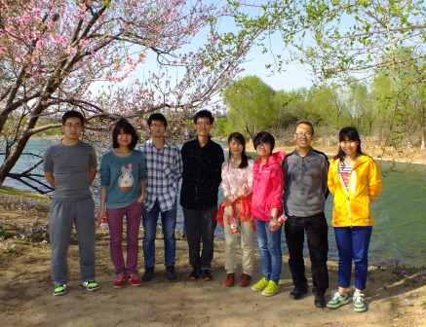
My group
http://qianlab.genetics.ac.cn/

Slide 4
My research
Single cell genetics
Variations among isogenic cells
Kinetics of gene expression
Protein synthesis/degradation
Transcriptional/translational burst
Quantitative functional genomics

Slide 5
My education
2006, B.S., Peking University
Biological Sciences
2012, Ph.D., University of Michigan
Evolutionary Genetics
Top 1% statistics among biologists

Slide 6
Course introduction
Applied biostatistics
Examples, examples, and examples
Try to make it not too heavy

Slide 7
Statistics
Statistics is the study of the collection, organization, analysis, interpretation and presentation of data.

Slide 8

Schedule
March 31: Probability
April 2: Introduction to R
April 9: Hypothesis testing
April 14: Analysis of covariance
April 16: Regression and correlation
April 21: Plots with R
April 23: Presentations (== final exam)
Prof. Yang

Slide 9
R language
Standard statistical tool in science
Will be introduced by Prof. Yang
You will need to bring your laptop to the class, with R installed.

Slide 10
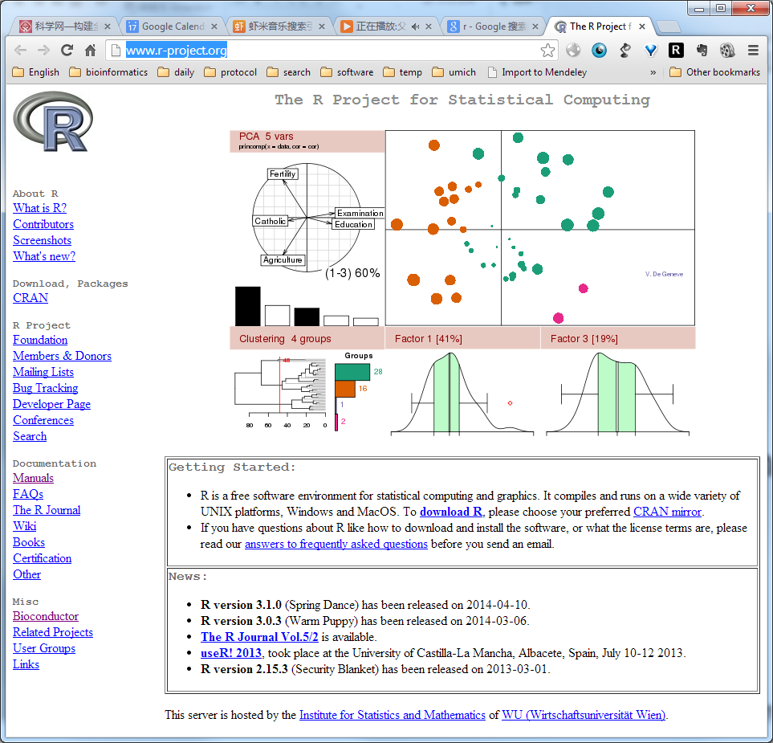
Download R
http://www.r-project.org/

Slide 11

R studio
http://www.rstudio.com/

Slide 12
Exam
Final exam is a report based on the use of statistics in a small project. The report should be between 1000 and 2000 words.
Ten-minute (including 2 min Q & A) oral defense of the report in front of the class.

Slide 13
PPT
Will be uploaded to my lab website after each class
qianlab.genetics.ac.cn
Words in red: waiting for your response
Words in green: the beginning of a new example

Slide 14
Textbook
Statistics: an introduction using R
By Michael J. Crawley
Other reference:
Biometry
by Robert R. Sokal & F. James Rohlf
What is a p-value anyway?
By Andrew Vickers

Slide 15
Your introduction

Slide 16
Statistics is the base of all sciences
The definition of the modern science?

Slide 17
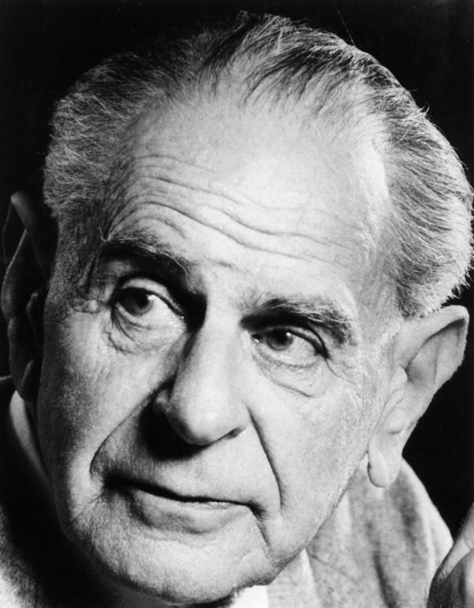
What is science?
A theory in the empirical sciences can never be proven, but it can be falsified, meaning that it can and should be scrutinized by decisive experiments.
Hypothesis testing
Karl Popper 1902-1994

Slide 18
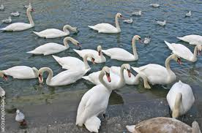
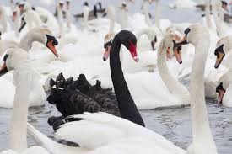
All swans are white

Slide 19
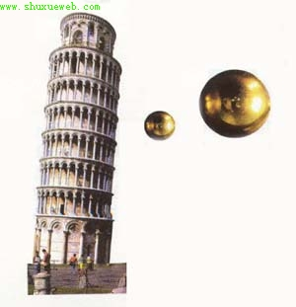
Science is about rejecting null hypothesis

Slide 20
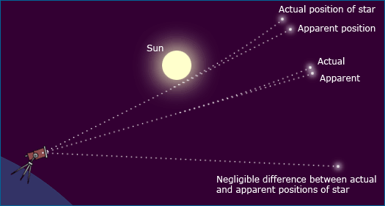
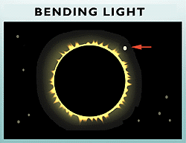
Science is about rejecting null hypothesis

Slide 21
In biology
In genetics
Mixing of traits
Mendelian genetics
Two copy of genes that can be separated in the next generation, generating the 3:1 ratio
Other examples?

Slide 22
A tale of wild south China tiger
The null hypothesis:
The wild south China tiger is extinct

Slide 23
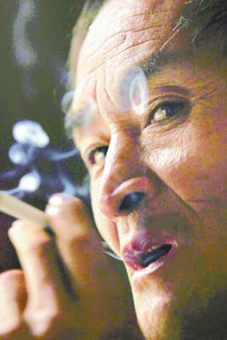
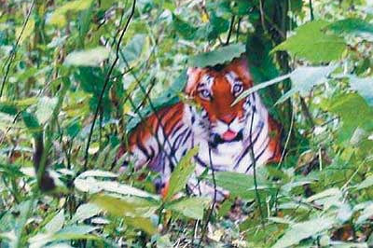
…and rejecting null hypothesis
Rejecting the null hypothesis:
The wild south China tiger is still present.
Real “dragon” Zhou

Slide 24
…and rejecting null hypothesis
The new null hypothesis:
The wild south China tiger is still present.

Slide 25

…and rejecting null hypothesis
The new null hypothesis:
The wild south China tiger is still present, which is rejected later by a poster printed earlier.

Slide 26
…and rejecting null hypothesis
The null hypothesis:
The wild south China tiger is still present, which is rejected later by a poster printed earlier.
What is the probability of the observation (the poster) given the null hypothesis (p value)?
P ≈ 0
So the null hypothesis is rejected.

Slide 27
…and rejecting null hypothesis

Slide 28
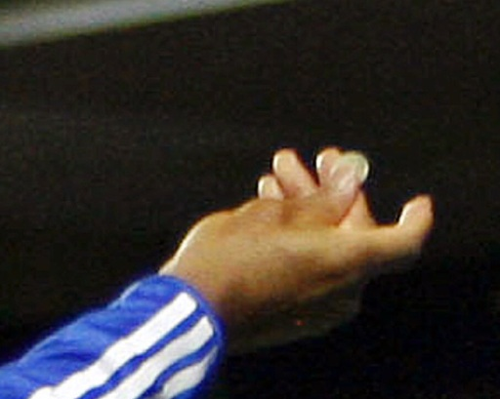
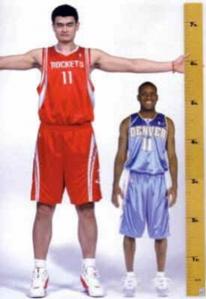

Deterministic vs stochastic events
Deterministic events
Stochastic events
If I toss a coin, I will get a face up
I will get up in the tomorrow morning
A child will grow up
Head or tail?
The exact time (minute and second) I wake up naturally
The height and weight of the child
Other examples?

Slide 29
Phenomena in biology
Are likely to be stochastic, compared to physical phenomena
In physical world
Sun rises
Planet moves
Water boils

Slide 30
In Biology
Weight and height
Disease
Life span
The outcome of your exam
Reason?

Slide 31
Reasons of stochasticity in life
Traits are determined by both genes and environments
Environment is heterogeneous
Most traits are affected by multiple genes with minor effect each
Developmental strategy (body plan)
Life sciences contains a huge number of factors, which makes stochasticity everywhere.

Slide 32
Regression to the mean
In statistics, regression toward (or to) the mean is the phenomenon that if a variable is extreme on its first measurement, it will tend to be closer to the average on its second measurement
An positive gene in your screen may not appear in the next time.
The best student in the collage could become ordinary later in his/her career
Why?

Slide 33
How do we describe stochastisity?
Distribution!

Slide 34
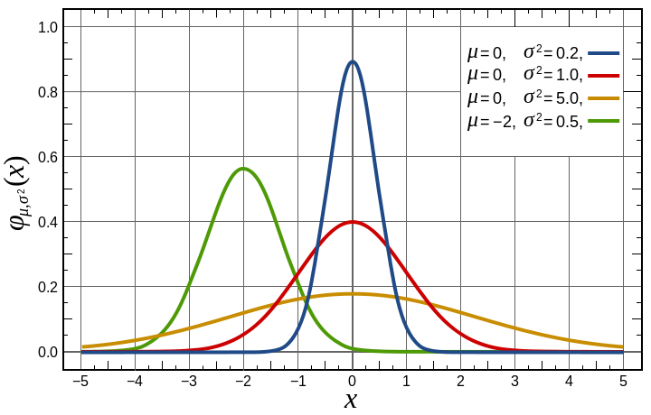
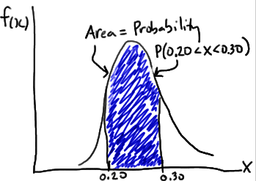
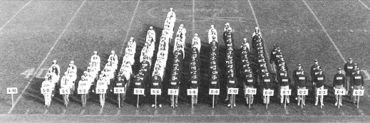
Density function

Slide 35
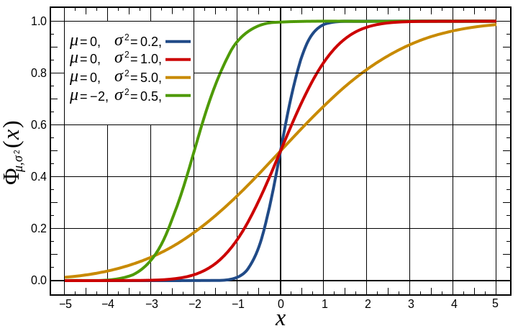
Density function
Cumulative density function

Slide 36
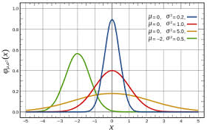
Normal distribution
The bell shape
Appears everywhere in biology
Why?
Traits are determined by both genes and environments
Many genes with minor effects
Additivity
What if not?

Slide 37
The probability of a person taller than 1.9 meter
If the distribution of height follows normal distribution, with mean = 1.75 and standard deviation = 0.06

Slide 38
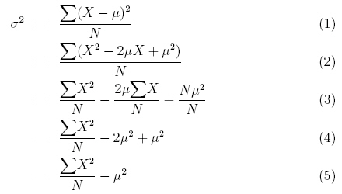
Descriptive statistics
Algebraic Mean (μ)
Variance (σ²)
Standard deviation (σ)

Slide 39
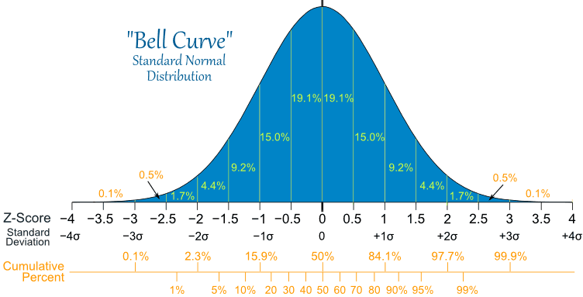
Normal distribution

Slide 40
The probability of a person taller than 1.9 meter
If the distribution of height follows normal distribution, with mean = 1.75 and standard deviation = 0.05
P = 1- “NORMDIST(1.9, 1.75, 0.05, 1)”
=0.6%

Slide 41
The height is more than 1.9 meter
If the distribution of height follows normal distribution, with mean = 1.75 and standard deviation = 0.05
What is the probability of less than 1.2 meter?

Slide 42
The height is more than 1.9 meter
If the distribution of height follows normal distribution, with mean = 1.75 and standard deviation = 0.05
What is the probability of less than 1.2 meter?
What if this number is different from your intuition?

Slide 43
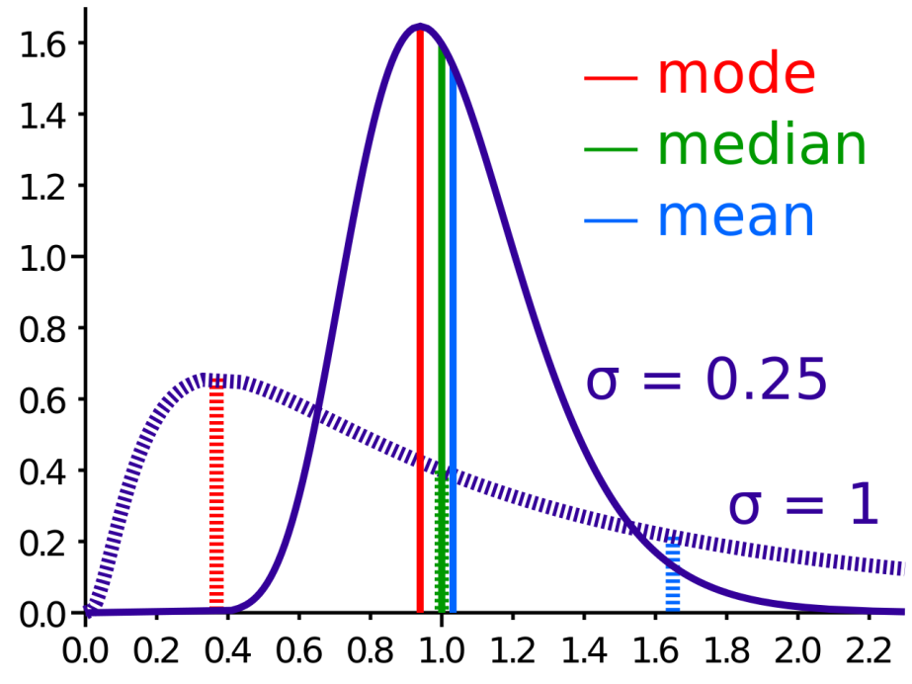
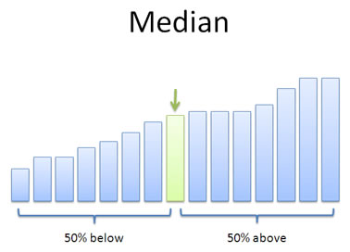
Bill Gates’ visit to a bar
Median

Slide 44
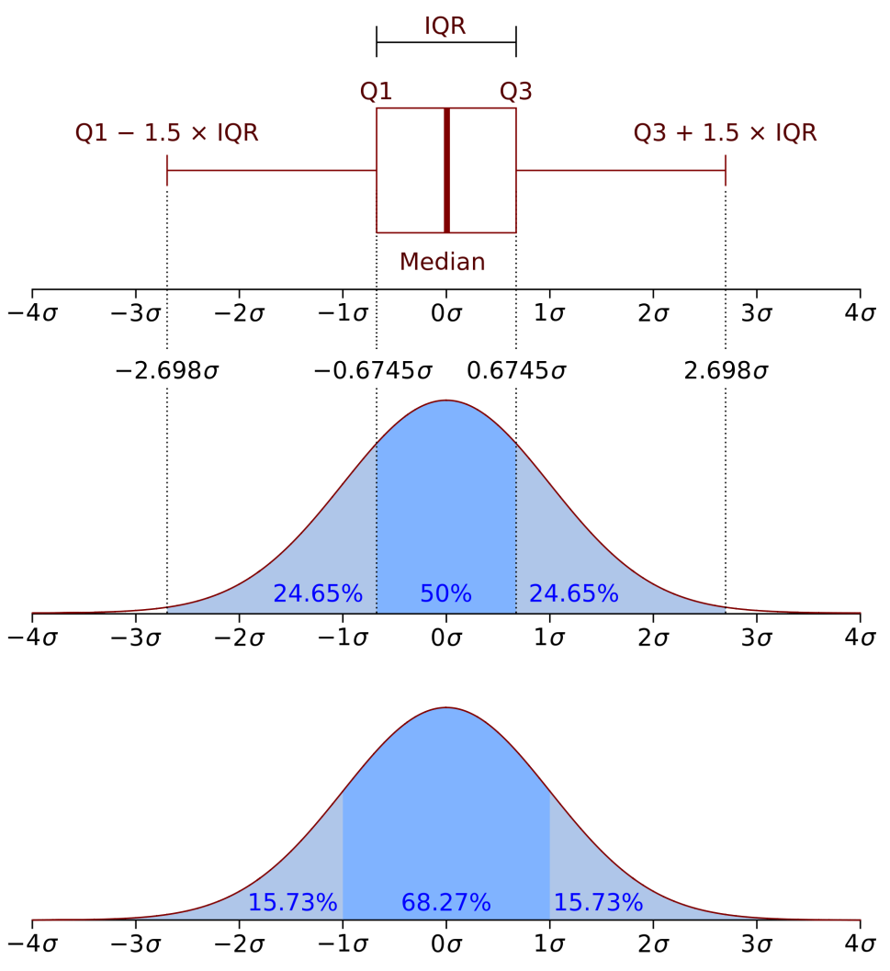
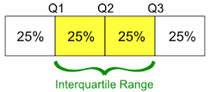
Bill Gates’ revisit to a bar
Boxplot
Interquartile range

Slide 45
How do we treat stochastic data
At a summer tea party in Cambridge, England, a guest states that tea poured into milk tastes different from milk poured into tea. Her notion is shouted down by the scientific minds of the group.
But one man, Ronald Fisher, proposes to scientifically test the hypothesis.

Slide 46
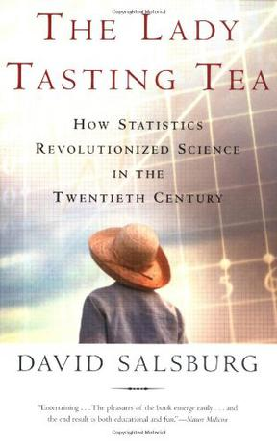
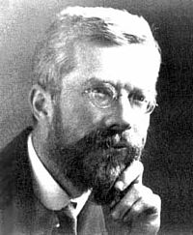

Slide 47
How to test the hypothesis?
H₀: There is not difference on order of milk and tea

Slide 48
How to test the hypothesis?
H₀: There is not difference on order or milk and tea
10 cups of drink
Mixed blind to the lady
Let the lady tell the order of milk and tea
If H₀ is correct, what is the probability the lady get all 10 guess correct?

Slide 49
How to test the hypothesis?
If H₀ is correct, what is the probability that the lady got all 10 guesses correct?

Slide 50
How to test the hypothesis?
If H₀ is correct, what is the probability the lady get all 10 guesses correct? 0.1%
It is unlikely that event with such low probability happened in a single test. Thus, the most likely scenario is that H₀ is incorrect, and there is difference between two orders.

Slide 51
What if…
Among 10 tests, the lady succeeded for 8 of them?

Slide 52
Binomial distribution
First child, Boy or Girl
Second, B or G
Third, B or G
Eight possibilities:
BBB, BBG, BGB, BGG, GBB, GBG, GGB, GGG
What is the probability of having 2 B in 3 children?

Slide 53

Binomial distribution
$P\left(x=k\right)=\left({n \atop k}\right)p^{k}{(1−p)}^{n−k}$
n=3
k=2
p=0.5

Slide 54
What if…
Among 10 tests, the lady succeeded for 8 of them?

Slide 55
Probability estimation
Alternatively, we can estimate the probability of success (E)
In this case 80%
We can get 95% confidence interval (CI)
If 0.5 is out of CI, we conclude a difference between the order

Slide 56
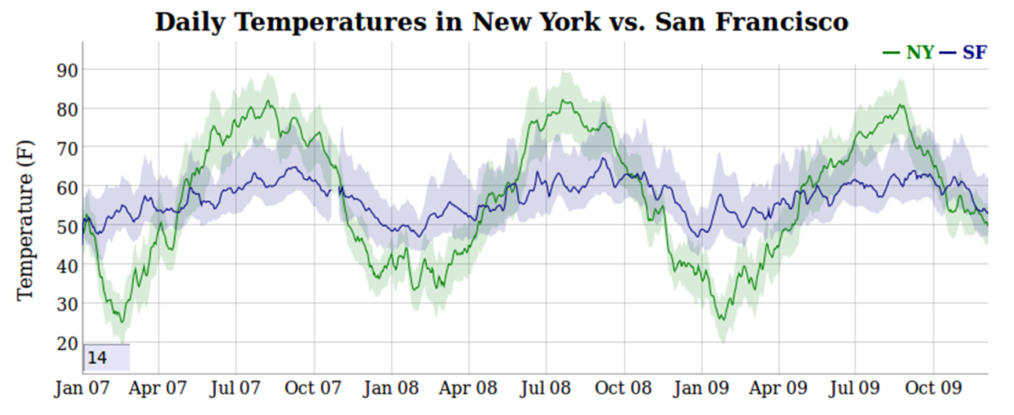
Confidence interval

Slide 57
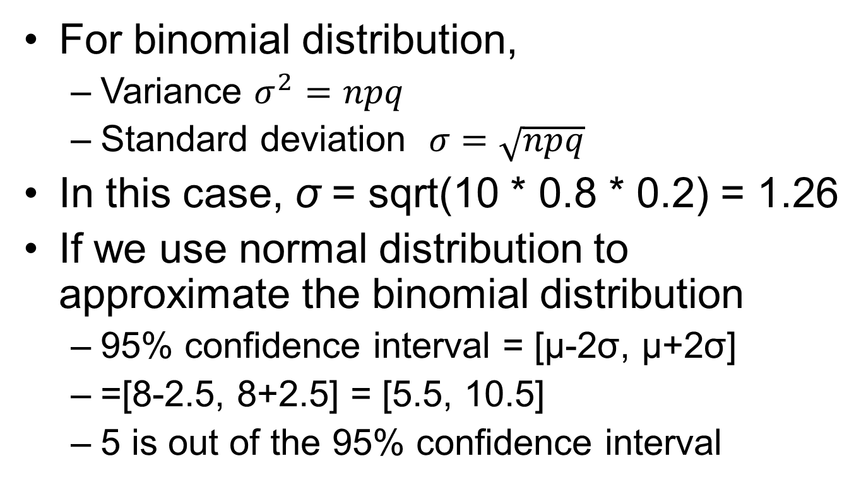
How to calculate confidence interval?
For binomial distribution,
Variance $σ^{2}=npq$
Standard deviation $σ=\sqrt{npq}$
In this case, σ = sqrt(10 * 0.8 * 0.2) = 1.26
If we use normal distribution to approximate the binomial distribution
95% confidence interval = [μ-2σ, μ+2σ]
=[8-2.5, 8+2.5] = [5.5, 10.5]
5 is out of the 95% confidence interval
Implications

Slide 58
Law of large number
The estimate of the probability 0.8 may not be accurate …
The larger the sample size, the more accurate our estimate is.
So that we could potentially distinguish 50% from 60%

Slide 59
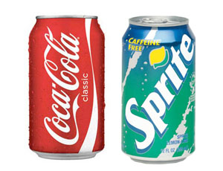
Applications of such idea
Hold your nose, and you may not be able to tell coke from sprite

Slide 60
Is a drug effective or not?
Other examples?

Slide 61
Number of left handed people
If the probability of left handed people is 5% in a population, what is the probability of a 50-student class containing exact 1 left handed people?

Slide 62

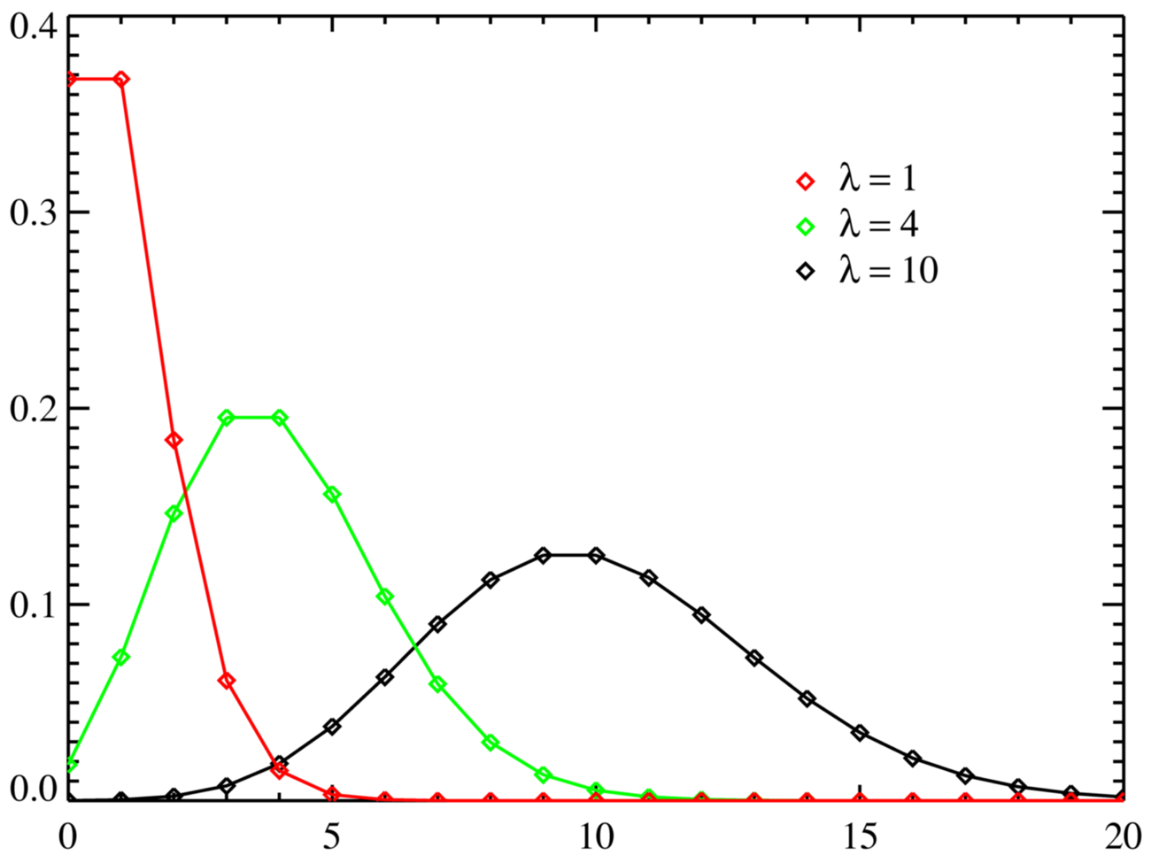
Poisson distribution
λ = mean = variance

Slide 63
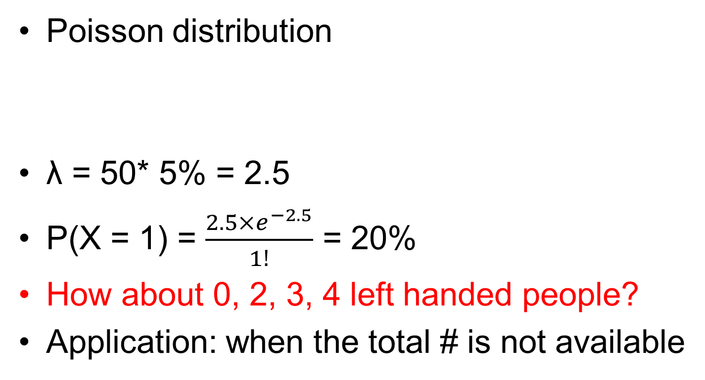
Number of left handed people
Poisson distribution
λ = 50* 5% = 2.5
P(X = 1) = $\frac{2.5×e^{−2.5}}{1!}$ = 20%
How about 0, 2, 3, 4 left handed people?
Application: when the total # is not available

Slide 64
Intuition is extremely important in statistics

Slide 65
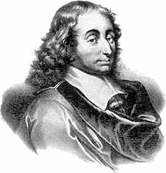
Blaise Pascal
1623-1662
Pascal's principle

Slide 66
Geek’s joke
One day, Einstein, Newton, and Pascal meet up and decide to play a game of hide and seek. Einstein volunteered to be “It.” As Einstein counted, eyes closed, to 100, Pascal ran away and hid, but Newton stood right in front of Einstein and drew a one meter by one meter square on the floor around himself. When Einstein opened his eyes, he immediately saw Newton and said “I found you Newton,” but Newton replied,

Slide 67
Einstein, Newton, and Pascal Play Hide and Seek
“No, you found one Newton per square meter. You found Pascal!”.

Slide 68
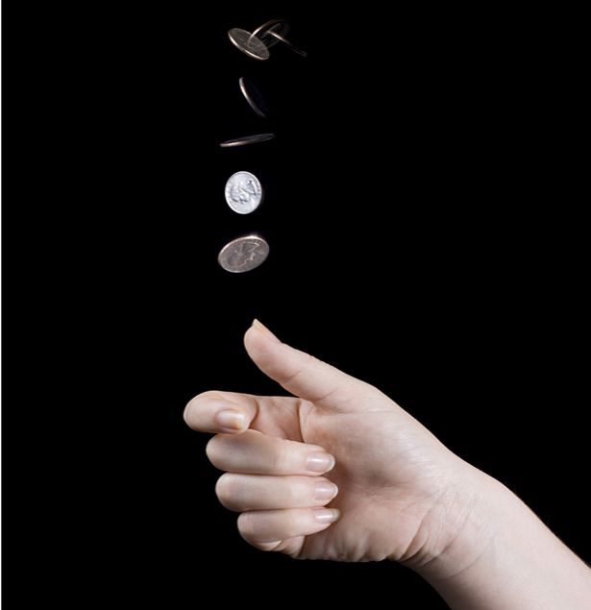
Pascal’s Problem
The rule of the game
Two people toss the coin one by one
They both bet 12 coins
Player A wins when s/he gets 3 “head”
Player B wins when s/he gets 3 “tail”
The game has to stop when A gets 2 “head” and B gets 1 “tail” because of King’s call
How to split the bet?

Slide 69
Opinions
B: A gets 2/3 and B gets 1/3
A needs one more “head”, P = 1/2
B needs two more “tails”, P = 1/4
A: A gets 3/4 and B gets 1/4
B wins only when B gets two “tails” P = 1/4
Otherwise, A wins P = 3/4
Who is correct?

Slide 70
Conclusion
A: A gets 3/4 and B gets 1/4

Slide 71
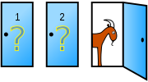
Monty Hall problem
Suppose you're on a game show, and you're given the choice of three doors: Behind one door is a car; behind the others, goats. You pick a door, say No. 1, and the host, who knows what's behind the doors, opens another door, say No. 3, which has a goat. He then says to you, "Do you want to pick door No. 2?" Is it to your advantage to switch your choice?
Your guess?

Slide 72
Monty Hall problem
If the car is not behind door 3, the probabilities of being behind door 1 and door 2 are equal
P = ½ for both.

Slide 73
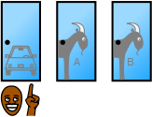


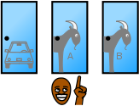
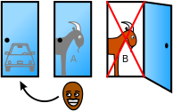
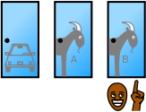
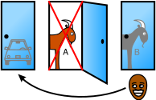
Solution 1
1/3
1/3
1/3

Slide 74
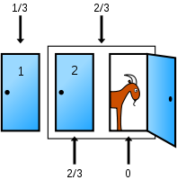
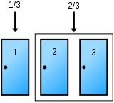
Solution 2

Slide 75
Intuition: Consider 10000 doors …
You chose door 1
The host open 9998 doors for you, and none of them have cars behind
Do you switch?

Slide 76
Monty Hall problem
Switch it!

Slide 77
The probability of the same birthday in a class
Consider a class with 50 people
What is the probability that at least two students have the same birthday?
Your guess?

Slide 78
The probability that all have different birthday
The first person: 1
The second person: 364/365
The third person: 363/365
…
The 50th person: 316/365
P = 0.03

Slide 79
The answer
The probability that all have different birthdays
P = 0.03
The probability that at least two students have the same birthday
1 – P =0.97

Slide 80
The success of an experiment
Two people A and B are doing an experiment in my lab
According to the history records, the successful rate for A is 0.8, and that for B is 0.7
Each of them does the experiment once
What is the probability of at least one success?

Slide 81
The success of an experiment
Consider the probability both of them fail
P = 1- 0.2 * 0.3 = 0.94

Slide 82
The success of an experiment
Consider the probability both of them fail
P = 1- 0.2 * 0.3 = 0.94
Any problems here?

Slide 83
The success of an experiment
Consider the probability both of them fail
P = 1- 0.2 * 0.3 = 0.94
Any problems here?
It depends on whether the two people are doing experiments independently!
Do they use the same set of reagents?
If true, then A’s failure increases the probability of B’s failure

Slide 84
The conditional probability
P(A|B)
The probability of A given B
The probability of girl given the first child is a boy in the family
P(the second child is a girl | the first child is a boy)
If independent P (2nd girl | 1st boy) = P (girl)

Slide 85
Probability of infection
A test can detect 95% of the people with infection (true positive)
There is 1% probability of false positive
The frequency of a infection is 0.5%
What is the probability of infection, given a positive result in the test

Slide 86

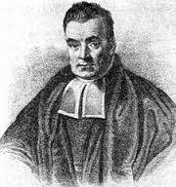
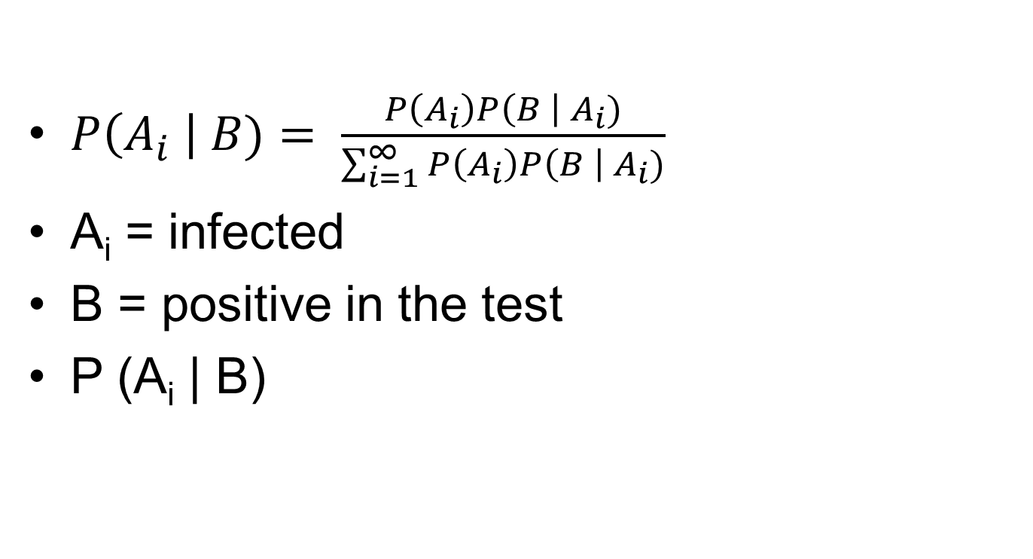
Bayesian theorem
$P\left(A_{i} \right| B)= \frac{P\left(A_{i}\right)P\left(B \right| A_{i})}{\sum_{i=1}^{∞}{P\left(A_{i}\right)P\left(B \right| A_{i})}}$
A_{i} = infected
B = positive in the test
P (A_{i} | B)

Slide 87
Autosomal single-locus disease
Patients
Normal individuals
?

Slide 88
Autosomal single-locus disease
Patients
Normal individuals
?

Slide 89
The probability of 4th girl in the family, given the first 3 are all girls
Your opinion?

Slide 90
Genetics or stochasticity
Model I: for some genetic reasons, only sperms with X chromosome survive.
Model II: the birth of sons and daughters are equally likely
For a family with 3 daughters, which model is more likely?

Slide 91
Genetics or stochasticity
Model I: for some genetic reasons, only sperms with X chromosome survive.
Model II: the birth of sons and daughters are equally likely
How to calculate it quantitatively?

Slide 92
Genetics or stochasticity
Model I: for some genetic reasons, only sperms with X chromosome survive.
Model II: the birth of sons and daughters are equally likely
LOD score: log₁₀ of odds
LOD = log₁₀(P(obs. | model I)/ P(obs. | model II))

Slide 93
Genetics or stochasticity
Model I: Genetics
Model II: By chance
LOD = log₁₀(P(obs. | model I)/ P(obs. | model II))
P(obs. | model I) = 1
P(obs. | model II) = 1/8
LOD =log₁₀(1/8) = -0.9
Threshold: >3 or <-3

