Slide 1
R Programming
Wu Shaohuan

Slide 2
Slides
Will be uploaded to our lab website after each class
http://qianlab.genetics.ac.cn/Teaching.html

Slide 3
What is R?
R is an open source programming language and software environment for statistical computing and graphics that is supported by the R Foundation for Statistical Computing. The R language is widely used among statisticians and data miners for developing statistical software and data analysis.
- Wikipedia

Slide 4
What is R?
programming language (to develop software)
Statisticians (Many of R's standard functions are written in R itself…, from Wikipedia)
software environment (data analysis)
Data scientists

Slide 5
What do we do with R (as biologists/ computational biologists)?
Data analysis
Statistical computing
Graphics

Slide 6
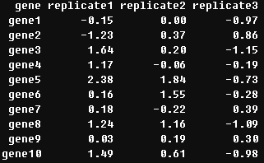
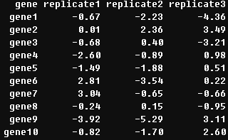
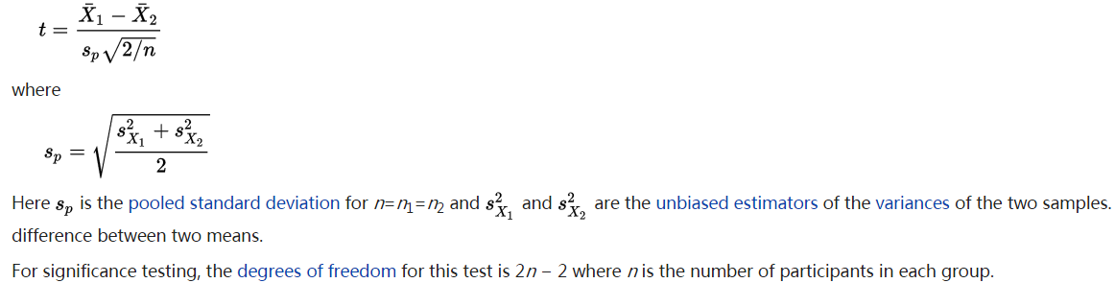
An example
Examine the expression change when a gene is deleted.
wild-type knock-out

Slide 7
Why R?
Google: "statistical software”
The strengths and weaknesses of R
https://www.zhihu.com/question/19611094
Open source, free
Specialized for statistics and data analysis
Easy to learn
Program is small, easy to install
Compatible with various operating systems
Graceful plotting
…

Slide 8
How to get R
R is freely available from the Comprehensive R Archive Network (CRAN) at http://cran.r-project.org.
Choosing a mirror which locates in China (e.g., http://mirrors.ustc.edu.cn/CRAN). Select the version for your operating system.

Slide 9
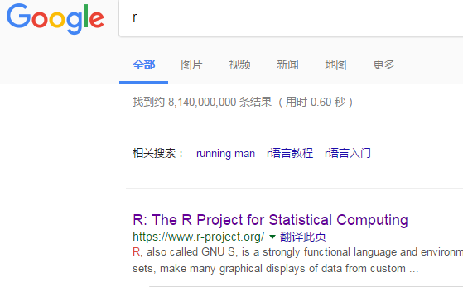
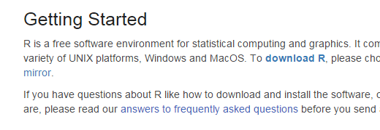
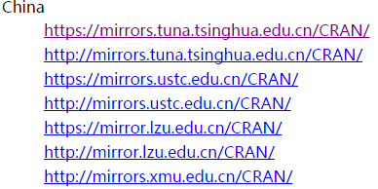
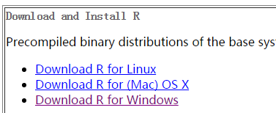
How to get R

Slide 10
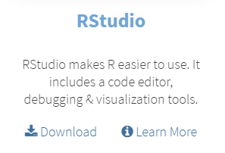
R studio
Is a powerful and user interface for R.
It’s also free and open source
It works great on Windows, Mac, and Linux.
https://www.rstudio.com/

Slide 11
Outline
Data
Data types
How to create
Operations on data
Subsetting (indexing)
Arithmetic, statistic and logical operators
Read/write data
How to get help …

Slide 12
Basic types of data
Numeric
1, 2, 1.1
Character
“a”, “b”, “ab”, “programming language”
Logical
TRUE or FALSE

Slide 13
Vector
Only one data type
e.g.,
c(1,1,1,1)
c(“True”, “True”, “True”, “True”)

Slide 14
Creating a vector
c()

Slide 15
Creating a vector
seq()
rep()
rev()

Slide 16
Exercise of vector
Create the vector below:
1 2 3 4 5 6 7 8 9 10 11 12 13 14 15 16 17 18 19 20 21 21 21 21 21 21 21 21 21 21 20 18 16 14 12 10 8 6 4 2
Relevant commands and operators:
c, seq, rep, rev

Slide 17
Matrix
Two-dimension
Containing only one data type
e.g.,
1 | 2
3 | 4
5 | 6

Slide 18
Creating a matrix
c() + dim()
c() + cbind()/ rbind()
matrix()

Slide 19
Exercise of matrix
1. Creating a matrix below:
1 | 5 | 9
2 | 6 | 10
3 | 7 | 11
4 | 8 | 12
Relevant commands and operators:
matrix

Slide 20
Data frame
Two-dimension
Could containing different types of data
e.g.,
Course | Ross | Joey | Chandler
Biology | 4 | 3 | 3
History | 5 | 3 | 2
Math | 4 | 2 | 5
Physics | 3 | 2 | 5

Slide 21
Creating a data frame
data.frame()

Slide 22
Exercise of data frame
Record the grade, height and weight of 6 people.
Names: Rachael, Ross, Monica, Chandler, Phoebe, Joey
Grade: 93,94,91,88, 86, 90
Height: 1.70, 1.80, 1.65, 1.75, 1.63, 1.80
Weight: 48, 70, 55, 75, 50, 65
Relevant commands and operators:
?data.frame

Slide 23
Summary
Course | Sheldon | Leonard | Penny
Biology | 2 | 4 | 2
History | 4 | 3 | 2
Math | 5 | 4 | 1
Physics | 5 | 4 | 1
Vector
Matrix
Data frame

Slide 24
Add-ons (relatively harder to understand)
Factor, a certain type of vector
Array, an data type which can store data in more than two dimensions
List, an data type which can contain elements of different types

Slide 25
Subsetting (get elements from vector/matrix/data frames, etc)
[]
indexing, vector, matrix, data frame
$
extract elements by name, data frame

Slide 26
Get elements from a vector
[]

Slide 27
Get elements from a matrix
[]

Slide 28
Get elements from a data frame
[]
$

Slide 29
Editing a vector
Add, delete, or replace elements in a vector

Slide 30
Editing a matrix
Add, delete, or replace rows/columns/elements in a matrix

Slide 31
Editing a data frame
Add, delete, or replace rows/columns/elements

Slide 32
Summary
A brief background of R
Data analysis, programming
Basic data types
Numeric, character, logical
Vector, matrix, data frames
Create each type of data
Get elements from each type of data
Edit elements from each type of data

Slide 33
Data analysis with R
Statistical computing using R

Slide 34
Arithmetic operator
Operator | Description | Sample
+ | Addition | 4 + 2 = 6
- | Subtraction | 4 – 2 = 2
* | Multiplication | 2*4 = 8
/ | Division | 8/2 = 4
** or ^ | Exponentiation(x^y equal to x^{y}) | 2^3 = 8
%% | Modulus | 5%%2 = 1
%/% | Integer division | 5%/%2 = 2

Slide 35
logical operator
R command | meaning
> | larger than
< | less than
>= | larger than or equal to
<= | less than or equal to
== | equal to
! | not
& | and
| | or

Slide 36
Statistic functions
Functions | Description | Sample
mean() | Mean | mean(c(1,2,3,6)) returns 3.
median() | Median | median(c(1,2,3,4)) returns 2.5
sd() | Standard deviation | sd(c(1,2,3,4)) returns 1.29
var() | Variance | var(c(1,2,3,4)) returns 1.67
sum() | Sum | sum(c(1,2,3,4)) returns 10
max() | Max | min(c(1,2,3,4)) returns 1
min() | Min | max(c(1,2,3,4)) returns 4

Slide 37
Exercise of operator
Creating the data frame “test.data” below:
Adding a new column named “z”, z = x * y
Calculating the mean of z – x
id | x | y
a | 1 | 11
b | 2 | 21
c | 3 | 31

Slide 38
Setting working directory
R needs to read or write some files, you should told it a directory.
setwd()
getwd()

Slide 39
Packages
install.packages(): install the package
library() : load the package
China (Beijing 3)
install.packages(“ggplot2")
library(“ggplot2")

Slide 40
Data input
read.table()
“Reads a file in table format and creates a data frame from it.”
read.table(file, header = FALSE, sep = "", quote = "\"'", as.is = !stringsAsFactors, skip = 0, comment.char = "#")

Slide 41
Data output
write.table()
“prints its required argument x (after converting it to a data frame if it is not one nor a matrix) to a file ”
write.table(x, file = "", append = FALSE, quote = FALSE, sep = “\t", row.names = FALSE, col.names = TRUE)
getwd()

Slide 42
Exercise of output and input
Write a data frame to a file called “test.txt”
Read the data in this file
Try the options of these two functions

Slide 43
How to get help
Built-in help system
e.g., “?matrix”
Google

Slide 44
Bugs
Run-time errors
occur while your program runs.
Logic errors:
prevent your program from doing what you intended it to do.

Slide 45
Behind every successful programmer
there's a lot of unsuccessful scripts

Slide 46
Analyzing expression levels
Gene_expression_dataset.txt
Set working directory
Read in the dataset
Calculate the average expression levels of mRNA and Protein in each species (Scer and Spar)
Examine if the average expression of mRNA/Protein is significantly different between 2 species
Examine if the expression level of mRNA/Protein is correlated with CDS length in each species

Slide 47
Take home message
Three data structure
Vector
Matrix
data frame
Subsetting and editing
[]
$
Input and output
read.table
write.table

