Slide 1
A digital signature is a mathematical scheme for demonstrating the authenticity of digital messages or documents. A valid digital signature gives a recipient reason to believe that the message was created by a known sender (authentication), that the sender cannot deny having sent the message (non-repudiation), and that the message was not altered in transit (integrity).
Digital signatures are often used to implement electronic signatures, a broader term that refers to any electronic data that carries the intent of a signature, but not all electronic signatures use digital signatures.In some countries, including the United States, Turkey, India,Brazil, Indonesia, Mexico, Saudi Arabia, Switzerland and the countries of theEuropean Union, electronic signatures have legal significance.

Slide 2
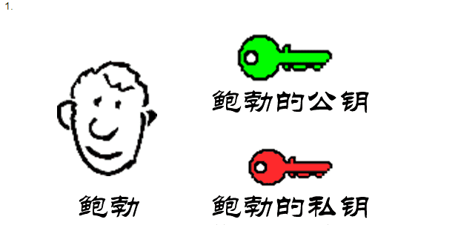
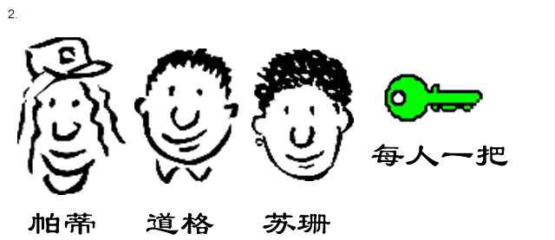
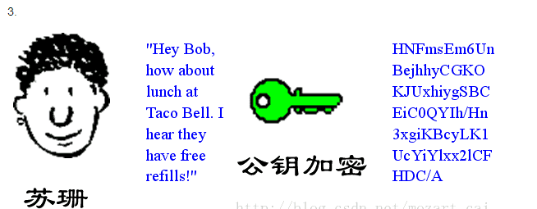
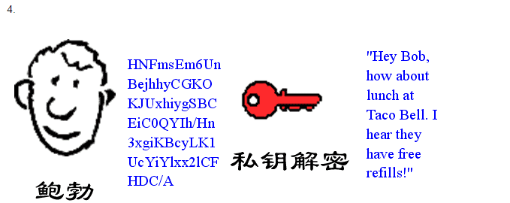

Slide 3
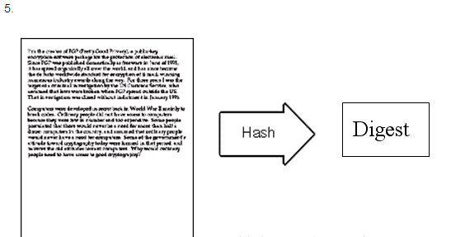
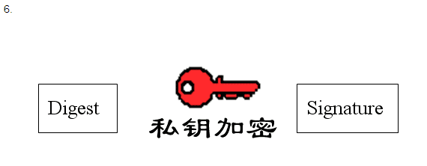
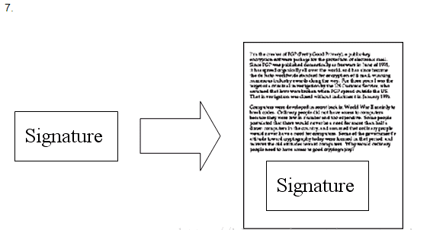
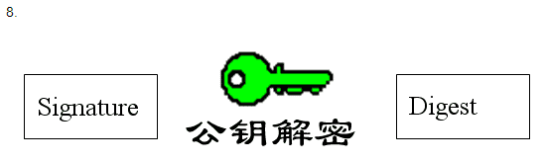
Digital Signature

Slide 4
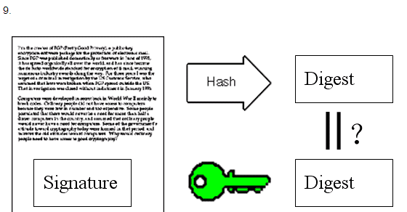
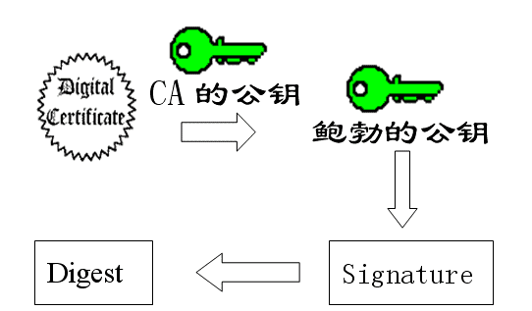
Certificate Authority(CA)
Digital Certificate(DC)

Slide 5
