Slide 1
Experiment plan
Fix parameters at average values of parameter distributions
Potential options of error measures used for measuring uncertainty
Focus on decision relevance
Identify multiplicative parameter relationships
Adjust parameter ranges and distributions
Results
Re-parameterization
Section 5.1
PCE validation with effect of parameter distributions
Run the model to generate samples for calibrating PCE
Section 5.2
Effect of parameter distributions on sensitivity index
Adaptive FF
Adaptive PCE based GSA and uncertainty-based parameter ranking
Approximate the error with a small sample size
Identify important parameters for varying and potential parameters to fix
Adaptive evaluation and robustness assessment
Section 5.3
Adaptive figure, approximation of error, and the decision on sample size
Discussion: Section 6.1
Robustness analysis of error measures
Increase sample size to assess the reliability of results
Reflection on FF and the next step
Reconsider whether fixing is necessary
Sections 5.4 & 5.5
Effect of uncertainty communication
Robustness assessment
Discussion: Section 6.2

Slide 2
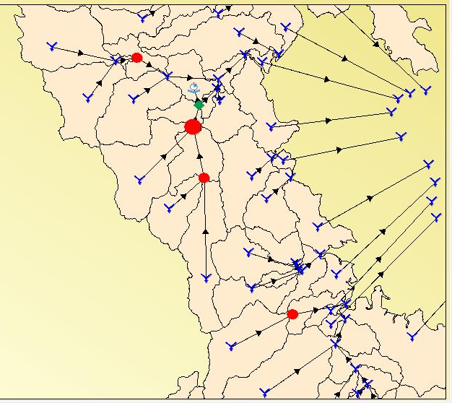
TSS generation models for different land uses
Grazing
Revised Universal Soil Loss Equation (RUSLE)
Gully
CSIRO gully model
Link transport of TSS
Conservation, forestry, horticulture, urban and others
Cropping and Sugarcane
Erosion Load TimeSeries Model (with external models involved)
Event Mean Concentration (EMC) and Dry Weather Concentration (DWC) model
Streambank Erosion
Streambank erosion model

Slide 3




7
Sample size N1
6
Sample size N2
Sensitivity rankings
5
4
3
2
1
0
…
$$x_{1}$$
$$x_{2}$$
$$x_{3}$$
$$x_{remain}$$
Factors

Slide 4
(a)
(b)
 | ST-S | ST-B | ST-U
Number of PCE regressions (*) | 500 (54)
Number of PCE runs (*) | 250, 000 (272) | --
Time for Beta distribution estimation (*) | -- | 19 | --
Total time (*) | 326 | 73 | 54
 | CV | NDMV (NDME )
Calculation type | Analytical | Numerical
Number of repetitions for error approximation | < 1 | 1, 000
Number of total evaluation |  | 24, 000
Total time (*) |  | 40
*: Time used in seconds

Slide 5
Legend
Parameters cannot be distinguished
Stable partial sort
More partial groups emerge
Start to distinguish parameters

Slide 6
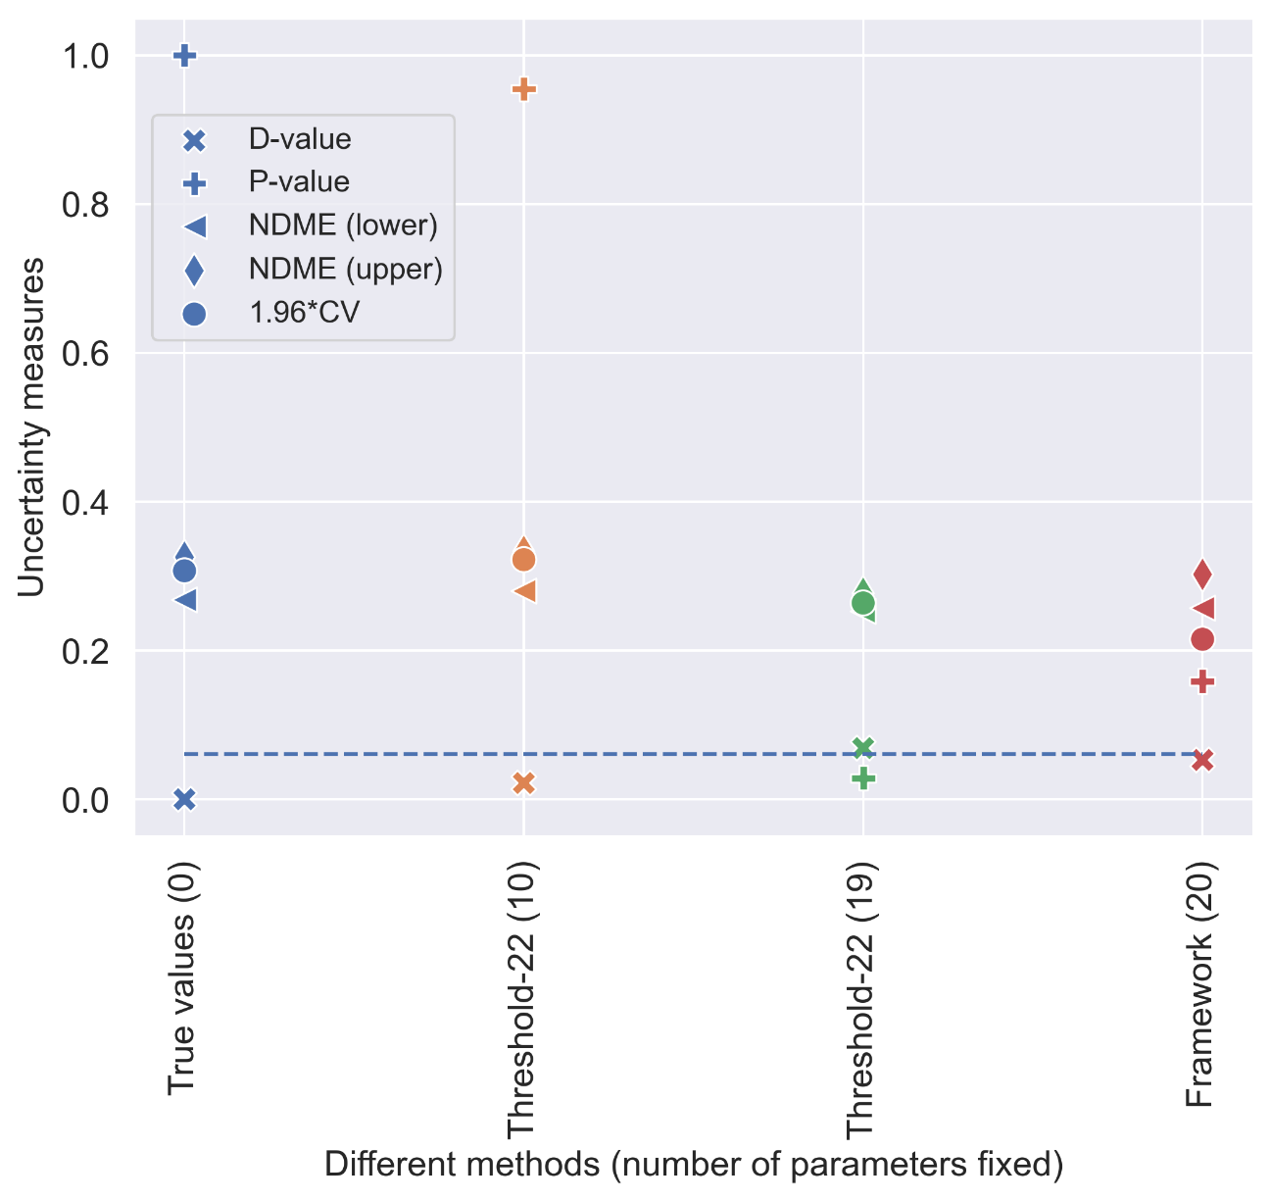
Model runs needed
The true values | 552
Dummy-22 | 552
Threshold-22 | 552
Framework | 156
critical value

Slide 7
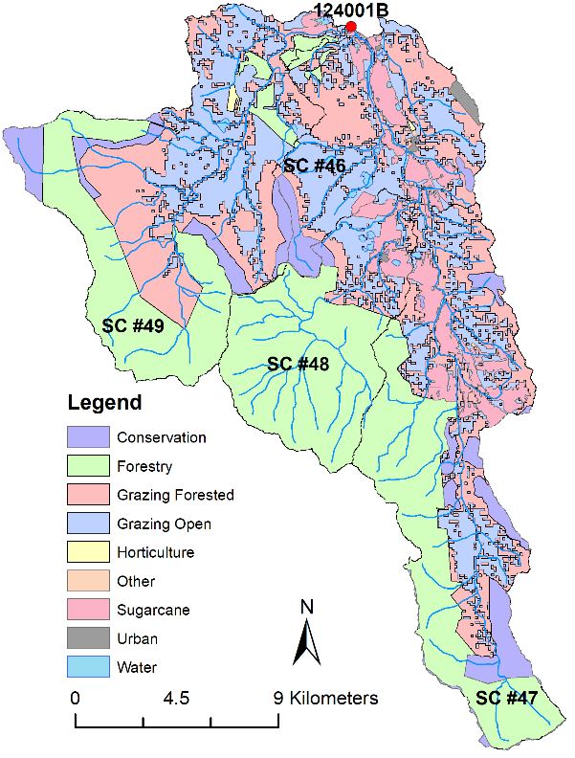
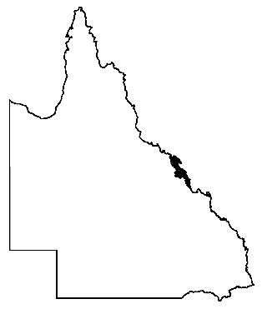

Queensland
Mackay Whitsunday

