Slide 1

Writing a dissertation for PG Data Science
Helen Costello
Academic Skills Centre

Slide 2
Sessions Outline
Session Outline:
Research questions, structure of the introduction and outline of the aims in the introduction
Further help available – where to go?

Slide 3
Session Aims
Identify and analyse the process of writing a dissertation and compare this to the process you will experience
Evaluate the importance of narrowing research questions for focus and direction
Consider the structure of an introduction as a way to set up your dissertation
Consider the importance of outlining your aims clearly and providing signposting in introductions

Slide 4
This course…
IS about the general principles of dissertation writing
IT IS NOT about answering questions specific to your discipline or topic – speak to your supervisor for help with those issues

Slide 5
Pairwork – 3 minutes
Ask your partner:
What is challenging about writing a dissertation as opposed to other forms of writing?

Slide 6
Challenges
It’s your own piece of research
You need to establish your own research question (s)
The extended nature of a dissertation can be challenging- you need to remain focused and maintain continuity among all chapters

Slide 7

All research projects have an aim
Which starts with a focused research question….

Slide 8
Reading must inform each stage of the process
Topic
Research question
Your aims

Slide 9
Pairwork – 3 minutes
Ask your partner:
Where are you in the reading process?
What are you doing with all the information? What is your notetaking process?

Slide 10
Narrowing from Topic to Research Question
Know what you are studying and why....!
Topic: I am studying _________
Question: because I want to find out how/why_____
Rationale: in order to understand how/why/whether______
Booth (1995)
Try this with your topic…

Slide 11
Reading must inform each stage of the process
Topic
Research question
Your aims

Slide 12
Research questions need to be:
Relevant
Manageable in terms of research and in terms of your own academic abilities
Substantial
Clear and simple
Interesting

Slide 13
Your research question needs to be focused
Your scope can be narrowed to:
Data Science methods
Key concepts
Types of participants
Key theory under consideration
Can you think of any other classifications that you can use to narrow your question?

Slide 14
Good Research Questions:
Help us to understand what further needs to be understood/solved.
Explore areas which are unknown and insights are useful and practical for the field
O’Leary (2018)

Slide 15
What’s wrong with this question? What is it missing?
Ways to narrow:
Data Science methods
Key concepts
Types of participants
Key theory under consideration
What is the role of genes in cancer?
Is the xxx gene implicated in cancer of the lung in non-smokers?”
Adapted from: http://www.biology.cam.ac.uk/undergrads/nst/bbs/dissertations

Slide 16
Reading must inform each stage of the process
Topic
Research question
Your aims

Slide 17
Dissertation Structure (IMRD)
A data-based (empirical) dissertation may contain:
Abstract
Introduction
Literature Review
Methodology
Results
Discussion
Conclusion
Reference List
Notes:
Today’s focus in bold

Slide 18
This means that:
Some dissertations will have:
A combined Introduction and Literature Review
A combined Discussion/conclusion chapter
Speak to your supervisor about what is appropriate for your dissertation

Slide 19
Movement in introductions and literature reviews
General
More specific
Most specific

Slide 20
Combined Literature Review and Introduction Chapter

Slide 21
Overall structure for a combined introduction and literature review
Outline the literature to:
Lead your reader to your gap
Gap in research
and hypothesis or statement of research questions
*NB with awareness of what the audience already knows
Adapted from Weissburg and Buker (1990, p.24)

Slide 22
Combined Introduction and Literature Review Structure
1. General introduction to the topic (establish that this is an area of interest and/or debate; include definitions if necessary)
2. More specific statements about aspects of the problem already studied by past writers. Organised logically
3. Statement of need for more investigation (identify a gap)
4. Indication that you will occupy the gap
5) Signposting - A brief guide to the structure of the dissertation (“Firstly, this dissertation will discuss… Next, the issue of … will be considered… Finally, I will turn to…”)

Slide 23
Stand Alone Introduction Chapter

Slide 24
Stand-alone Introduction structure
Introduce the topic/establish controversy
Define key concepts and limiting scope of research
Move toward the gap in research
State the gap in research
State the aims of your study/possibly state your hypothesis and signpost to future chapters

Slide 25
The research question from our sample dissertation
Can Machine Learning Accurately Predict the Success of a Start-Up?
What are the main ideas in this question?

Slide 26
Can machine learning
Accurately predict
The success of a startup?

Slide 27
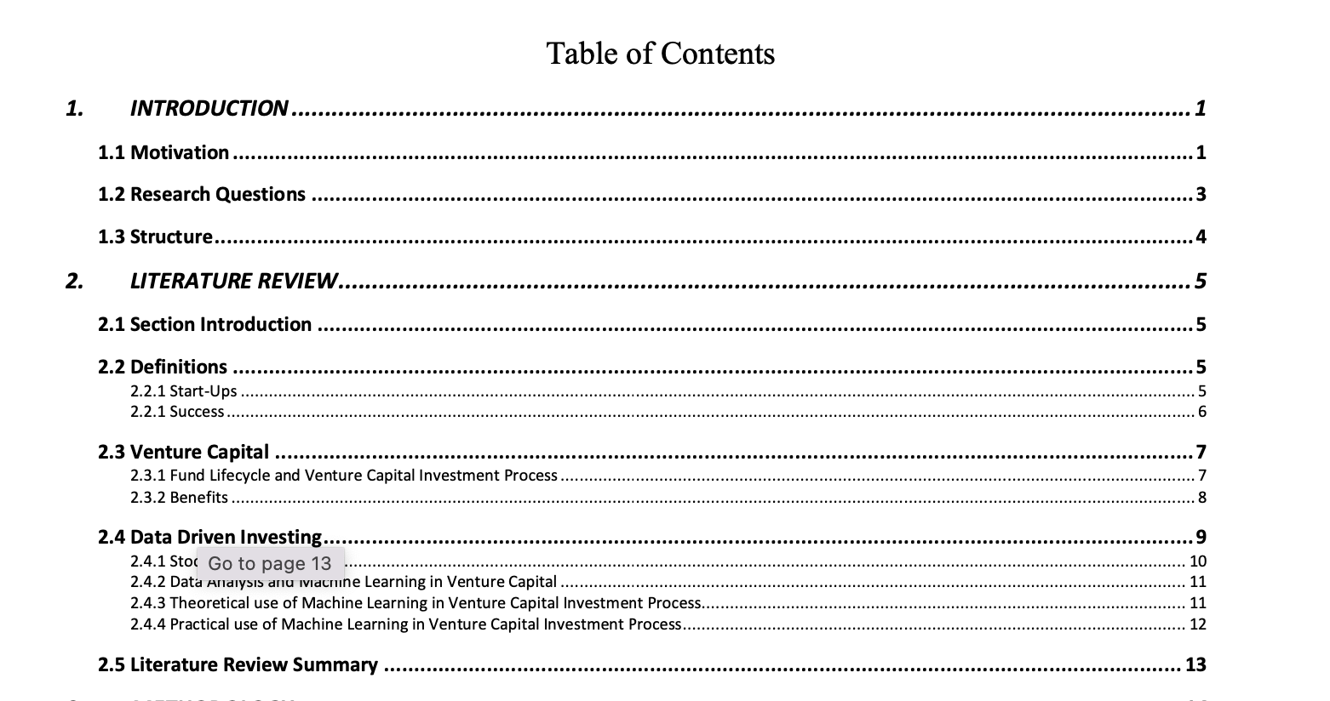
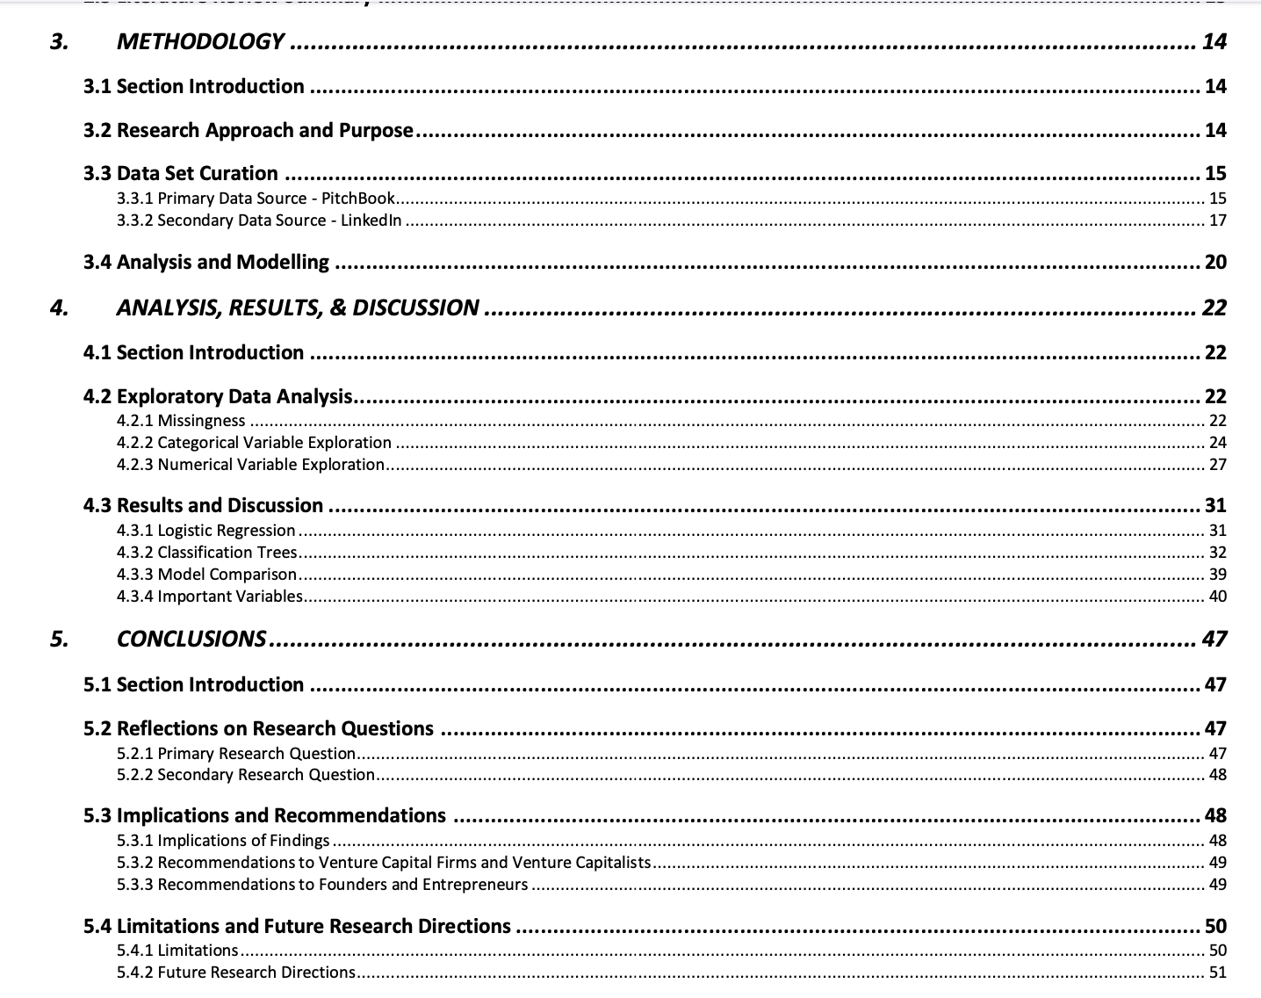
This dissertation’s structure:

Slide 28
Activity
Read through part of the introduction and
Identify the different sections (where relevant)
Dissertation Title: Can Machine Learning Accurately Predict the Success of a Start-Up?

Slide 29
In conclusion
Establish a clear research question and follow it through in all chapters
Lead your reader to your aims by following a general to specific structure in your combined introduction and literature review or stand-alone introduction

Slide 30

Help available to you…

Slide 31



Academic Skills Drop-ins
Need study or writing advice? Come and see us!
In-person
Tuesdays 12-3pm: Top Floor TLC
Wednesdays 12-3pm: Bill Bryson Library
Thursdays 12-3pm: Top Floor TLC
Online
Wednesdays 12-3pm: via Teams

Slide 32

(Glasman-Deal, 2010)
Contains lots of useful language sections to avoid repeating favourite expressions and phrases!

Slide 33

A Useful Resource (e-copies in the library)

Slide 34
References
Booth, Wayne C. et.al. (1995) The Craft of Research, University of Chicago Press, Chicago.
O’Leary, Zara (2018) Little Quick Fix: Research Question, Sage Publications, London.

