Slide 1
Lab 2: Introduction to Perl
Sanjeev and Qian
8/31/2015

Slide 2
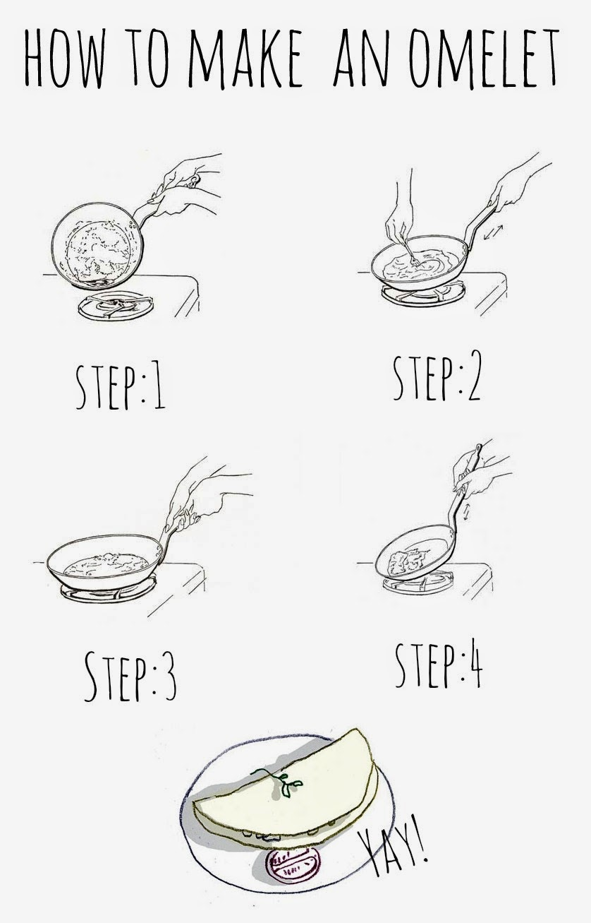
What is Programming?
A process of writing down a set of instructions (a program) for a computer to do something
hHp:titiwww.wiley.comtiegeticmtiakmtietichap05tietigor.htm
Notes:
computer is a tool that requires recipes.
Programming is a way of creating recipes for computer to follow.
Think of computer as a really good cook but it requires recipes to cook your favorite omelettes, fajitas.

Slide 3
Program
Data
Computer
Output
Notes:
program to provide specific instructions on how to work on the data to get desired result
Data are the ingredients for the recipe(program)
Results=omelettes

Slide 4
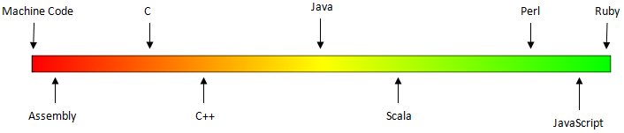
Programming language
languages used by programmers to write instructions for a computer to execute.
Two types: high level and low level languages
hHp:titiwww.codecommit.comtigtiavtieﬁning‐high‐mid‐and‐low‐level‐languages
Notes:
mostly we will be using high level languages which are closer to human language does not understand human language but has tremendous power to calculate data.

Slide 5
Low‐Level VS High‐Level
Generally speaking, high‐Level languages are near to human languages while low‐level languages are closer to machine code.
High‐level languages are easy to learn while low‐ level languages are hard.
High‐Level languages are machine independent. They can run on diﬀerent hardware pla[orms. They are normally used to write application programs.
Low‐level languages are normally used to write hardware programs.
Notes:
C is middle level.

Slide 6

Why Perl?
A high level language created by Larry Wall in 1987
It has been called a glue language
It focuses strongly on text processing, regular expressions are an integral part of Perl. So, the pattern matching and substitution options are incredibly rich.
It has been being used for a long time by biologists (see How Perl saved human genome)
Notes:
Perl was first designed for web applications which connects computer(database) to web servers so a glue language
This incredibly rich tools in perl make it an ideal tool for biology because we deal with strings most of the time.
For human genome project the problem was that there were different databases but they could not find a way to consolidate those information.
Perl was used to combine information from both databases to aid in human genome annotation.

Slide 7
Features of Perl:
TIMTOWTDI, pronounced "Tim Toady", or "There's more than one way to do it!”
DWIM philosophy (do what I mean)
Baby Perl ??
Write Once, Read Never
Notes:
You can cook the same dish in different ways and end result will be same...maybe some ways are better than others.
Given a cursory understanding of Perl (especially context; Context), it should be possible to understand the intent of an unfamiliar Perl expression
Programmers don’t need to know everything to write their codes… superficial knowledge will allow you to write many powerful programs

Slide 8
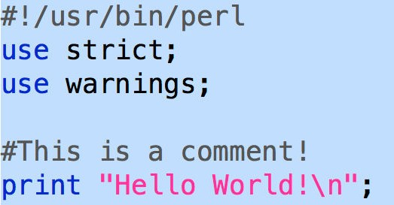
Your ﬁrst program
The ﬁrst line starting with “#!” is called “Shebang line”. It tells the computer that this is a perl program and the path to the perl program itself.
To ﬁgured out where your perl program is, just type : “which perl” in your terminal.
A command like use strict is called a pragma. They are special modules that tell Perl interpreter do something about your code.
Perl statements end with the semicolon character (;)

Slide 9
use strict: check for unsafe programming constructs and force you declare your variables
use warnings: detect possible typo errors and look for potential problems
Always use them.

Slide 10
Comments in Perl
To comment a line out, just use the “#”character, anything aier “#” will be ignored
The Shebang line is a very special “comment”
You can also comment multiple lines using the POD(Plain Old Documentation format) system
Notes:
POD will be rarely used
starts with =start and =cut

Slide 11
Perl Variables

Slide 12
What’s a variable?
A variable is a memory location. They are simply containers holding values.
The value stored in a variable can be accessed through its name, also known as its identiﬁer.
Notes:
can have a constant value or a changing value

Slide 13
Types of Variable
Three main types: scalars, arrays, and hashes. They can be easily diﬀerentiated by the symbols before their names.
Type | Symbol | Descrip0on
Scalars | $ | Stores a single value, a number, a string, or a reference
Arrays | @ | Stores a list of values, numbers, strings, or even another array
Hashes | % | Store sets of key/value pairs
Examples:
my $a=10;
my @a=(1,2,3,4,5);
my %hash=(key1=>value1, key2=>value2,…};

Slide 14
Variable naming and declaration
Must start with an underscore or letter and be comprised of only letters, numbers, or underscores.
Can’t start with a number
Variable names are case sensitive
You don’t need to declare variables before using it, but you should always declare it using my keyword.
Notes:
fortran in case-insensitive

Slide 15
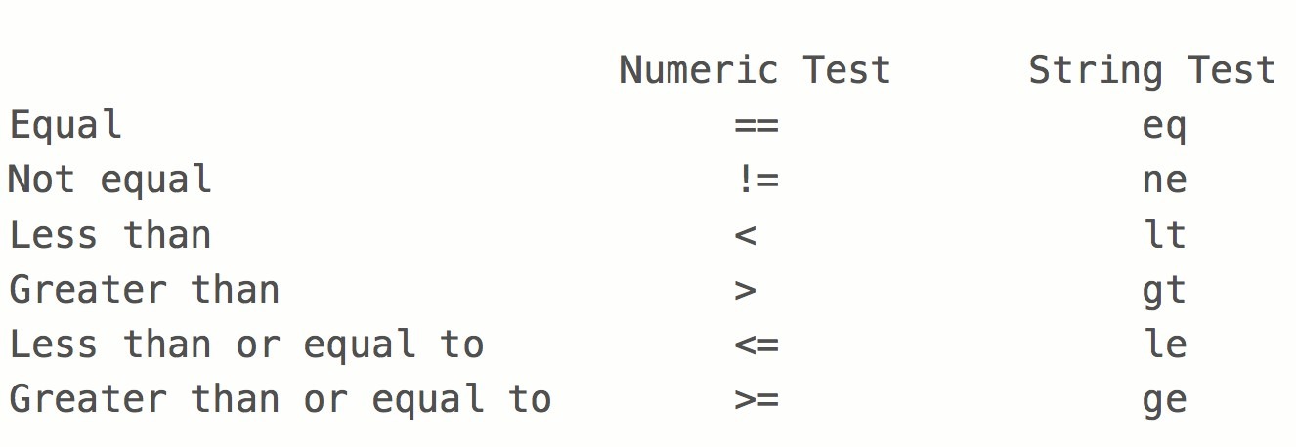
Logical Operators in Perl
Logical operators are mainly used to control program ﬂow. Before gedng into control statements, you should know what they are
Notes:
you can combine string with numbers, but they will still be considered strings.

Slide 16
Conditional Statements
use an expression to check if a condition is met. The return values can be either true or false
if … else
if … elsif … else

Slide 17
if … else
if (CONDITION) {
# Code block executed
# if condition is true.
} else {
# Code block executed
# if condi0on is false.
}
my $x = 5; if ($x > 4) {
print “x is greater than 4\n”;
} else {
print ”x is less than or equal to 4\n”;
}

Slide 18
if … elsif … else
if (CONDITION_ONE) {
# Code block executed
# if condi0on one is true.
} elsif (CONDITION_TWO) {
# Code block executed
# if condi0on two is true.
} else {
# Code block executed
# if all other conditions are false.
}
my $x = “C”;
if ($x eq “A”) {
print “X is adenine\n”;
} elsif ($x eq “G”) {
print “X is guanine\n”;
} elsif ($x eq ”C”) {
print “X is Cytosine\n”;
} else {
print ”X is thymine\n”;
}

Slide 19
Loop Statements
checks a condition and executes the statements included in curly braces until that condition is evaluated true or false
while
for
foreach

Slide 20
while Loop
while(condition)
{
statement(s);
}
my $z = 10;
while( $z < 20 ){
print "Value of z: $z\n";
$z = $z + 1;
}
print “Z is $z\n”;
Notes:
while is mostly used when one does not know when a condition will be met or what the range of the loop should be

Slide 21
foreach
It is specially designed to iterate over arrays
foreach value (array) { # Code block executed } | my @array = (1,2,3,4,5); foreach my $number (@array){ print "Value of number: $number\n"; }

Slide 22
for
for statement argument section is composed of three parts: initialization, test and re‐ initialization.
execute a speciﬁc number of times
for ( init; condition; increment ){ statement(s);
}
for (my $i = 1; $i <= 10; $i++) { print "$i\n";
}
Notes:
for loop is used when one knows the range...it's usually finite.
i++ increment of one or i=i+1

Slide 23
Input and Output
STDIN (Standard input): reads input from keys typed at the keyboard
STDOUT: output generated by print statements goes to STDOUT
From ﬁles
print "What is your favorite number?";
my $your_input = <>;
print "Your favorite is: $your_input";
Notes:
print == STDOUT
STDIN usually done through <>

Slide 24
File Handling: open, read, write and close ﬁles

Slide 25
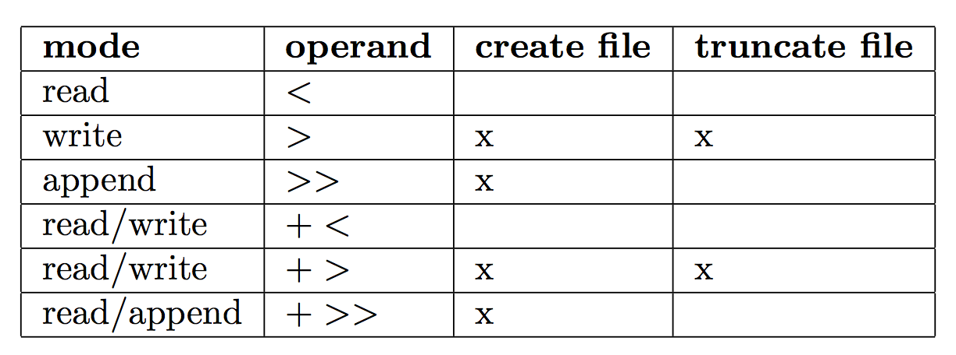
Open and close ﬁles
open ( FILE ,”<“, ‘myﬁle.txt’) || die $!;
……
close (FILE);
Notes:
FILE is a file handler which means it substitutes the name of file now.
|| is or statement. We can use it in if statements as well.
die $! displays standard error when it cannot read the file and does a standard exit, but you can also write a message after die for your own message for exceptions
should always close a file after it's done.

Slide 26
read ﬁles
Using while loop to read a ﬁle line by line
while (my $line = <FILE>)
{
chomp $line;
print "$line\n";
}
Notes:
chomp removes newline characters in everyline.

Slide 27
write to ﬁles
simply use the print statement followed by the ﬁle handle
my $str = "ATCG";
open (FILE, ">ﬁle.txt”) or die $!;
print FILE "$str\n";
Notes:
OR
open (FILE, “>”,”ﬁle.txt”) or die $!;

Slide 28
FASTA format
text‐based format
begins with a single‐line description, followed by lines of sequence data
description line starts with a ">" sign
> sequence1
ATCGATCG…..
> Sequence2
AACCTTGG……

Slide 29
Class assignment: GC Content Recipe
Open the file (open ( FILE ,”<“, ‘myﬁle.txt’))
Remove the new line characters (CHOMP)
Count number of A, C, G, T.
Total = sum of all counts
GCnumber=count of G + count of C
GCcontent=GCnumber/Total*100

