Slide 1
Lab 4
Module 1 - Day 2
Primer Design
Sanjeev and Qian
9/21/2015

Slide 2
Review: module1- day1
Command-line argument
@ARGV = [“argument_1”,”argument_2”]
Perl:
my $filein = $ARGV[0];
Linux:
perl module1.pl salmonella.fasta
perl module1.pl my_input_file.fasta my_gene_list.txt
$ARGV[0] $ARGV[1]

Slide 3
Review: module1- day1
$string =~ modifier1/pattern/modifier2
$string =~ /Mr\./
$string =~ /money\?/
\d{n} = for numbers 0-9
\w{n}= for alphanumeric characters
^ = start of a string
$ = end of string
modifiers:
m = treat string as multiple lines
g = for global matching
Example:
my $string= "6870 Myrtle Drive, Knoxville, TN 37890”;
# regex/pattern \d{5}
if ($string =~ /\d{5}/)
{
print ”Zip code\n”;
}

Slide 4
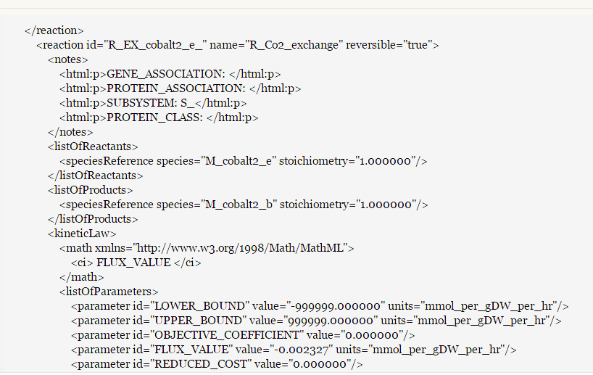
Discussion Board
Thanks to Sergio

Slide 5
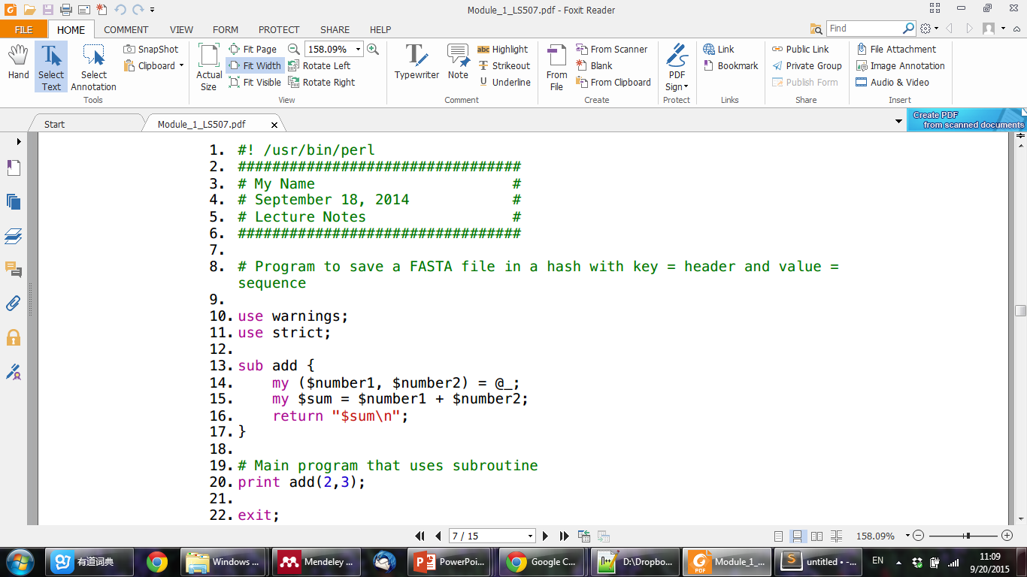
Perl: Subroutine
Like any good programming language, Perl allows the user to define their own functions, called subroutines.
sub namesub
{
print "Not a very interesting routine\n";
print "This does the same thing every time\n";
}
#Notice that a subroutine is called with an & character in front of the name:
&namesub; # Call the subroutine
&namesub(1,2); # Call it with two parameters

Slide 6
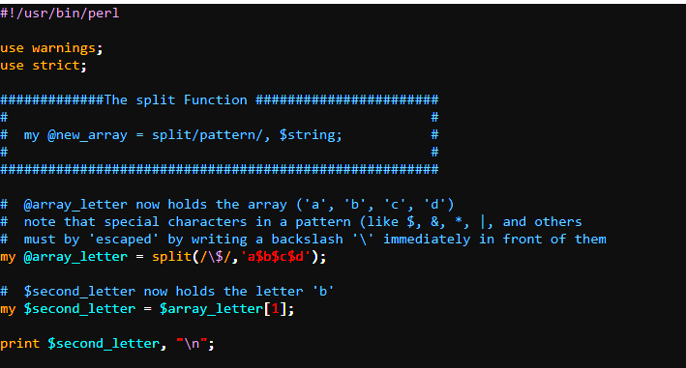
Perl: Split

Slide 7
Practice: Subroutine, Split
1) write a perl script minus.pl with sub, calculate “2-1=?”, and print the result to Linux screen.
2) write a perl script split.pl to split the string ‘The source code generally was not there when I needed it.’ with whitespace, and only print ‘code’ to Linux Screen. (hint: regex for whitespace is \s)

Slide 8
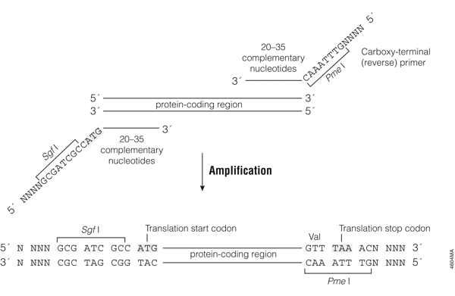
For Primer Design

Slide 9
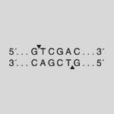
For Primer Design: restriction enzymes
Find out if any of the following restriction enzymes will cut the sequence
Sal I
Sma I
Cla I
Sal I

Slide 10
For Primer Design: restriction enzymes
Now, let’s use perl for restriction enzyme Sal I.
download sequence file m1d2_fasta.txt and perl script enzyme_fill.pl from BlackBoard
Pipeline: REPLACE ‘?????’ with your commands
1) read the fasta file, as on last Monday
2) complete the sub check_for_cut to count how many times the enzyme Sal I can be found in ‘one sequence’
3) complete the main program: loop for each sequence; print short header, which is the first part of the header (split by whitespace), eg “lcl|NC_000913.3_cds_NP_414634.1_90”, print the short headers and the counts

Slide 11
Homework
Due Monday September 28. Use module-1-Day-1 sequence: MG1655FastaNt_m1.txt
Your assignment for this week is to add to the previous week’s homework in a new file called <your name>_<module#>_<day#/HW#>.pl to:
Make a subroutine in which you:
Create a hash with the following restriction site keys and values:
Determine whether any of the restriction enzyme cut sites in the hash are present in a given sequence.
Returns a single restriction enzyme that does not cut the current sequence, or returns an error if all restriction enzymes can cut. If genes have restrictions sites for 2 or more enzymes, they will print out an error because now you cannot use the combination..SalI-ClaI, SalI-SmaI, SmaI,ClaI.
Key: | claI, | value: | ATCGAT
Key: | SmaI, | value: | CCCGGG
Key: | SalI, | value: | GTCGAC

Slide 12
Homework
Hint: Use a variable to keep track of how many restriction enzymes do not cut; if this variable reaches 3, all restriction enzymes cut and an error message should be returned
B. Split your current header line by ‘\s’ (whitespace), and take the first component of the array for printing to file.
C. Print our the gene id followed by the output of your subroutine to a new file called yournetid_primer_design_2.txt
i.e. >lcl|NC_000913.3_cds_NP_414634.1_90543211
>lcl|NC_000913.3_cds_NP_414555.1_13
etc …
SmaI SalI

