Slide 1
Module 3: Statistical assessment of proteins day1
Sanjeev Dahal and Qian Zhang

Slide 2
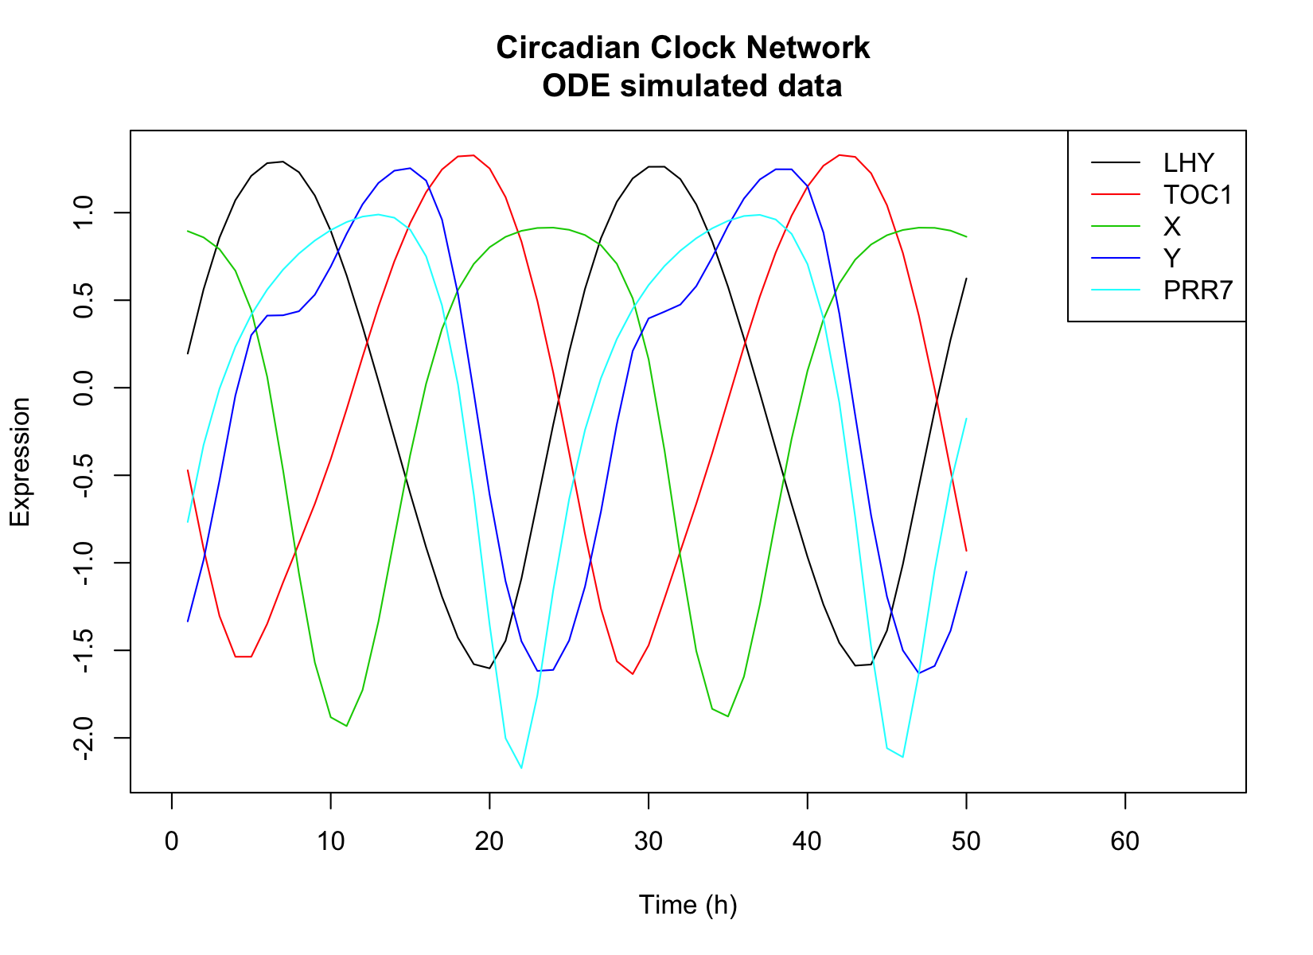
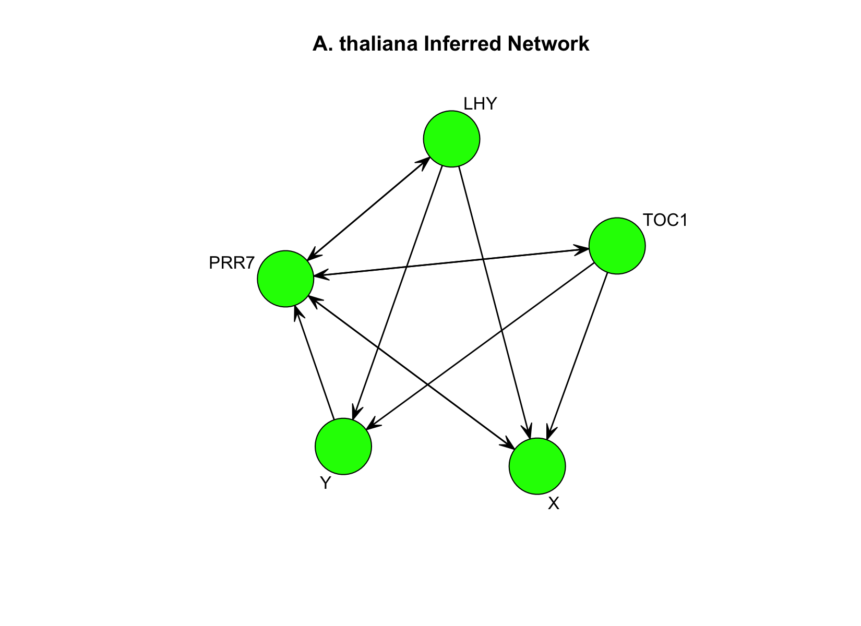
Module 4 - Day 2
Something was wrong with the script.
I made changes to it.
Posted as HWScript_Edited.

Slide 3
BACK TO PERL AGAIN
Working with directories
More on pattern matching
Testing files

Slide 4
Handling directories
opendir : open a directory
readdir : read the contents of a directory
chdir : change directory
closedir : close directory

Slide 5
Diamond operator
Read files line by line
We can also use it to loop through each file in a current directory
foreach my $dir (<∗>){

Slide 6
TEST FILES
-e File exists.
-z File has zero size (is empty).
-s File has nonzero size (returns size in bytes).
-f File is a plain file.
-d File is a directory.

Slide 7
A sample script
foreach my $dir(<∗>){
#loops through each dir in current dir ( excluding . and . . )
if(−d $dir){
#check if $dir is a directory (vs a file)
chdir($dir)
#if it is a directory, change dir into it
}

Slide 8
A sample script
foreach my $dir(<∗>){
#loops through each dir in current dir ( excluding . and . . )
if(−d $dir){
#check if $dir is a directory (vs a file)
chdir($dir)
#if it is a directory, change dir into it
}

Slide 9
A sample script
foreach my $dir(<∗>){
#loops through each dir in current dir ( excluding . and . . )
if(−d $dir){
#check if $dir is a directory (vs a file)
chdir($dir)
#if it is a directory, change dir into it
}

Slide 10
A sample script
foreach my $dir(<∗>){
#loops through each dir in current dir ( excluding . and . . )
if(−d $dir){
#check if $dir is a directory (vs a file)
chdir($dir)
#if it is a directory, change dir into it
}

Slide 11
Regular Expressions
REGEX are used for pattern matching
Within a pattern, they can substitute letters, digits and so on.
if ($line =~/^>/){
#do sth
}

Slide 12
Common Regex – In front of /
m : match – uses two backslashes m/pattern/
$line =~ m/^>/
s : substitute - uses three backslashes s/search pattern/substitution/
$line =~ s/^>/Header/
tr : transliterate - uses three backslashes tr/translate this pattern/to this pattern/
$line =~ tr/ATCG/TAGC/

Slide 13
Common Regex – between slashes
. any character
\w alphanumeric character (includes "_")
\W NOT alphanumeric character
\d digit
\D NOT digit
\s whitespace character
\t tab
\n newline
\r return

Slide 14
Common Regex – between slashes
[a-z] : range of lowercase letters
[A-Z] : range of uppercase letters
[0-9] : range of digits

Slide 15
Common Regex – between slashes
* : 0 or more times
+ : 1 or more times
? : 1 or 0 times
{n} : exactly n times

Slide 16
Common Regex – between slashes
^ : beginning of line - m/^pattern/
$ : end of line - m/pattern$/
\ : escape character - to escape meaning of special characters or escape normal meaning of a letter
() : capture group - any part of your pattern inside parenthesis can be returned with variables $1, $2, $&, etc.

Slide 17
Common Regex (Example)
my $string = ”abcdefghi”;
if($string =~ /(abc)def(ghi)/){
#patterns that start with any lowercase letter #followed by ’at ’ and start with ’hi ’ followed
#by any letter are captured with ()
print ”First pattern: $1\n”;
#first instance of first ( pattern )

Slide 18
Common Regex – after slash
i : case insensitive
g : global - continue to pattern match even after one match has been found

Slide 19
In class assignment
Find the file inClassSeq.txt by going through the directory given (dataDir).
Open and read the file
Find all the pattern starting with AS followed by 8 random characters and ending with A. We do not need ^ and $ here.
Print all those strings that matched to the terminal.

Slide 20
Homework M3D1
Remove the directory myClass before the assignment.
Loop through the contents of the directory dataDir
Access each file in each subdirectory
Burkholderia and Streptomyces
Go through the sequence and count the number of the motif DDXXD (terpene synthase) where D = aspartate and X=any other amino acid
Print the file path and number of motif counts found to a new tab- separated file; new file should look like this:
path_to_file_1 motif_count_1
path_to_file_2 motif_count_2
path_to_file_3 motif_count_3
OUTPUT file name: output_<yourname>_m3d1.txt
PERL file name: <yourname>_m3d1.pl

