Slide 1
Module 3 Day 2: Data search and analysis
Sanjeev and Qian
11/16/2015

Slide 2
M3d1 review
Handling files
Diamond operator
Test files
Regular expression
In front of /
between slashes
after slash

Slide 3
Homework M3D1
Remove the directory myClass before the assignment.
Loop through the contents of the directory dataDir
Access each file in each subdirectory
Burkholderia and Streptomyces
Go through the sequence and count the number of the motif DDXXD (terpene synthase) where D = aspartate and X=any other amino acid
Print the file path and number of motif counts found to a new tab- separated file; new file should look like this:
path_to_file_1 motif_count_1
path_to_file_2 motif_count_2
path_to_file_3 motif_count_3
OUTPUT file name: output_<yourname>_m3d1.txt
PERL file name: <yourname>_m3d1.pl

Slide 4
Today…
whether the frequency of your protein motif is significantly different between these two datasets: Streptomyces and Burkholderia
How to compare them?

Slide 5
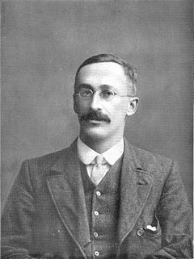
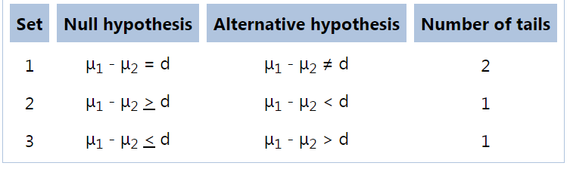
Two sample t-test
Student t-distribution
Student t-test
small-sample
William Sealy Gosset
Pen name: student

Slide 6
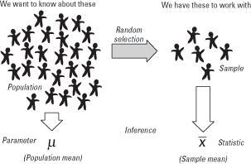
Population and samples

Slide 7
Two sample
compare population mean

Slide 8
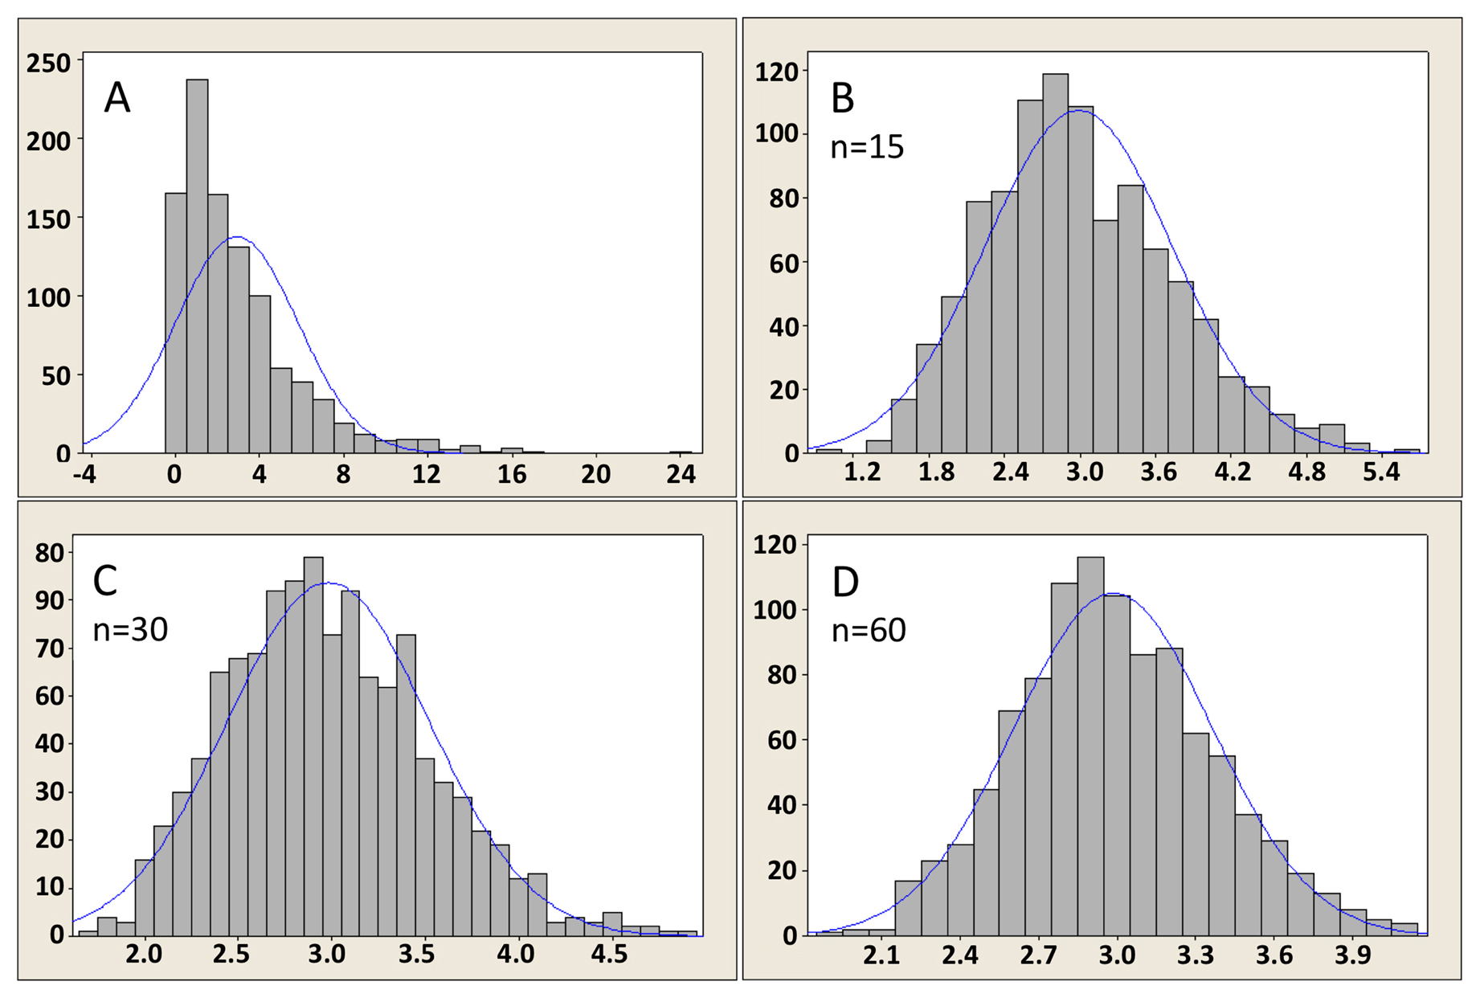
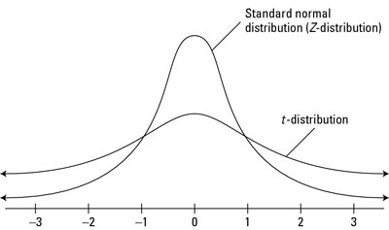
Central limit theorem
Sample means follow a specific distribution
Z distribution: large sample
T-distribution: small sample
http://www.wormbook.org/chapters/www_statisticalanalysis/statisticalanalysis.html

Slide 9
Two sample t-test
Student t-distribution
Student t-test
small-sample
William Sealy Gosset
Pen name: student

Slide 10
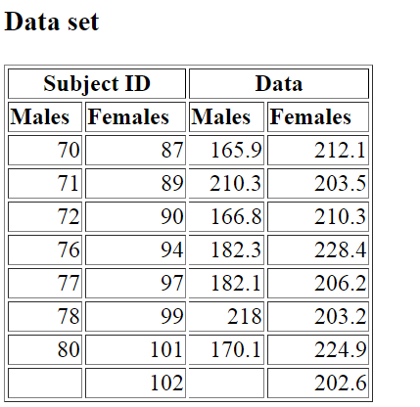
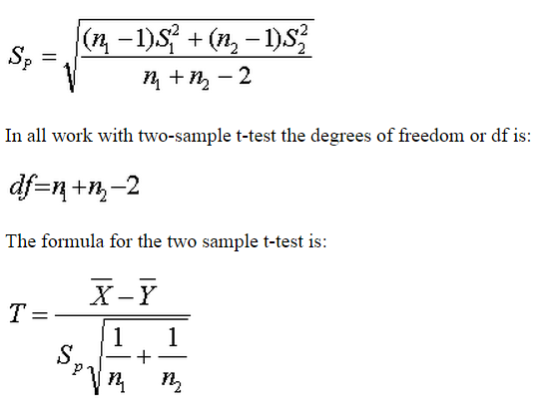
In class practice: Two sample t-test
T table: http://www.sjsu.edu/faculty/gerstman/StatPrimer/t-table.pdf

Slide 11
In class practice: Two sample t-test
Mean1: 185.071428571429
Mean2: 211.4
variance1: 380.402040816327
variance2: 88.3850000000001
Pooled SD: 14.9386109046786
T stat: -2.81189922885446
T table: http://www.sjsu.edu/faculty/gerstman/StatPrimer/t-table.pdf

Slide 12
Homework: m3d2
Count the number of terpene synthase protein motifs in each file for each of the 2 datasets. (should be able to use previous week’s code)
Write a Perl code to run a two-sample t-test; use your knowledge of t-tests to determine what your assumptions are. Your output will be a t-test statistic printed to terminal
Write up your method of finding and counting protein motifs, describe any problems you encountered and how you addressed them, explain why your t-test assumptions fit the data, explain how you implemented your t-test, and discuss what conclusions you can draw about the existence of terpene synthases in Streptomyces and Burkholderia.
Submit m3d2_yourname.pl and m3d2_yourname.txt

