Slide 1

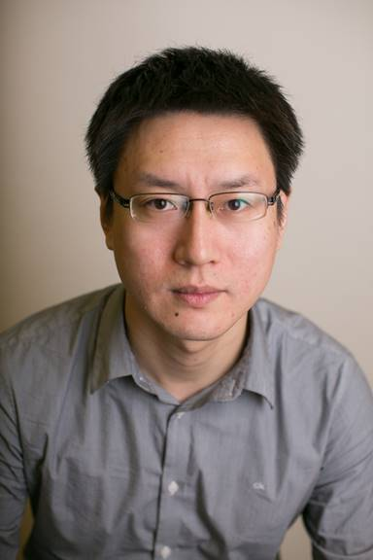
Open PhD/MSc Positions at the Memorial University
Qiang Ye Assistant Professor Department of Computer Science Memorial University of Newfoundland, Canada Email: qiangy@mun.ca Personal Webpage: https://www.cs.mun.ca/~qiangy
Position Overview
Professor Qiang Ye currently has several PhD/MSc openings for Fall 2023. Areas of research include AI-assisted B5G/6G wireless networking, network slicing, edge intelligence, digital-twin-enabled networking, autonomous vehicular networks, and Internet of Things. Highly self-motivated students are welcome to apply. If interested, please send me by email your CV, transcripts, sample publications (if any), and TOFEL/IELTS scores in a single PDF file. Competitive funding packages will be provided to the Ph.D. and M.Sc. (Thesis Route) students with full financial support. Admission to the Ph.D. or M.Sc. (Thesis Route) program is mainly granted for Fall and Winter semesters (flexible application deadlines). Visiting scholars/students are also welcomed worldwide. Please refer to the position details on my webpage: https://www.cs.mun.ca/~qiangy/Open_Position.html and the guide on the Graduate School website: https://www.mun.ca/become/graduate/apply-to-memorial/.
Brief Bio
Qiang Ye received the PhD degree in Electrical and Computer Engineering from the University of Waterloo, ON, Canada, in 2016. Since Sept. 2021, he has been an Assistant Professor with the Department of Computer Science, Memorial University of Newfoundland, NL, Canada. Before joining Memorial, he had been with the Department of Electrical and Computer Engineering and Technology, Minnesota State University, Mankato, USA, as an Assistant Professor from Sept. 2019 to Aug. 2021 and with the Department of Electrical and Computer Engineering, University of Waterloo as a Postdoctoral Fellow and Research Associate from Dec. 2016 to Sept. 2019. He has published over 50 research articles on top-ranked IEEE Journals and Conference Proceedings. He is/was General/TPC co-chairs for different international conferences and workshops, including the IEEE VTC’22, IEEE INFOCOM’22, and IEEE IPCCC’21. He serves/served as associate editors of IEEE Transactions on Cognitive Communications and Networking (TCCN), IEEE Open Journal of the Communications Society (OJ-COMS), Peer-to-Peer Networking and Applications, ACM/Wireless Networks, and International Journal of Distributed Sensor Networks. He is a Senior Member of IEEE.
About Memorial
The Memorial University of Newfoundland has been one of the top 20 research universities in Canada and is ranked in 7th place by the 2023 Maclean’s Best Comprehensive Universities. The university is also ranked in good places on different global university ranking lists: 751 (QS, 2023), 701 (Shanghai Ranking, 2022), and 601 (Times, 2022). The Memorial University is located at St. John’s, the capital and largest city of the province Newfoundland and Labrador. St. John’s is also the most easterly coastal city in North America with beautiful landscape.

