Slide 1

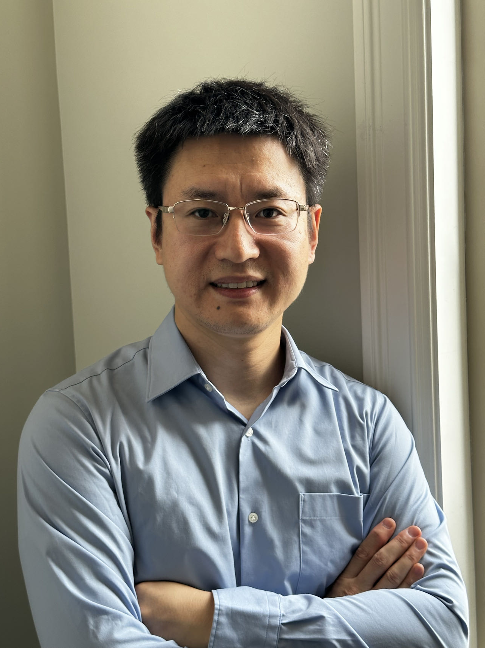
Open PhD/MSc Positions at the University of Calgary
Qiang (John) Ye Assistant Professor, PhD, SMIEEE Department of Electrical and Software Engineering Schulich School of Engineering
University of Calgary, Canada Email: qiang.ye@ucalgary.ca Webpage: https://profiles.ucalgary.ca/qiang-john-ye
Position Overview
Professor Qiang Ye currently has PhD/MSc openings for Fall 2024. Areas of research include AI-assisted B5G/6G wireless networking, network slicing, edge intelligence, digital-twin-assisted networking, autonomous vehicular networks, and protocol design for Internet-of-Things. Highly self-motivated students are welcome to apply. If interested, please send me by email with the subject line as "Prospective [MSc/PhD] Student - [Your Name]" and attach your CV, transcripts, sample publications (if any), and TOFEL/IELTS test results. Admitted PhD/MSc students will be provided with full financial support. Admission to the PhD or the MSc program is mainlygranted for the Fall and Winter intake semesters (application deadline: Jan. 31st and Apr. 30th). Please refer to the application guides on the Faculty of Graduate Studies website for [MSc] and [PhD] programs. [Visiting scholars/students] are also welcomed worldwide.
Brief Bio
Qiang (John) Ye received the PhD degree in Electrical and Computer Engineering from the University of Waterloo, ON, Canada, in 2016. Since Sept. 2023, he has been an Assistant Professor with the Department of Electrical and Software Engineering, Schulich School of Engineering, University of Calgary, AB, Canada. Before joining UCalgary, he worked as an Assistant Professor with the Department of Computer Science, Memorial University of Newfoundland, NL, Canada from Sept. 2021 to Aug. 2023 and with the Department of Electrical and Computer Engineering and Technology, Minnesota State University, Mankato, USA, from Sept. 2019 to Aug. 2021, respectively. He was with the Department of Electrical and Computer Engineering, University of Waterloo as a Postdoctoral Fellow and then a Research Associate from Dec. 2016 to Sept. 2019. He has published around 70 research articles on top-ranked journals and conference proceedings. He is/was the General, Publication, Program Co-chairs for different reputable international conferences and workshops, and serves/served as Associate Editors of prestigious international journals, e.g., IEEE TVT, TCCN, OJ-COMS, and PPNA, etc. He also serves as the IEEE Vehicular Technology Society (VTS) Regions 1-7 Chapters Coordinator (2022-2023). He is a Senior Member of IEEE.
About UCalgary
The University of Calgary is among Top 10 universities in Canada and among Top 200 universities worldwide (182, QS 2024). It is ranked in the 7th place according to the 2024 Maclean's Best Medical Doctoral Canadian Universities. The UCalgary is located at the City of Calgary, the largest city in the Canadian province of Alberta. Calgary is the third-largest city and the fourth-largest metro area in Canada. Calgary is ranked the 1st most liveable city in North America and the 7th in the world (2023 Global Liveability Ranking, Economist Intelligence Unit).

