Slide 1
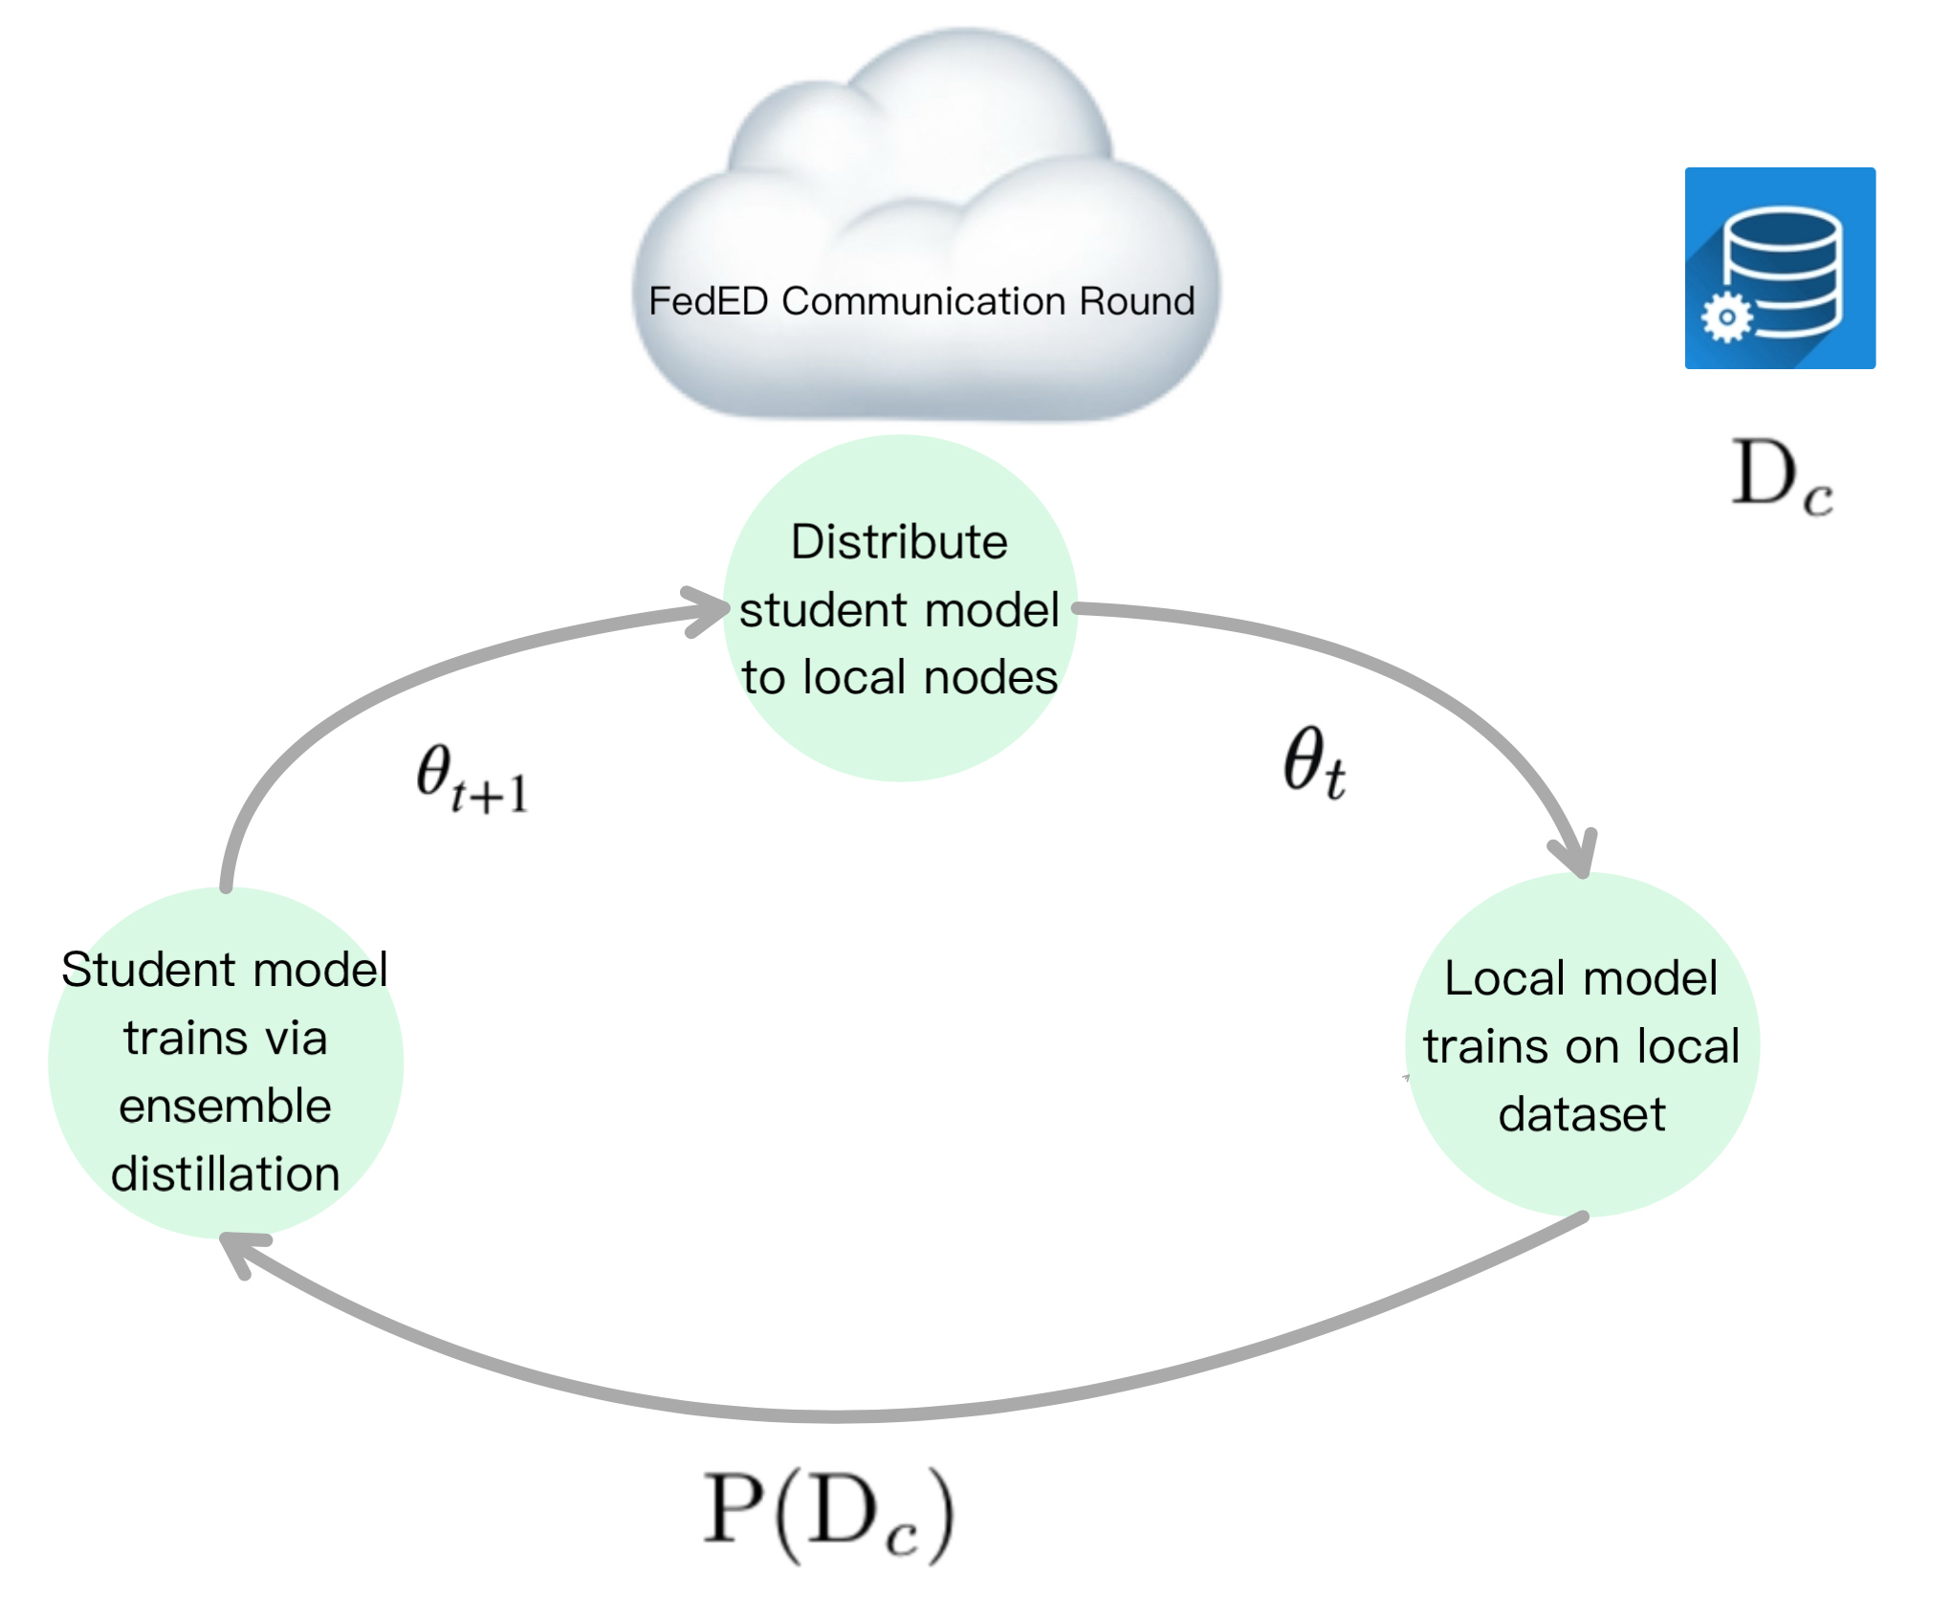
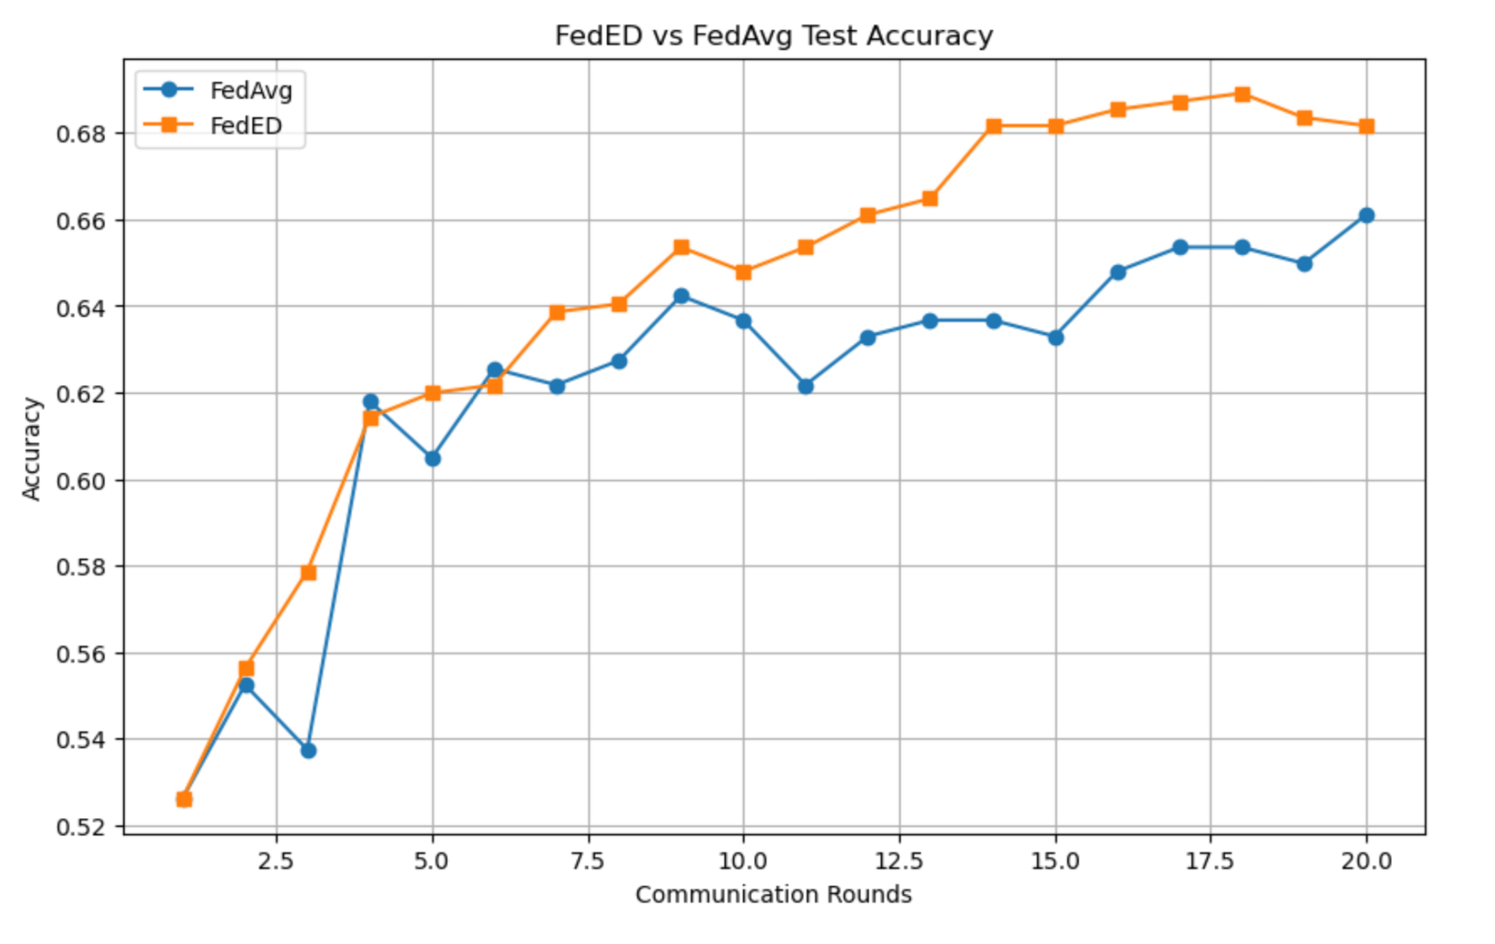
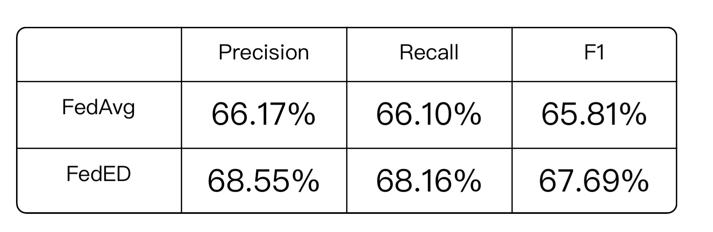
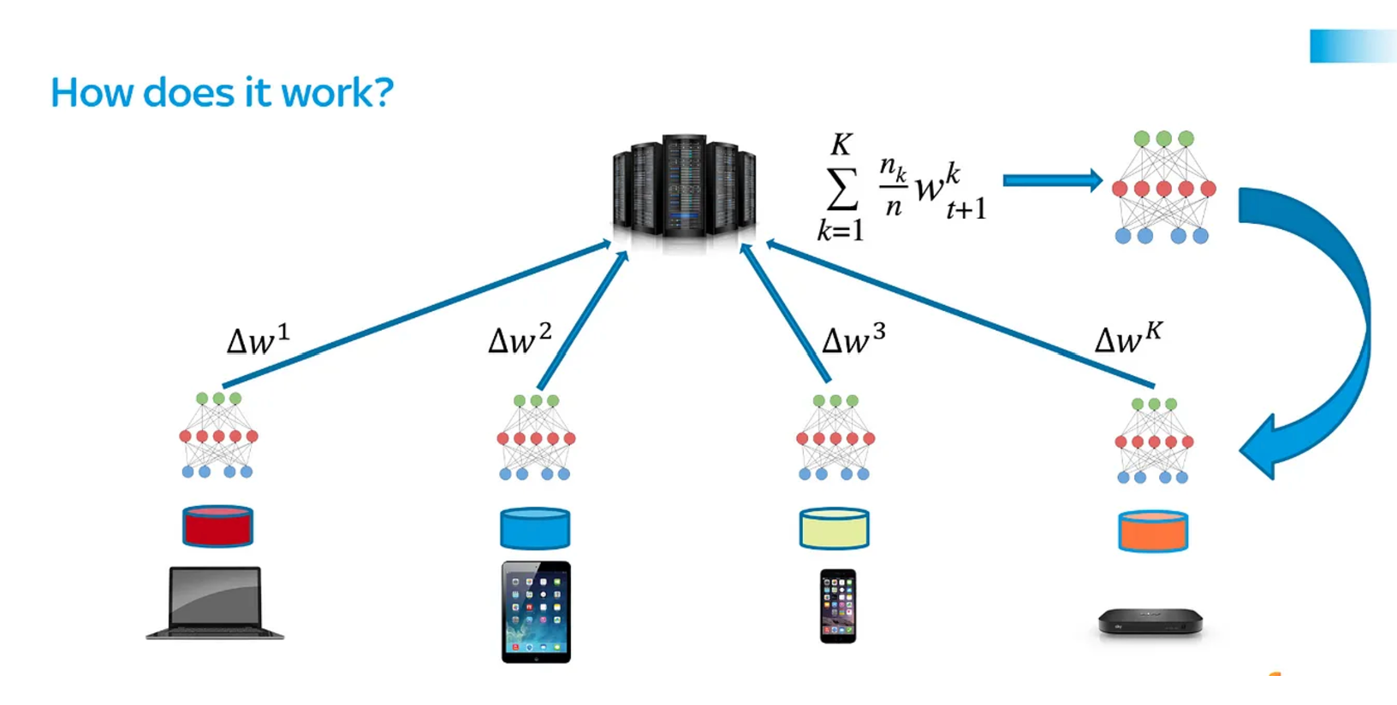
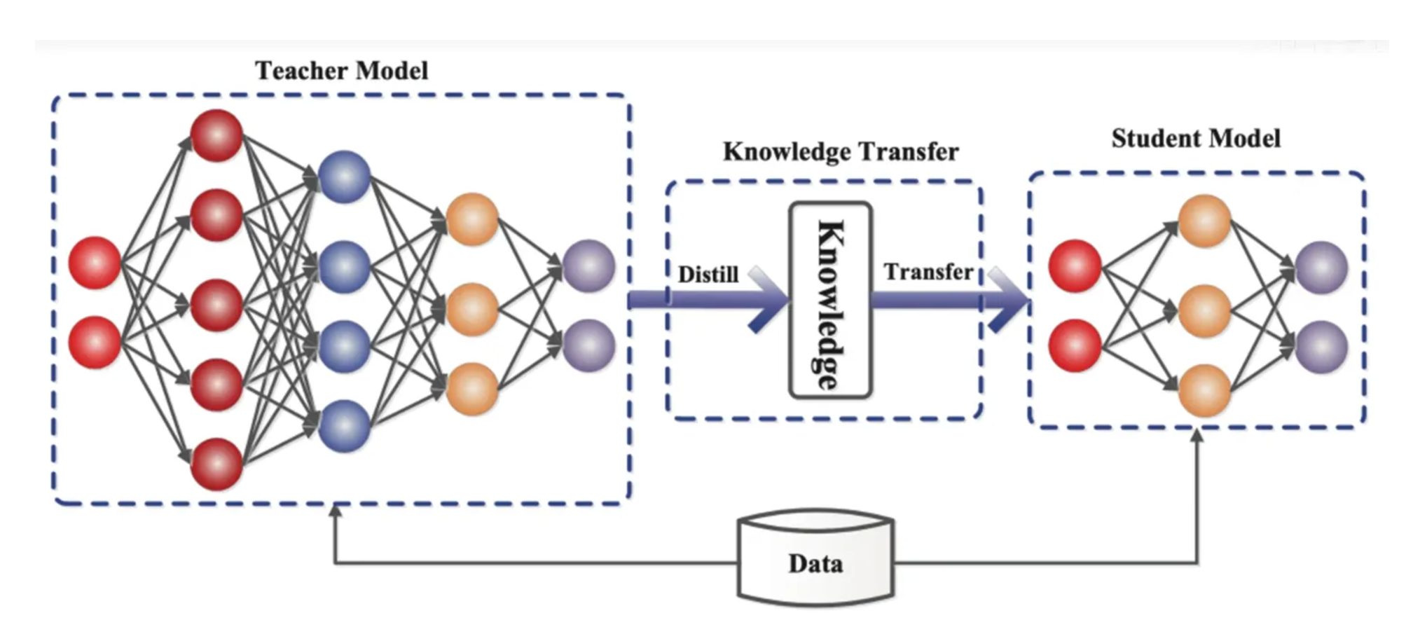
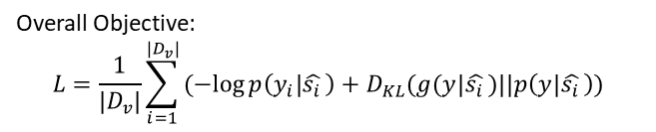
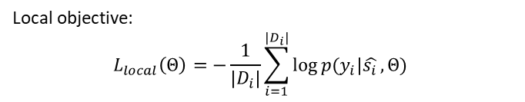
FedED: Federated Learning via Ensemble Distillation for Medical Relation Extraction
Author:Dianbo Sui, Yubo Chen, Jun Zhao, Yantao Jia, Yuantao Xie, Weijian Sun
Abstract
In this paper, they propose a privacy preserving medical relation extraction model based on federated learning, which enables training a central model with no single piece of private local data being shared or exchanged.
Introduction
The goal of this paper is to train a medical relation extraction model using data distributed across multiple nodes without violating privacy and communication constraints. Federated Learning (FL) is an appropriate framework for this kind of problem and is utilized in the paper. In typical FL algorithms (such as FedAvg) we rely on uploading model parameters across the network. This is infeasible for Deep Learning models with possibly billions of parameters to send.
We used BioBERT as encoder to embed the texts from GAD dataset. GAD, or Gene Associations Database, is a corpus of gene-disease associations curated from genetic association studies. It contains the medical relation texts with true or false labels.
Result:
Federated Learning
Knowledge Distillation
Conclusion
Local objective:
$$L_{local}\left(Θ\right)=−\frac{1}{|D_{i}|}\sum_{i=1}^{|D_{i}|}{\log{p(y_{i}|\hat{s_{i }}, Θ) }}$$
FedED trains with better performance than FedAvg while bypassing the need to upload millions/billions of parameters but still needs to download them
Requires a central dataset which may not be available in general
Might not be able to handle usual Federated Learning assumptions including data/communication heterogeneity among nodes
Overall Objective:
$$L=\frac{1}{|D_{v}|}\sum_{i=1}^{|D_{v}|}{(−log{p\left(y_{i} | \hat{s_{i }}\right)+D_{KL}(g(y|\hat{s_{i }})||p\left(y | \hat{s_{i }}\right))}}$$
Methodology
In the algorithm, instead of sending the model parameters to the central server, we employ knowledge distillation techniques by only uploading predictions to central model. Nodes still rely on retrieving parameters from the central server.
Github link: https://github.com/QianjiaoChen/FedED-project

