Slide 1

Trending YouTube Video Statistics
Yixiang Cao & QianqianTang

Slide 2
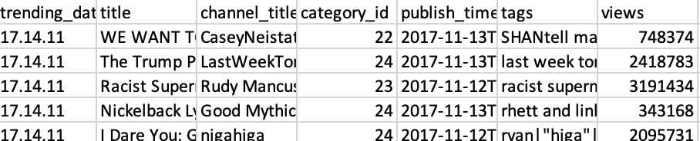
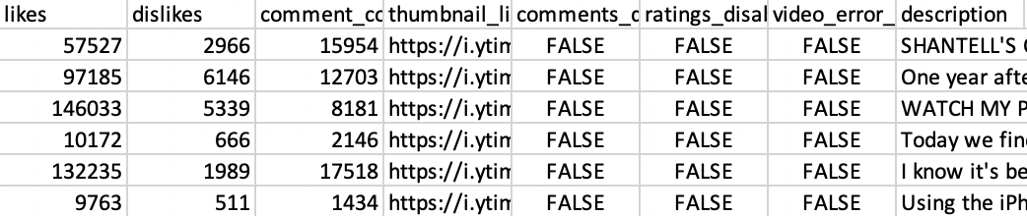
Dataset
Examples of Dataset:
16 attributes:
5 numerical attributes
2 time attributes
6 string attributes
3 bool attributes

Slide 3
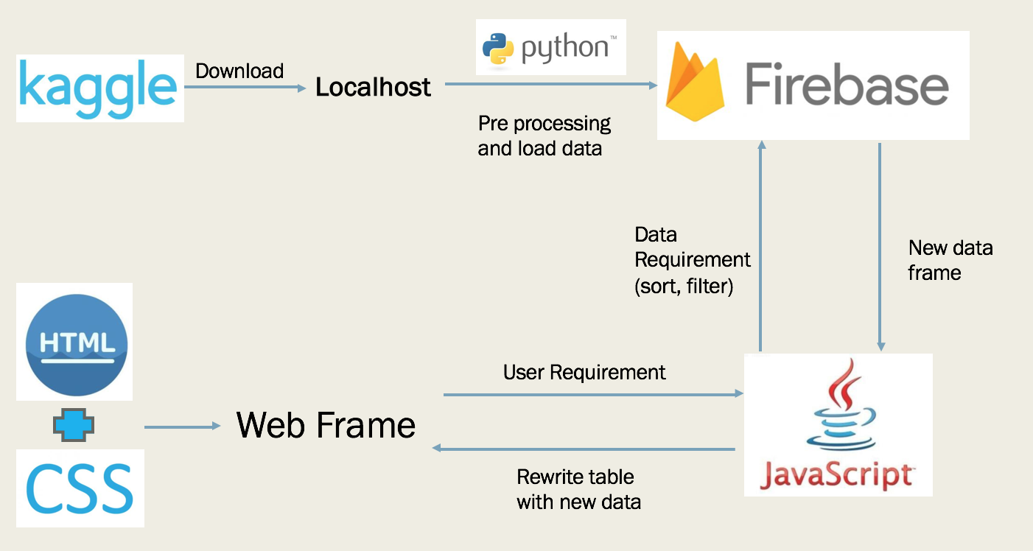
Architecture

Slide 4
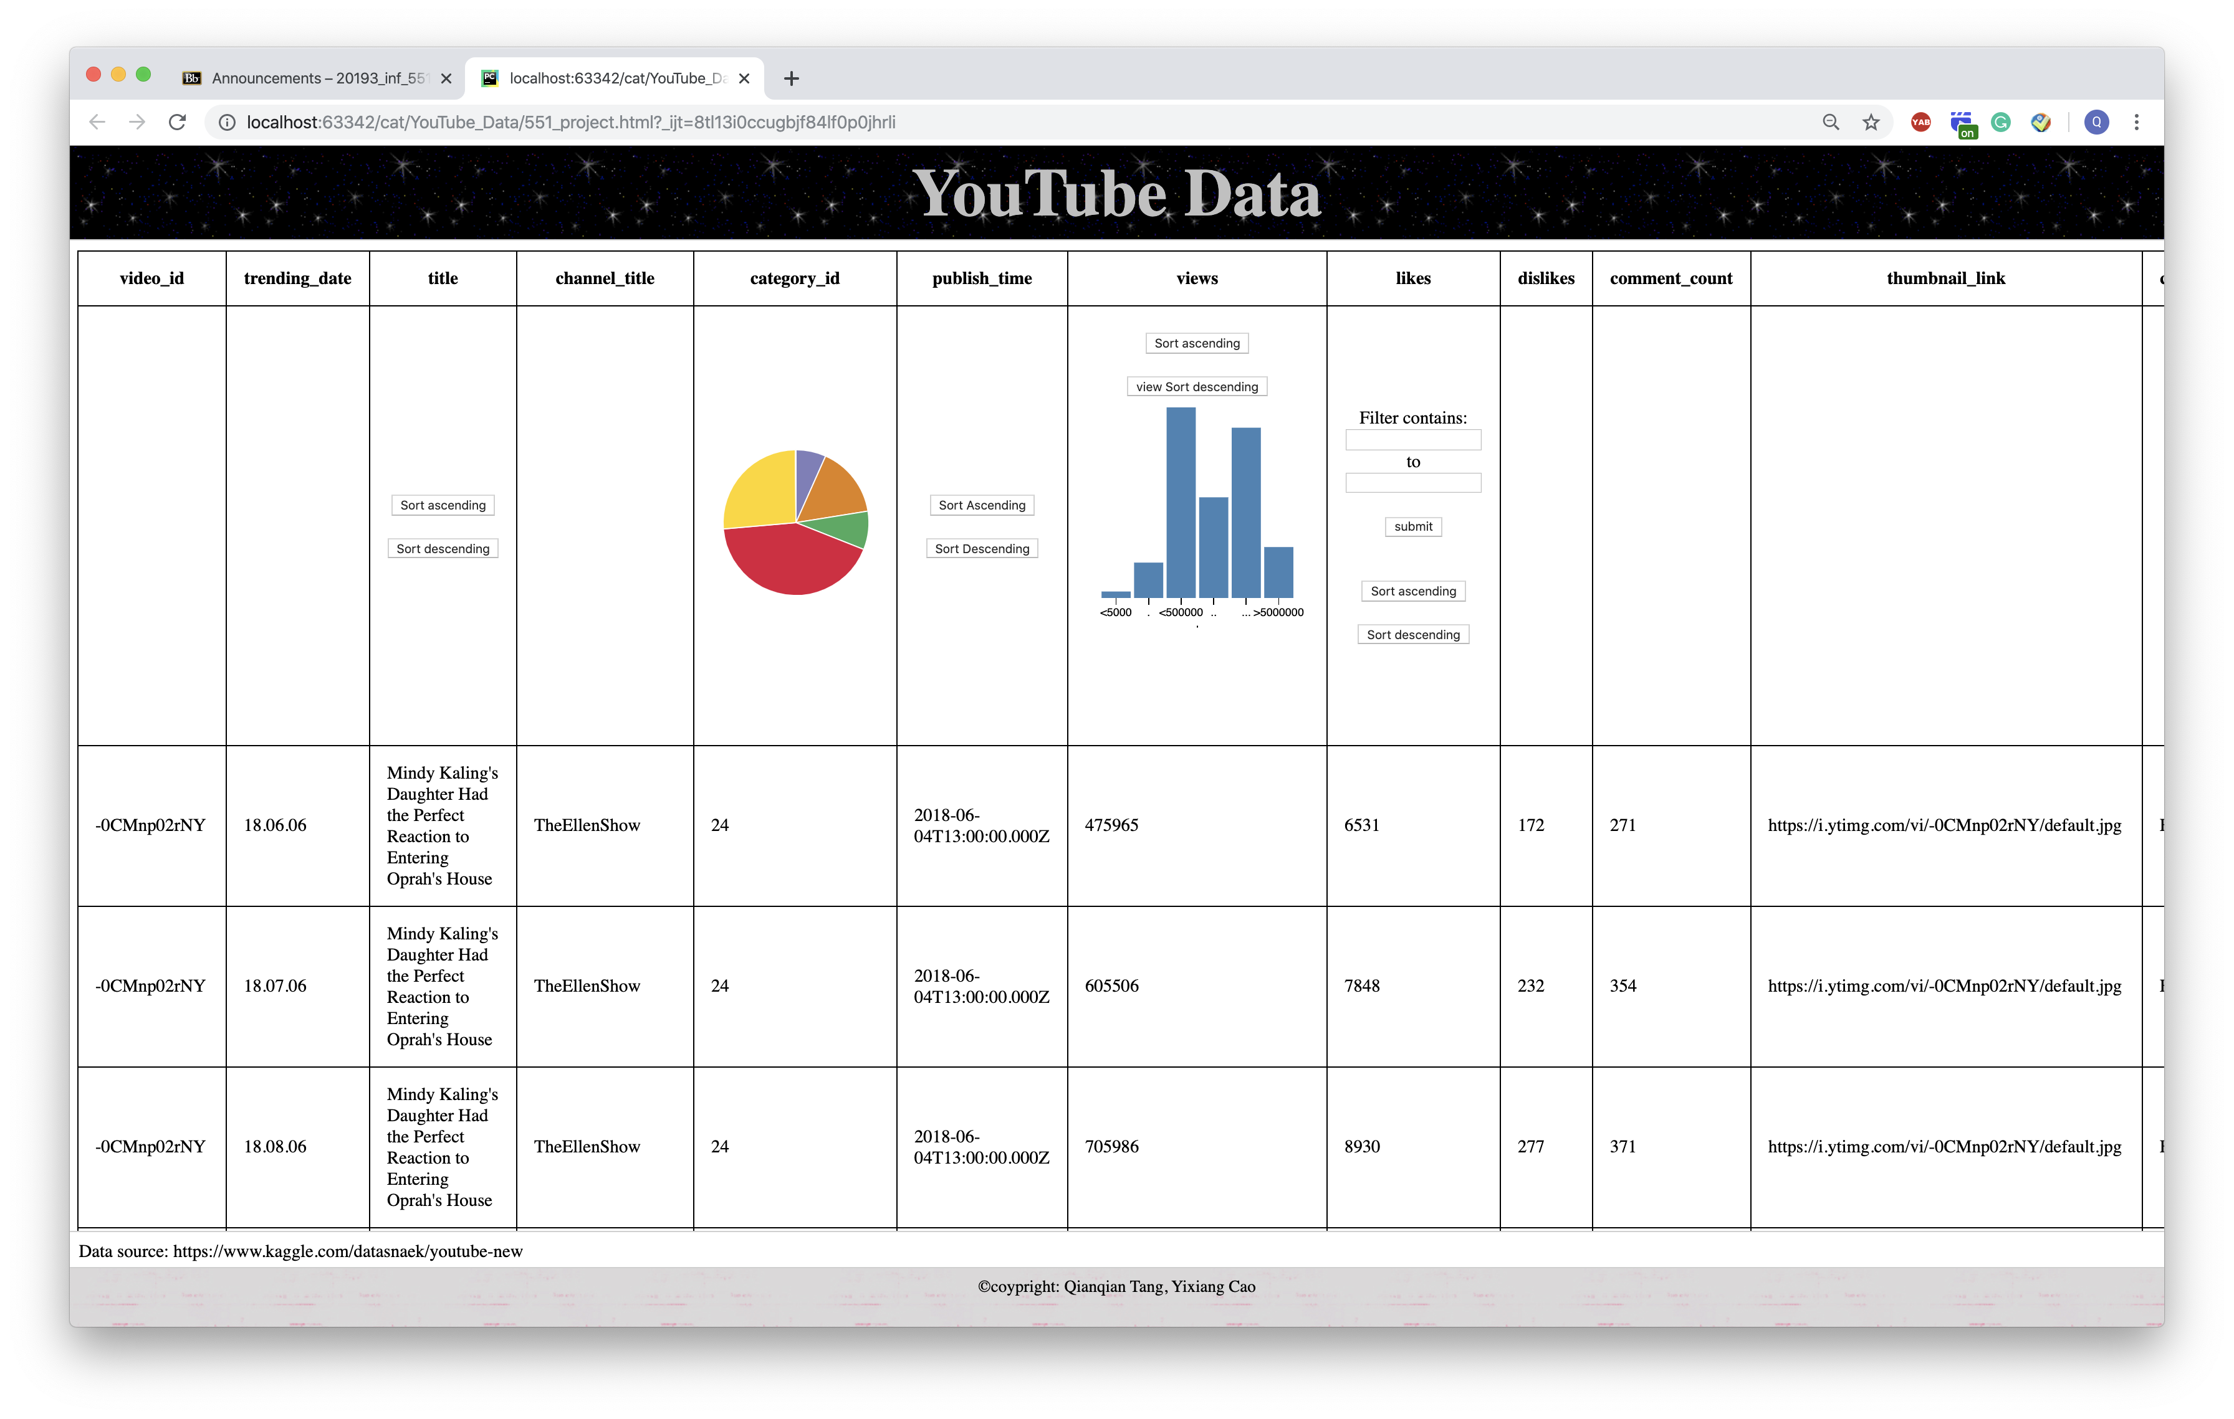

Slide 5
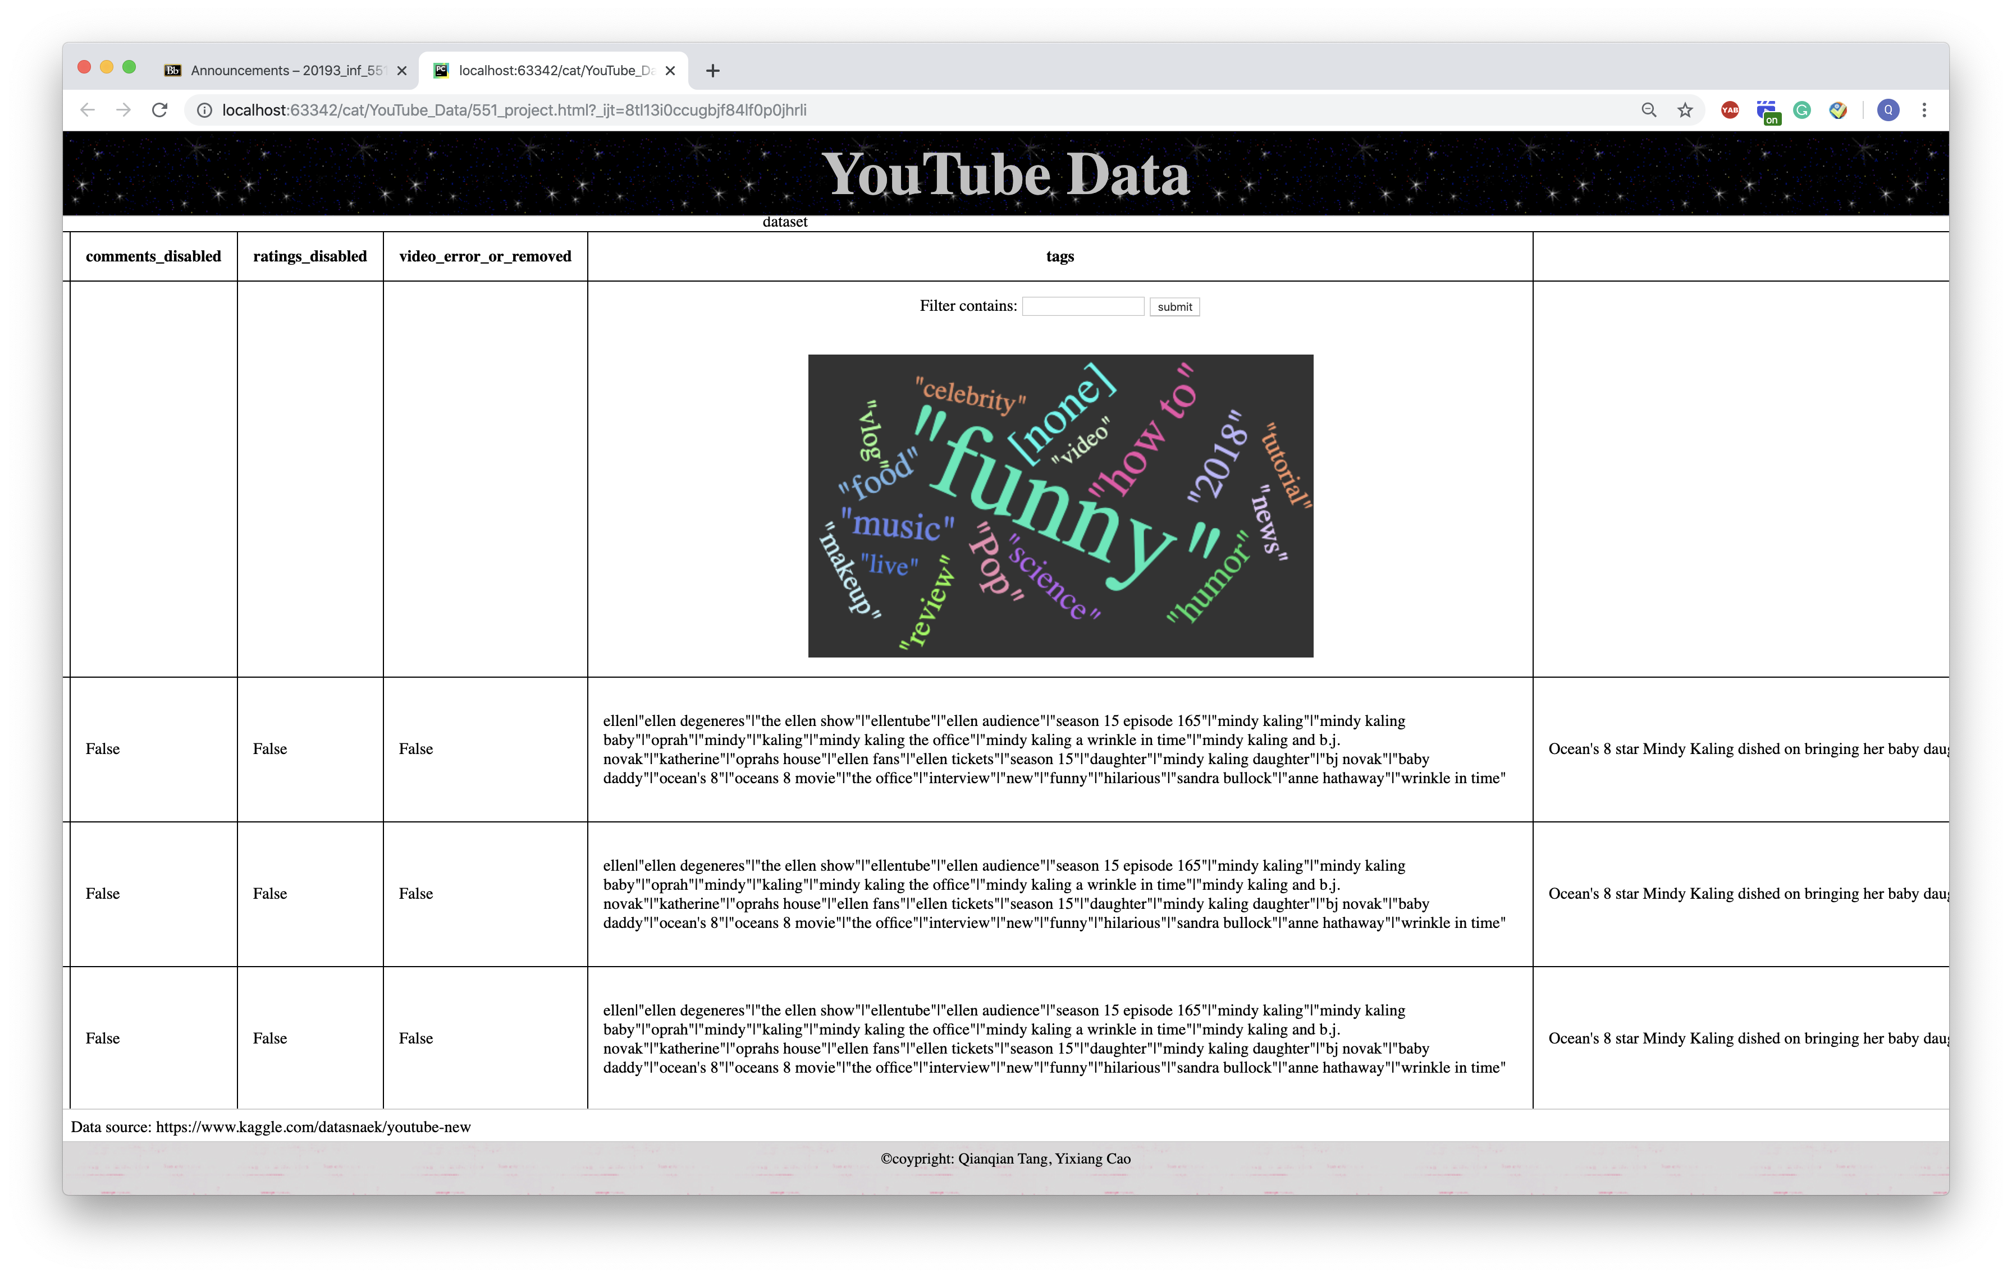

Slide 6
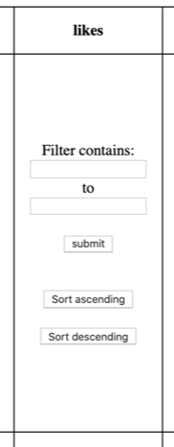
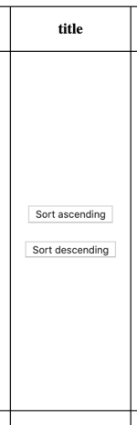
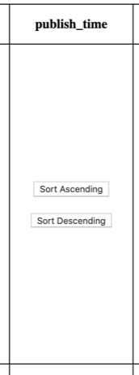
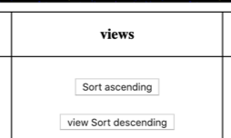
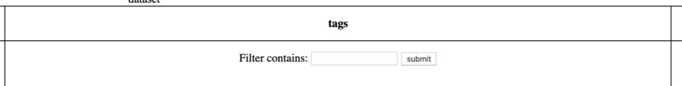
Function realization
Attributes showing
Sorting functions:
Numerical: likes
Non-numerical: publish time & title
Filters:
Numerical: likes
Non-numerical: tags

Slide 7
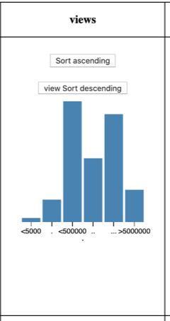
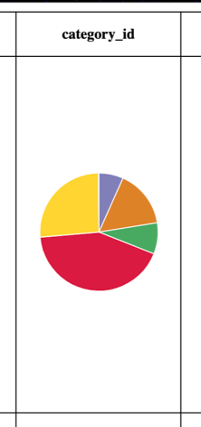
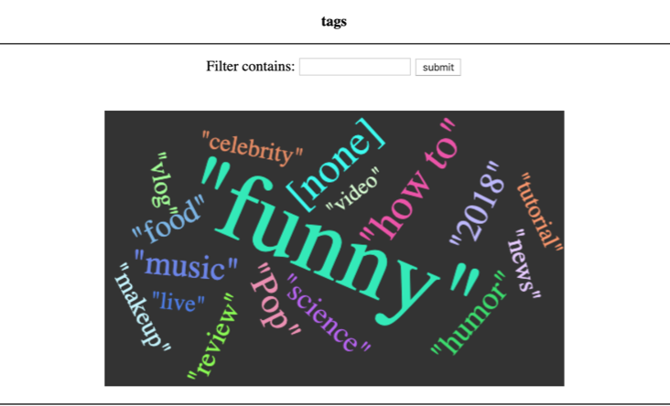
Function Realization
4. Data Visualization:
1. Statistical Histogram: views
2. Pie Chart: Category id
3. Word Cloud: tag (crawl keywords)

Slide 8
Q&A

