Slide 1


Yelp Pizza Restaurants’ Review Analysis
Group2
Jiacheng Miao, Hao Qin, Shirley Zhang, Xiyue Wang

Slide 2
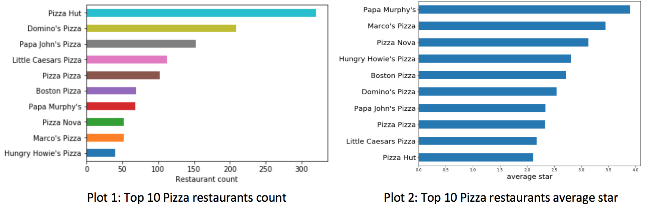
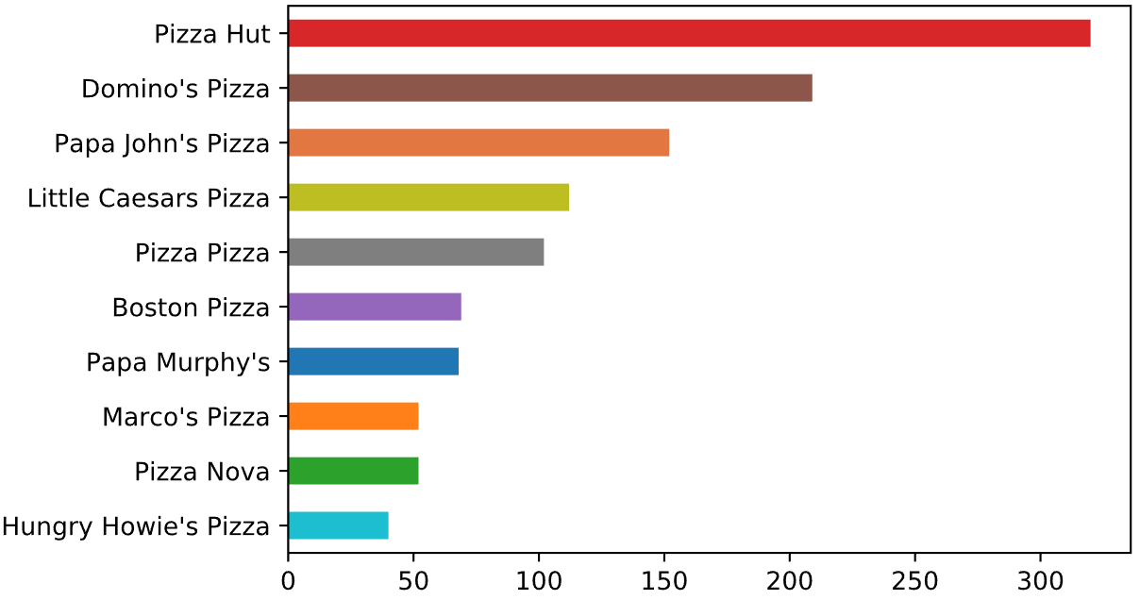
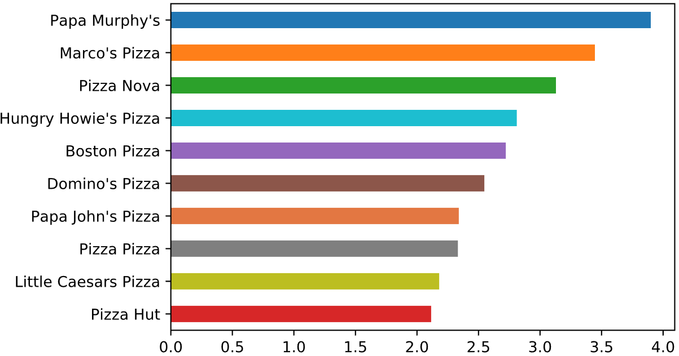
Last time
Most restaurants, lowest stars => Further Analysis

Slide 3
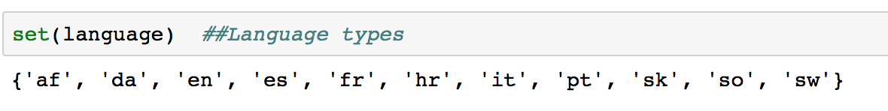
Translation
Afrikaans | Danish | Spanish | French | Croatian
Italian | Portuguese | Slovak | Somali | Swahili
English

Slide 4
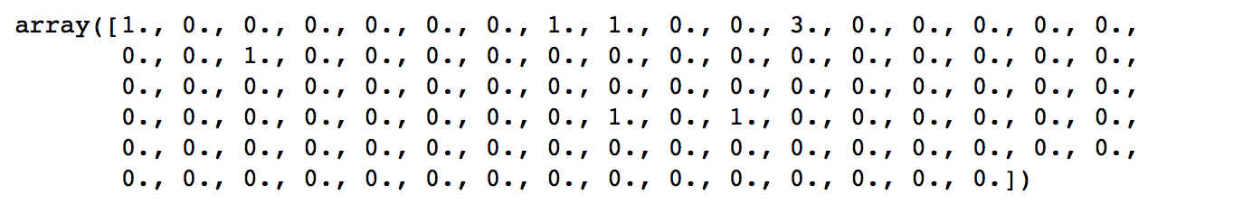
Which adjectives are important?
X feature matrix (Nxp)
N: Number of reviews (17951)
p: Number of selected adj words (100)
Eg: A row of matrix
First adj word good appear in this review once

Slide 5
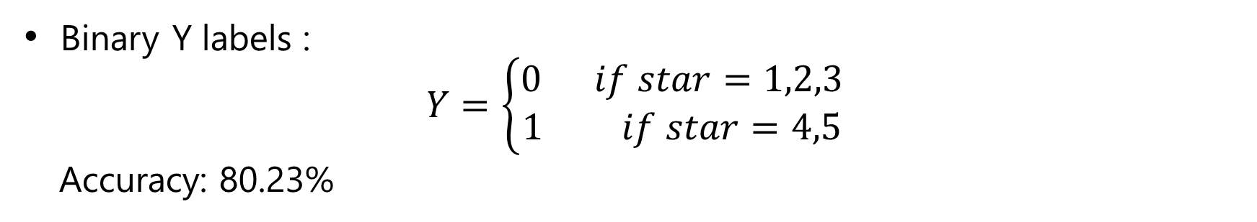
Logistic Regression
Binary Y labels :
$$Y=\left\{\begin{aligned}0 if star=1,2,3 \\ 1 if star=4,5\end{aligned}\right.$$
Accuracy: 80.23%
Linear Regression
Y labels : Star for each review
MSE: 3.933

Slide 6
User Weight
Which variables did us take into consideration?
Review Counts, Amount of Followers,
Number of useful/funny/cool votes sent by the user,
Number of plain/funny/cool compliments received by the user
How to compute user weights based on these variables?
Entropy Weight Method
Based on amount of information to determine the index's weight, then use them to compute user's weight and help with next steps.
More than 86% user's weight almost haven't been changed. This method only influrnced points which should be highlighted.

Slide 7
User Weight
High - Weighted Users
Name | Review count | Fans | Cool | Funny | Useful | Compliment Cool | Compliment Fun | Compliment Plain
Fox | 6407 | 1574 | 82128 | 86122 | 89418 | 5429 | 5429 | 4379
Bruce | 10022 | 528 | 61383 | 49785 | 74829 | 2502 | 2502 | 2749
Stefany | 4321 | 641 | 30846 | 22790 | 44667 | 1635 | 1635 | 1497
Joyce | 763 | 738 | 32269 | 24344 | 34316 | 5462 | 5462 | 3686
Jennifer | 6314 | 715 | 12995 | 8823 | 20336 | 1606 | 1606 | 3629
Dave | 2678 | 305 | 36081 | 21461 | 43324 | 1859 | 1859 | 1353
Karen | 2340 | 411 | 30626 | 19182 | 34815 | 3411 | 3411 | 2312

Slide 8
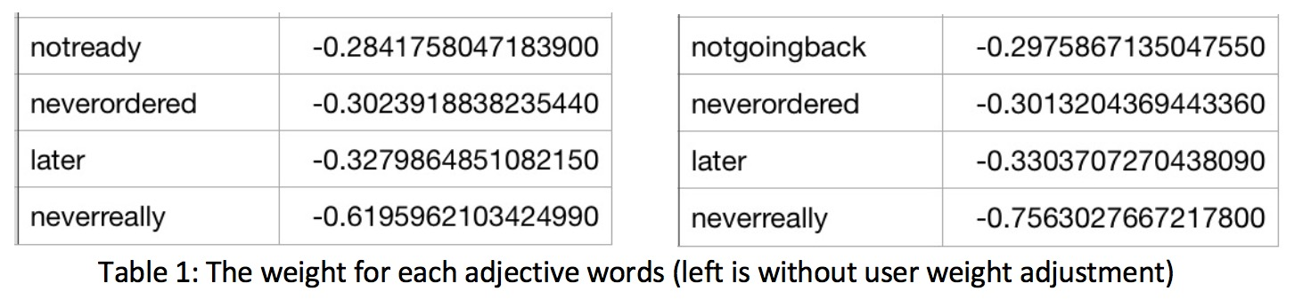

Local Weighted Linear Regression(LWLR)
Formula: $\hat{β}={{(X}^{′}WX)}^{−1}(X^{′}WY)$
W: User weight matrix
MSE: 3.683

Slide 9
LDA combined with Regression
Data
Preprocessing
Regression/
Classification
Modified LDA

Slide 10

Local Weighted LDA
Local weighted idf term
$$widf_{\left\{i,j\right\}}=w_{j}∗lg(\frac{\left|D\right|}{\left\{j:t_{i}∈ d_{j}\right\}})$$
$w_{i}$ is the weight corresponding to the j$th$ user, D is the total number of all reviews and the denominator is the number the review which includes the $ith$ word.

Slide 11
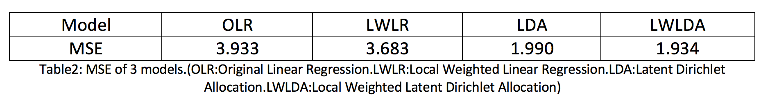
Model compare
Best Model

Slide 12
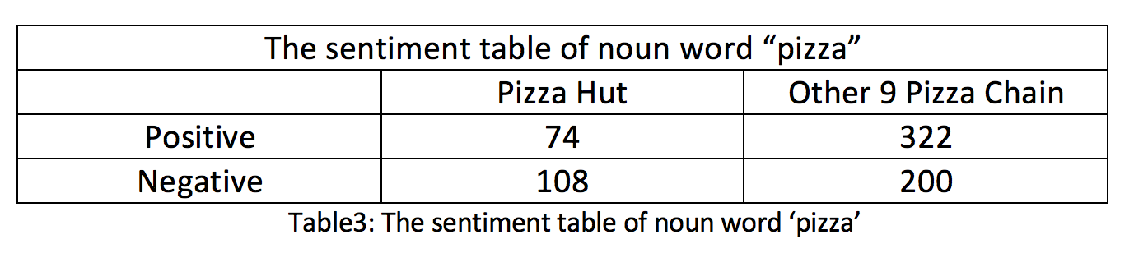
Contingency Table Test
chi-square test :
P-value = 1.318e-06
The brand effect is significant

Slide 13
Business Suggestion
Noun and "Fast" pairs (in every 1278 nouns)
Noun. | PizzaHut | Other 9 Pizza Chain
Delivery | 39 | 31
Service | 32 | 17
Pizza | 7 | 5
Noun and "Delicious" pairs (in every 1278 nouns)
Noun. | PizzaHut | Other 9 Pizza Chains
Pizza | 15 | 35
Food | 5 | 32
Crust | 1 | 17
Efficient, good at delivery, high-speed
More knids of nouns appear in other 9:
gralic, dessert, pepperoni, cream, jalapeño, ravioli, breadstick, sangria, cheesecake, burger

Slide 14
Business Suggestion
SWOT Analysis
Strength | High work efficiency, delivery on time
Weakness | Poor selection menu, not so tasty
Opportunities | Brand impact, well-funded to carry out business plan
Threats | Hard to diffuse new technology or new strategy to all chains
“Our focus on digital efforts is clearly to make certain we are appealing to younger audiences, which will be the future of the overall business.”
—— Steve Richie
Papa John’s CEO

Slide 15
The strength and weakness
Strength:
Introducing highlighted users
Accurate sentiment detection model
Weakness:
Words are exchangeable
Have not mine enough information from short reviews

Slide 16
Thank You
Shinny link:
https://jiacheng-miao.shinyapps.io/Module3/

