Slide 1
Opposition
Author: Amanda Dennehy; Moa Johansson;
Anushika Chathupani; Gincy Simon; Qianqian Yang
Professor: Annika Lantz-Andersson
Author: Qianqian Yang
Supervisor: Thomas Fischer

Slide 2
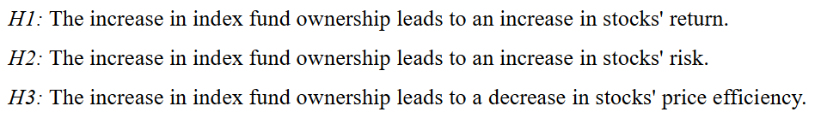
1. Choice of subject
This study investigates the consequences of stocks being included in an index, in terms of returns, risk, and pricing efficiency.
Question: Why analyze this subject?

Slide 3
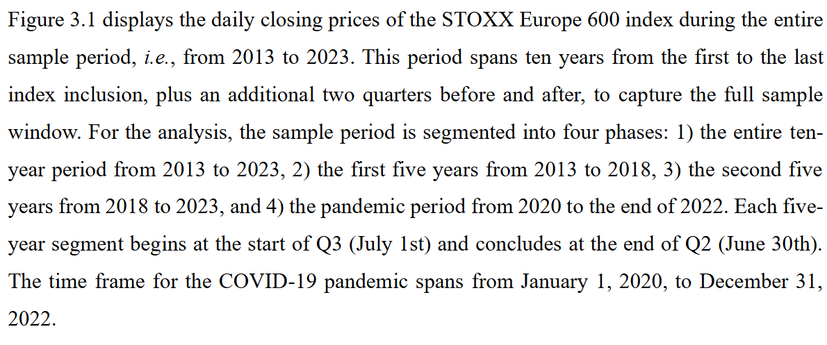
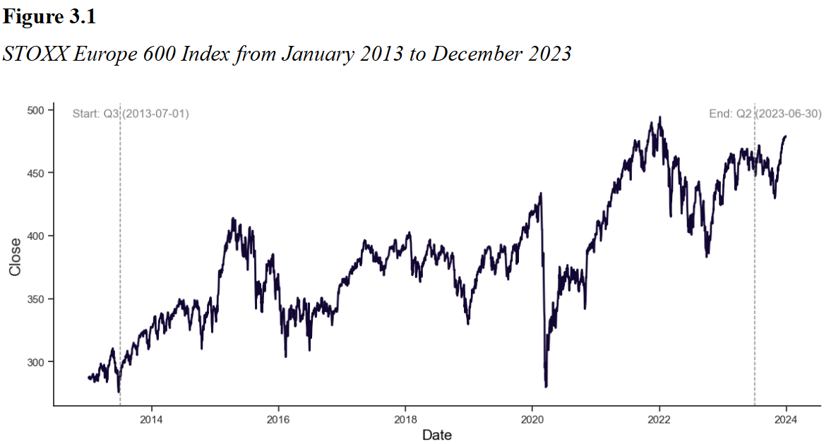
2. Data
Question: Why separate the period in this four phases?

Slide 4
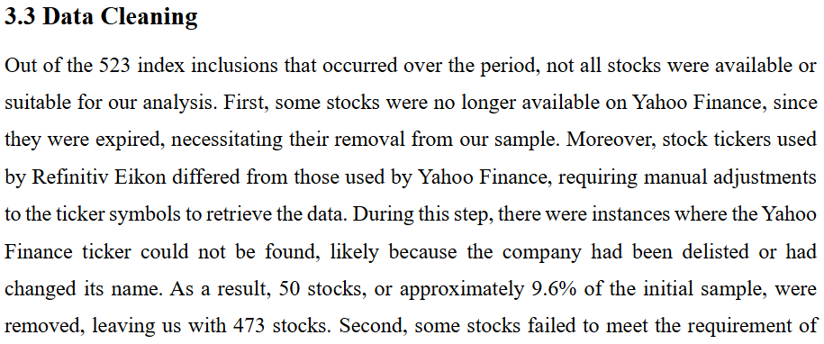
2. Data
Question: Why need to use different databases?

Slide 5
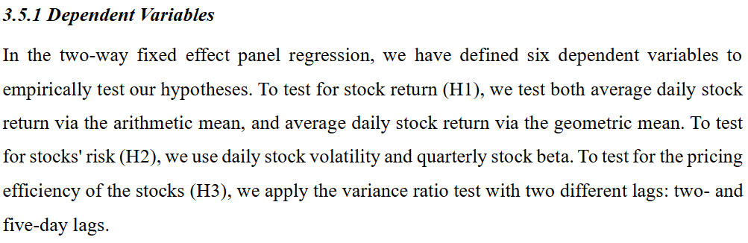
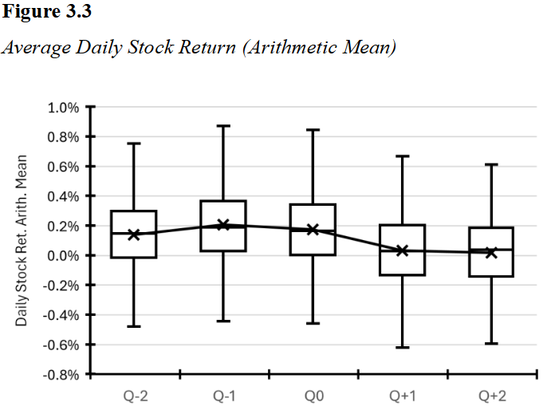
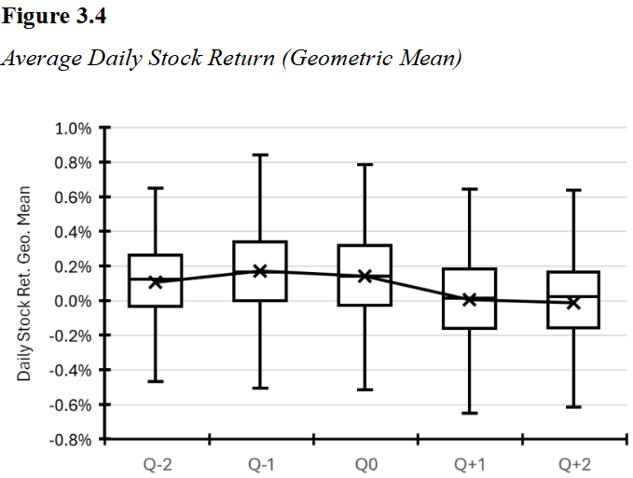
2. Data
Question : Why need stock returns of arithmetic and geometric means?

Slide 6
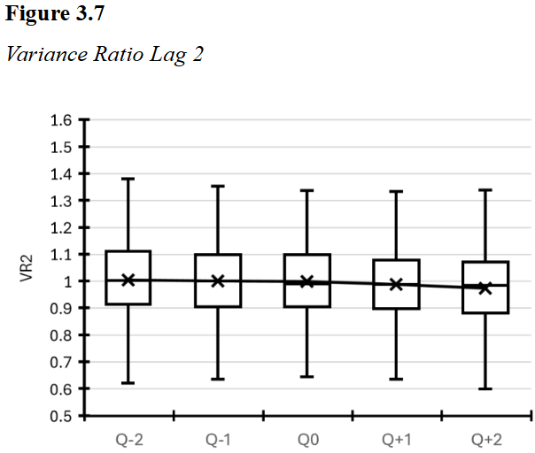
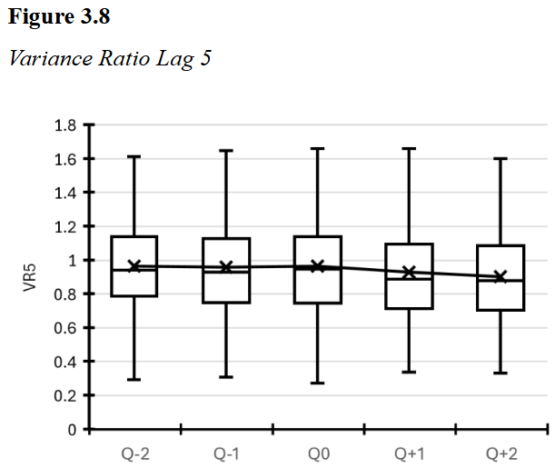
2. Data
Question: The choice of Variance Ratio lag

Slide 7
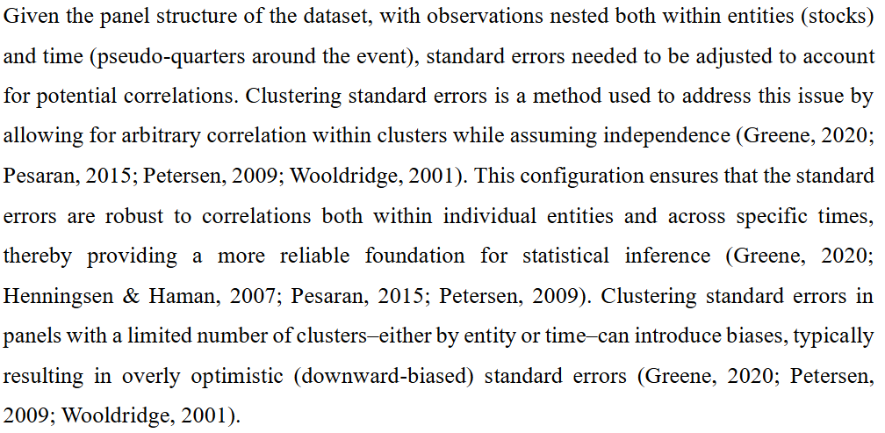
3. Model
Question: Why need to consider the potential correlations?

Slide 8
3. Model
Welch's t-test & the Mann-Whitney U Test on Active and Passive Fund Ownership Change
Question: Why need to study the Ownership Change? How is this related to the subject, hypothesis, or subsequent analysis?

Slide 9
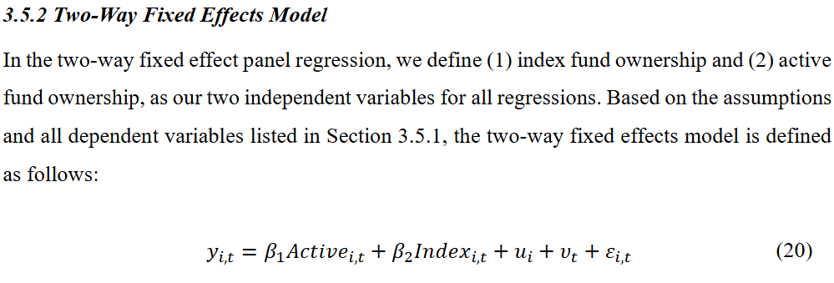
3. Model
Question: Are there any control variables to be added?

Slide 10
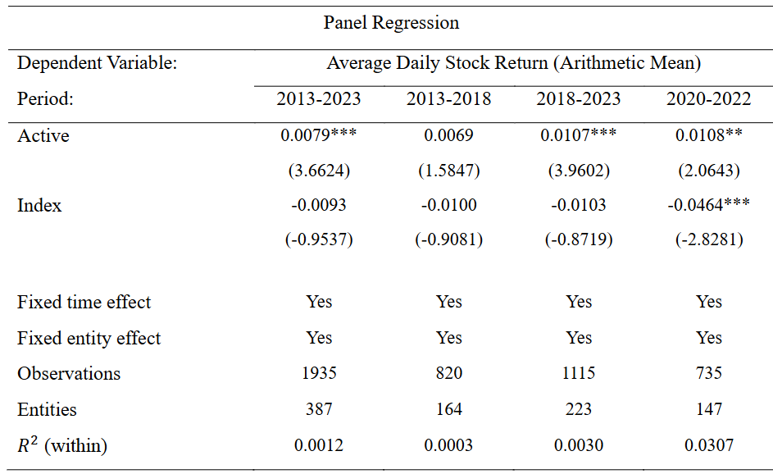
4. Result
Question: Can one of the fixed time or entity effects be analyzed?

Slide 11
4. Result
Question: What are the implications of the low R-squared?

Slide 12
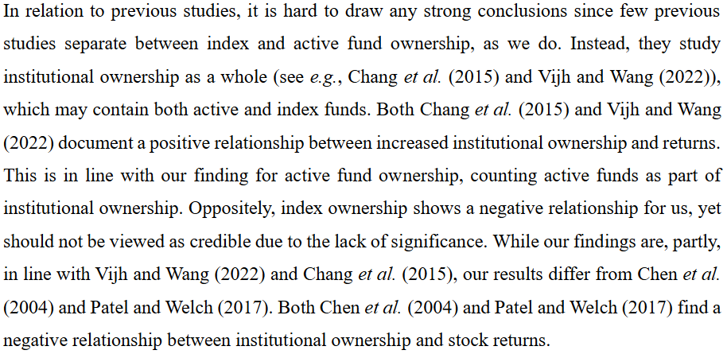
4. Result
Question: Why do results differ from some of the other articles?

Slide 13

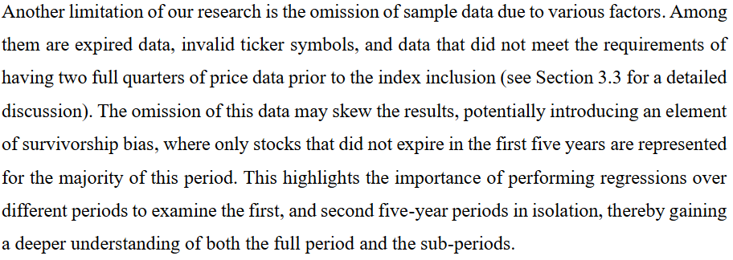
5. Conclusion
Question: Is there any possible solution for the limitations?

