Slide 1
基于树莓派的网络附属存储
By 崔景育 林弘韬 彭乾旸
2016年6月

Slide 2
目录 Contents
1
Motivation
2
Related Work
3
System Overview
4
Detailed Work
5
Application
5
Work Distribution

Slide 3
Motivation
Our motivation is to build a NAS (Network Attached Storage) system based on Raspberry Pi3
Include functions:
Personal homepage
FTP file management
HTTP and P2P remote download and file sharing
Useful situations: Personal/ family/ dorm.
Advantage:
Cheap
Energy-saving
Multiuser Supportive

Slide 4
Related Work
System Architecture: LNMP (Linux + Nginx + MySQL + PHP)
Remote Control: VNC viewer
Homepage: Wordpress
Downloader: Aria2, YAAW
FTP: Vsftpd
P2P: BitTorrent

Slide 5
System Overview
Hardware structure:
SD card
..01101..
Internet
Raspberry Pi
mobile hard disk drive
..01101..
..01101..
power supply
USB hub

Slide 6
System Overview
Linux
MySQL
Nginx
PHP
Vsftpd
Operating system
Database
Web server
Web application
Wordpress
YAAW
FTP

Slide 7
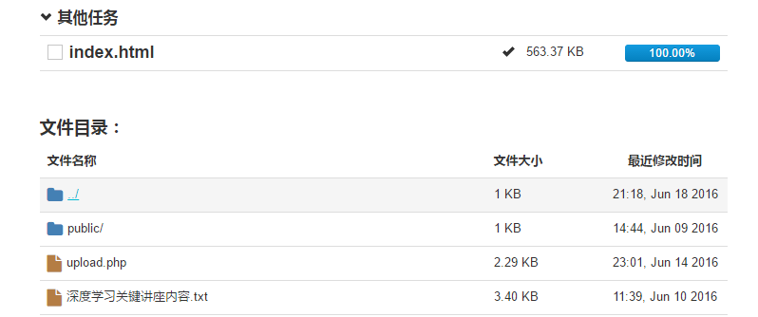
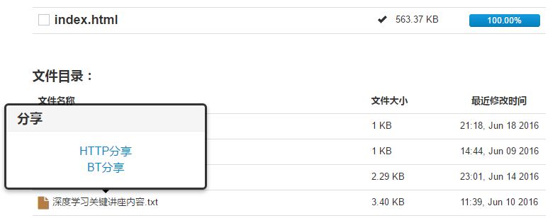
Detailed Work (1)
User system:
Basic: Register, Log in etc.
Customization for YAAW: Download Configuration etc.
Extension to YAAW:
File system visualization ( Security Issues..
Share files by HTTP link!
Share files by generated BT seed!

Slide 8
Detailed Work (2)
FTP system
Virtual user: vsftpd & MySQL configuration
Authentication: pam-mysql
Different authority: admin and public
Ext4 file system: allow chmod and chown commands
PHP takeover: register automatically
Grant root privilege to Nginx
Creating directories and adding records to MySQL

Slide 9
Detailed Work (3)
Personal homepage
Use Wordpress as the blog platform.
An independent copy of wordpress package is kept for each user.
Visitors can view the homepage without loggin in.
BitTorrent file sharing
Use a BitTorrent server to enable bt downloads.
A specified folder is used to save all the files and torrents to share.
Scan over this folder periodically and update the newly generalized torrents;
Avoid potential errors due to user’s file modifications;
Prevent different users from sharing the same file.

Slide 10
Application
Three scenarios
Download something when you are outside/ playing games/ downloading huge files
Homepage for abroad university application
BT download when you are in countries where such operations are illegal

Slide 11
Work Distribution
Qianyang Peng:
Designed the hardware structure;
Configured the LNMP framework and HTTP server;
Implemented the features about personal homepage;
Configured the BitTorrent server and implemented the P2P file sharing system.
Hongtao Lin:
The main structure of user system (register, login and main entrance logic);
The configuration and modification of YAAW system.
Jingyu Cui:
Installed the system and enabled remote controlling;
UI Design;
Configured vsftpd system;
Implemented virtual users;
Implemented the controlling of FTP accounts using PHP;
Maintained the hardware, including backup and recovery.

Slide 12
Thanks!

