Slide 1
Distributed Systems
(4th edition, version 01)
https://www.distributed-systems.net/
Chapter 02: Architecture

Slide 2
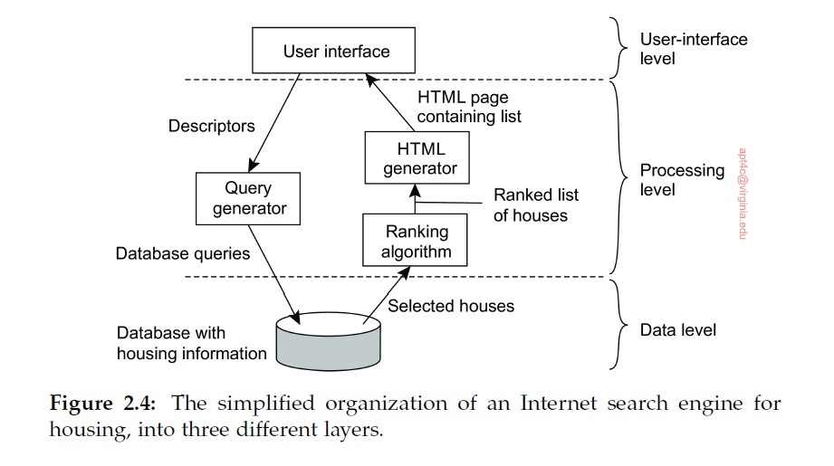
I. Three-Tier Architecture Diagram
Introduction From networked systems to distributed systems
Distributed versus decentralized systems

Slide 3
II. Simple Client-Server Architecture
Introduction From networked systems to distributed systems

Slide 4
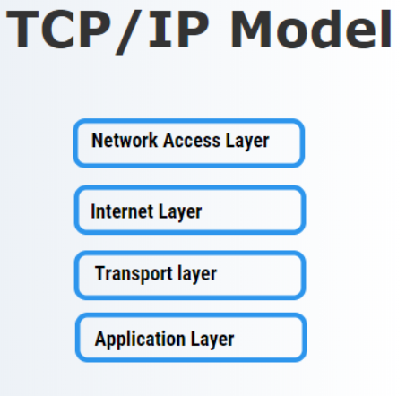
II. Background: Connection-Oriented Protocol
Introduction From networked systems to distributed systems
Most common is TCP/IP = Transmission Control Protocol / Internet Protocol
Standard “language” of the internet and most modern networks
Defines how devices connect, send, and receive data reliably
Nearly all internet application protocols use TCP/IP connections
Distributed versus decentralized systems

Slide 5
II. Connection-Oriented Protocol
Introduction From networked systems to distributed systems
Benefits of TCP/IP:
Reliability
- TCP breaks data into packets, numbers them, and ensures all arrive in order
- Lost or corrupted packets get retransmitted automatically.
Distributed versus decentralized systems

Slide 6
II. Connection-Oriented Protocol
Introduction From networked systems to distributed systems
Benefits of TCP/IP:
Reliability
- TCP breaks data into packets, numbers them, and ensures all arrive in order
- Lost or corrupted packets get retransmitted automatically.
Interoperability - Every major OS, router, and application supports TCP/IP.
Distributed versus decentralized systems

Slide 7
II. Connection-Oriented Protocol
Introduction From networked systems to distributed systems
Benefits of TCP/IP:
Reliability
- TCP breaks data into packets, numbers them, and ensures all arrive in order
- Lost or corrupted packets get retransmitted automatically.
Interoperability - Every major OS, router, and application supports TCP/IP.
Scalability - Scales to billions of devices
Distributed versus decentralized systems

Slide 8
II. Connection-Oriented Protocol
Introduction From networked systems to distributed systems
Benefits of TCP/IP:
Reliability
- TCP breaks data into packets, numbers them, and ensures all arrive in order
- Lost or corrupted packets get retransmitted automatically.
Interoperability - Every major OS, router, and application supports TCP/IP.
Scalability - Scales to billions of devices
Flexibility - Supports multiple application protocols: HTTP(S), FTP, SSH, email, streaming
Distributed versus decentralized systems

Slide 9
II. Connection-Oriented Protocol, contd.
Introduction From networked systems to distributed systems
Mechanics of TCP/IP:
Before client requests service, connection set up w/server
Server uses same connection to send reply message
When communication finished, connection torn down
Distributed versus decentralized systems

Slide 10
II. Connection-Oriented Protocol, contd.
Introduction From networked systems to distributed systems
What happens if we don’t use a connection?
Distributed versus decentralized systems

Slide 11
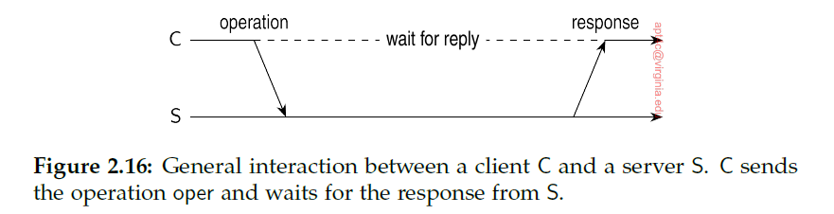
II. Simple Client-Server Architecture (No connection)
Introduction From networked systems to distributed systems
1) Client packages message for server,
identifying the service it wants,
along with necessary input data
2) Message sent to server
3) Server will wait for incoming request, process it, and package results in a reply message sent to client
Distributed versus decentralized systems

Slide 12
II. Simple Client-Server Architecture (No connection), contd.
Introduction From networked systems to distributed systems
When it works, this is efficient …
… but what if the result doesn’t come back?
Distributed versus decentralized systems

Slide 13
II. Simple Client-Server Architecture (No connection), contd.
Introduction From networked systems to distributed systems
When it works, this is efficient …
… but what if the result doesn’t come back?
1) Was original request lost?
2) Did transmission of response fail?
We won’t know
Distributed versus decentralized systems

Slide 14
II. Simple Client-Server Architecture (No connection), contd.
Introduction From networked systems to distributed systems
When it works, this is efficient …
… but what if the result doesn’t come back?
1) Was original request lost?
2) Did transmission of response fail?
We won’t know
In first case, might resend. In second case, don’t want to resend.
Transaction that can safely be repeated is called idempotent
Distributed versus decentralized systems

Slide 15
II. Simple Client-Server Architecture (No connection), contd.
Introduction From networked systems to distributed systems
Examples:
Request 1: transfer $10K from bank account
Not safe to resend
Request 2: Tell me bank account balance
Safe to resend
Distributed versus decentralized systems

Slide 16
III. Cloud Computing
Introduction From networked systems to distributed systems

Slide 17
Architectures
Hybrid system architectures
III. Cloud computing
The model for cloud computing can be regarded as four layers
Cloud computing

Slide 18
Architectures
Hybrid system architectures
III. Cloud computing
The model for cloud computing can be regarded as four layers
Hardware: Processors, routers, power and cooling systems. Customers normally never get to see these.
Cloud computing

Slide 19
Architectures
Hybrid system architectures
III. Cloud computing
The model for cloud computing can be regarded as four layers
Infrastructure: Deploys virtualization techniques. Evolves around allocating and managing virtual storage devices and virtual servers.
Hardware: Processors, routers, power and cooling systems. Customers normally never get to see these.
Cloud computing

Slide 20
Architectures
Hybrid system architectures
III. Cloud computing
The model for cloud computing can be regarded as four layers
Platform: Provides higher-level abstractions for storage and such. Example: Amazon S3 storage system offers an API for (locally created) files to be organized and stored in so-called buckets.
Infrastructure: Deploys virtualization techniques. Evolves around allocating and managing virtual storage devices and virtual servers.
Hardware: Processors, routers, power and cooling systems. Customers normally never get to see these.
Cloud computing

Slide 21
Architectures
Hybrid system architectures
III. Cloud computing
The model for cloud computing can be regarded as four layers
Application: Actual applications, such as office suites (text processors, spreadsheet applications, GenAI services). Comparable to the suite of apps shipped with OSes.
Platform: Provides higher-level abstractions for storage and such. Example: Amazon S3 storage system offers an API for (locally created) files to be organized and stored in so-called buckets.
Infrastructure: Deploys virtualization techniques. Evolves around allocating and managing virtual storage devices and virtual servers.
Hardware: Processors, routers, power and cooling systems. Customers normally never get to see these.
Cloud computing

Slide 22
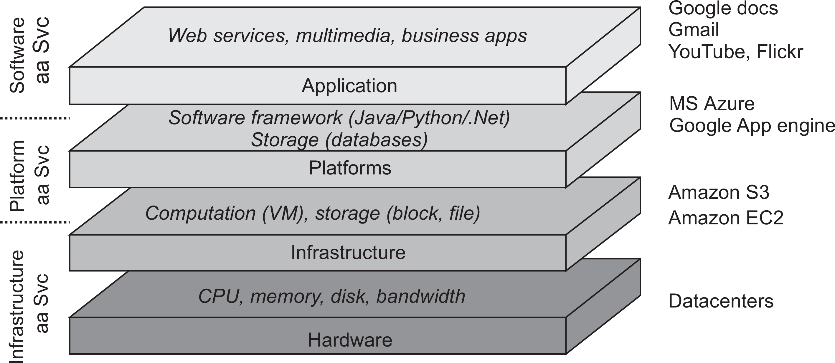
Architectures
Hybrid system architectures
III. Cloud computing
Cloud computing

