Slide 1
Distributed Systems
(4th edition, version 01)
https://www.distributed-systems.net/
Chapter 01: Introduction

Slide 2
Brief Computing History
Introduction From networked systems to distributed systems
1945: modern computer era begins
1945-1985: computers large and expensive. no way to connect them.
mid-1980s:
- powerful microprocessors
- invention of high-speed computer networks
Distributed versus decentralized systems

Slide 3
Brief Computing History - Networks
Introduction From networked systems to distributed systems
Local-area networks (LANs) Allow thousands of machines within building to be connected
Wide-area network (WANs) Allow hundreds of millions of machines all over the earth
to be connected
Speeds varying from tens of thousands to hundreds of millions bps and more.
Distributed versus decentralized systems

Slide 4
Brief Computing History
Introduction From networked systems to distributed systems
Now: miniaturization of computer systems, with perhaps the smartphone as the most impressive outcome.
The size of a networked computer system may vary from a handful of
devices, to millions of computers.
Most networked computer systems can be accessed from
anywhere in the world because they are connected to Internet.
Distributed versus decentralized systems

Slide 5
Alternative approach
Introduction From networked systems to distributed systems
Two definitions
A decentralized system is a networked computer system in which processes and resources are necessarily spread across multiple computers.
A distributed system is a networked computer system in which processes and resources are sufficiently spread across multiple computers.
Distributed versus decentralized systems

Slide 6
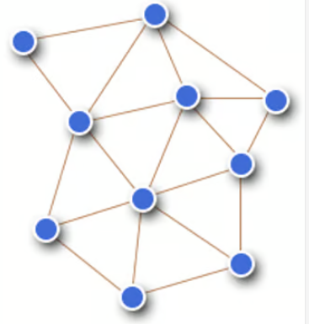
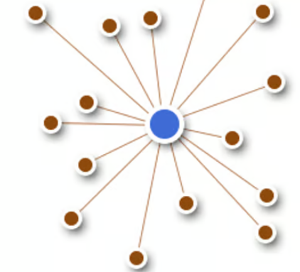
Distributed vs Centralized
Introduction From networked systems to distributed systems
Distributed system uses multiple computers in a network
Each node has its own memory
Centralized system follows client-server architecture built around single, powerful server.
Less powerful nodes submit requests to central server
Easier to manage
But...entire system depends on central server
Distributed versus decentralized systems

Slide 7
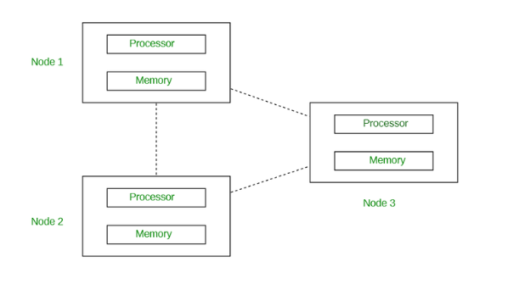
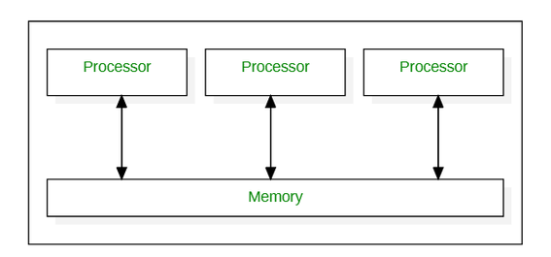
Distributed vs Parallel
Introduction From networked systems to distributed systems
Distributed computing uses multiple computers in a network
Each node has its own memory
Parallel computing usually uses one computer with multiple processors
There is a single memory unit
Distributed Computing
Parallel Computing
Source: https://www.geeksforgeeks.org/different-computing-paradigms/
Distributed versus decentralized systems

Slide 8
Distributed System – Example 1
Introduction From networked systems to distributed systems
Gmail
Close to 1.8 billion users as of 2025
Seems to use two servers: inbox and outbox
Behind the scenes, the entire Google Mail service has been implemented and spread across many computers
Distributed versus decentralized systems

Slide 9
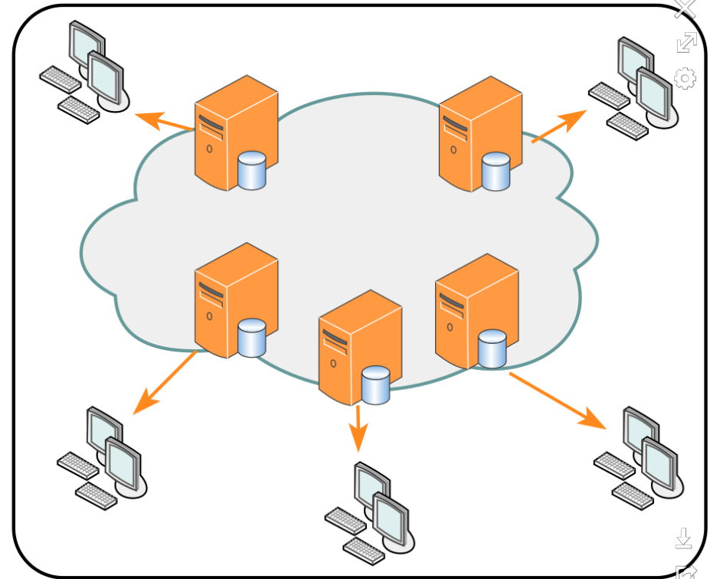
Distributed System – Example 2
Introduction From networked systems to distributed systems
Content Delivery Networks (CDNs)
Geographically distributed network of servers and their data centers
Content copied and spread across various servers of the CDN
When visiting a website, user is redirected to nearby server that holds relevant content.
Source: Wikipedia
Distributed versus decentralized systems

Slide 10
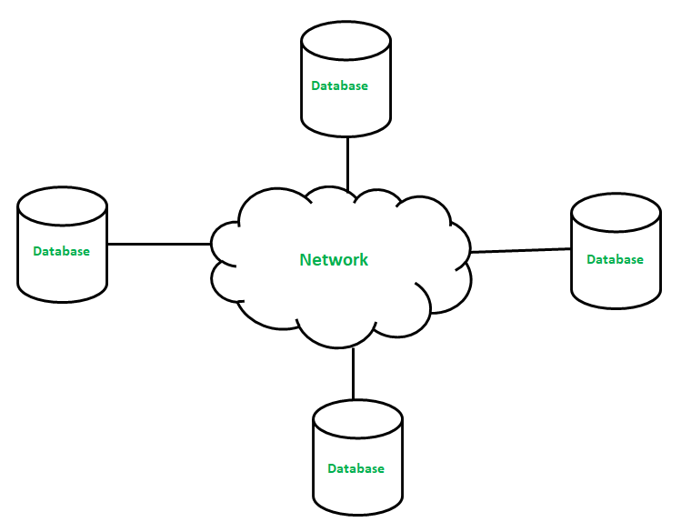
Distributed System – Example 3
Introduction From networked systems to distributed systems
Distributed Database (e.g., Amazon DynamoDB)
Scalable: Automatically distributes data and traffic across multiple servers to handle varying throughput and storage requirements.
High Availability and Durability:
Data automatically replicated across multiple Availability Zones within an AWS Region.
Flexibility and Data Model: DynamoDB supports a flexible NoSQL data model, accommodating both key-value and document data.
Distributed versus decentralized systems

Slide 11
Perspectives on distributed systems
Introduction From networked systems to distributed systems
Distributed systems are complex: take perspectives
Architecture: common organizations
Process: what kind of processes, and their relationships
Communication: facilities for exchanging data
Coordination: application-independent algorithms
Naming: how do you identify resources?
Consistency and replication: performance requires of data, which need to be the same
Fault tolerance: keep running in the presence of partial failures
Security: ensure authorized access to resources
Studying distributed systems

Slide 12
Introduction
Design goals
What do we want to achieve?
Overall design goals
Support sharing of resources
Distribution transparency – a bit of a confusing term, means that users don’t realize the system is distributed (details are abstracted away)
Openness – includes extensibility
Scalability

Slide 13
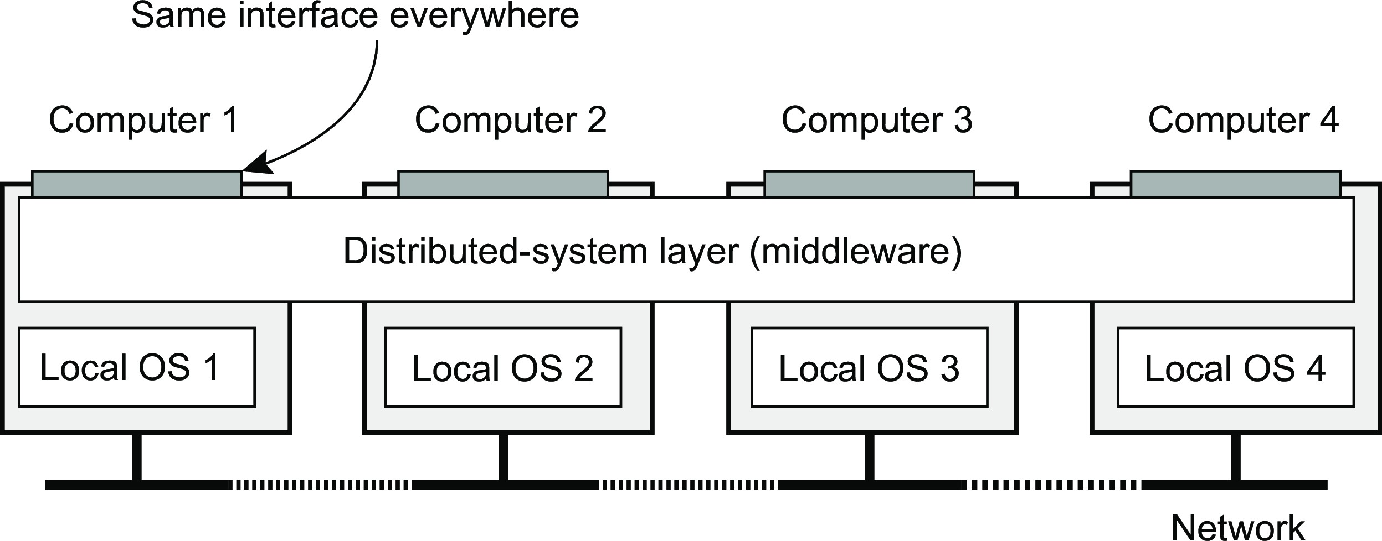
Introduction
Design goals
Distribution transparency
What is transparency?
The phenomenon by which a distributed system attempts to hide the fact that its processes and resources are physically distributed across multiple computers, possibly separated by large distances.
Distribution transparency

Slide 14
Introduction
Design goals
Distribution transparency
What is transparency?
The phenomenon by which a distributed system attempts to hide the fact that its processes and resources are physically distributed across multiple computers, possibly separated by large distances.
Observation
Distribution transparancy is handled through many different techniques in a layer between applications and operating systems: a middleware layer
Distribution transparency

Slide 15
Introduction
Design goals
Scale in distributed systems
Observation
Many developers of modern distributed systems easily use the adjective “scalable” without making clear why their system actually scales.
Scalability

Slide 16
Introduction
Design goals
Scale in distributed systems
Observation
Many developers of modern distributed systems easily use the adjective “scalable” without making clear why their system actually scales.
At least three components
Number of users or processes (size scalability)
Maximum distance between nodes (geographical scalability)
Number of administrative domains (administrative scalability)
Scalability

Slide 17
Size scalability
Introduction Design goals
Root causes for scalability problems with centralized solutions
The computational capacity, limited by the CPUs
The storage capacity, including the transfer rate between CPUs and disks
The network between the user and the centralized service
Scalability

Slide 18
Introduction
Design goals
Techniques for scaling
Hide communication latencies
Make use of asynchronous communication
Have separate handler for incoming response
Problem: not every application fits this model
Scalability

Slide 19
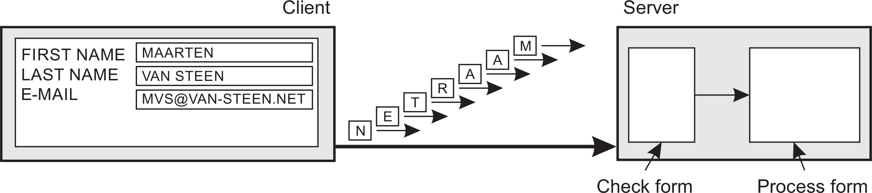
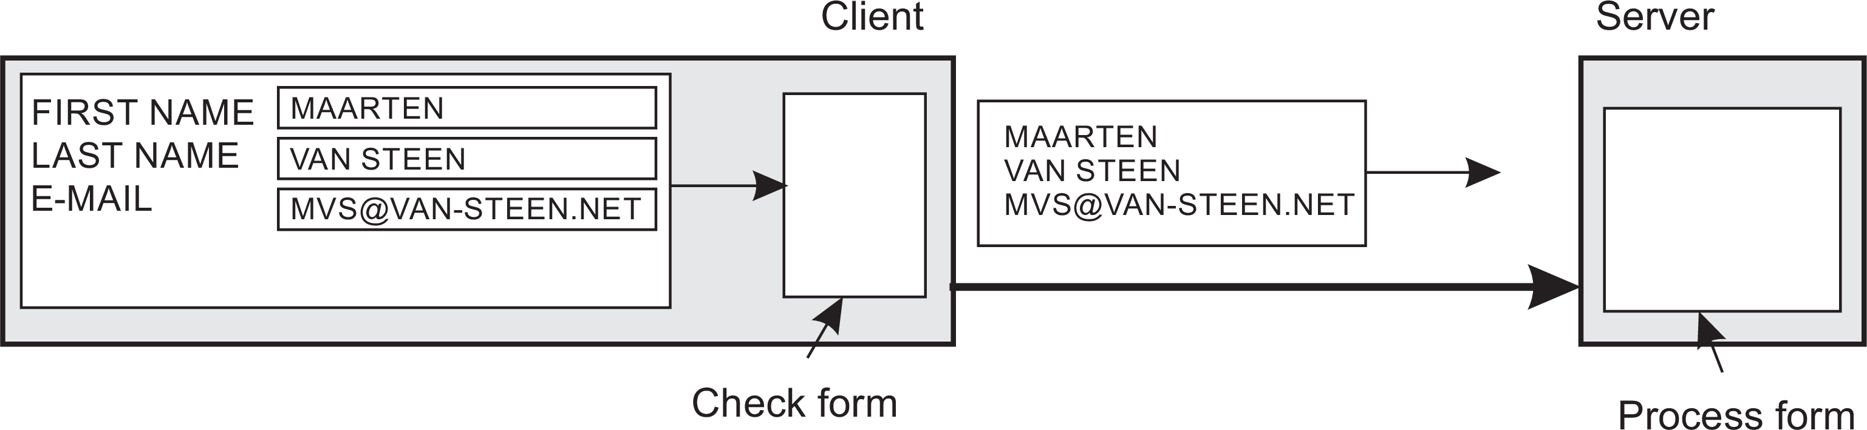
Introduction
Design goals
Techniques for scaling
Facilitate solution by moving computations to client
Scalability

Slide 20
Introduction
Design goals
Techniques for scaling
Partition data and computations across multiple machines
Move computations to clients (Java applets and scripts)
Decentralized naming services (DNS)
Decentralized information systems (WWW)
Scalability

Slide 21
Introduction
Design goals
Techniques for scaling
Replication and caching: Make copies of data available at different machines
Replicated file servers and databases
Mirrored Websites
Web caches (in browsers and proxies) Store copies of web files on user device or intermediary servers
File caching (at server and client)
Scalability

Slide 22
Introduction
Design goals
Scaling: The problem with replication
Applying replication is easy, except for one thing
Scalability

Slide 23
Introduction
Design goals
Scaling: The problem with replication
Applying replication is easy, except for one thing
Having multiple copies (cached or replicated), leads to inconsistencies: modifying one copy makes that copy different from the rest.
Scalability

Slide 24
Introduction
Design goals
Scaling: The problem with replication
Applying replication is easy, except for one thing
Having multiple copies (cached or replicated), leads to inconsistencies: modifying one copy makes that copy different from the rest.
Always keeping copies consistent and in a general way requires global synchronization on each modification.
Scalability

Slide 25
Introduction
Design goals
Scaling: The problem with replication
Applying replication is easy, except for one thing
Having multiple copies (cached or replicated), leads to inconsistencies: modifying one copy makes that copy different from the rest.
Always keeping copies consistent and in a general way requires global synchronization on each modification.
Global synchronization precludes large-scale solutions.
Scalability

Slide 26
Introduction
Design goals
Scaling: The problem with replication
Applying replication is easy, except for one thing
Having multiple copies (cached or replicated), leads to inconsistencies: modifying one copy makes that copy different from the rest.
Always keeping copies consistent and in a general way requires global synchronization on each modification.
Global synchronization precludes large-scale solutions.
Observation
If we can tolerate inconsistencies, we may reduce the need for global synchronization, but tolerating inconsistencies is application dependent.
Example: For some social media apps, inconsistency may be fine (e.g., different users see different messages temporarily)
Scalability

Slide 27
Introduction
Pitfalls
Developing distributed systems: Pitfalls
Observation
Many distributed systems are needlessly complex, caused by mistakes that required patching later on. Many false assumptions are often made.

Slide 28
Introduction
Pitfalls
Developing distributed systems: Pitfalls
Observation
Many distributed systems are needlessly complex, caused by mistakes that required patching later on. Many false assumptions are often made.
False (and often hidden) assumptions

Slide 29
Introduction
Pitfalls
Developing distributed systems: Pitfalls
Observation
Many distributed systems are needlessly complex, caused by mistakes that required patching later on. Many false assumptions are often made.
False (and often hidden) assumptions
The network is reliable

Slide 30
Introduction
Pitfalls
Developing distributed systems: Pitfalls
Observation
Many distributed systems are needlessly complex, caused by mistakes
that required patching later on. Many false assumptions are often made.
False (and often hidden) assumptions
The network is reliable
The network is secure

Slide 31
Introduction
Pitfalls
Developing distributed systems: Pitfalls
Observation
Many distributed systems are needlessly complex, caused by mistakes
that required patching later on. Many false assumptions are often made.
False (and often hidden) assumptions
The network is reliable
The network is secure
The network is homogeneous

Slide 32
Introduction
Pitfalls
Developing distributed systems: Pitfalls
Observation
Many distributed systems are needlessly complex, caused by mistakes
that required patching later on. Many false assumptions are often made.
False (and often hidden) assumptions
The network is reliable
The network is secure
The network is homogeneous
The topology does not change

Slide 33
Introduction
Pitfalls
Developing distributed systems: Pitfalls
Observation
Many distributed systems are needlessly complex, caused by mistakes
that required patching later on. Many false assumptions are often made.
False (and often hidden) assumptions
The network is reliable
The network is secure
The network is homogeneous
The topology does not change
Latency is zero

Slide 34
Introduction
Pitfalls
Developing distributed systems: Pitfalls
Observation
Many distributed systems are needlessly complex, caused by mistakes
that required patching later on. Many false assumptions are often made.
False (and often hidden) assumptions
The network is reliable
The network is secure
The network is homogeneous
The topology does not change
Latency is zero
Bandwidth is infinite

Slide 35
Introduction
Pitfalls
Developing distributed systems: Pitfalls
Observation
Many distributed systems are needlessly complex, caused by mistakes
that required patching later on. Many false assumptions are often made.
False (and often hidden) assumptions
The network is reliable
The network is secure
The network is homogeneous
The topology does not change
Latency is zero
Bandwidth is infinite
Transport cost is zero

Slide 36
Introduction
Pitfalls
Developing distributed systems: Pitfalls
Observation
Many distributed systems are needlessly complex, caused by mistakes
that required patching later on. Many false assumptions are often made.
False (and often hidden) assumptions
The network is reliable
The network is secure
The network is homogeneous
The topology does not change
Latency is zero
Bandwidth is infinite
Transport cost is zero
There is one administrator

