Slide 1
ANN Lab 1 Forward Learning and Backward Propagation, Perceptron Learning and Delta Rule, One-Layer, Two-Layer and Multi-Layer Learning for classification and regression, Encoder Problem
Ravi Bir|ravib@kth.se
Bharat Sharma|bsharma@kth.se
Qiao Ren|qiaor@kth.se
February 5, 2020

Slide 2
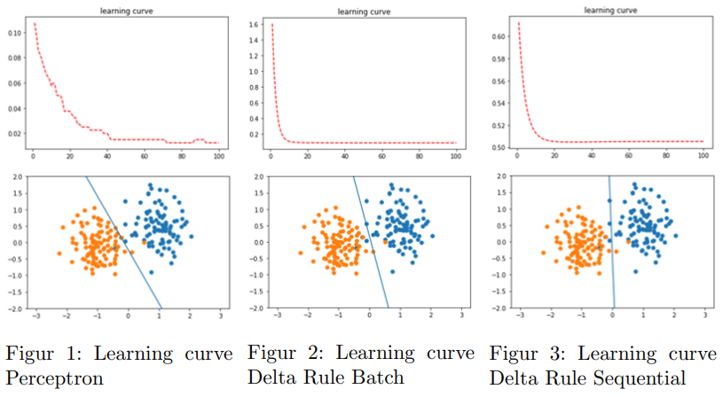
Single-layer perceptron
Delta Batch converged fastest, then delta sequential, then perceptron
Learning rate of 0.001 gave the fastest convergence for all 3

Slide 3
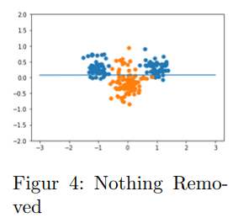
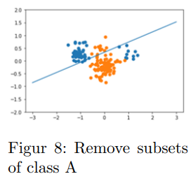
Non Linearly Separable Data
Obvious that linear boundary not sufficient- need 2 layer perceptron

Slide 4
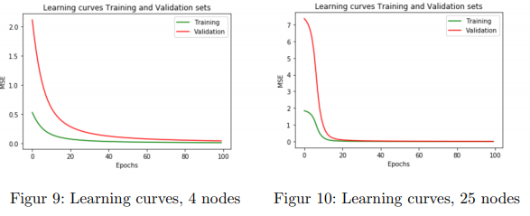
Classification with a two-layer perceptron
More nodes means faster convergence, but chance of overfitting
Learning rate 0.009

Slide 5
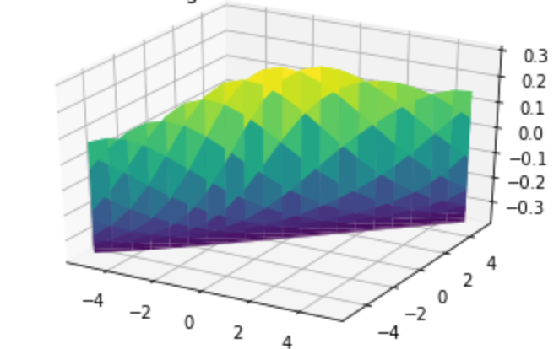
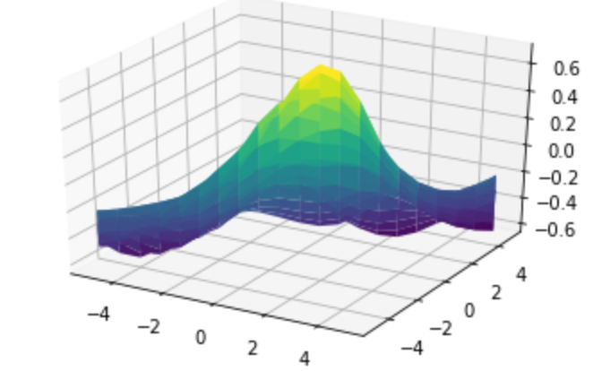
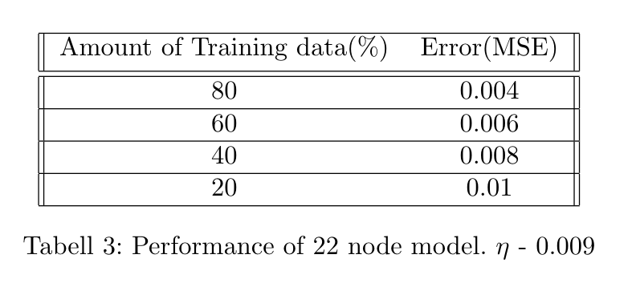
Encoder and Function approximation
Encoder used for dimensionality reduction and reducing the number of hidden nodes cause the encoder to take more epochs to converge.
For learning rate 0.009, converges in 20-30 epochs.
Each input used for activation of hidden layer.
Function approximation -
2 Hidden nodes
25 hidden nodes

Slide 6
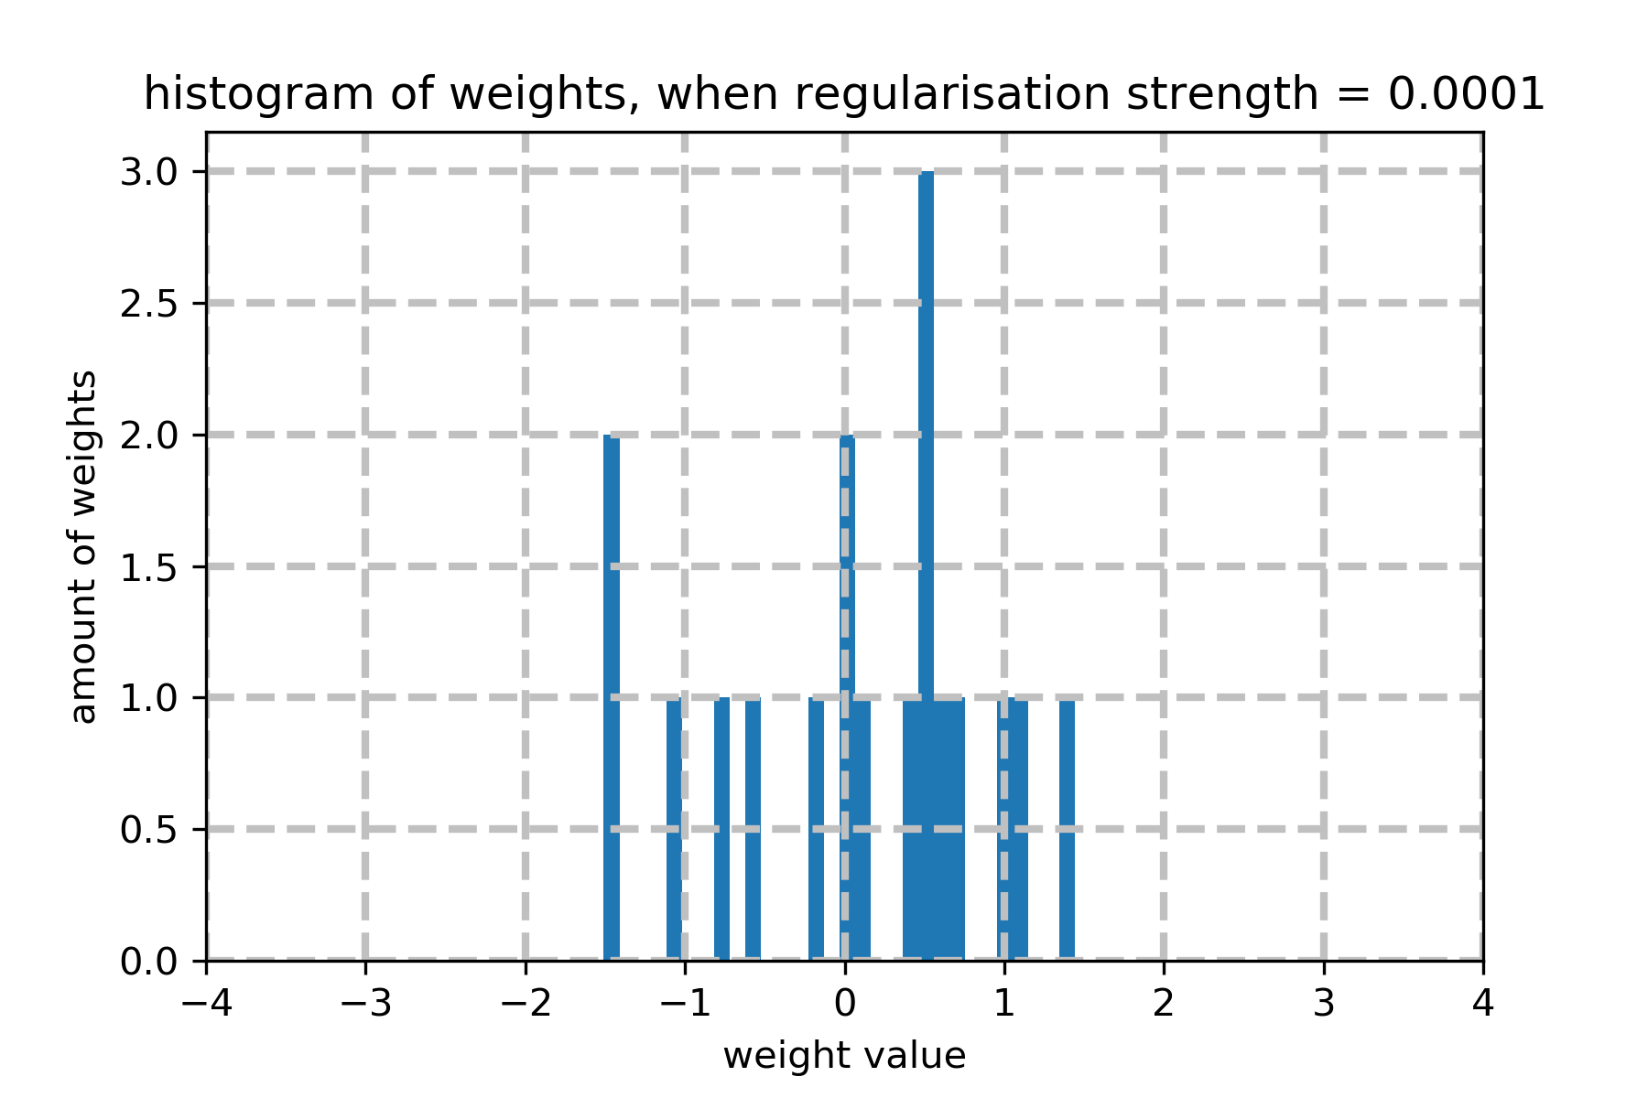
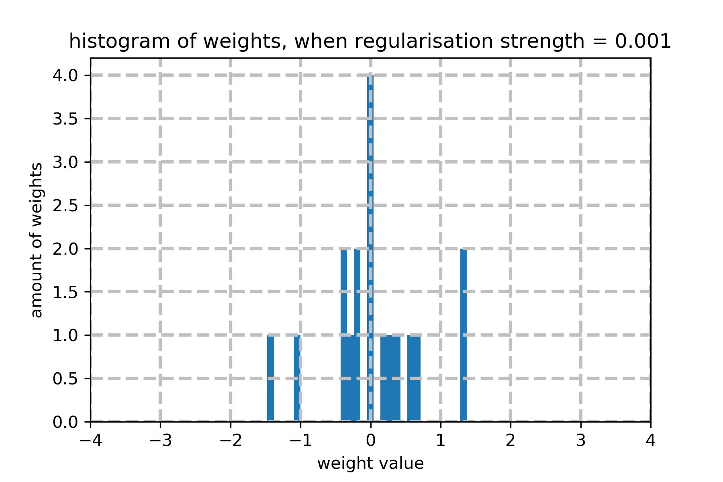
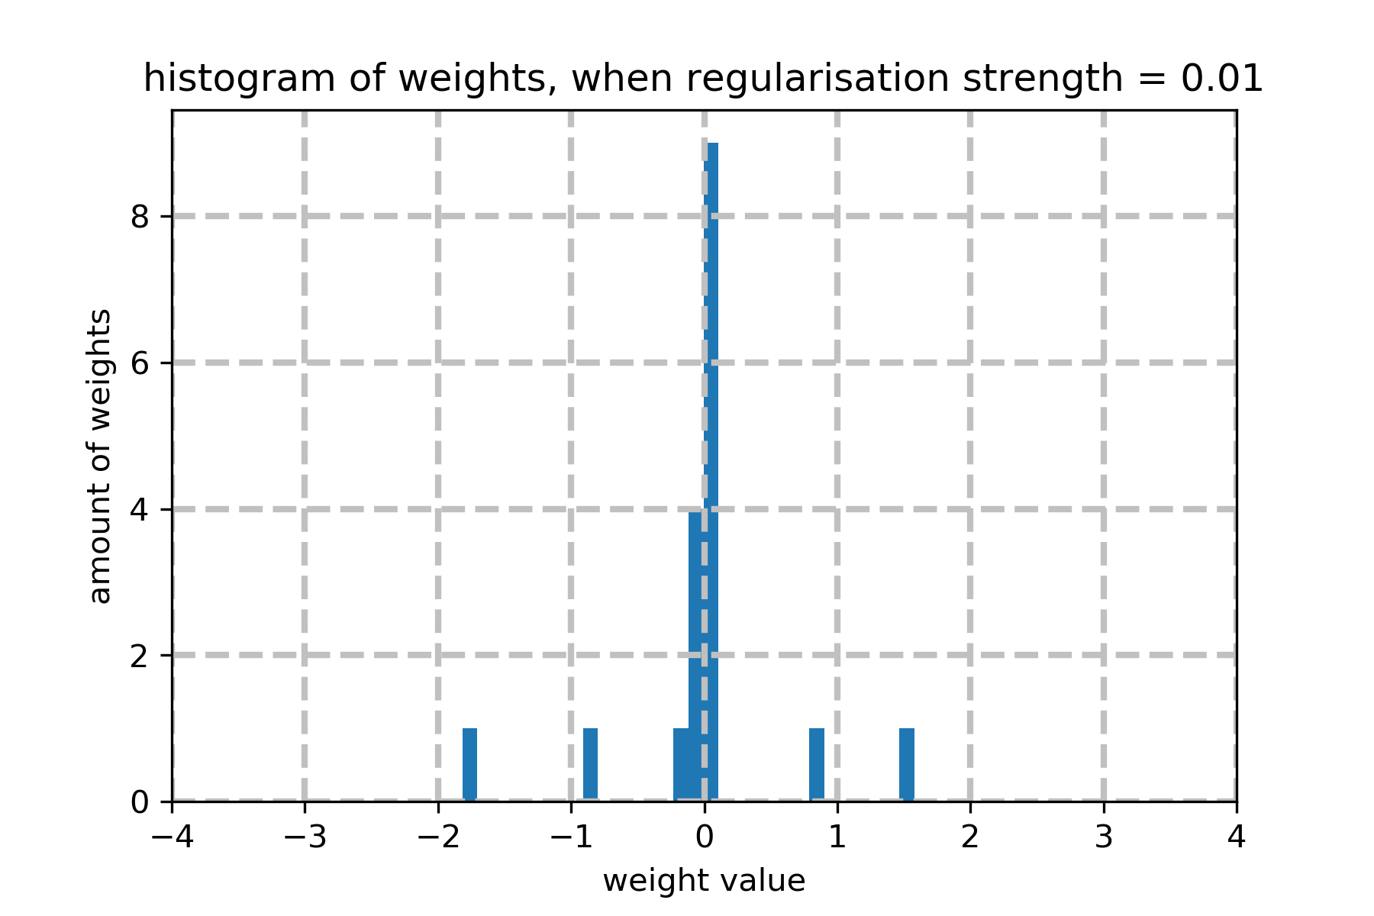
Two layer Model
large regularization strength reduces lots of weights to small values (close to zero)
Notes:
when we add the regularization term into the loss, the weights will be reduced to small numbers.

Slide 7
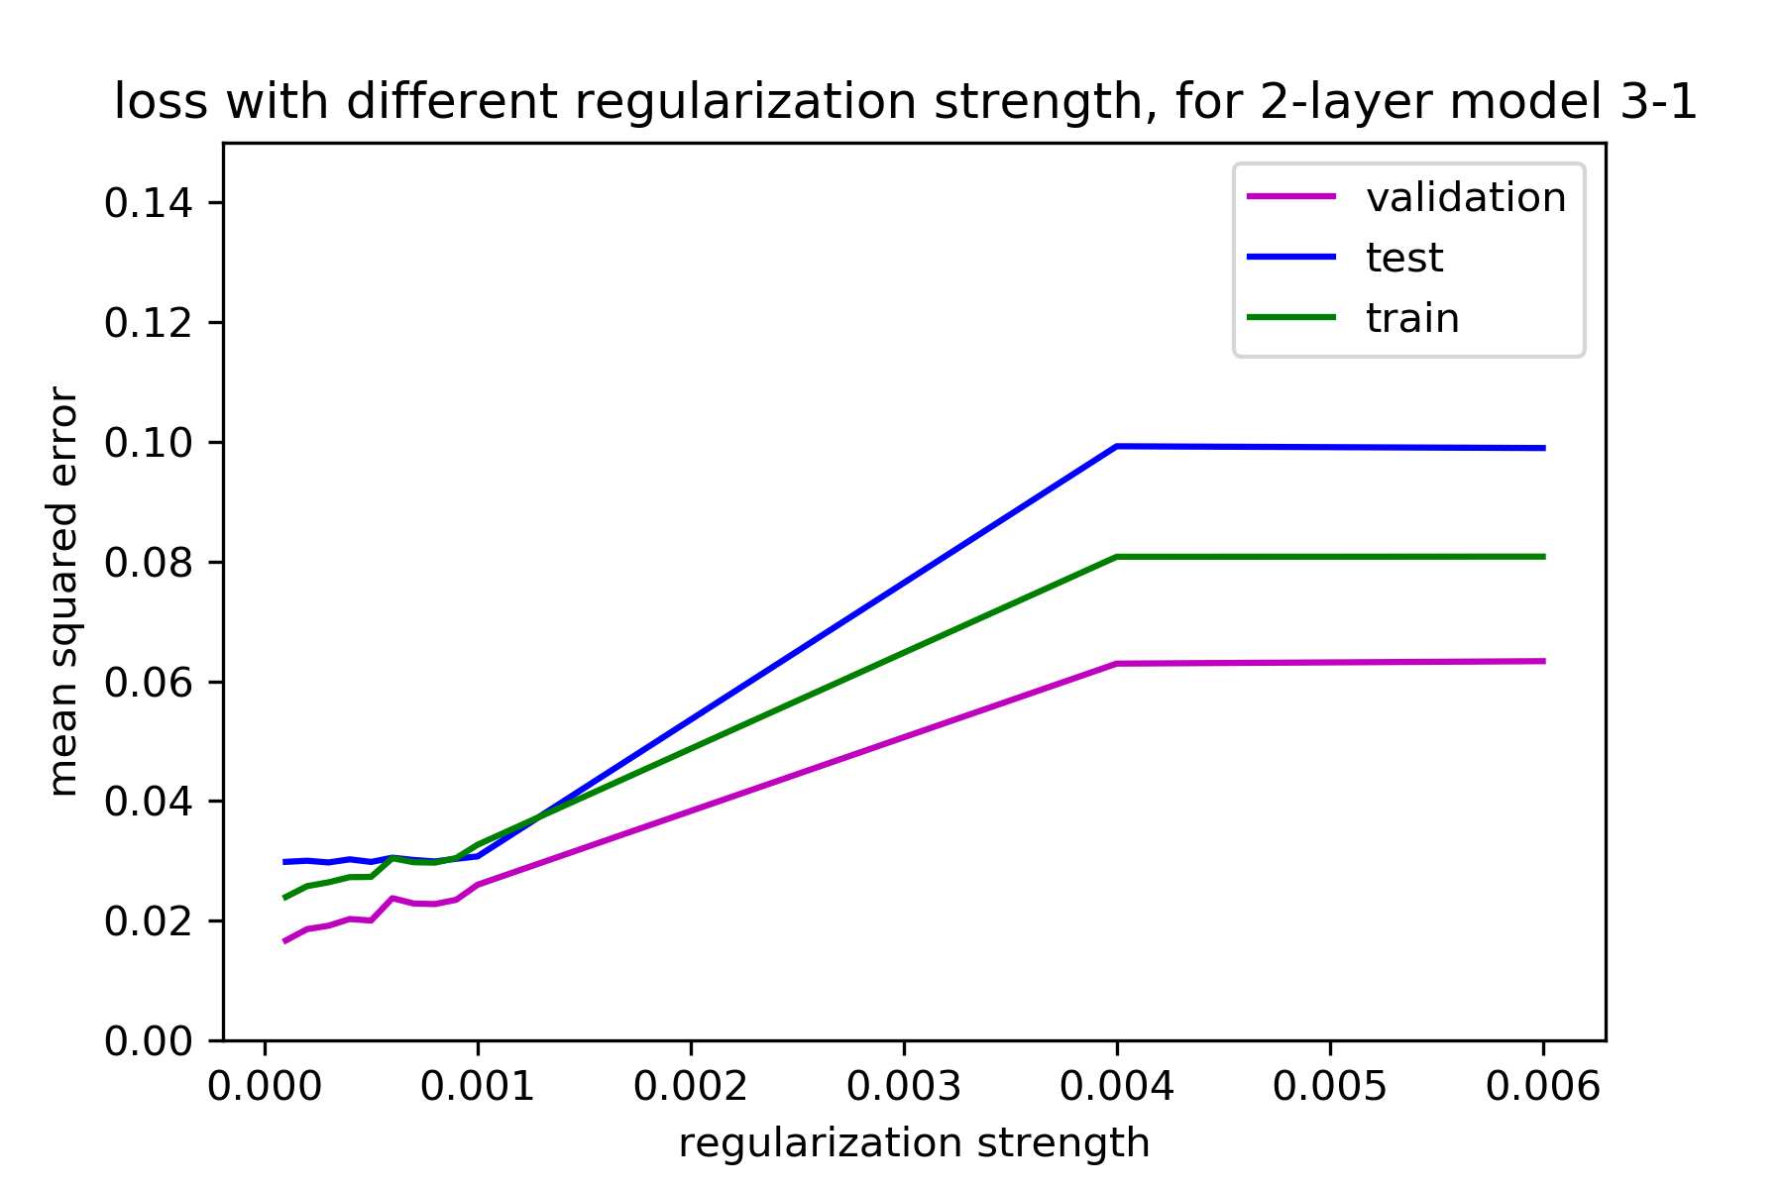
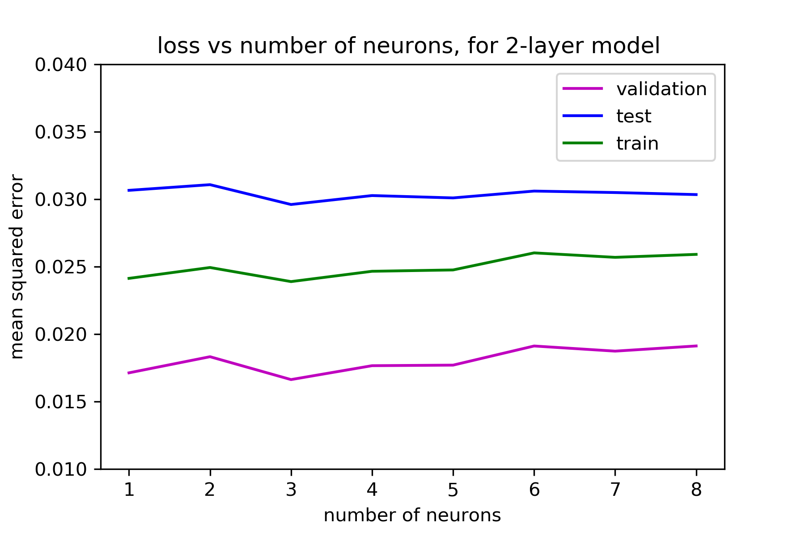
Two layer Model
regularization term penalize the weights, reduce the complexity
we chose regularization strength= 0.0001 (this is a simple model)

Slide 8
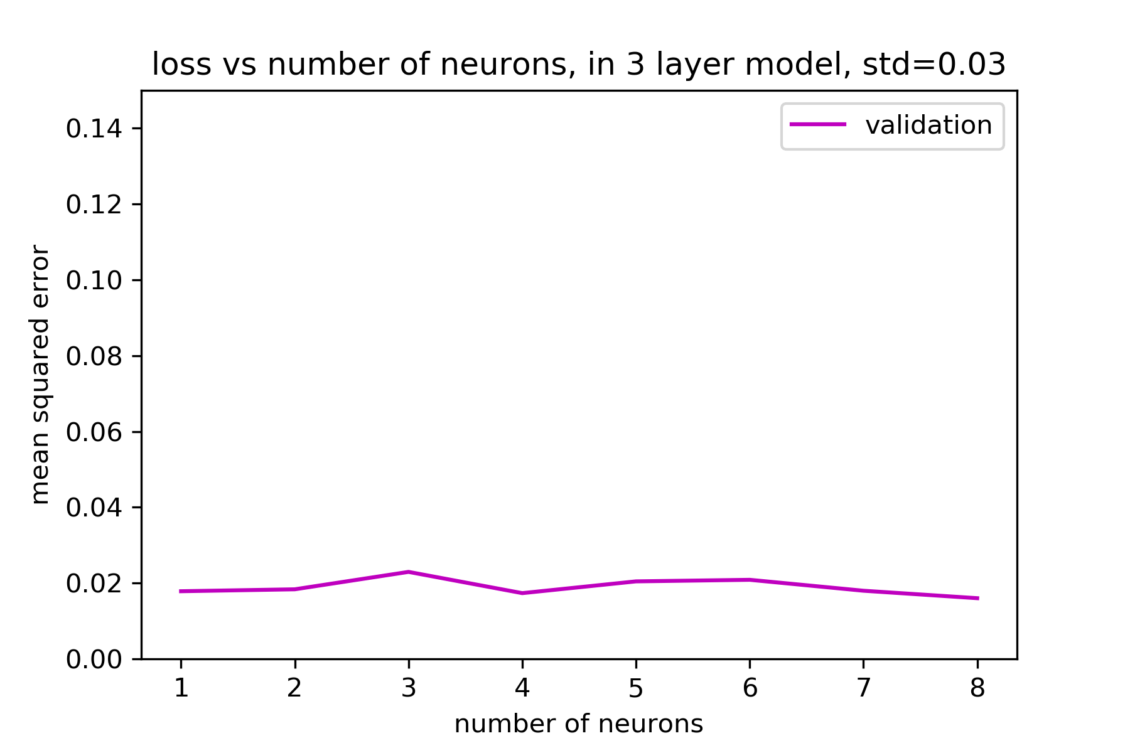
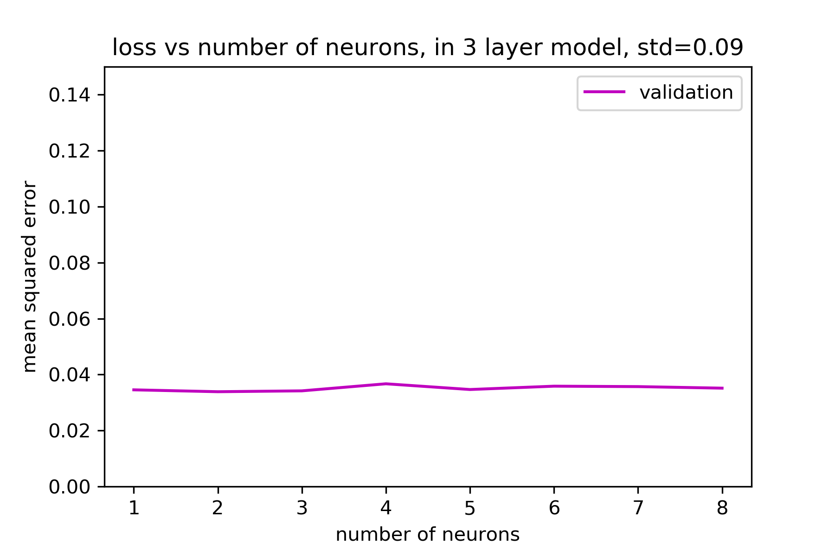
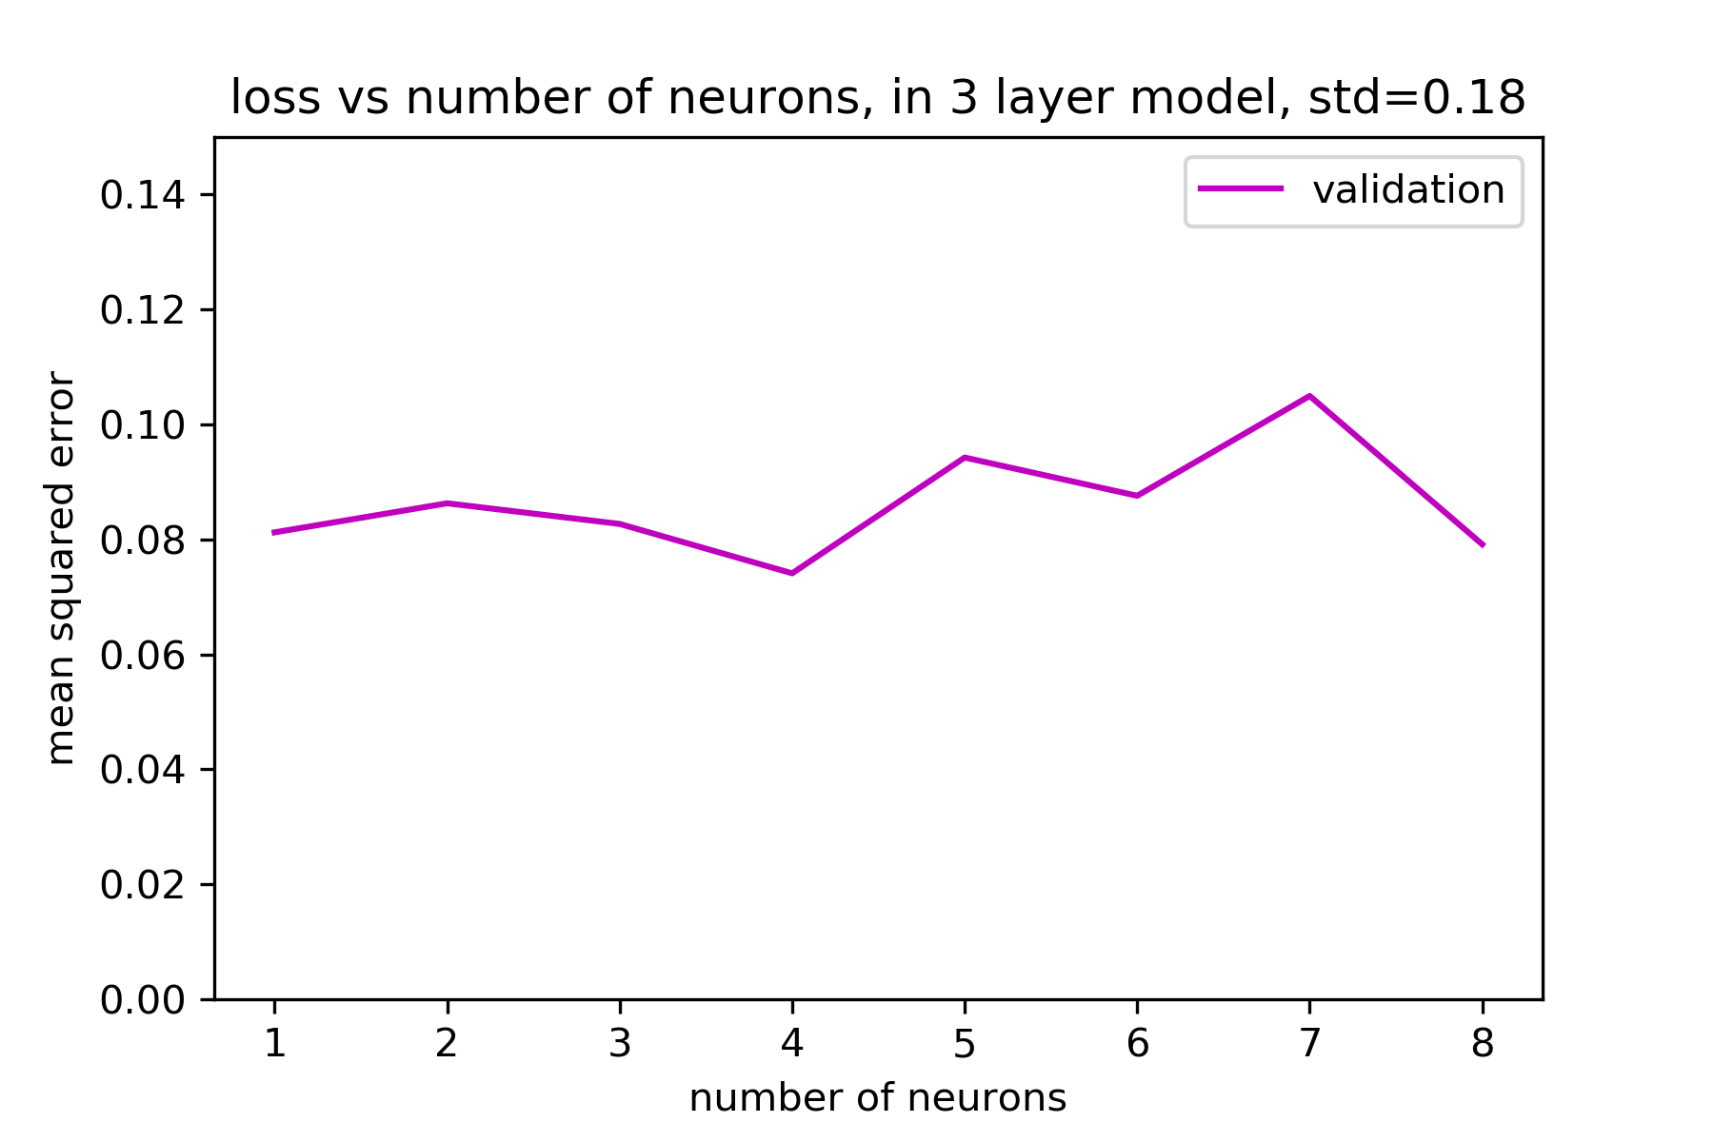
Three layer Model
larger noise raises up the MSE on validation data
the optimal amount of neurons on 2nd layer varies when the noise is different

Slide 9
Comparison on Two-Layer and Three-Layer Model
each model has been run for 10 times. We recorded the average.
MSE: 3-2-1 is lower computational time: 3-1 < 3-2-1
could not generalize the conclusion, because only run 10 times
Model | Parameters | Validation MSE | Test MSE | Computational Time (second)
2 layer model: 3-1 | lr=0.001, regu=0.0001 | 0.0305 | 0.0417 | 6.5209
3 layer model: 3-2-1 | lr=0.001, regu=0.0001 | 0.0291 | 0.0393 | 6.8346

