Slide 1
ANN Lab 2 Radial Basis Function, Self Organizing Map
Ravi Bir|ravib@kth.se
Bharat Sharma|bsharma@kth.se
Qiao Ren|qiaor@kth.se
February 19, 2020

Slide 2
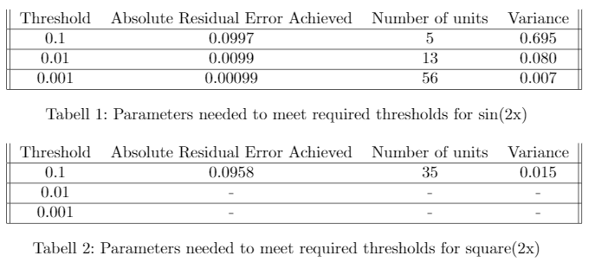
Batch RBF Thresholds
To reduce the residual error to 0 for the square(2x) function, we could use a sign activation function

Slide 3
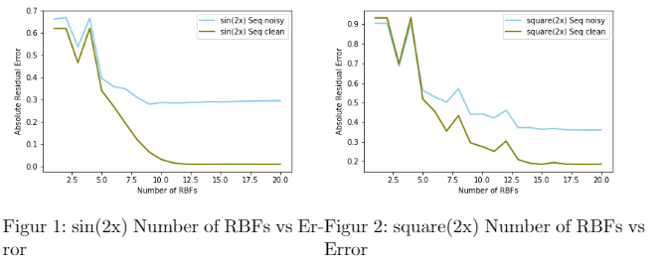
On-line Number of RBFs

Slide 4
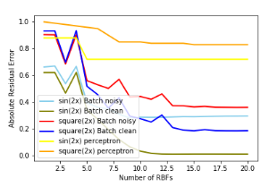
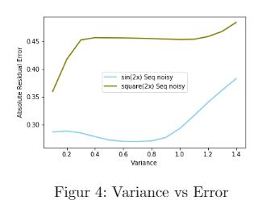
Batch RBFs and Variance

Slide 5
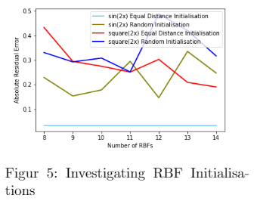
RBF initialisations

Slide 6
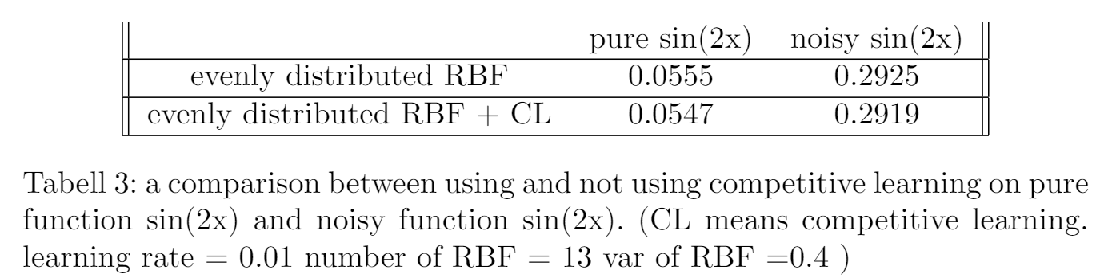
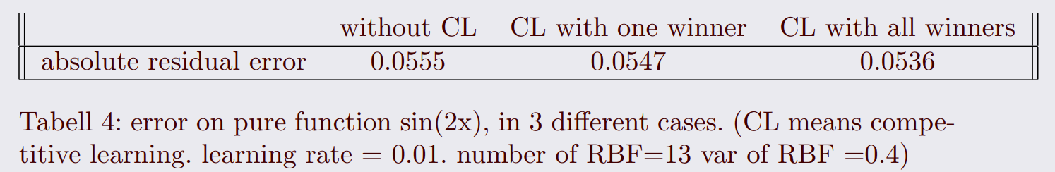
competitive learning
avoiding dead units
Notes:
CL improves performance of RBF

Slide 7
different ways to initialize RBFs' positions
Error on Pure sin(2x)
by hand | 0.0555 | random | 0.1135 | on data point | 0.157
by hand +CL | 0.0547 | random +CL | 0.0561 | on data point +CL | 0.113
--by hand: evenly distribute RBF's positions in range (0,2pie)
--random: randomly place RBF's positions in range (0,2pie)
--on data point: put RBF exactly on the randomly select several data points
--CL: competitive learning

Slide 8
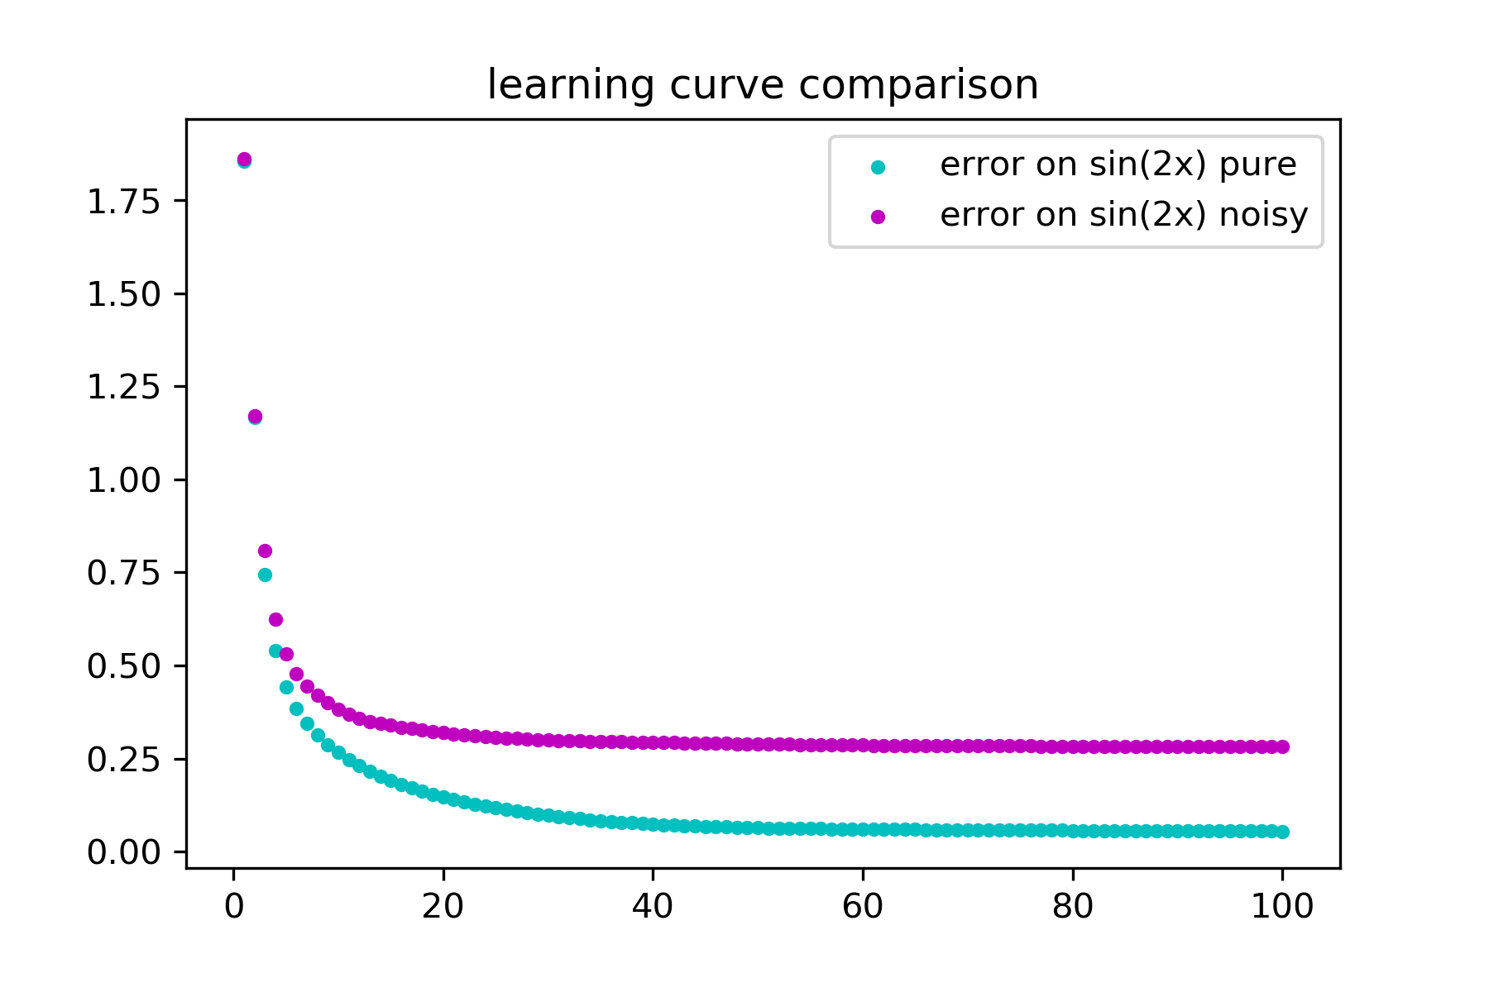
convergence of learning rate
learning curve of pure and noisy sin(2x), when using competitive learning with only one winner

Slide 9
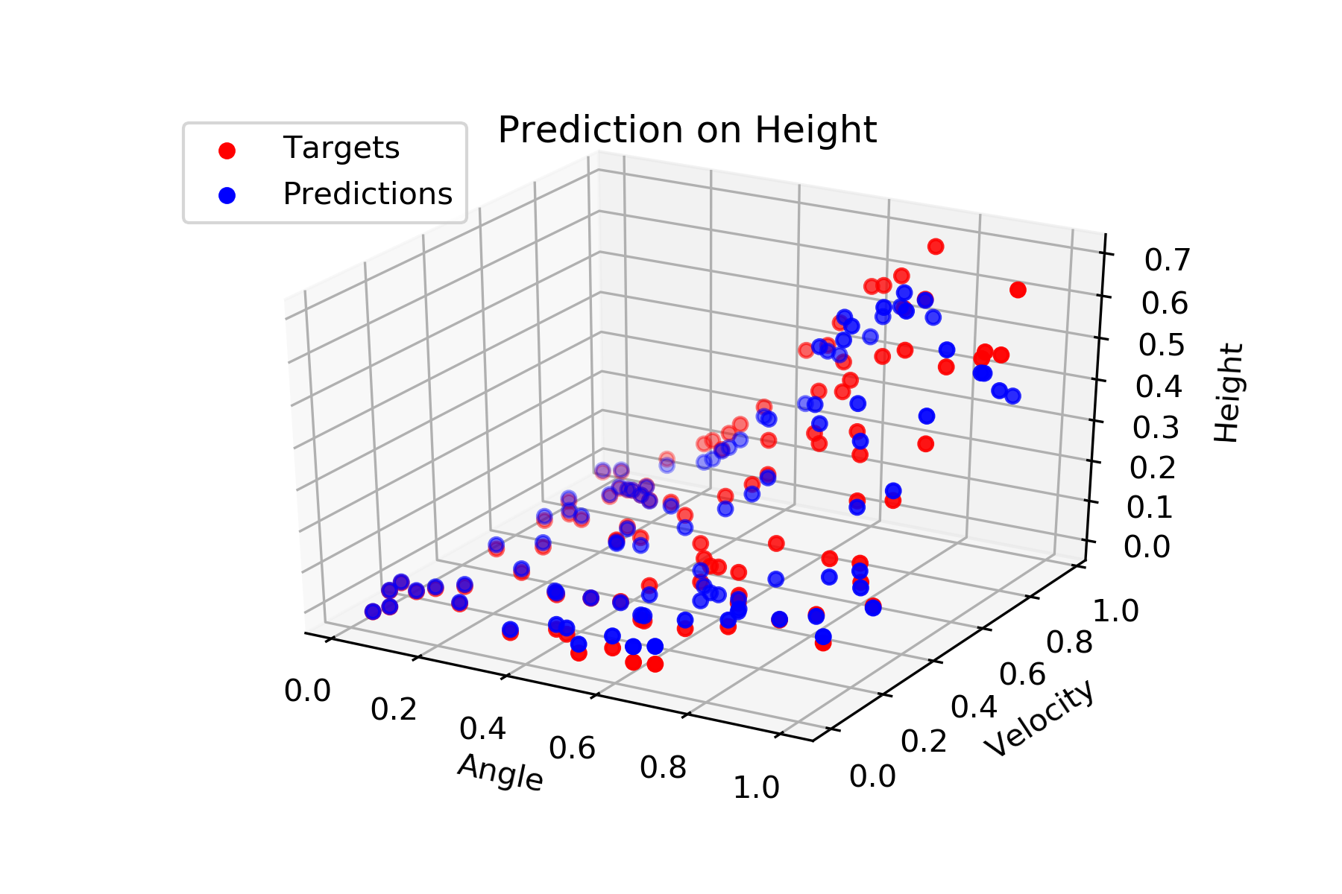
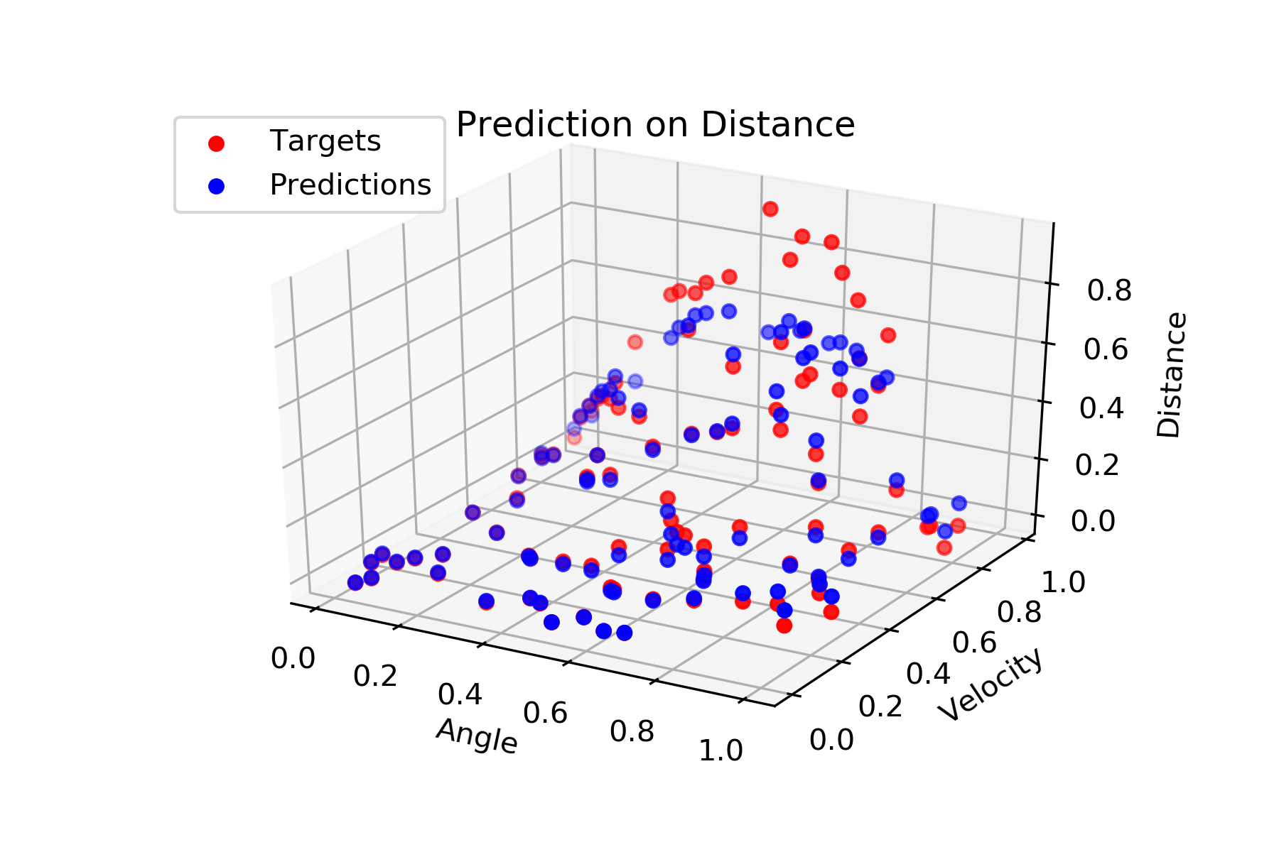
RBF learning on two-dimentional dataset
error of prediction: 0.0304
output: height
output: distance

Slide 10
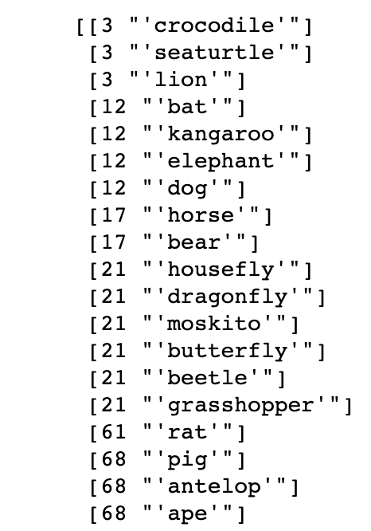
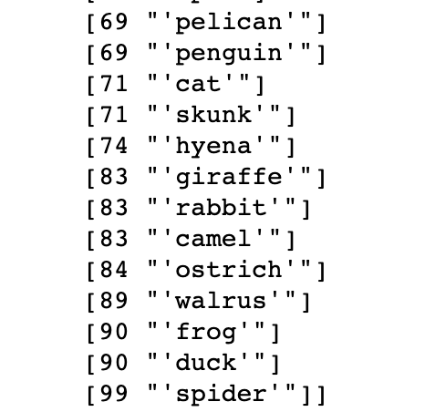
SOMS
Animal Ordering -
We can see that insects are grouped together. Sea turtle and crocodile are often together as well as frog and duck as they are water type. 4-legged species are often together.

Slide 11
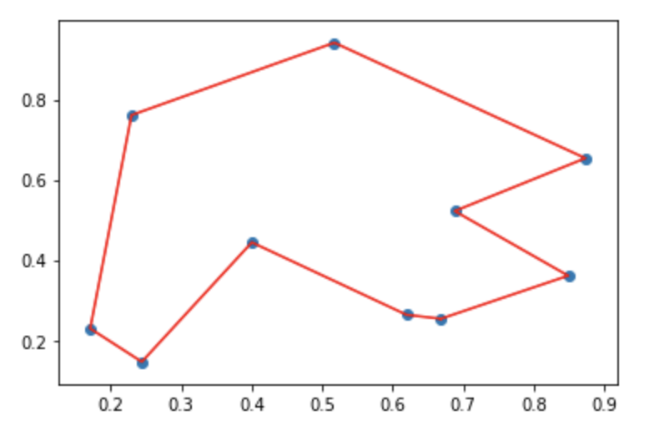
Cyclic Tour
We keep on decreasing the neighbourhood after each epoch. We are able to find a good tour as shown in the figure above but sometimes, the algorithm takes a detour between the two points in the bottom left edge. This might be due to very small neighbourhood or less training.

Slide 12
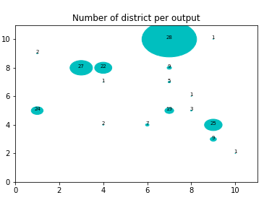
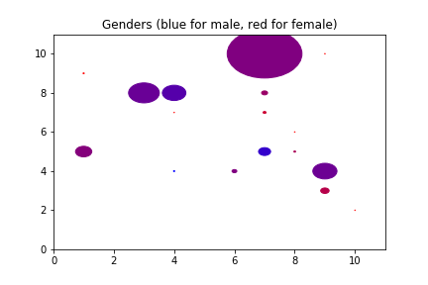
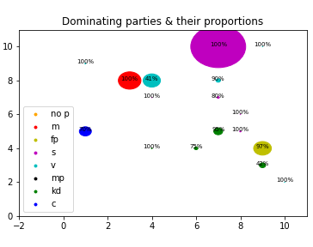
Clustering with SOMS
Sex and district doesn’t decide the voting patterns. Party on the other side affects voting majorly.

