Slide 1
ANN Lab 3 Hopfield Network
Ravi Bir|ravib@kth.se
Bharat Sharma|bsharma@kth.se
Qiao Ren|qiaor@kth.se
March 3, 2020

Slide 2
Convergence and Attractors
The network was able to store all the patterns successfully.
No, with Little model update, x2d didn’t converge to the stored pattern. Only x1d and x3d were able to converge to their stored patterns x1 and x3.
By trying out every possible combination of input patterns, we found that they converged to a total of 14 attractors.
When we make the distorted patterns dissimilar to the stored ones by more than 50 percent, the patterns don’t converge to the given attractors anymore, they converge to different patterns.

Slide 3
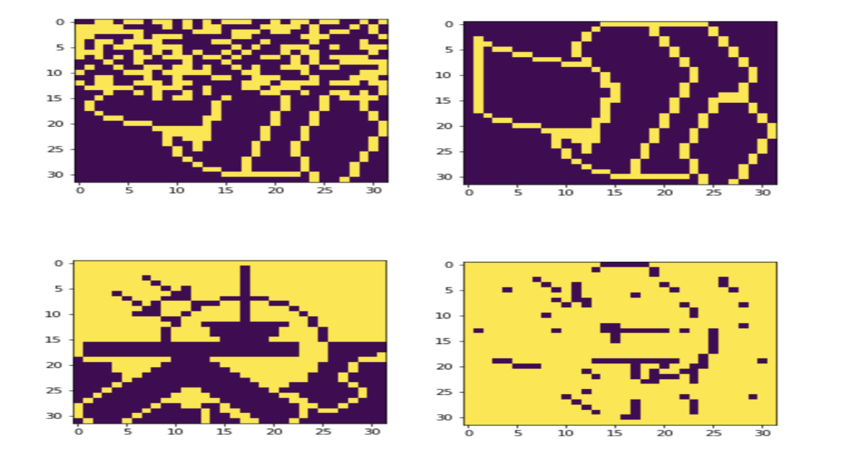
Sequential Update
In batch mode, the network was able to retrieve the complete p1 pattern from p10 but nothing from p11.
In sequential mode, the network was able to retrieve p1 from p10 and was able to retrieve p3 from p11, but not p2 from p11

Slide 4
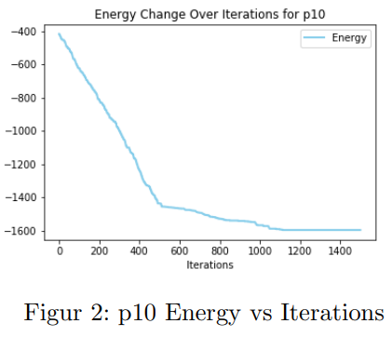
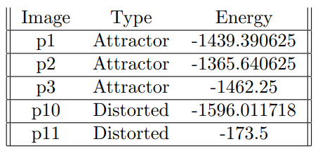
Energy

Slide 5
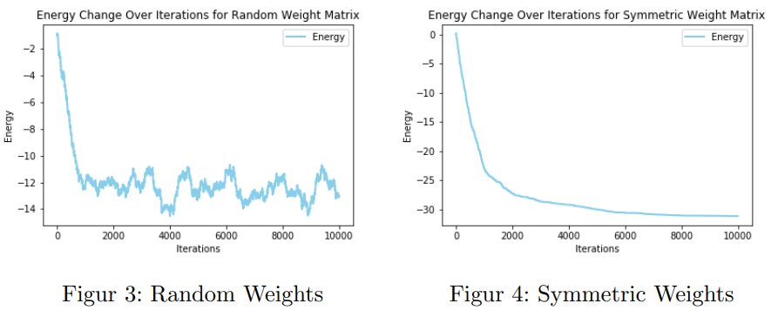

Slide 6
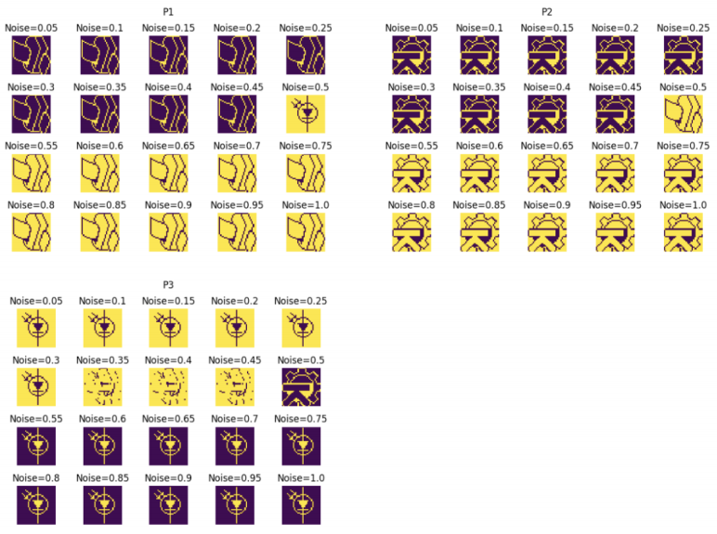
Distortion Resistance

Slide 7
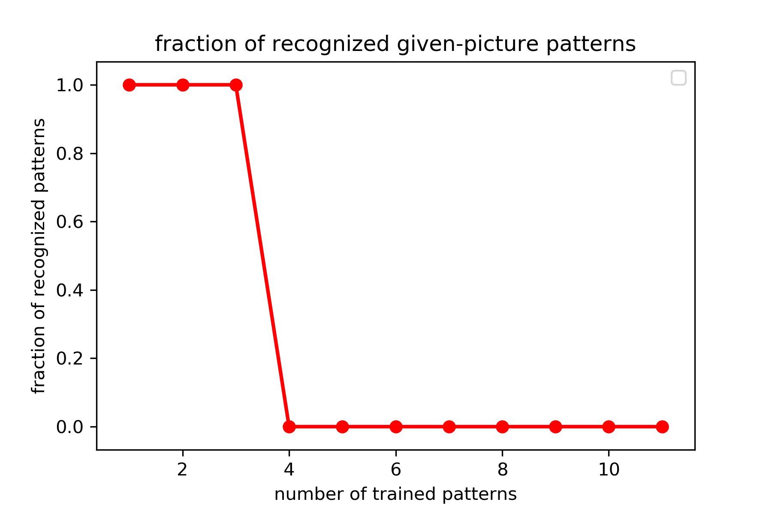
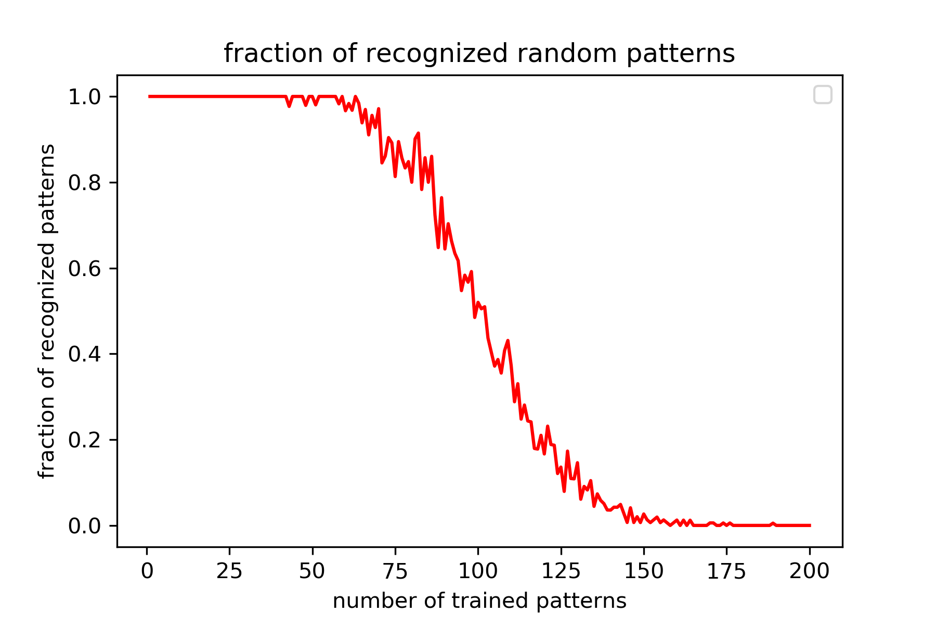
Capacity
given patterns
random patterns
Notes:
The network has a maximum capacity of storing 3 images.
With random images, the network can store up to 50 images.
because random imgs makes the weights to have more diversity

Slide 8
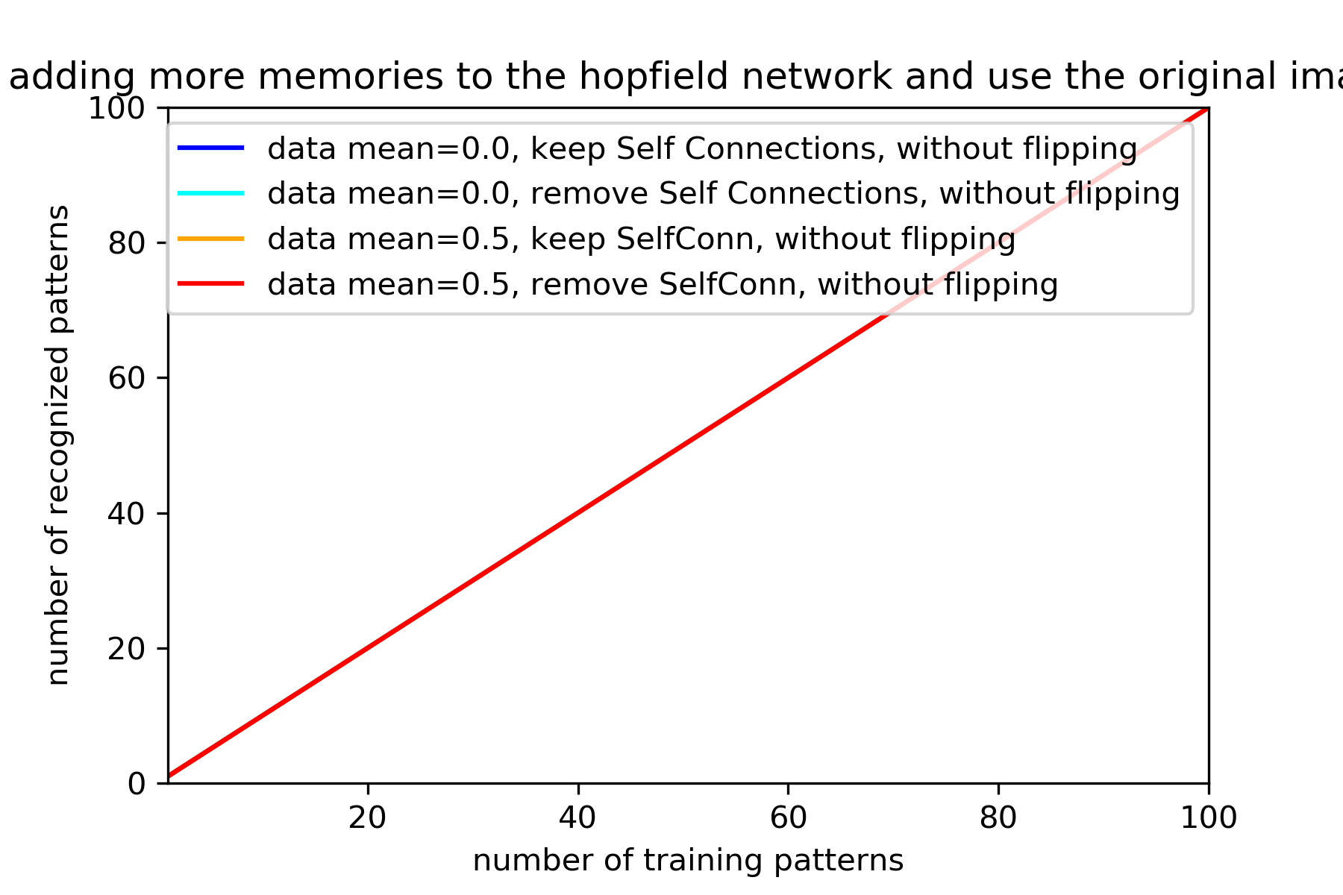
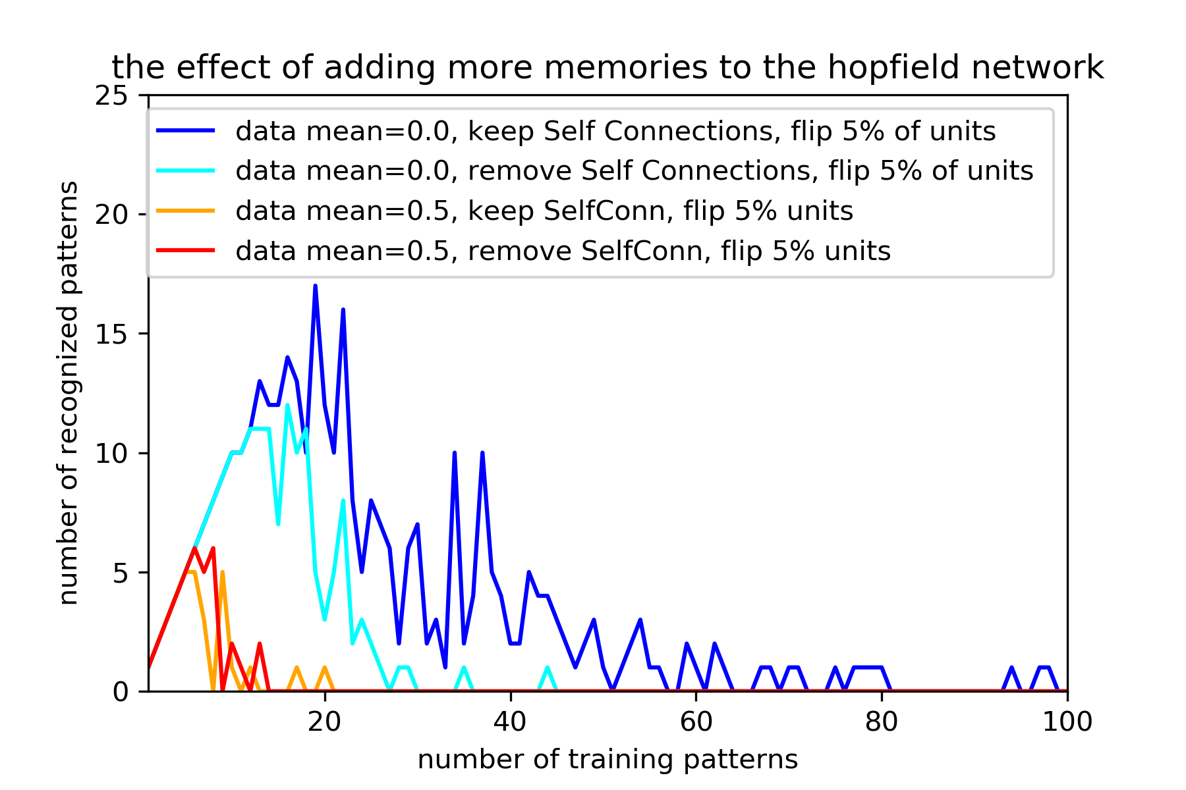
Capacity
recover patterns from undistorted arrays
recover patterns from distorted arrays
(5 percent of units are flipped)
Notes:
removing self connections lowers the memory performance
bias decreases the number of recognized patterns

Slide 9
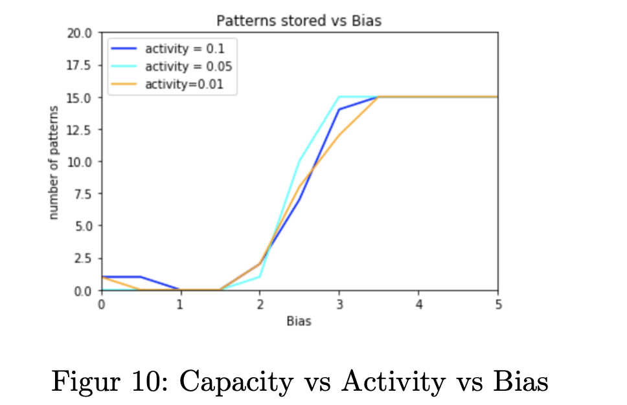
Sparse Patterns
The highest number of patterns that can be stored (15) can be seen at a bias of around 3.4 for each activity level.

