Slide 1
ANN Lab 4 Restricted Boltzmann Machines and Deep Belief Nets
Ravi Bir|ravib@kth.se
Bharat Sharma|bsharma@kth.se
Qiao Ren|qiaor@kth.se
April 29th, 2020

Slide 2
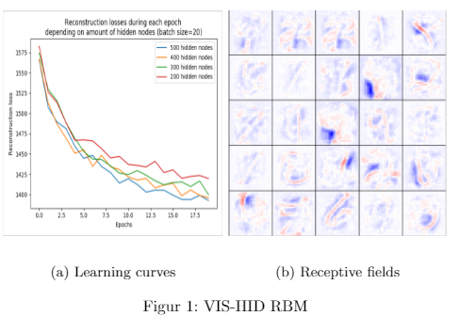
RBM for recognising MNIST image

Slide 3

Deep Networks - Greedy Layerwise Pre-training
Extended the single-hidden
layer network to a deeper
architecture by following the
idea of greedy layer-wise
pretraining

Slide 4
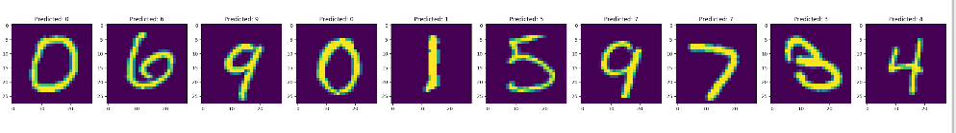
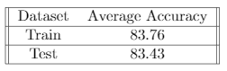
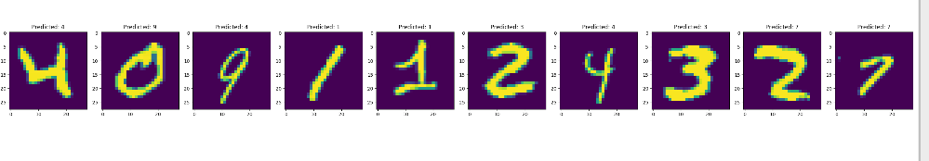
Image Recognition
Test
Training
Figure shows some samples and their estimated labels. As you can see some of them are incorrect.

Slide 5
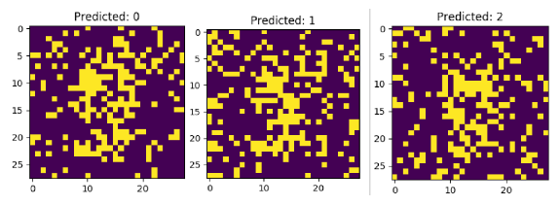
Image Generation

Slide 6
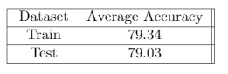
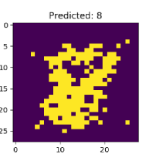
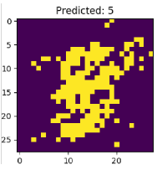
Supervised fine-tuning of the DBN
Fine tuning significantly increases the performance of image generation and very slightly lowers the performance of image recognition

Slide 7
Simpler architecture
The DBN that we had been using until now had the structure (784, 500, 500+10, 2000).
We explored using a simpler architecture (784, 500+10, 2000).
Results after fine tuning -
Training – 79.05
Test – 79.14

Slide 8
Final Remarks
This was a useful assignment to get deeper knowledge about RBMs and DBNs.
However, we found this lab to be the hardest of all others and one of the main challenges of this assignment was the run-time.
Also, the theory as well as the implementation of DBNs was quite difficult to grasp.
The provided code skeleton helped us in that regard!

