Slide 1
Flow control
Structure Theorem
Selection Statement

Slide 2
Objective
After working through this session you should:
  Understand the implication of the structure theorem;
  Understand how selection of statements is implemented;
  Be familiar with Boolean expressions;
  Be able to read and write 'if', 'if else' and 'switch' statements;
  Be able to read and write nested 'if' statements;

Slide 3
The Structure Theorem
Any computer program can be built up by combing three fundamental constructs in various ways.
These constructs are:
  Sequence
    simply doing one statement after the other, down the page.
  Decision
    deciding whether or not to execute a certain statement on the basis of some condition being true or false. Also known to computer scientists as selection.
  Repetition
    repeating a block of code by returning to the start of the "loop" if some condition has not been satisfied. Called iteration by computer scientists.

Slide 4
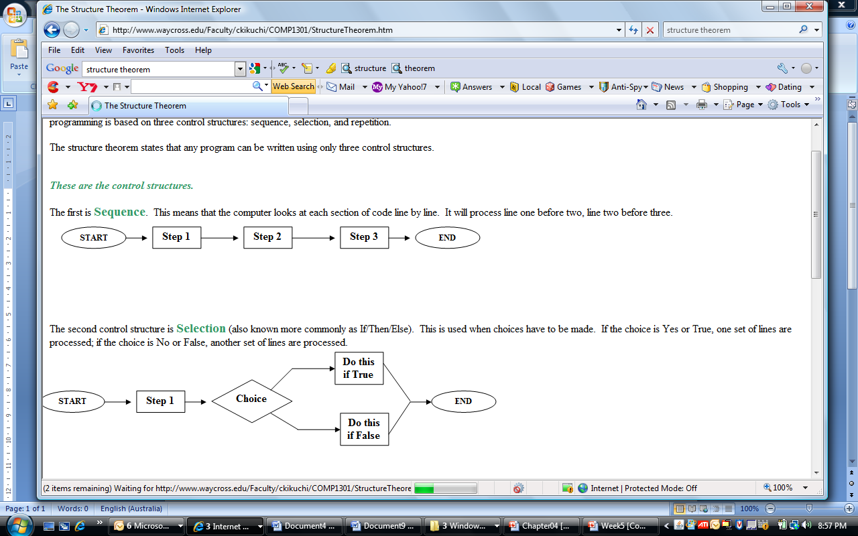
The Structure Theorem
The first is Sequence:
  This means that the computer looks at each section of code line by line.
  It will process line one before two, line two before three.

Slide 5
The Structure Theorem
Selection (also known more commonly as If/Then/Else):
  This is used when choices have to be made.
  If the choice is Yes or True, one set of lines are processed;
  if the choice is No or False, another set of lines are processed.
Start Step 1 Choice
Do this Do this
        if True if False
        Step 2

Slide 6
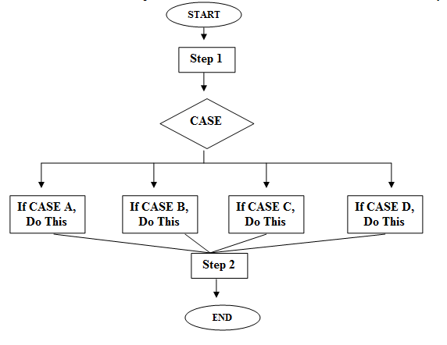
The Structure Theorem
A form of selection that has multiple choices is known as the Case Statement.
  It is used mainly for menus. Choice 1, 2, 3, etc.

Slide 7
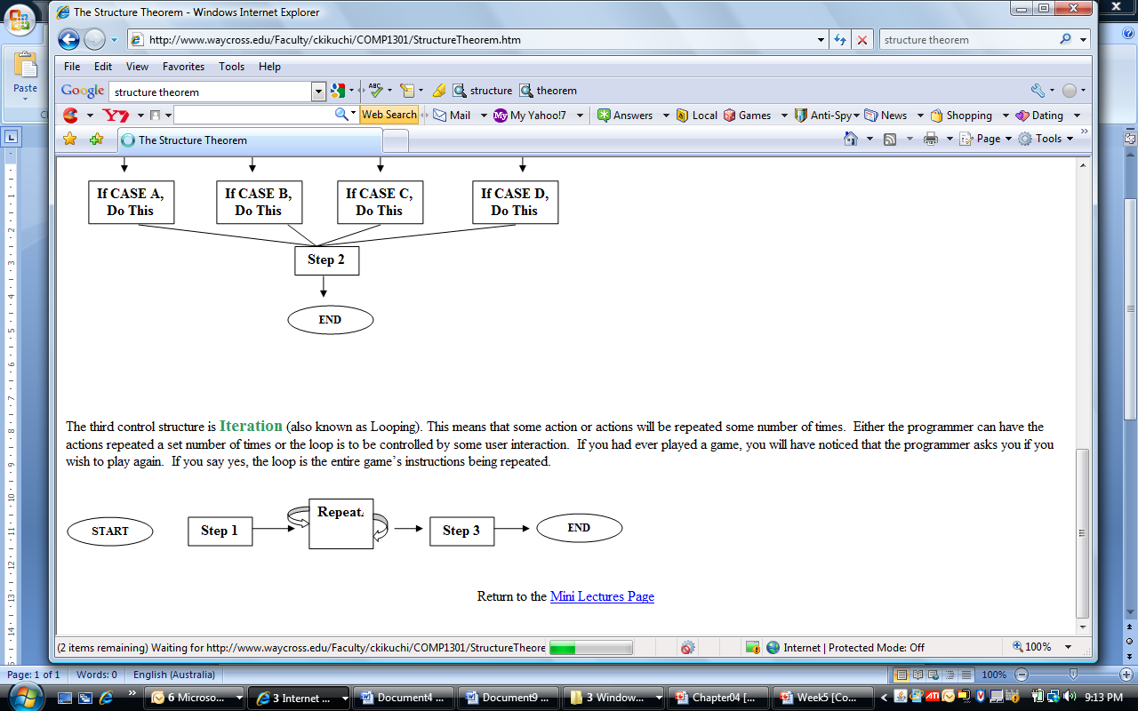
The Structure Theorem
Iteration (also known as Looping): This means that some action or actions will be repeated some number of times.
  Either the programmer can have the actions repeated a set number of times or the loop is to be controlled by some user interaction.
  If you had ever played a game, you will have noticed that the programmer asks you if you wish to play again.
  If you say yes, the loop is the entire game’s instructions being repeated.

Slide 8
Relational Operators Test Conditions
Usually a condition is formed using a relational operator
A relational operator determines if a specific relationship exists between two values
  > Greater than
  < Less than
  == Equal to
  != Not equal to
  >= Greater than or equal to
  <= Less than or equal to

Slide 9
Binary Operators
Relational operators are binary – meaning they use two operands, for example:
  length > width Is length greater than width?
  size <= 10 Is size less than or equal 10?
  size < 11 Is size less than 10?
Relational operators yield a True or False result

Slide 10
Logical Operators
Operator Meaning
& AND
| OR
^ XOR (exclusive OR)
|| Short-circuit OR
&& Short-circuit AND
! NOT

Slide 11
True – False table for OR (|| in C#)
A B A || B
false false false
false true true
true false true
true true true
Any condition is true the result will be true

Slide 12
True – False table for AND (&& in C#)
A B A && B
false false false
false true false
true false false
true true true
Both conditions are true, the result will be true

Slide 13
True – False table for NOT (! in C#)
A ! A
false true
true false
Reverse the condition, true to false and false to true (useful for toggle CheckBox or RadioBox control in GUI)

Slide 14
True – False table for XOR (^ in C#)
A B A ^ B
false false false
false true true
true false true
true true false
Both conditions are different, the result is true. Both conditions are same, result is false.
https://msdn.microsoft.com/en-us/library/office/gg264132.aspx

Slide 15
Logical Operators
if( a > 10 && a < 20 ) // a should be from 11 to 19
if ( a < 10 && a > 20 ) // wrong can’t have any value
//smaller than 10 and greater than 20
if ( a < 10 || a > 20 ) // any number NOT from 10 to 20
if( answer == "Y" || answer == "y")
if( answer == "Y" && answer == "y") // wrong
if( answer != "n" && answer != "N")
if( answer != "n" || answer != "N") // always true
// any value not n or N
// when n (condition 1 if false) the NOT N is true
//and N (condition 2 is false) but Not n is true

Slide 16
Precedence of Logical Operators
For example, in the statement
  if (x < 0 && y > 100 || z == 50)
  x < 0 && y > 100 is evaluated first
  If the And condition is true, we do not need to evaluate z is 50
  True || z == 50 // results is true
  If the And condition is false, we then must evaluate z
  False || z == 50 // only true if z is 50
If the Or condition is to be evaluated first parentheses must be used
  if (x < 0 && (y > 100 || z == 50))
  x < 0 is false // result will be false
  x < 0 (evaluate 1st if true then
  y > 100 (if true no to need check z)

Slide 17
Math, Relational, & Logical Operators
Evaluate the following if
int a = 5, b = 7, x = 100, y = 30;
  if ( x > a * 10 && y < b + 20 )
  Evaluating the math operators leaves us with
  if ( x > 50 && y < 27 )
  Evaluating the relational operators leaves
  if (true && false)
  Evaluating the logical operators leaves
  false
Parentheses make order of operations clear
  if (x > (a * 10)) && (y < (b + 20))

Slide 18
if… Statement Syntax
if Statement
  An if statement allows you to take different paths of logic, depending on a given condition.
  When the condition evaluates to a boolean true, a block of code for that true condition will execute.
if(condition)
statement;
if(condition)
{
statement
(more statements as needed)
}

Slide 19
if… Examples
// Bonus awarded if sales greater than 50000
if ( SalesAmount > 50000 )
GetBonus = true;
// Bonus, 12% commission rate, and a day off
// awarded if sales greater than 50000
if ( SalesAmount > 50000 )
{
GetBonus = true;
CommissionRate = 0.12F;
DaysOff ++;
}

Slide 20
if… else… Statement Syntax
You have the option of a single if statement, multiple else if statements, and an optional else statement.
if(condition)
statement;
else
statement;
if(condition)
{
statement
(more statements as needed)
}
else
{
statement
(more statements as needed)
}

Slide 21
if…else… Example
if (temperature < 40)
Console.WriteLine("A little cold, isn’t it?");
else
Console.WriteLine("Nice weather we’re having!");
if (Mark < 50) Then
{
Grade = "N";
FailedCount++;
}
else
{ Grade = "P";
PassedCount++;
}

Slide 22
if... And if...else example
public static void Main()
{
string myInput;
int myInt;
Console.Write("Please enter a number: ");
myInput = Console.ReadLine(); // make sure input is a number NOT text
myInt = Int32.Parse(myInput); // myInt = int32.Parse(Console.ReadLine());
// Single Decision and Action with braces
if (myInt > 0)
Console.WriteLine("Your number {0} is greater than zero.", myInt);
// Single Decision and Action without brackets
if (myInt < 0)
Console.WriteLine("Your number {0} is less than zero.", myInt);
// Either/Or Decision
if (myInt != 0)
Console.WriteLine("Your number {0} is not equal to zero.", myInt);
else
Console.WriteLine("Your number {0} is equal to zero.", myInt);
}

Slide 23
Nested if... else
if(condition)
if (condition)
statement;
else // not of 2nd if
statement;
if(condition)
if (condition)
statement;
else
statement;
else
if (condition)
statement;
else
statement;
if (condition)
{
if (condition)
statement;
}
else
statement;

Slide 24
Nested if... Else example
if (gender == "Female")
{
if (age > 55)
Console.WriteLine("You might be entitled to receive the pension");
}
else // Male
if (age > 65) // do not need a block as only 1 statement to perform
Console.WriteLine("You might be entitled to receive the pension");
if (gender == "Female")
if (age > 55)
Console.WriteLine("You might be entitled to receive the pension");
else // Female <= 55
if (age > 65) // this condition is never be true
Console.WriteLine("You might be entitled to receive the pension");

Slide 25
Multiple Possible Choices
The if…else if… statement allows for an entire series of possible choices
In pseudo code:
If it is very cold Then
Wear a coat
Else if it is chilly Then
Wear a light jacket
Else if it is windy Then
Wear a windbreaker
Else if it is hot Then
Wear no jacket
End If

Slide 26
Multiple Possible Choices
Each of the series of conditions in an if…else if… is tested in sequence
When a condition is true, the remaining conditions are ignored
The order of the conditions is vital
  Wrong order can result in wrong decision
  What if it’s chilly and windy?
  If windy is tested before chilly, you’d go out with a windbreaker when you need a jacket

Slide 27
If… else if… in C# Syntax
if (condition1)
Statement;
else if (condition2)
Statement;
else if (condition3)
Statement;
…
else
Statement;

Slide 28
If… else if… example
if ( mark < 0 || mark > 100 )
Console.WriteLine("Please check... Mark should be in 0-100 ONLY");
else if (mark > 79)
Console.WriteLine("Grade: HD");
else if (mark > 69)
Console.WriteLine("Grade: D");
else if (mark > 59)
Console.WriteLine("Grade: C");
else if (mark > 49)
Console.WriteLine("Grade: P");
else
Console.WriteLine("Grade: N");
}
Does the order of these conditions matter?
What happens if we reverse the order?

Slide 29
The Same Code Without else If
if (mark < 50)
Console.WriteLine("Grade: N");
if (mark < 60)
Console.WriteLine("Grade: P");
if (mark < 70)
Console.WriteLine("Grade: C");
if (mark < 80)
Console.WriteLine("Grade: D");
if (mark < 101)
Console.WriteLine("Grade: HD");
Does this code function correctly?
What is assigned to mark a 65?
or 75?

Slide 30
The (Optional) Trailing Else
A sequence of else if’s may end with a plain Else, called a trailing Else
If none of the conditions are true, the trailing else statement(s) will be executed
If mark is greater than 100, prompt is assigned the text "Invalid mark"
if (mark < 50) // negative
Console.WriteLine("Grade: N");
else if (mark < 60)
Console.WriteLine("Grade: P");
else if (mark < 70)
Console.WriteLine("Grade: C");
else if (mark < 80)
Console.WriteLine("Grade: D");
else if (mark < 101)
Console.WriteLine("Grade: HD");
else // > 100 only
Console.WriteLine("Invalid mark");

Slide 31
The switch… case Statement
In a Select Case Statement, One of Several Possible Actions Is Taken, Depending on the Value of an Expression
Similar to if…else if
  Performs a series of tests
  Conditionally executes the first true condition
switch … case is different in that:
  A single test expression may be evaluated (exact match value)
  The test expression is listed once
  There is NO possible values of the expression NOR the listed with their conditional statements
default may be included and executed if none of the values match the expression

Slide 32
switch example
switch(DayOfWeek)
{
case 0: Console.WriteLine("Day 1 is Sunday."); break;
case 1: Console.WriteLine("Day 1 is Monday."); break;
case 2: Console.WriteLine("Day 2 is Tuesday."); break;
case 3: Console.WriteLine("Day 3 is Wednesday."); break;
case 4: Console.WriteLine("Day 4 is Thursday."); break;
case 5: Console.WriteLine("Day 5 is Friday."); break;
case 6: Console.WriteLine("Day 6 is Saturday."); break;
default: Console.WriteLine("That value is invalid."); break;
}

Slide 33
switch example
string pet = "Lions";
switch(pet)
{
case "Dogs": case "Cats":
Console.WriteLine ("House Pets");
break;
case "Cows": case "Pigs": case "Goats":
Console.WriteLine ("Farm Animals");
break;
case "Lions": case "Tigers": case "Bears":
Console.WriteLine ("Wild Animals!");
break;
default: Console.WriteLine("Not classified in the list...");
break;
}
//Note: Some computer language c, c++ or java might not support string in switch

Slide 34
switch example
public static void Main()
{
Console.Write("Enter an integer number (e.g., 5)? ");
int num = Convert.ToInt32(Console.ReadLine());
switch(num)
{
case 0: Console.WriteLine ("num is 0"); break;
default: switch(num/Math.Abs(num))
{
case 1: Console.WriteLine ("num is a positive value"); break;
default: Console.WriteLine ("num is a negative value"); break;
}
break;
}
}
}

Slide 35
Another switch example
switch(mark/10) // mark must be pre-check in 0-100
{
case 10: case 9: case 8: grade = "HD"; break;
case 7: grade = " D"; break;
case 6: grade = " C"; break;
case 5: grade = " P"; break;
default: grade = " N"; break;
}

Slide 36
Exercises for If validation
Input validation for the Banking Details.
- Make sure all the input can't be blank.
- Prompt user to enter the Bank Account ID, Amount to deposit, Term (in Months) and the Post Code.
- The account ID should be seven characters long.
- The first three characters of ID should NOT be either "AAA" or "AAB" or any upper or lower case arrangement of these.
- The last four characters should all be digits (a space is not a digit).

Slide 37
Data Type Validation
- The amount should be convertible to a Decimal.
- It should be between $0.00 and $10,000.00 inclusive.
- The term should be an integer (without rounding).
- The term should be either: 1, 2, 3, 4, or 5 or a non-zero multiple of 6.
- The postcode must consist of 4 digits (a space is not a digit).
- The first digit must not be 1, 8 or 9.

Slide 38
switch Validation
- The valid post code the following state should be show in the confirmation output
First Digit State
0 NT
2 NSW
3 VIC
4 QLD
5 SA
6 WA
7 TAS

